Slide 1
Methods in Quantitative Biology:
Introduction and Best Practices
Dr. Kelly Ruggles
9/5/2018

Slide 2

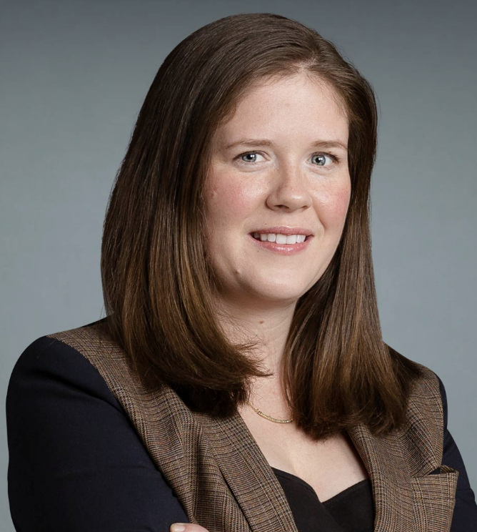

Course Overview
Course Directors
Teaching Assistant
Dr. David Fenyo
David@fenyolab.org
Dr. Kelly Ruggles
Kelly.Ruggles@nyulangone.org
Cooper Devlin
Joseph.devlin@nyulangone.org

Slide 3
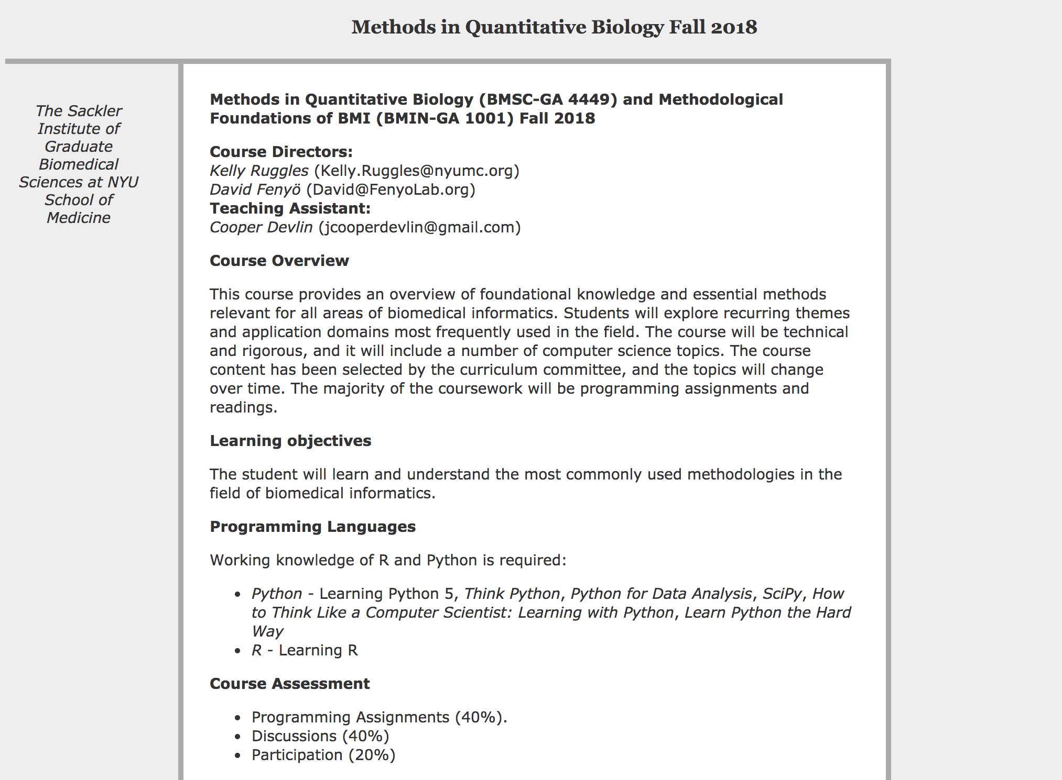
Course Website
http://fenyolab.org/methods2018

Slide 4
Course Overview
Week 1: Overview and HPC
Weeks 2 & 3: Biomedical Data
Weeks 4 & 5: Signal Processing
Weeks 6 & 7: Modeling & Simulation
Weeks 8 & 9: Data Visualization

Slide 5
Course Assessment
Programming Assignments (50%)
  Signal Processing: Due Oct 5
  Modeling/Simulation: Due Nov 9
  Ggplot2: Due Nov 16
  Adobe Illustrator: Due Nov 21
  Interactive data viz: Due Nov 30
Discussions (30%)
  Biomedical Data I: Sept 14
  Modeling/Simulation: Oct 26
  Data Visualization: Nov 7
Participation (20%)

Slide 6
Submitting Assignments
Share a Google Drive folder with:
  david.fenyo@gmail.com
  kelly.ruggles@gmail.com
  jcooperdevlin@gmail.com
Homework
  Create a google doc for each assignment with the module name and due date.
  Example: SignalProcessing_Oct5

Slide 7
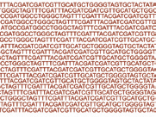
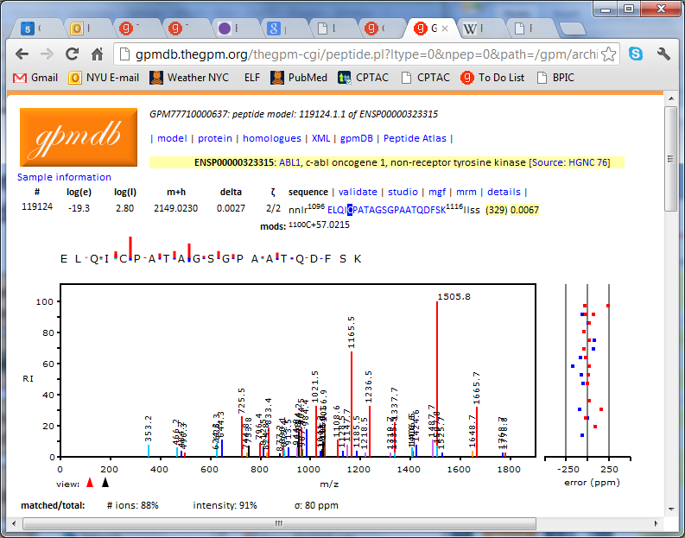
Week 2: Biomedical Data I
Molecular Data
Next Generation Sequencing
Proteomics
Phosphoproteomics
Mutation calls
Copy Number
Gene Expression
Mass Spectrometry
DNA methylation/Epigenetics
MicroRNA
Metabolomics
Phenotype Data
Samples
Genes/loci

Slide 8
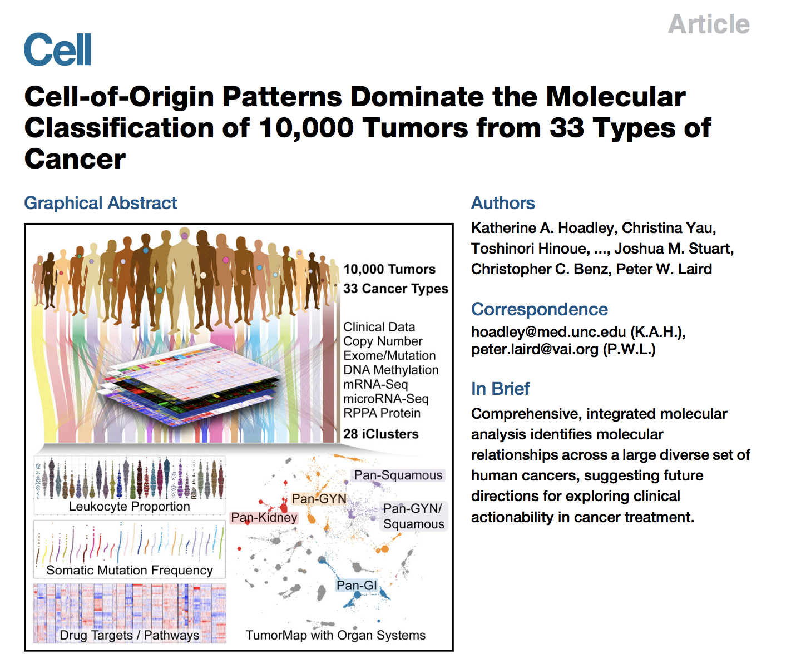
Week 2: Biomedical Data I Discussion

Slide 9

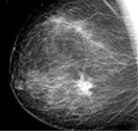
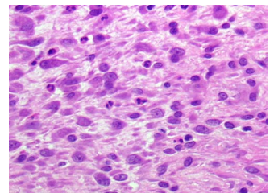
Week 3: Biomedical Data II
Clinical Data
EHR
Imaging

Slide 10
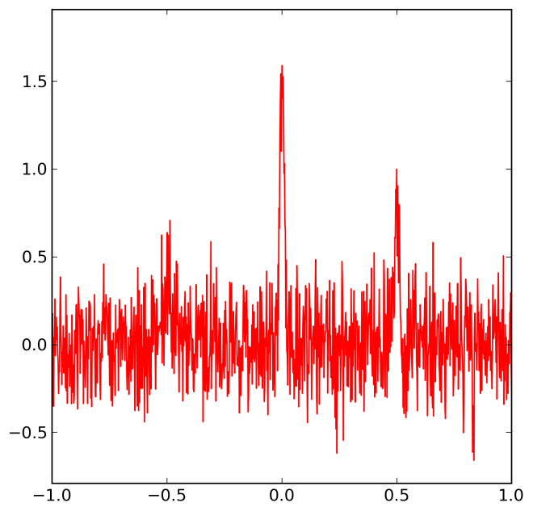
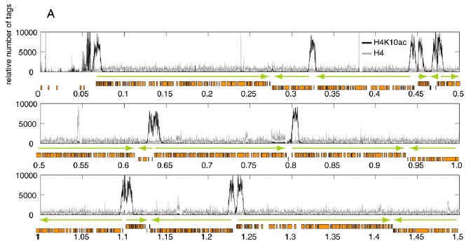
Week 3: Signal Processing I
Chip-Seq Data
T.N. Siegel, et al. Genes Dev. 23 (2009) 1063-1076.
Assignment: Add comments to the signal processing code provided describing what is being done in the code.

Slide 11
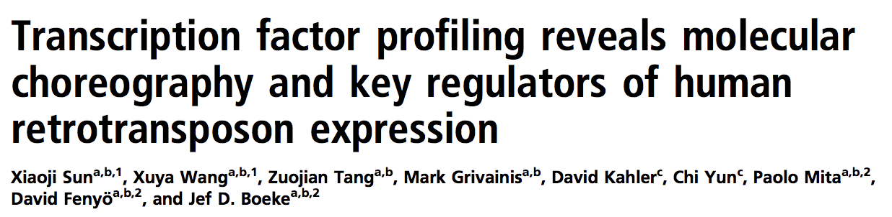
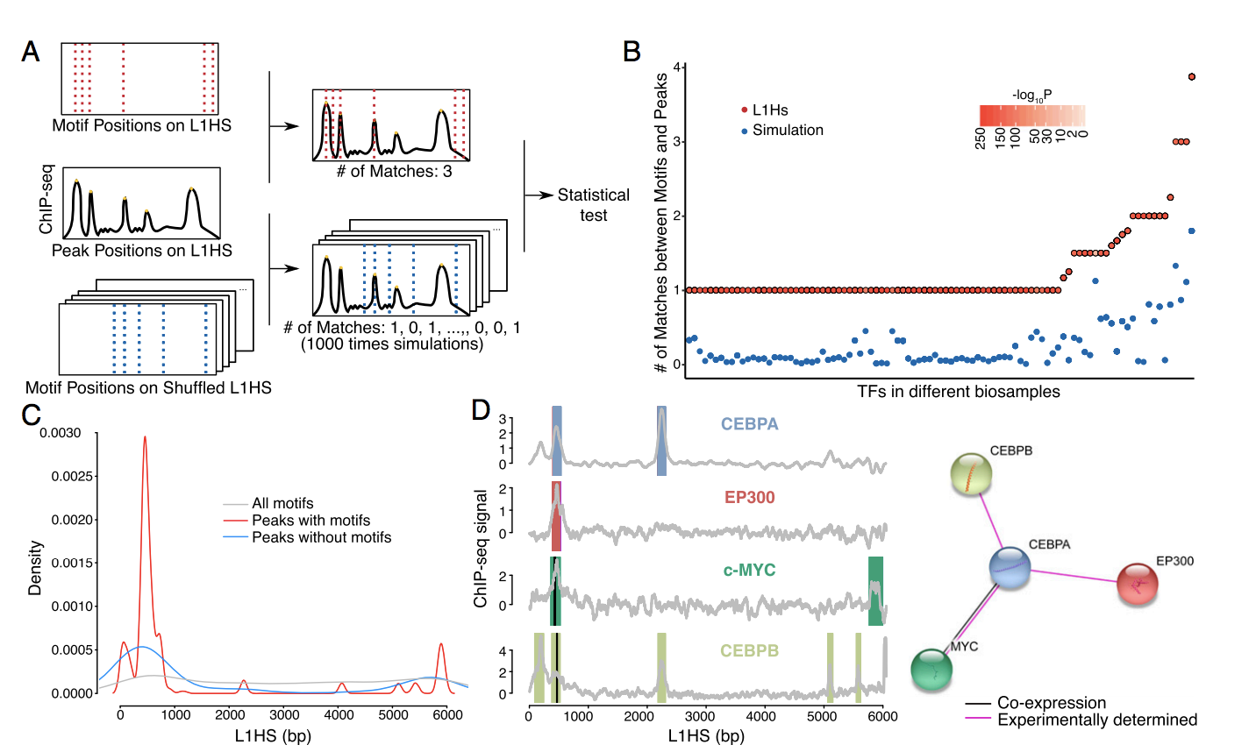
Week 4: Signal Processing II Discussion

Slide 12
Week 5: Modeling & Simulation I
Chicken Pox, Influenza, Measels, Rubella
Births
Transmission
Susceptible
Infected
Infectious
Immune
Death
Death
Death
Death
Vaccine

Slide 13
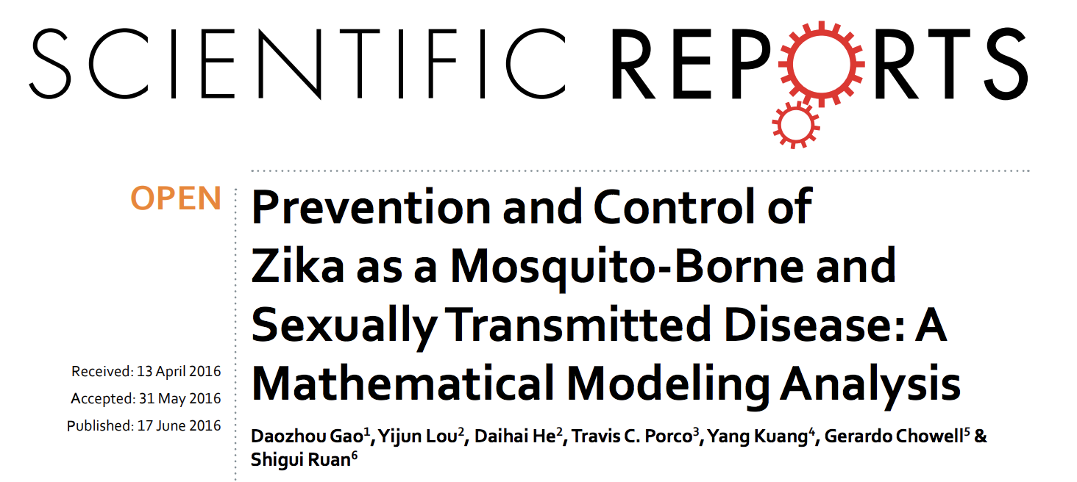
Week 5: Modeling & Simulation I: Discussion

Slide 14
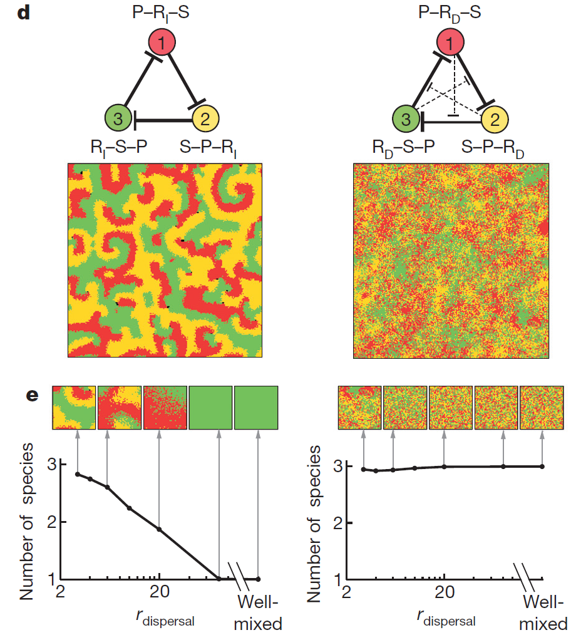
Week 6: Modeling & Simulation II
Counteraction of antibiotic production and degradation stabilizes microbial communities
Kelsic ED, et al., Nature 521 (2015) 516-9

Slide 15
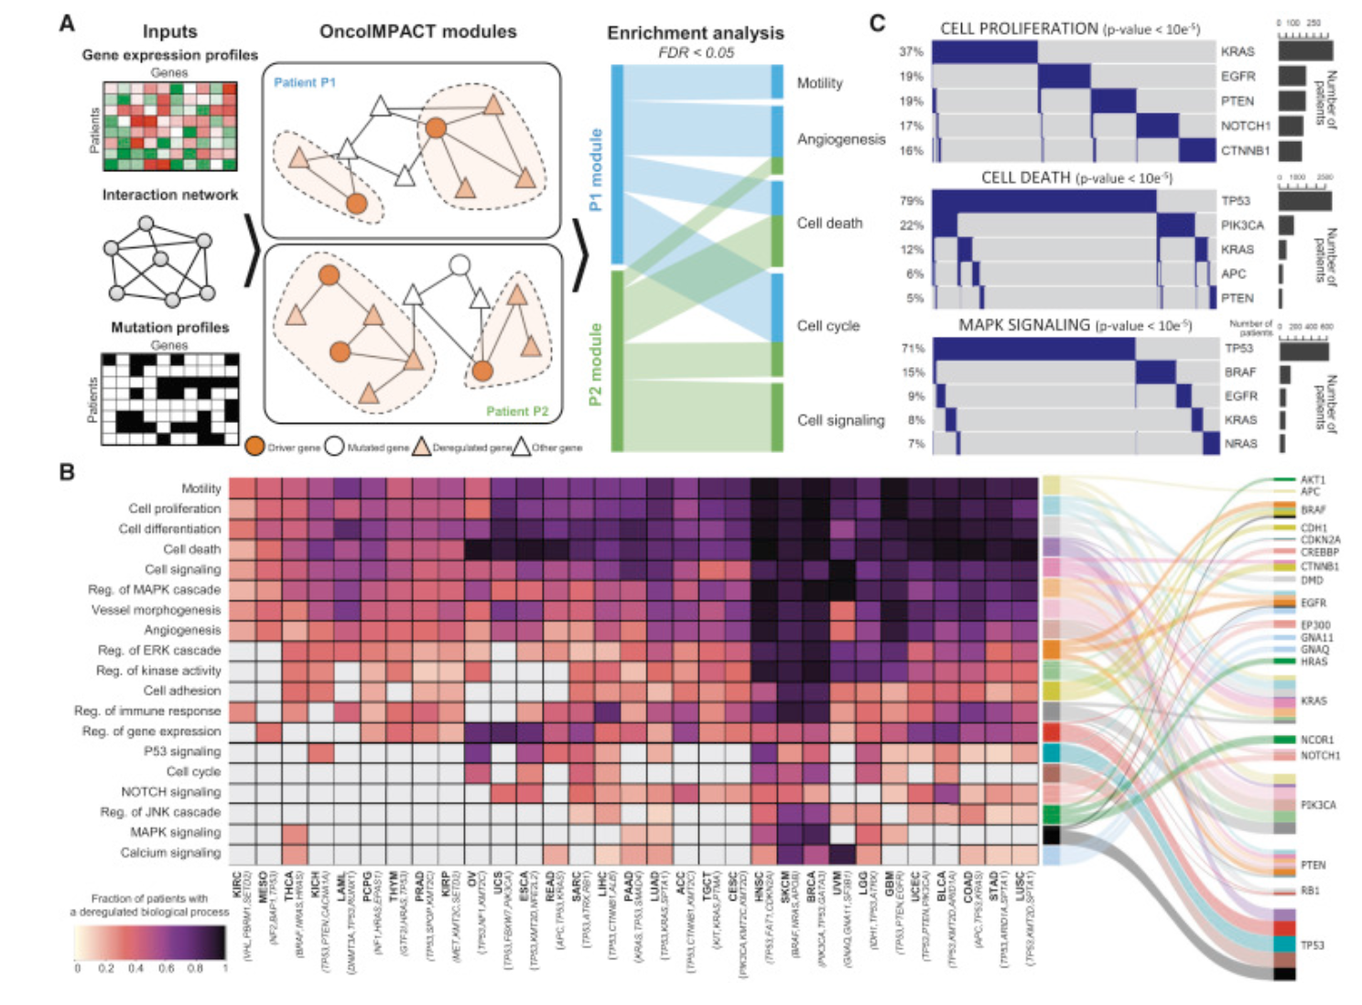
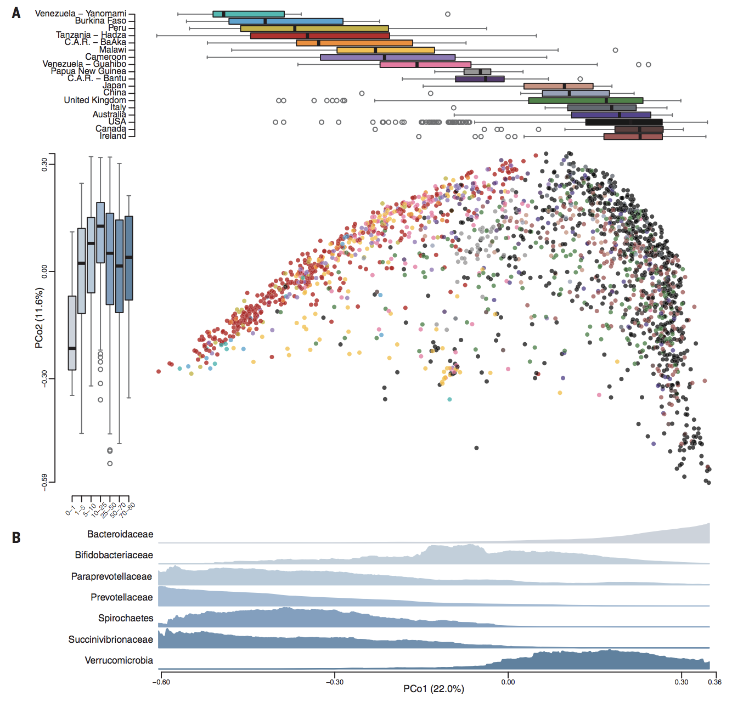
Week 8: Data Visualization I
Ding et al., (2018) Cell
Smits et al., (2017) Science

Slide 16
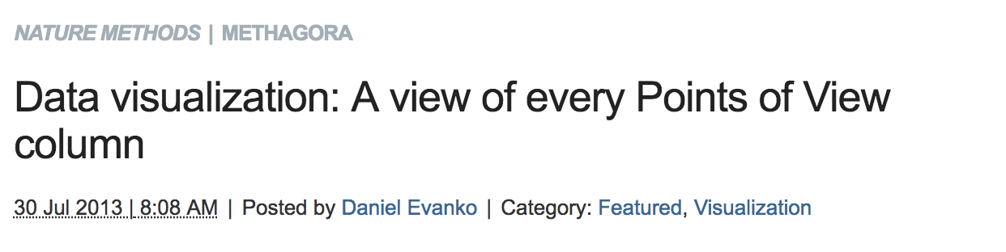
Week 8: Data Visualization I: Discussion
Assignment: Based on best-practices described by the reading, find a figure from a publication that you feel is particularly good. Each student will present 2 minutes on why their figure is the best choice and students will vote on their top pick.

Slide 17
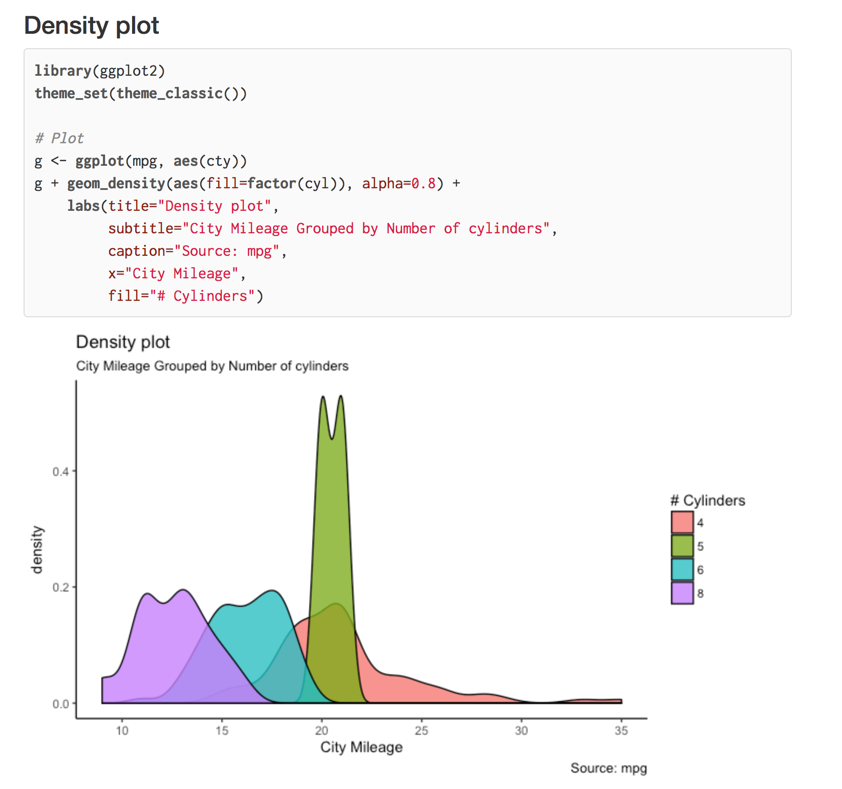
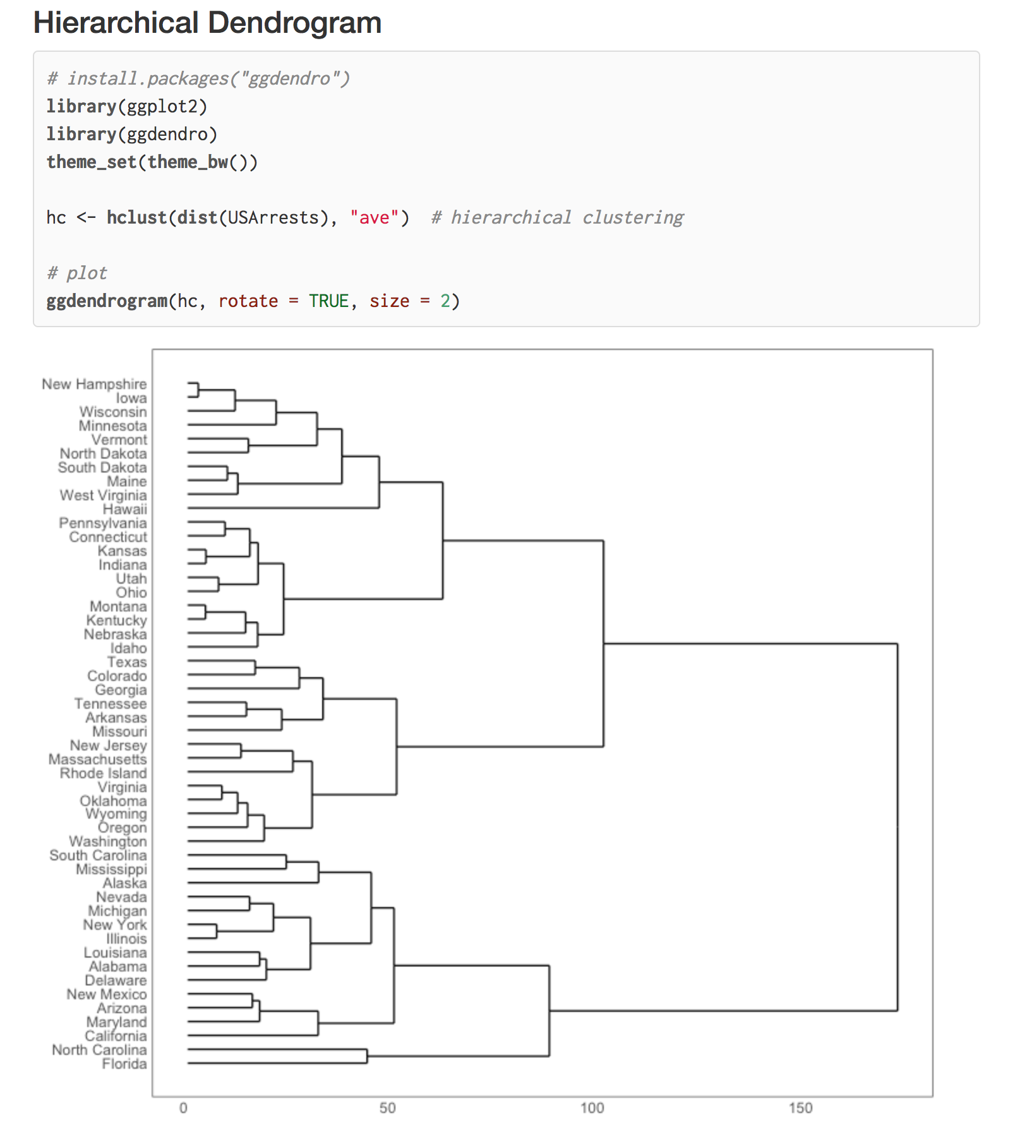
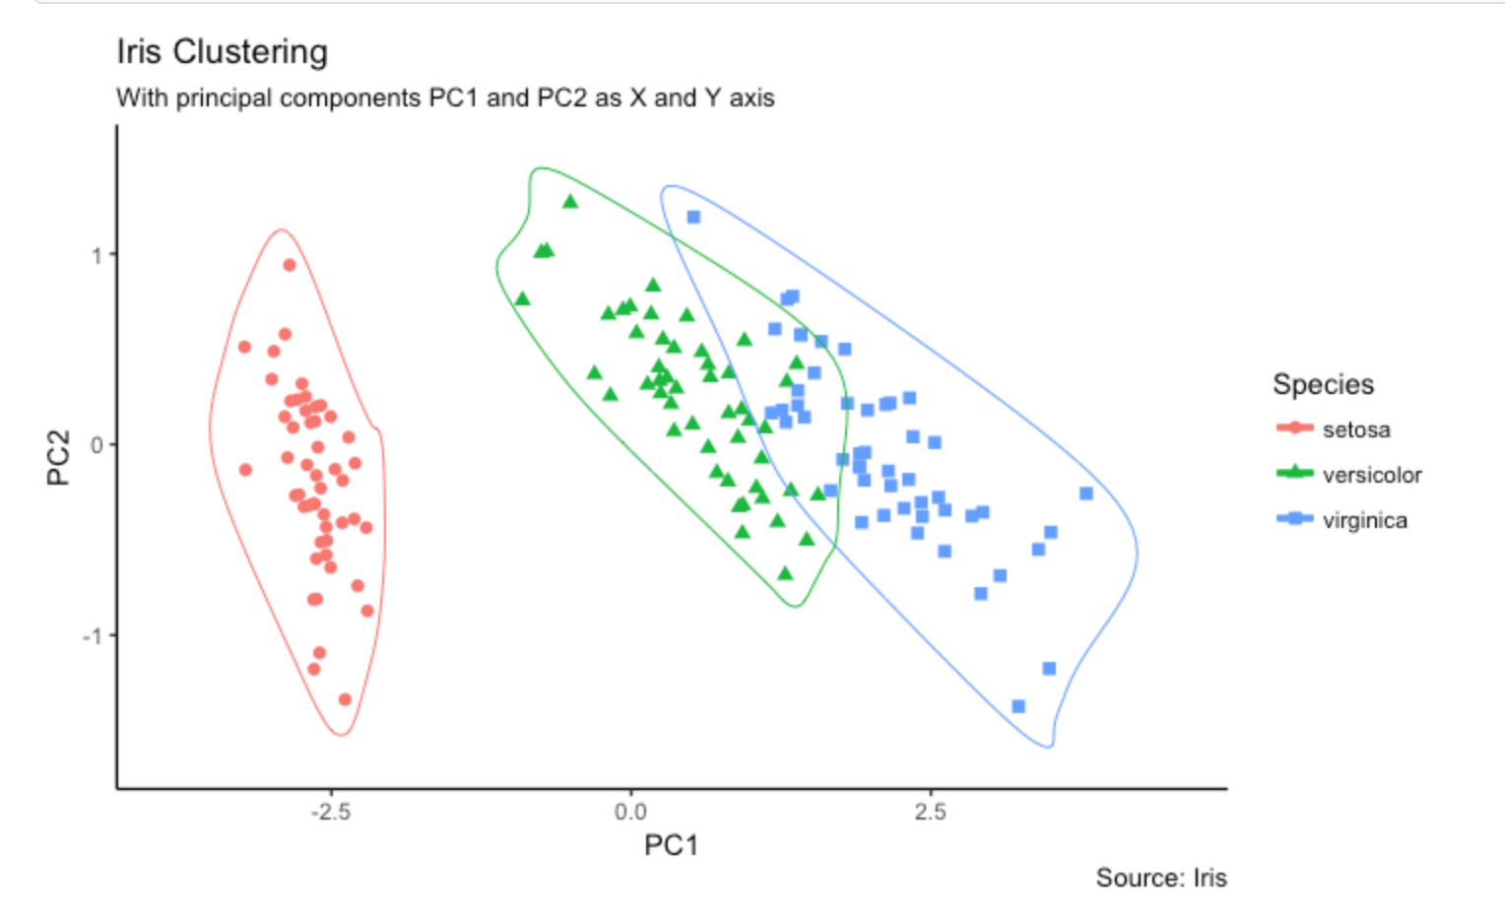
Week 8: Data Visualization I: DataViz with R
http://r-statistics.co/Top50-Ggplot2-Visualizations-MasterList-R-Code.html
Assignment: TBD

Slide 18
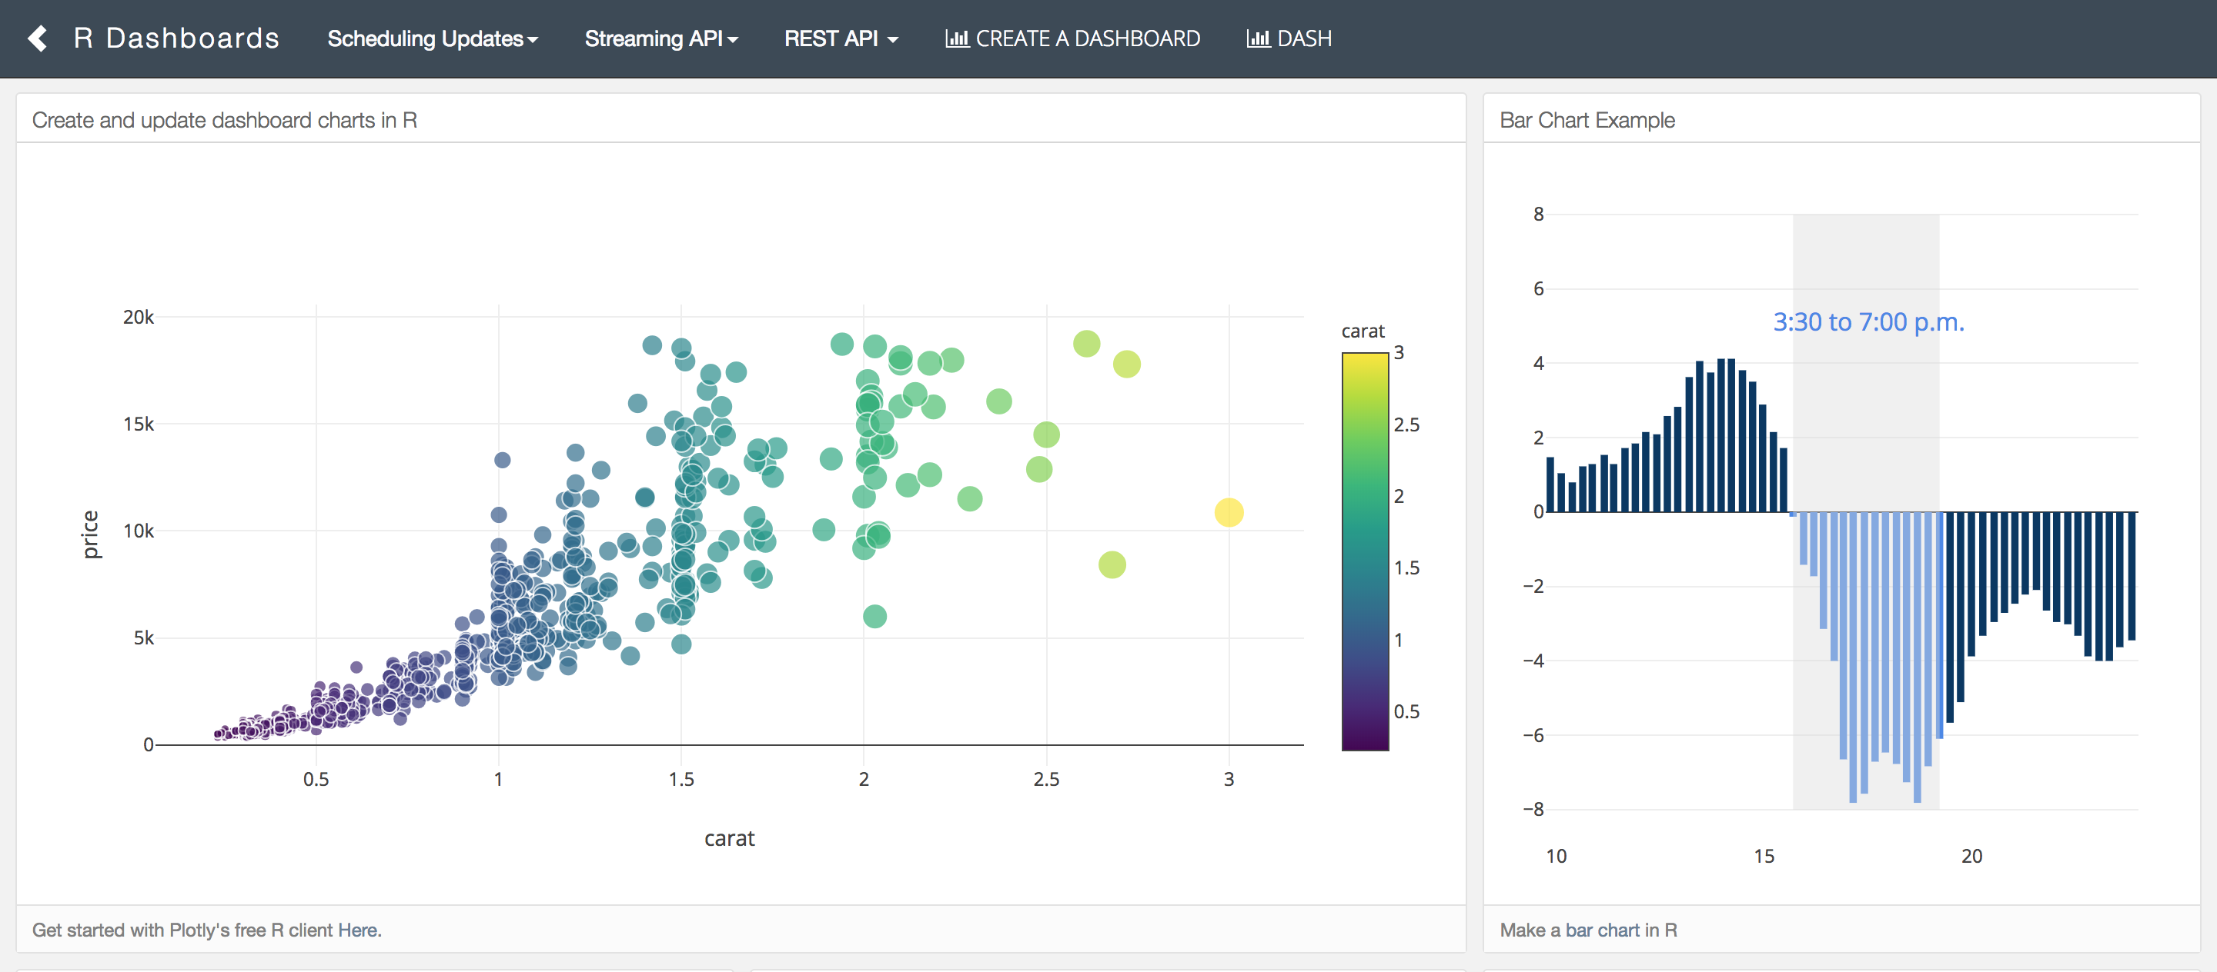
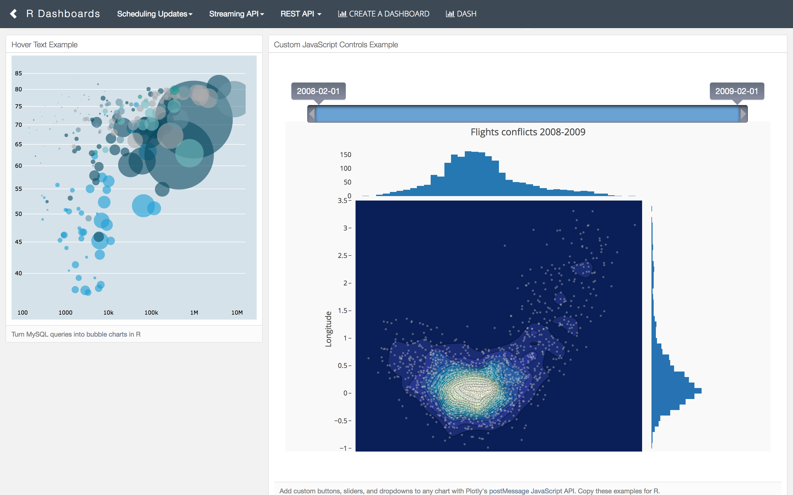
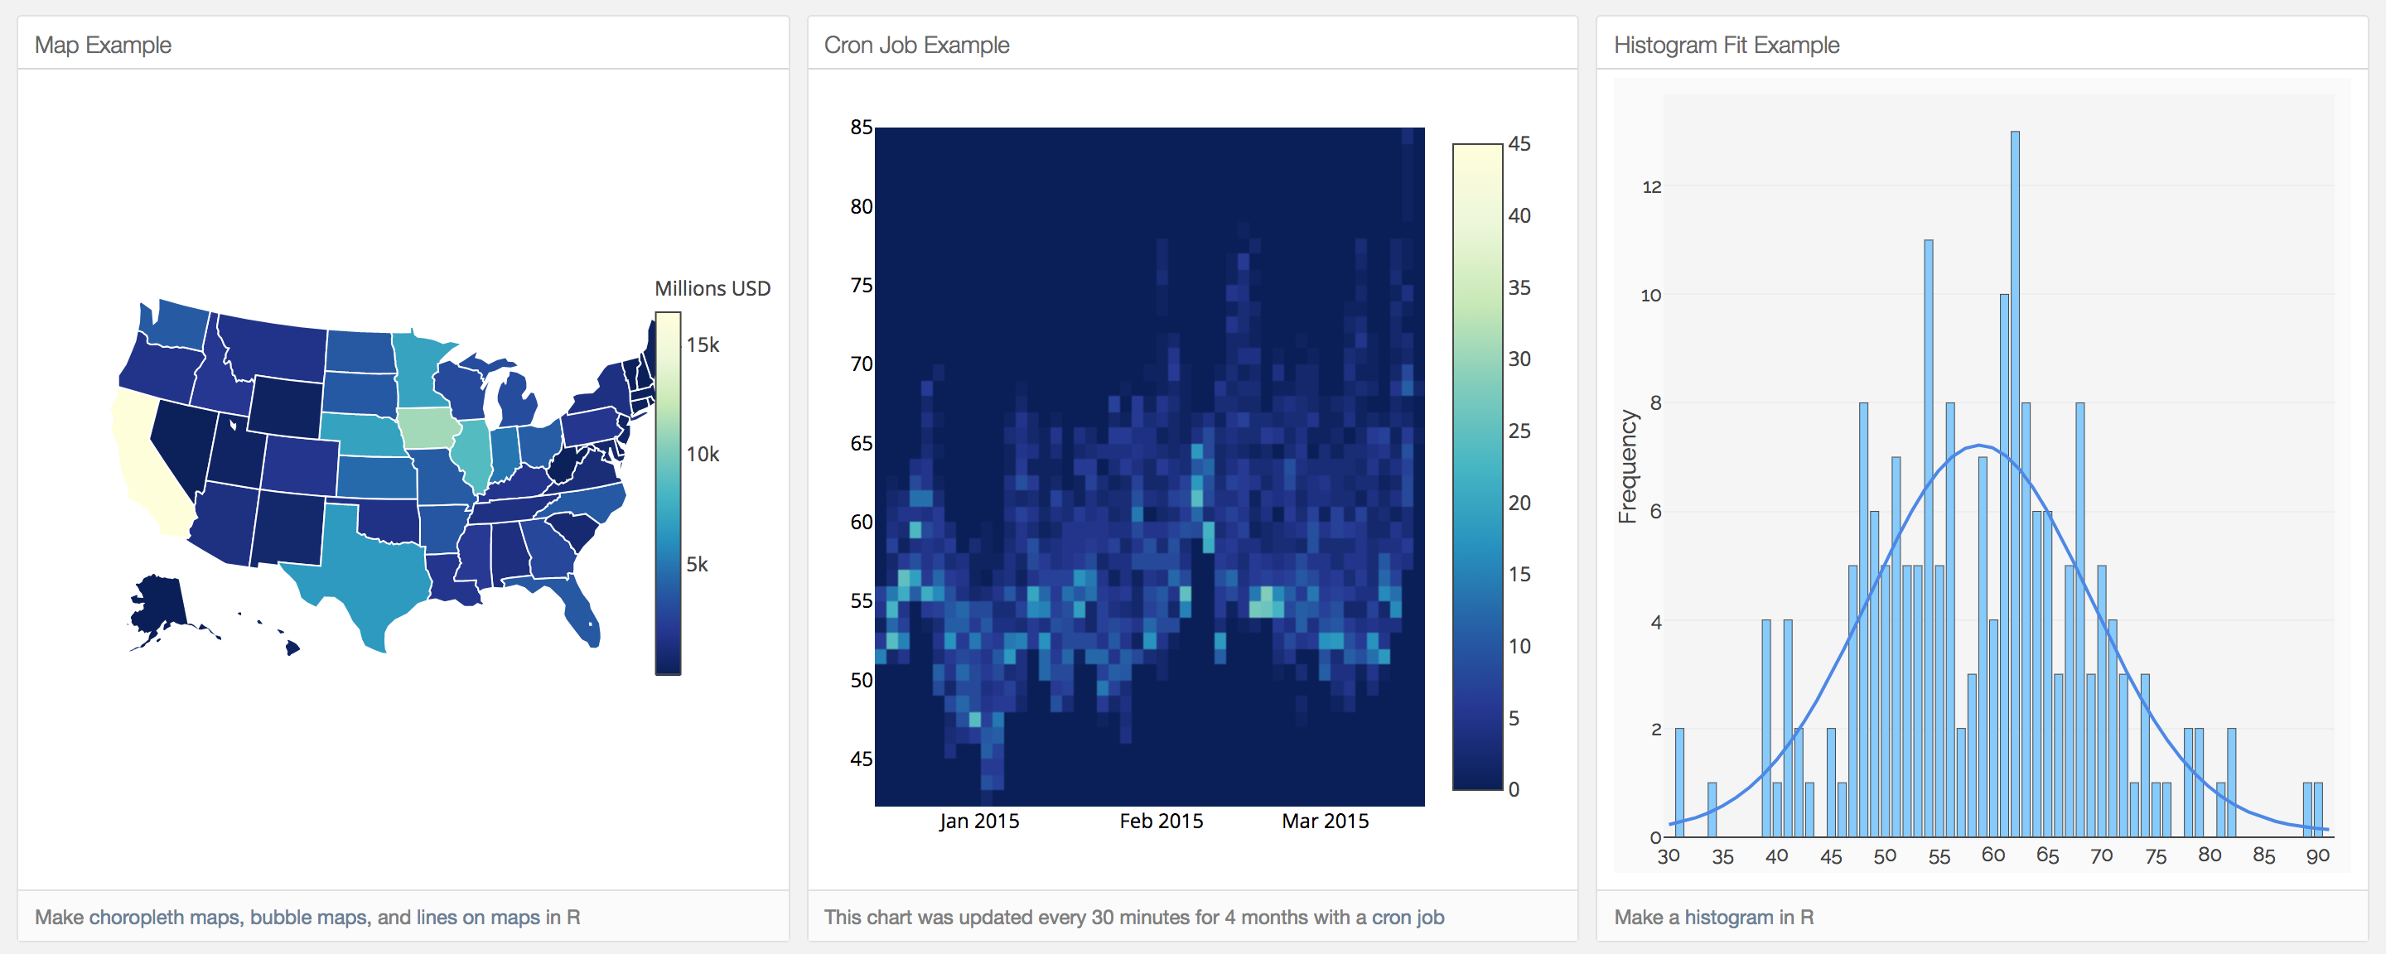
Week 8: Data Visualization I: DataViz with R
https://plot.ly/r/

Slide 19
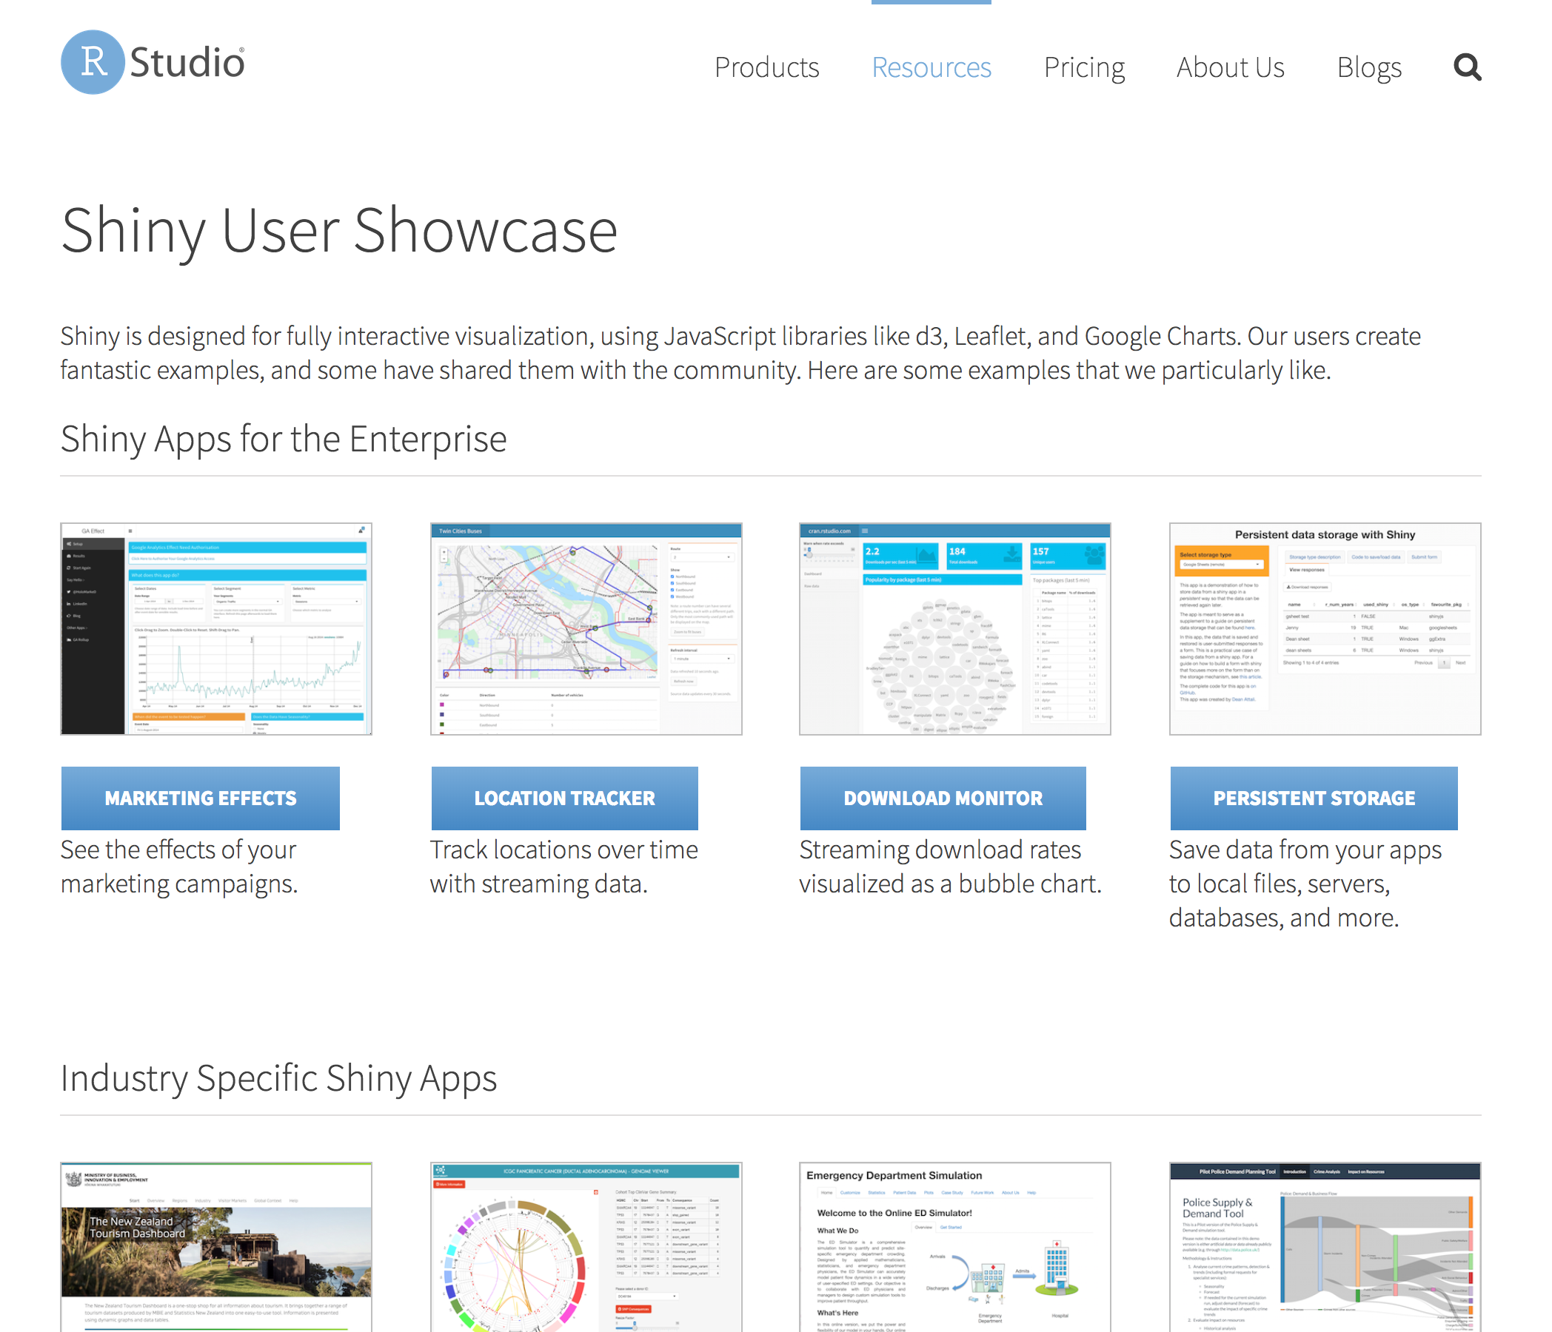
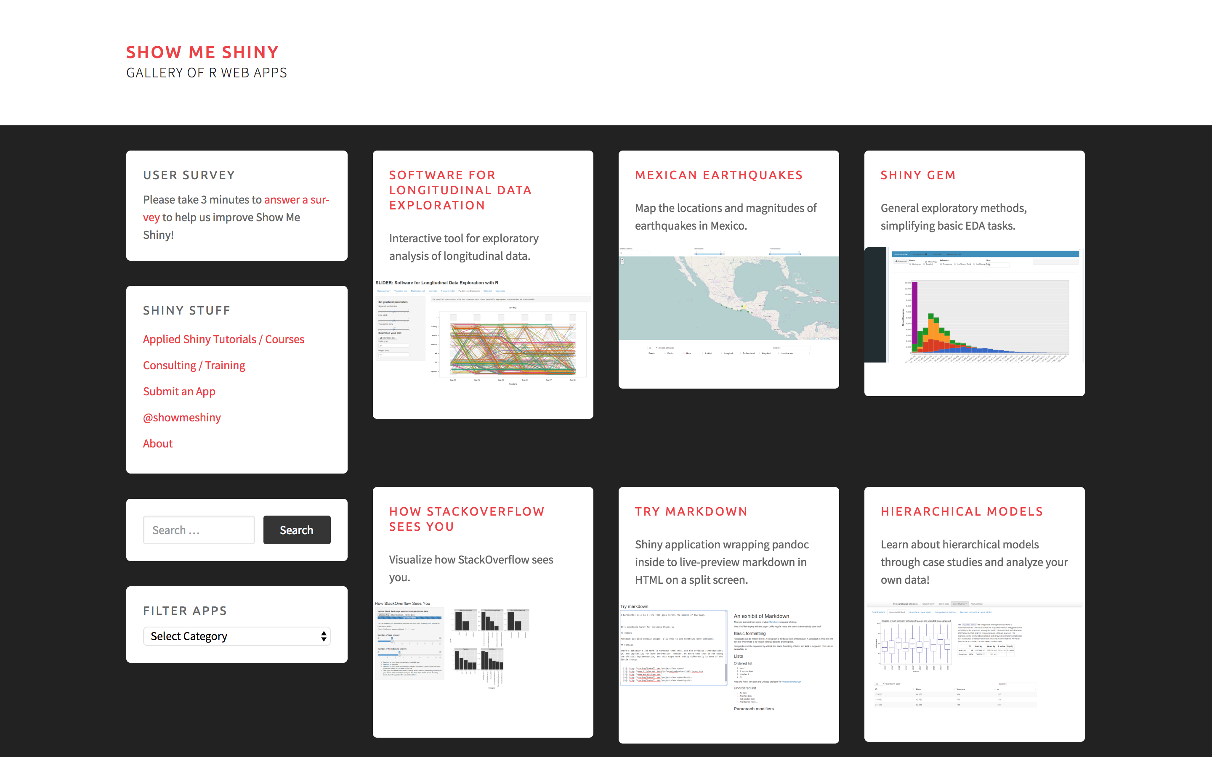
Week 8: Data Visualization I: DataViz with R
https://www.rstudio.com/products/shiny/shiny-user-showcase/
http://www.showmeshiny.com/

Slide 20
Week 8: Data Visualization II: Adobe Illustrator
Assignment: Given a figure, improve the formatting and layout of the and add a schematic drawing of the associated cellular pathway.

Slide 21
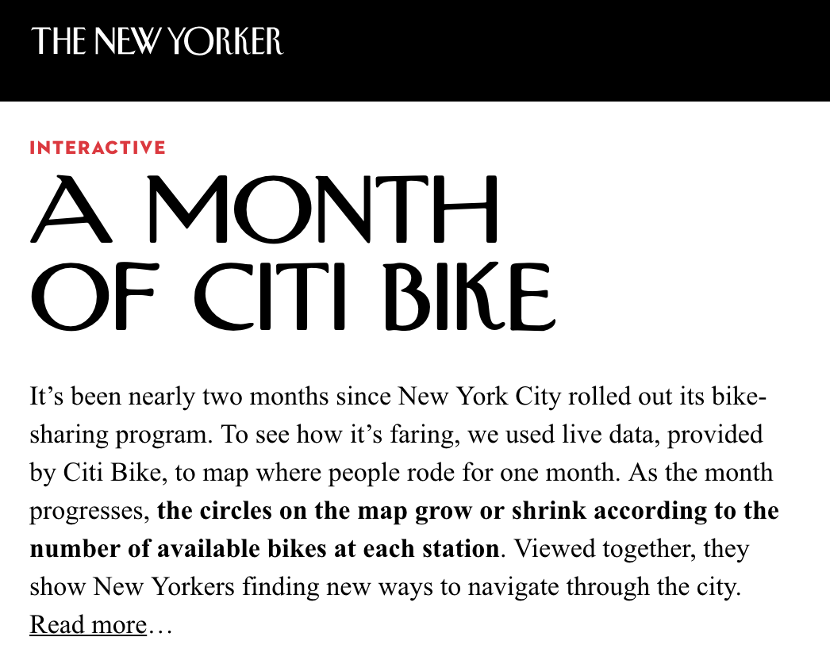
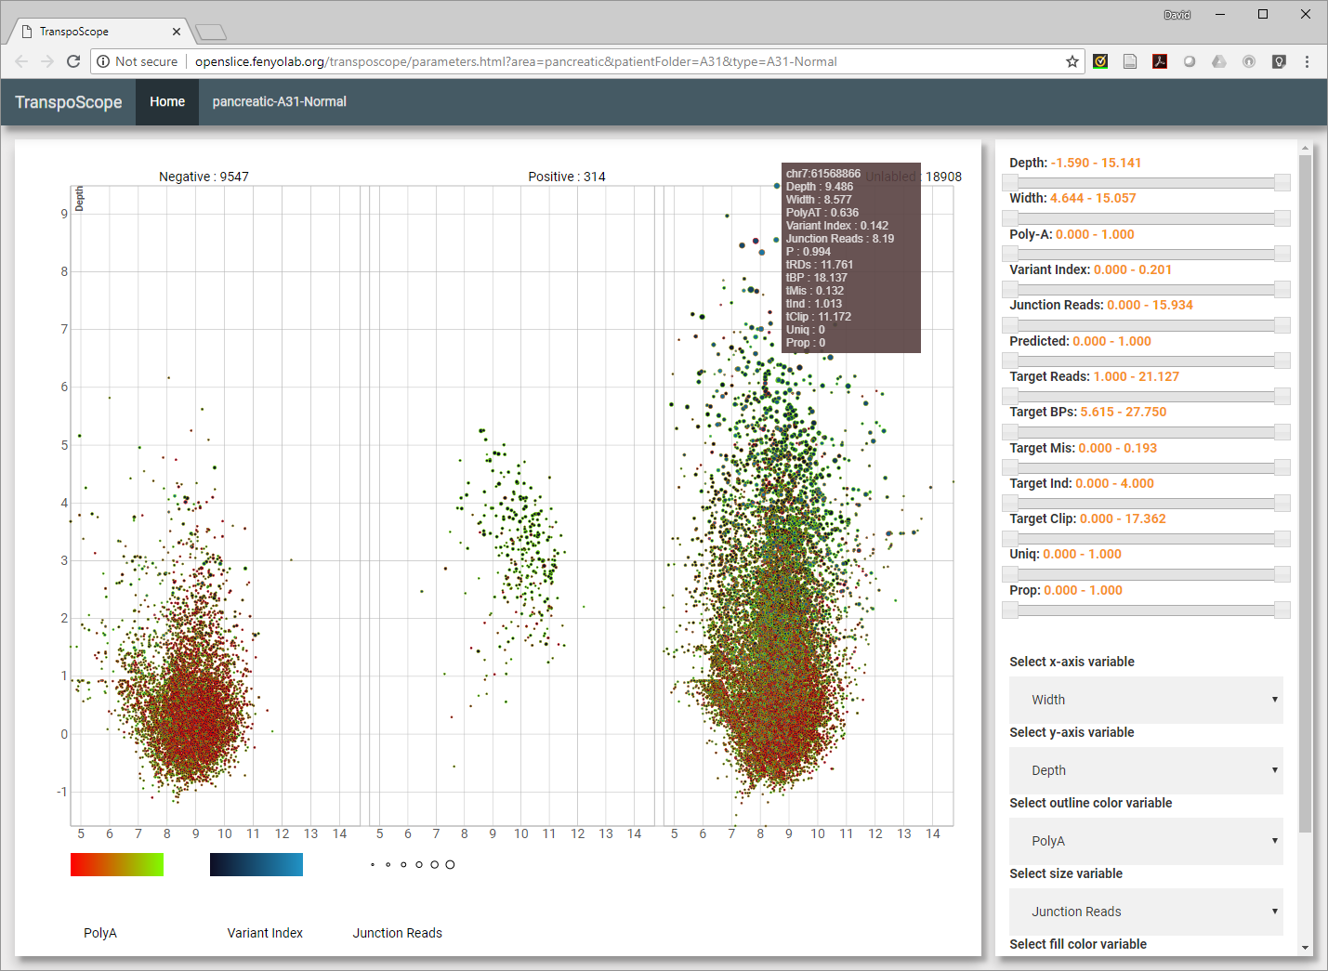
Week 8: Data Visualization II: Interactive Data Viz
https://projects.newyorker.com/story/citi-bike.html
http://transposcope.fenyolab.org
Assignment: TBD

Slide 22
What is Quantitative Biology?
Statistics
Computer
Science
Mathematics
QB
Machine
Learning
Data
Processing
Biology

Slide 23
What is Quantitative Biology?
Includes subfields of:
  Mathematical Biology
  Computational Biology
  Bioinformatics
  Biostatistics
  Systems Biology
  Synthetic Biology
  Epidemiology
Statistics
Computer
Science
Mathematics
QB
Machine
Learning
Data
Processing
Biology

Slide 24
What we’ll Cover
Week #
Subfields | 2 | 3 | 4 | 5 | 6 | 7 | 8 | 9
Mathematical Biology
Computational Biology
Bioinformatics
Biostatistics
Systems Biology
Synthetic Biology
Epidemiology
Biomedical Data I
Data Visualization I
Signal Processing I
Modeling & Sim. II
Biomedical Data II
Modeling & Sim. I
Signal Processing II
Data Visualization II

Slide 25
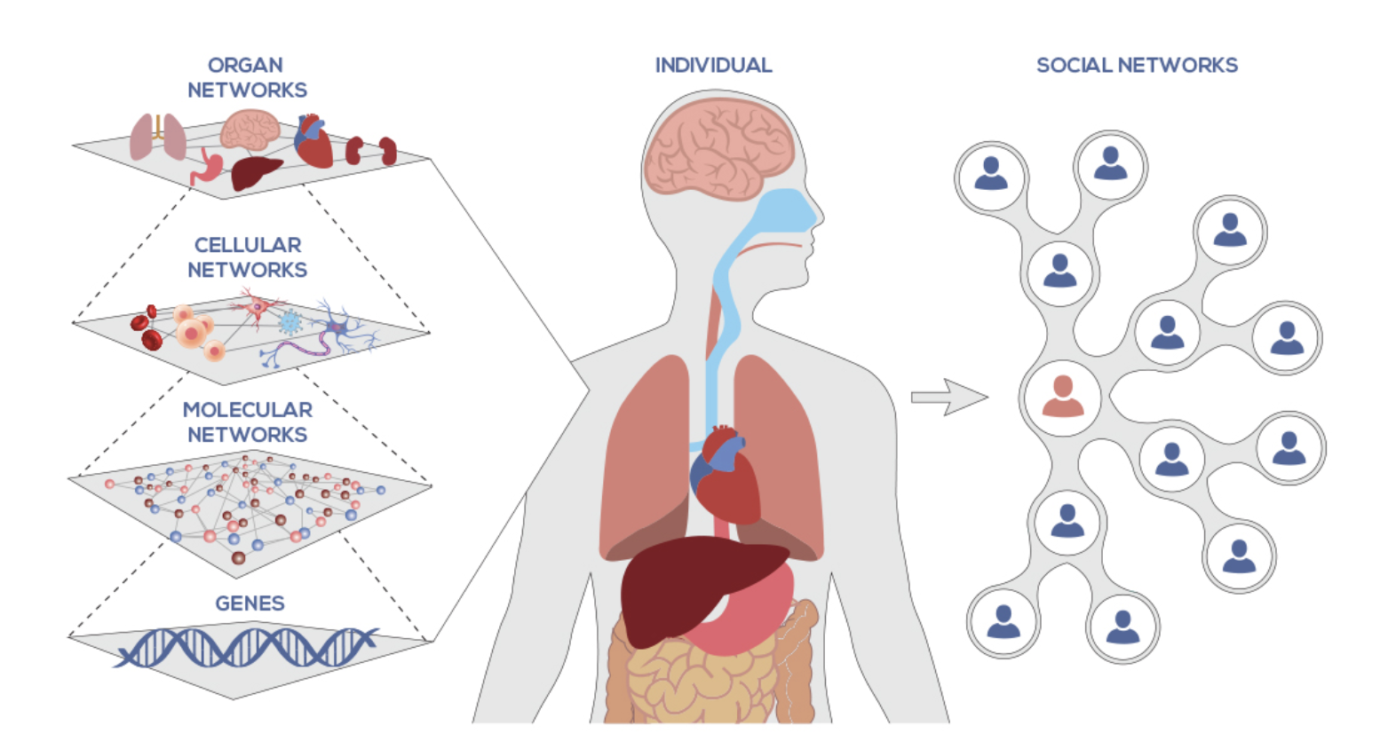
Systems Biology in Human Disease
Cell-level
Multi-omics
https://systemsbiology.org/about/what-is-systems-biology/

Slide 26
Diversity of Omics in Biomedicine
Genome
  Long term information storage
Transcriptome
  Retrieval of information
Proteome
  Short term information storage
Interactome
  Signaling networks
Metabolome, Lipidome
  State
Proteomics
Phosphoproteomics
Mutation calls
Copy Number
Gene Expression
DNA methylation/Epigenetics
MicroRNA
Metabolomics
Phenotype Data
Samples
Genes/loci

Slide 27
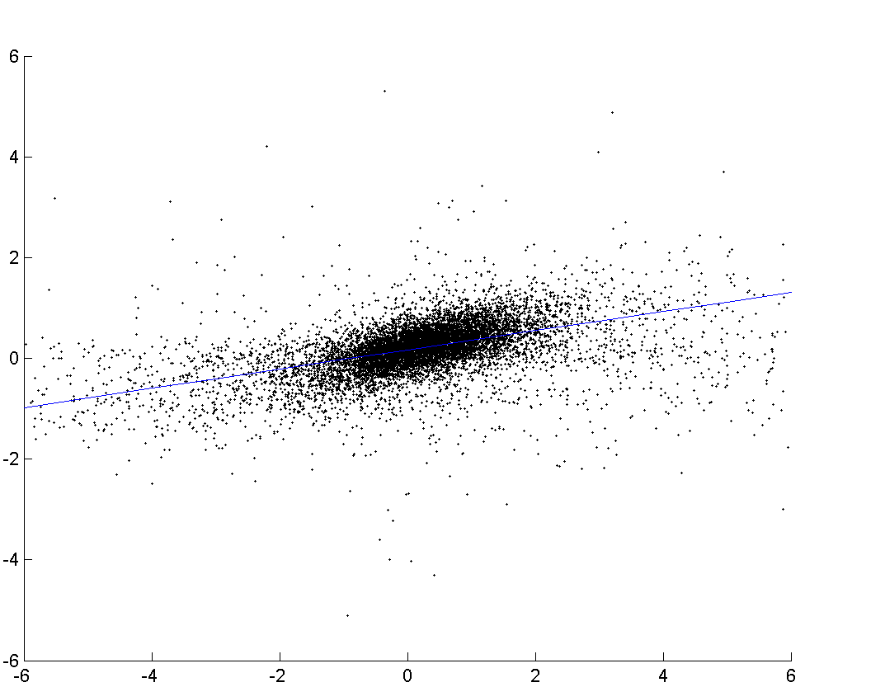
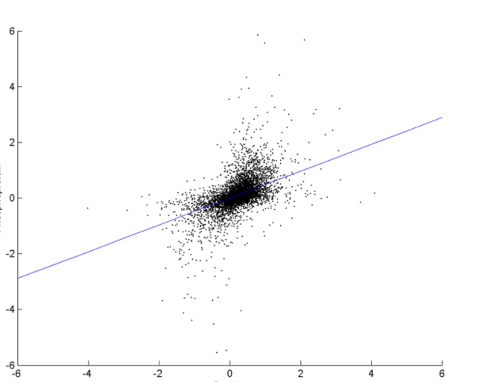
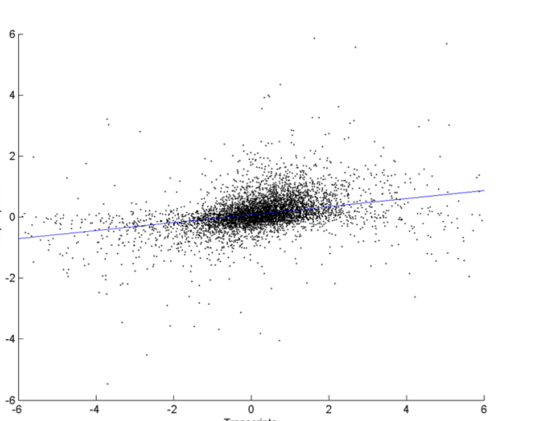
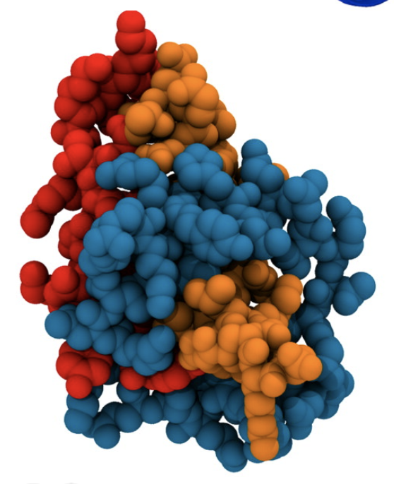
Intracellular System-level Analysis
“I don’t know why you bother measuring proteomics, all you need to understand cancer is RNA-Seq” – Anonymous Tenured Professor
r²=0.4698
r²=0.3718
r²=0.2577
Protein
Phosphoprotein
Phosphoprotein
mRNA
Protein
mRNA
Degradation
Translational
regulation
P
Kinase
Degradation
Phosphatase

Slide 28
Proteomics vs. Genomics
Ellis et al., Cancer Discovery 2013

Slide 29
Inter-cellular Systems
Inter-cellular
Multi-omics
https://systemsbiology.org/about/what-is-systems-biology/

Slide 30
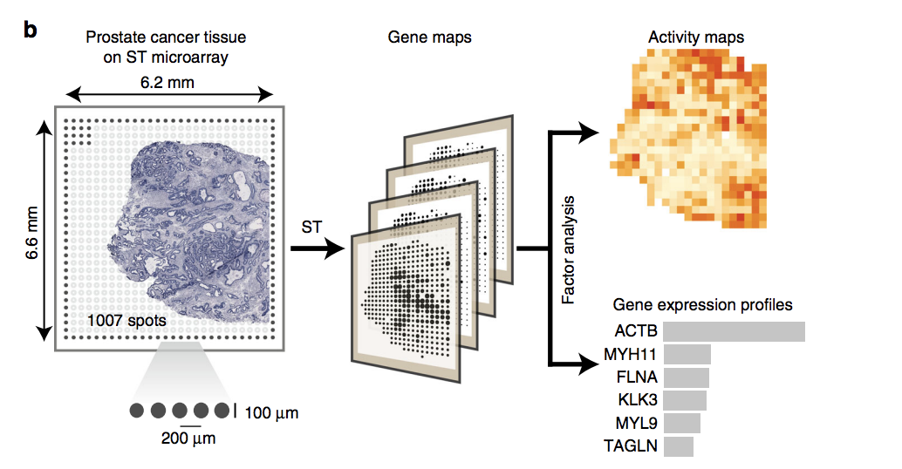
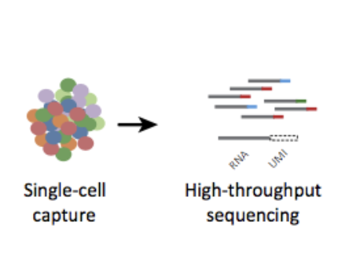
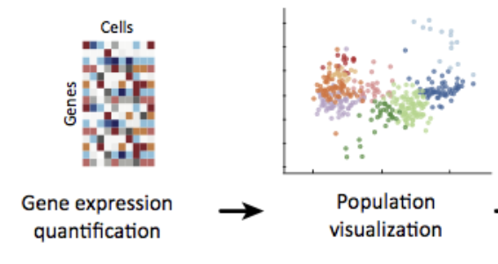
Inter-cellular Systems
Spatial Transcriptomics
Inter-cellular
Multi-omics
Single Cell RNA-Seq
Berglund et al., Nature Communications 2018

Slide 31
Inter-organ Systems
Inter-organ
Multi-omics
https://systemsbiology.org/about/what-is-systems-biology/

Slide 32

Inter-organ Systems
MoTrPAC: Molecular Transducers of Physical Activity in Humans Consortium
Inter-organ
Multi-omics
Investigating how physical exercise alters the function of tissues in the body
Extensive cataloguing of biological molecules affected by exercise (genomic, epigenomic, transcriptomic, proteomics and metabolomic)
https://commonfund.nih.gov/moleculartransducers

Slide 33
Inter-personal Systems
https://systemsbiology.org/about/what-is-systems-biology/
Inter-personal multi-omics

Slide 34
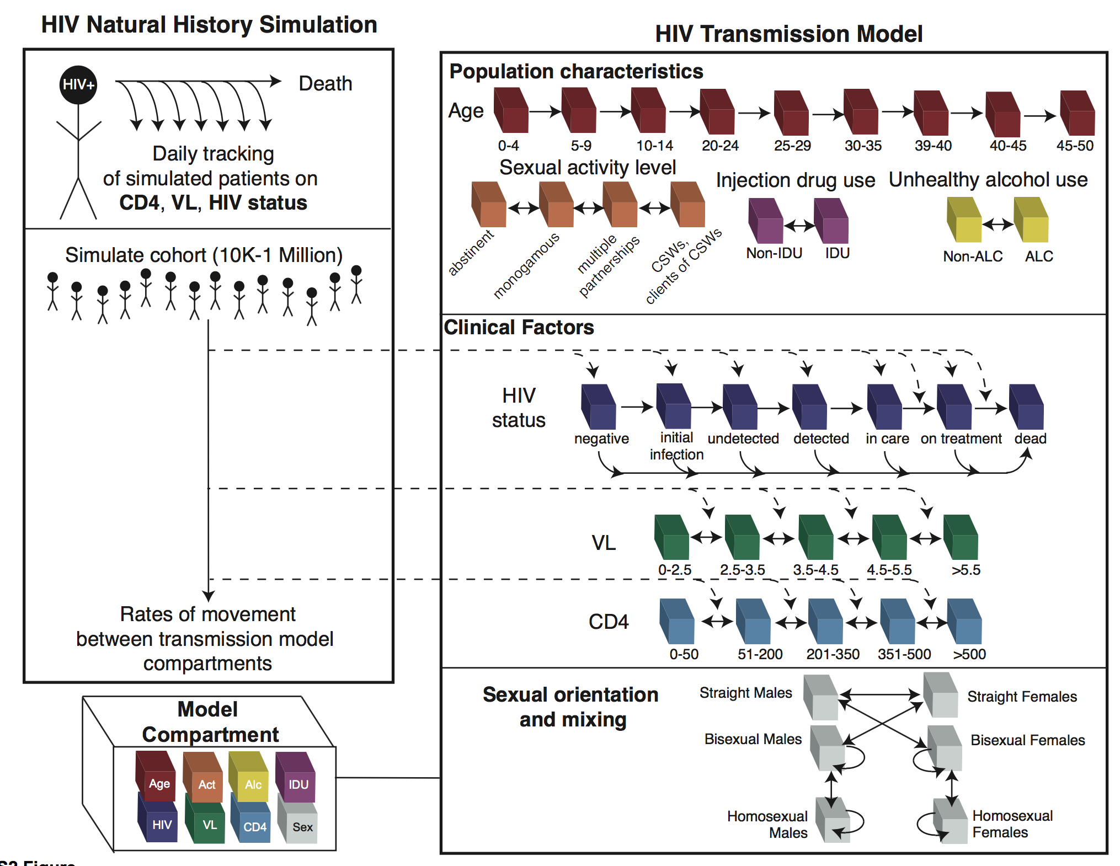
Social System-level
Mathematical Modeling of HIV in India
Seeding of the Infant Gut Microbiome by Mothers
Ruggles et al., PLoS One, 2017
Backhed, et al., Cell Host & Microbe 2015
Dominguez-Bello, Nature Medicine 2016

Slide 35
Multi-omics and Personalized Medicine
https://systemsbiology.org/about/what-is-systems-biology/
http://biobydesign.com/blog/role-synthetic-biology-personalised-medicine/

Slide 36
Quantitative Biology Best Practices
Visualize
Clean
Transform
Communicate
Model
Modified from R for Data Science, Wickham & Grolemund

Slide 37
Data Cleaning
Visualize
Clean
Transform
Communicate
Model
Modified from R for Data Science, Wickham & Grolemund

Slide 38
Data Cleaning
Often gene and sample names are not formatted exactly as needed for downstream analysis
 | TCGA-A2-A0CM-01A-31R-A034-07 | TCGA-A2-A0D0-01A-11R-A00Z-07 | TCGA-A2-A0D1-01A-11R-A034-07
UBC|7316 | 0.052 | 0.360 | -0.476
GUCY2D|3000 |  | -2.085 | 3.337
C11orf95|65998 | 0.405 | 0.446 | 1.011
C17orf81|23587 | -0.129 | 0.273 | -0.024
ANKMY2|57037 | -0.890 | -1.851 | -1.510
TTC36|143941 |  | -6.382
Or a different reference database was used and the accessions don’t match (ex: Ensembl vs. RefSeq)
 | AO-A12D.01TCGA | C8-A131.01TCGA | AO-A12B.01TCGA
NP_958782 | 1.10 | 2.61 | -0.66
NP_958785 | 1.11 | 2.65 | -0.65
NP_958786 | 1.11 | 2.65 | -0.65
NP_000436 | 1.11 | 2.65 | -0.63
NP_958781 | 1.12 | 2.65 | -0.64
NP_958780 | 1.11 | 2.65 | -0.65

Slide 39
Data Cleaning
Missing data:
  Are missing values in the dataset coded as ‘0’, ’NA’, ‘NaN’, Blanks?
  Should genes (rows) be removed if they have more than a certain number of missing values?
Are there repeat samples in the matrix?
  Technical or experimental replicates?
Are there repeat genes or proteins in the matrix?

Slide 40
Data Transformation
Visualize
Transform
Clean
Communicate
Model
Modified from R for Data Science, Wickham & Grolemund

Slide 41
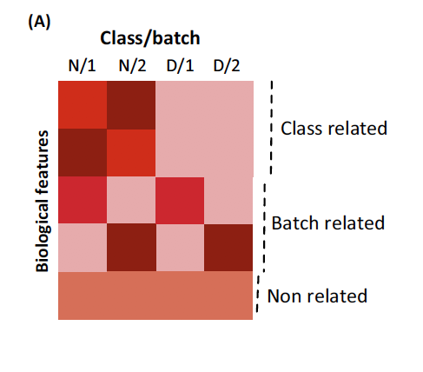
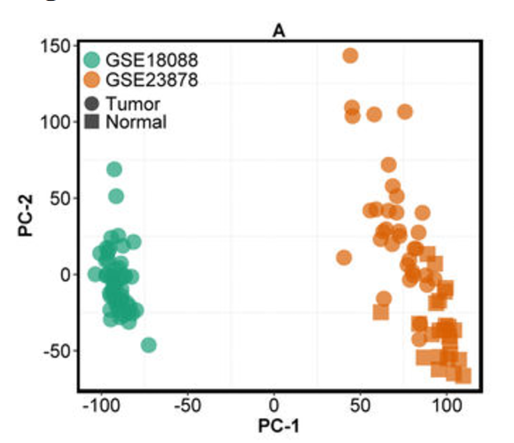
Data Transformation
Bias in omics can be defined as non-biological signal or features of the data that can be explained by experimental or technical reasons
  ”Batch Effect”
Normalization can be used to remove these biases
Class related:
e.g. Normal vs. disease
Goh, 2017
Nyamundanda, 2017
Notes:
ombating batch effect (ComBat), an empirical Bayes method for batch correction on each gene²; distance-weighted discrimination (DWD), which employs support vector machines (SVMs) to find a hyper-plane separating the batches³ (both ComBat and DWD were used by us in multiple instances^{4,5,6,7}); FAbatch, an extension of ComBat with batch-specific latent variables that is only suitable when the outcome of interest is known and binary⁸; mean-adjustment of microarray data by batches using prediction analysis of microarrays - PAM⁹; gene standardisation by z-score¹⁰; cross-platform normalisation (XPN),

Slide 42
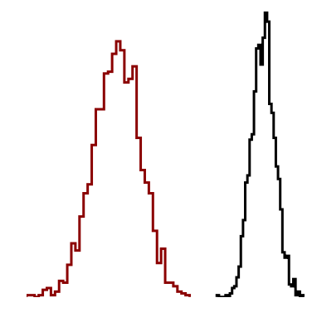
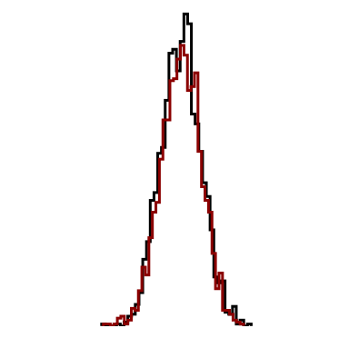
Data Normalization
Raw Data
Simple cases: adjusting values measured on different scales to a common scale
  Allow the comparison of values from different data sets or with different protein concentrations
Complicated cases: intention is to bring the entire probability distribution of adjusted values into alignment
  Align all data to a normal distribution
  Align quantiles of different measurements
Normalized:
mean=0, std=1

Slide 43
Normalization Methods
Global Adjustment
  Used to force the distribution of the log intensity values to center around the mean or median for each sample
  Assumptions:
    Most gene abundances do not change, so distribution of intensities across samples should be similar
  LOG2 normalization
    Simplifies statistics
    LOG2 used because we can easily translate into fold change
Lowess regression: used in microarrays
Quantile Normalization
Two component Gaussian
Z-score Normalization

Slide 44
Remove “Wonky” samples
Normal
Proteome
Phosphoproteome
Density (number of proteins)
Bimodal
Bimodal
Bimodal
Log2 iTRAQ tumor / reference
Some tumors have bimodal distribution of both proteins and phosphopeptides with lower overall abundance
Not a processing or technical artifact
Not specific to subtype, PAM50 status or histology
Normal: 54 (total 75)
Bimodal: 26 (total 30)

Slide 45
Data Imputation
Replacing missing data with substituted values
Problems caused by missing data:
  Introduces bias if the missingness is not random
  Makes analysis of data more difficult
Imputing data can also introduce new bias
In many statistical packages, if one or more missing values are present that case is discarded
  Does not add any bias but reduces sample size/power

Slide 46
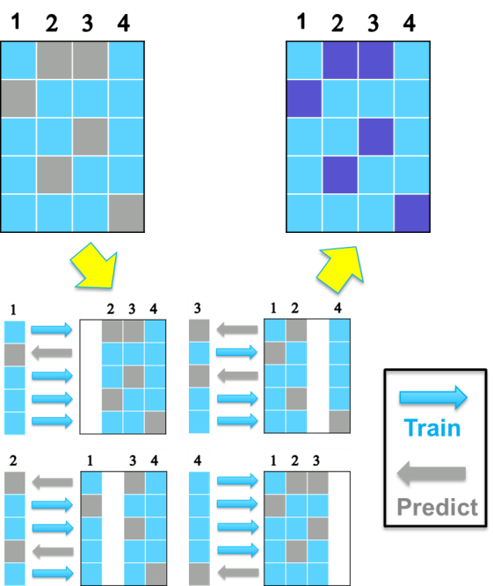
Data Imputation Tools
Non-informative Imputation
  Fixed-value imputation: median or minimum
  Perseus (S. Tyanova, et al. 2016): sampling from a non-informative distribution.
Low rank matrix completion
  softImpute (R. Mazumder, et al. 2010): imagine processing; a regularized SVD decomposition. R-package: ‘softImpute’.
Prediction based imputation
  KNN: R-package: ‘pamr’.
  Lasso: R-package: ‘glmnet’.
  Xgboost (T. Chen, et al. 2016): R-package: ‘xgboost’.
Machine-learning based imputation
  missForest (D. J. Stekhoven, et al. 2012): R-package: ‘missForest’.
  ADMIN: A multi-layer prediction model learned through an iterative procedure.
Perseus.c (center) /.t (tail)
Prediction based imputation
Notes:
Non-informative imputation
Fixed-value imputation
median/minimum)
A random distribution imputation Perseus(center/tail)
2. Low rank matrix completion
softImpute (SVD decomposition)
3. Predict model on the other proteins
xgboost
KNN
LASSO
4. Iterative algorithm with prediction models
missForest
ADMIN

Slide 47
Data Exploration
Visualize
Clean
Transform
Communicate
Model
Modified from R for Data Science, Wickham & Grolemund

Slide 48
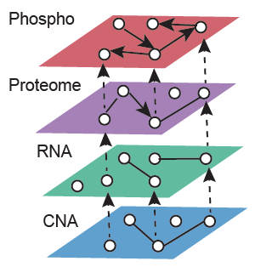
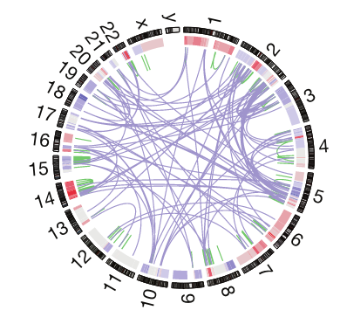
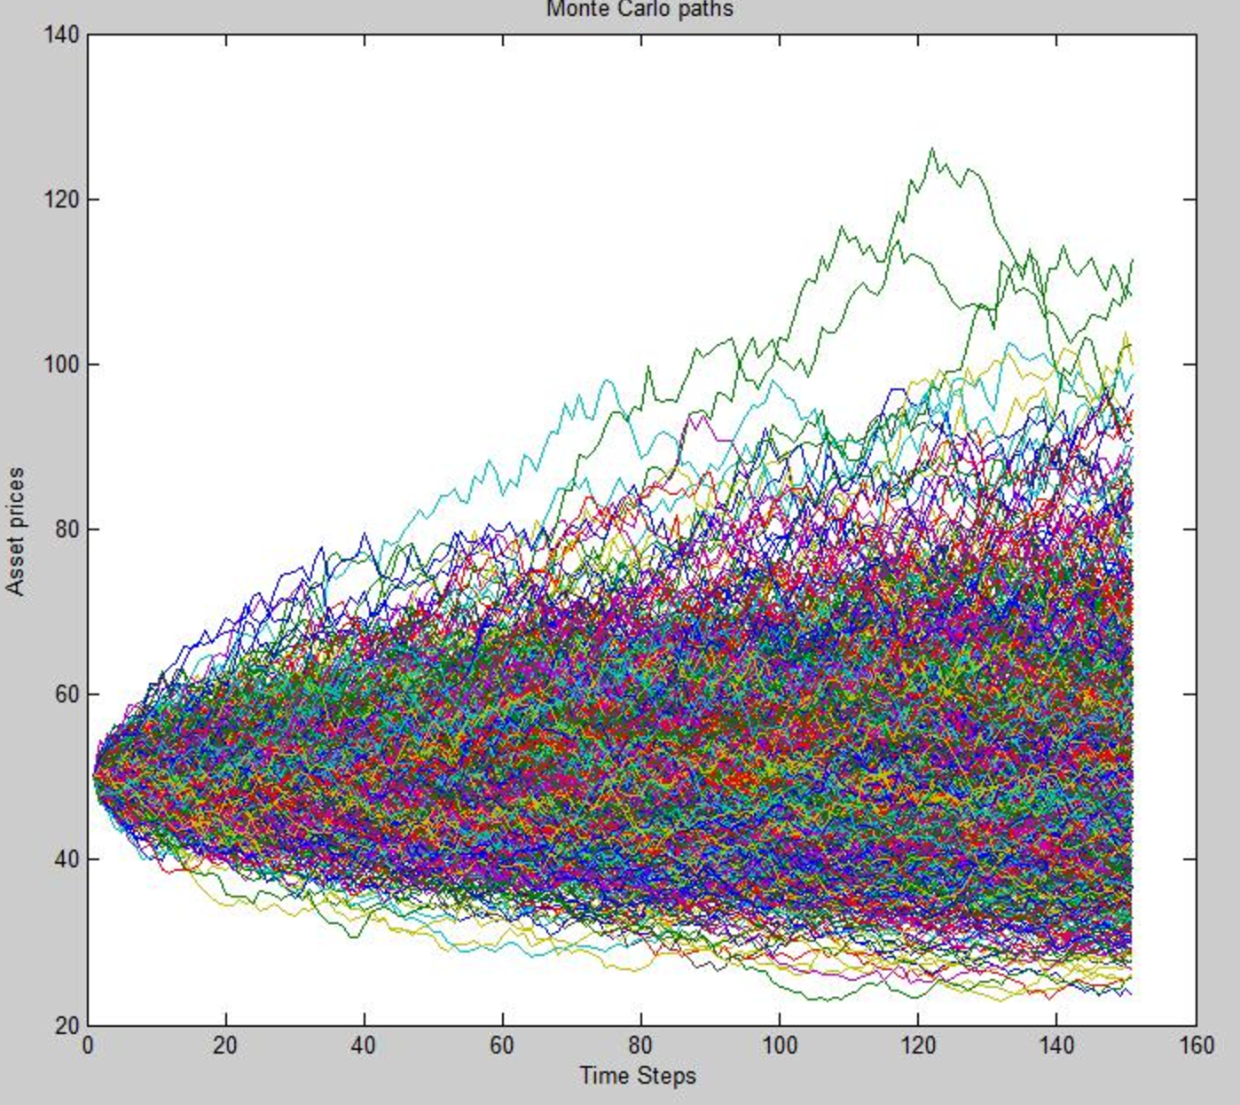
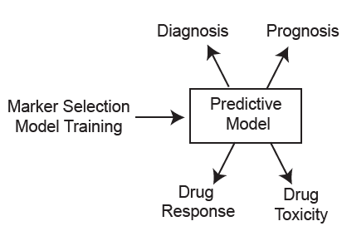
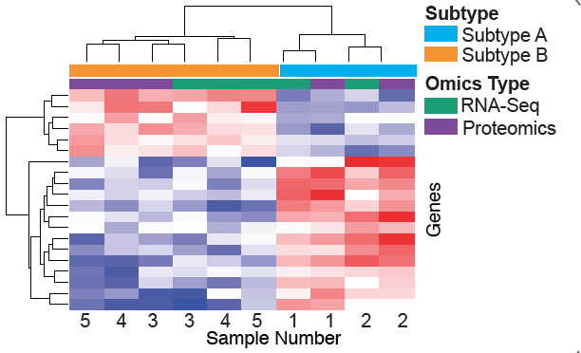
Data Exploration Overview
Data Processing
Data Integration
Data Visualization
Next Generation Sequencing
Proteomics
Metabolomics, Lipidomics
Gene, Protein Expression
Metabolite, Lipid quantitation
Epigenetic Information
Microbial Taxa
Data Simulation
Predictive Modeling
and Statistics

Slide 49
Questions?
https://xkcd.com/1605/

