Slide 1
Proteomics Informatics –
Protein characterization: post-translational modifications and protein-protein interactions (Week 10)

Slide 2
Top down / bottom up
Top down
Bottom up
intensity
mass/charge

Slide 3
Top down Bottom up
Charge distribution
2+
27+
31+
intensity
intensity
3+
4+
1+
mass/charge
mass/charge

Slide 4
Top down Bottom up
Isotope distribution
intensity
intensity
mass/charge
mass/charge

Slide 5
Fragmentation
Top down
Bottom up
Fragmentation

Slide 6
Correlations between modifications
Top down
Bottom up

Slide 7
Alternative Splicing
Top down
Exon 1
2
3
Bottom up

Slide 8
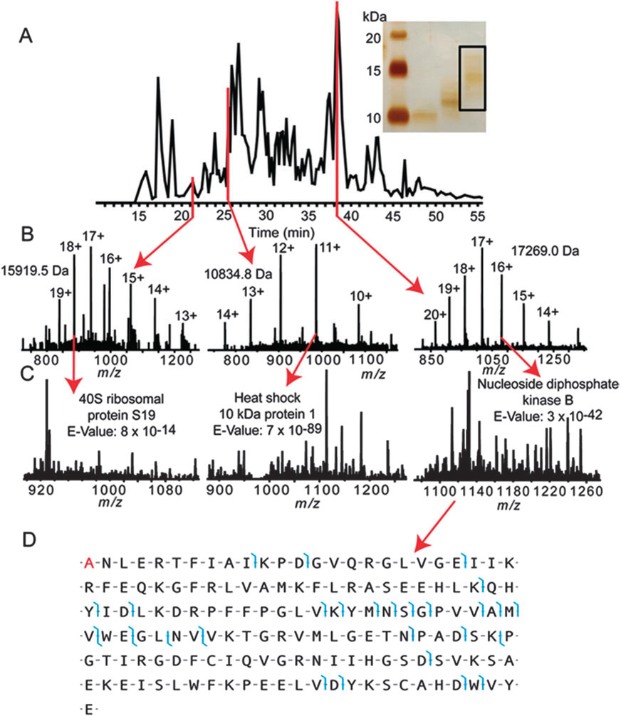
Top down
Protein
mass spectra
Fragment
mass spectra
Kellie et al., Molecular BioSystems 2010

Slide 9
Protein Complexes
A
D
A
C
B
Digestion
Mass spectrometry

Slide 10
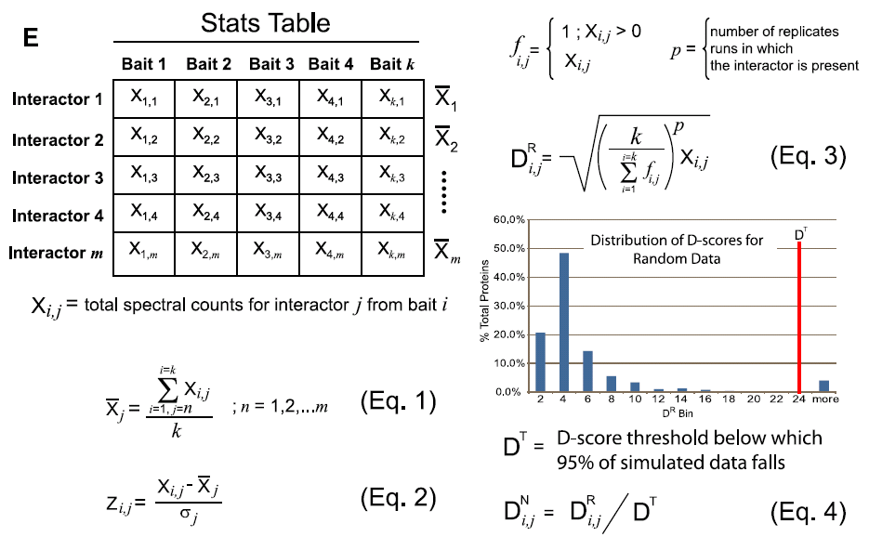
Protein Complexes – specific/non-specific binding
Sowa et al., Cell 2009

Slide 11
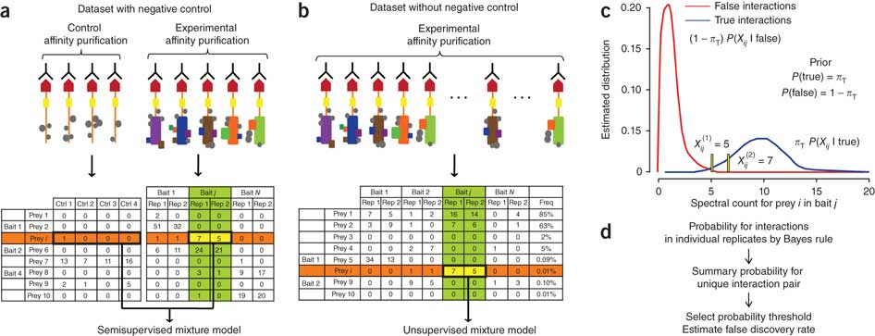
Protein Complexes – specific/non-specific binding
Choi et al., Nature Methods 2010

Slide 12
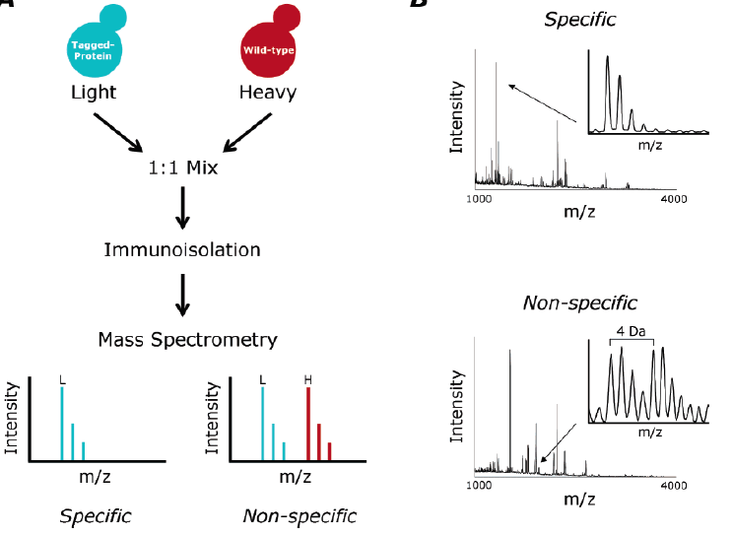
Protein Complexes – specific/non-specific binding
Tackett et al. JPR 2005

Slide 13
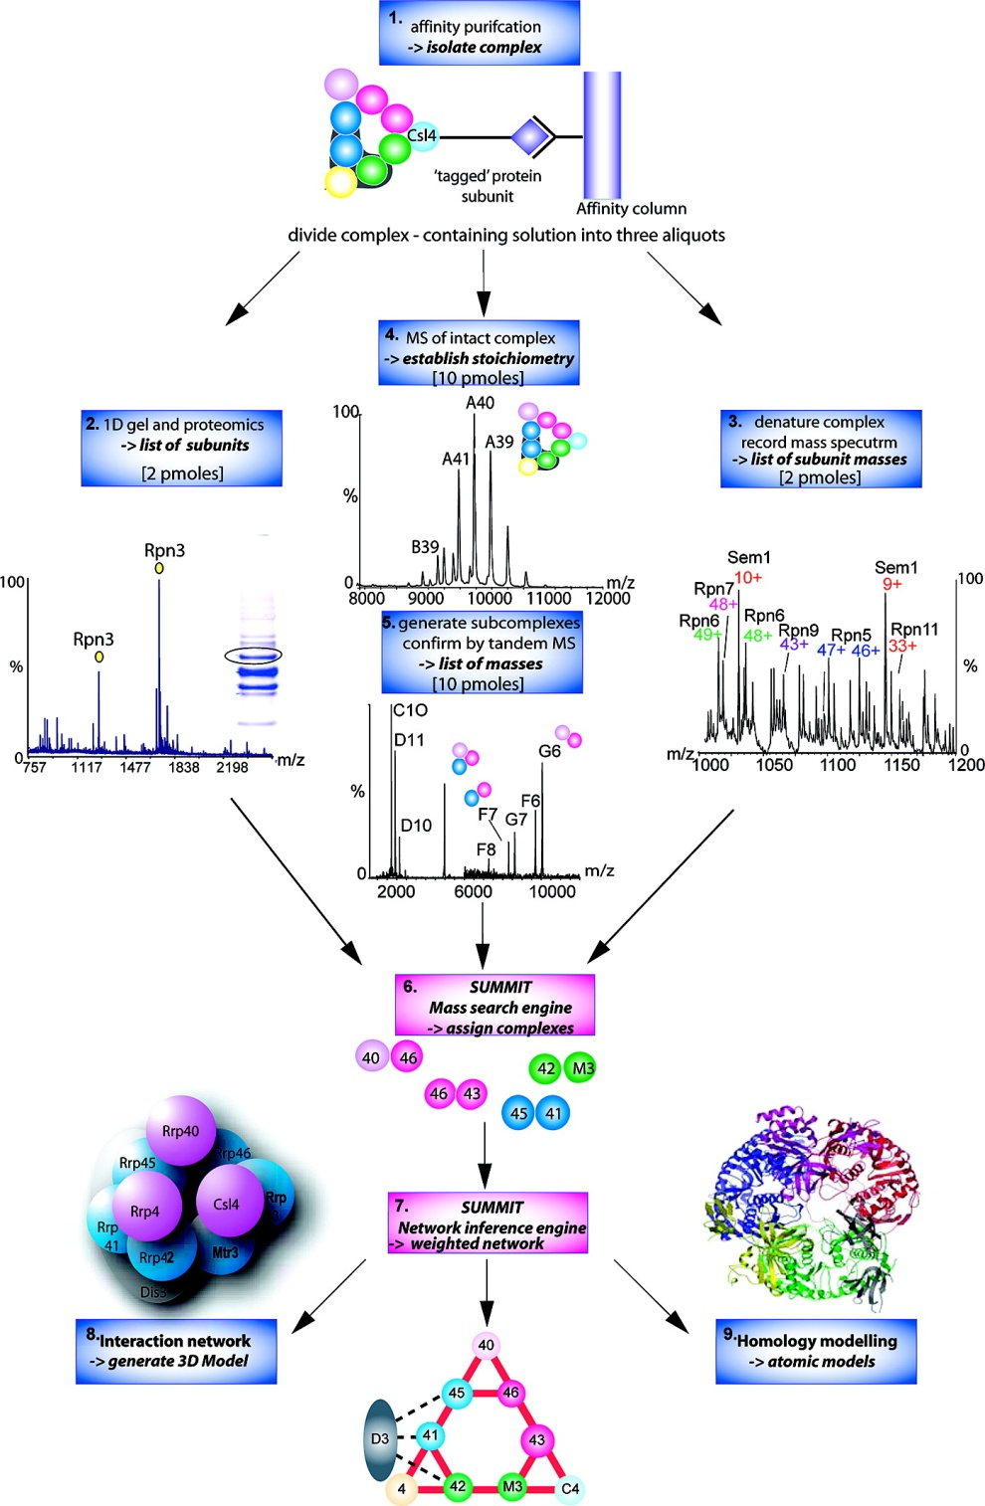
Analysis of Non-Covalent Protein Complexes
Taverner et al., Acc Chem Res 2008

Slide 14
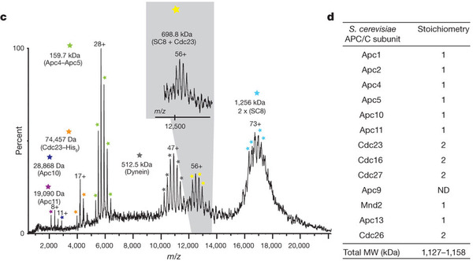
Non-Covalent Protein Complexes
Schreiber et al., Nature 2011

Slide 15
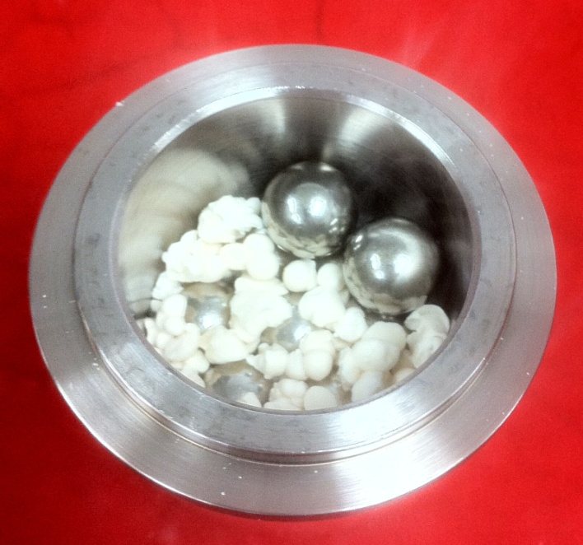
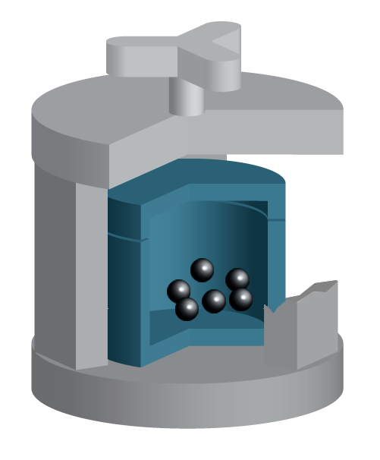
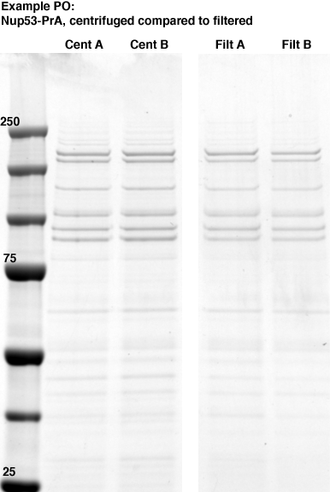
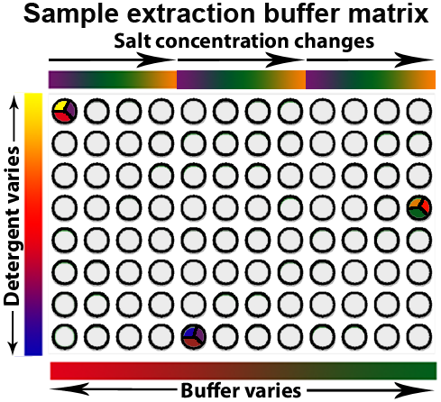
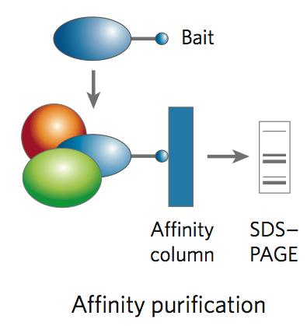
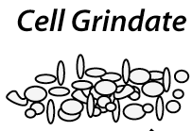
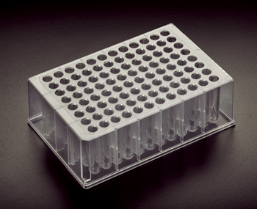
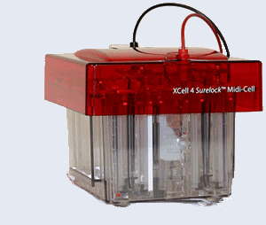
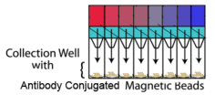
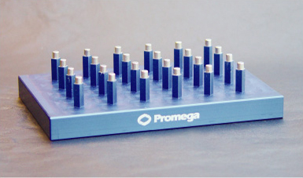
Affinity Capture Optimization Screen
Cell extraction
More / better quality interactions
+
Filtration
Lysate clearance/
Batch Binding
SDS-PAGE
Binding/Washing/Eluting
LaCava, Hakhverdyan, Domanski, Rout
Notes:
Grindate is critical!
~100mg of yeast is ~40mL of an avg mid-late log culture – in a single 1.2ml deep well
development of a non-fouling filter was critical - Orochem

Slide 16
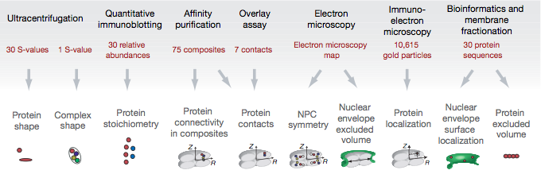
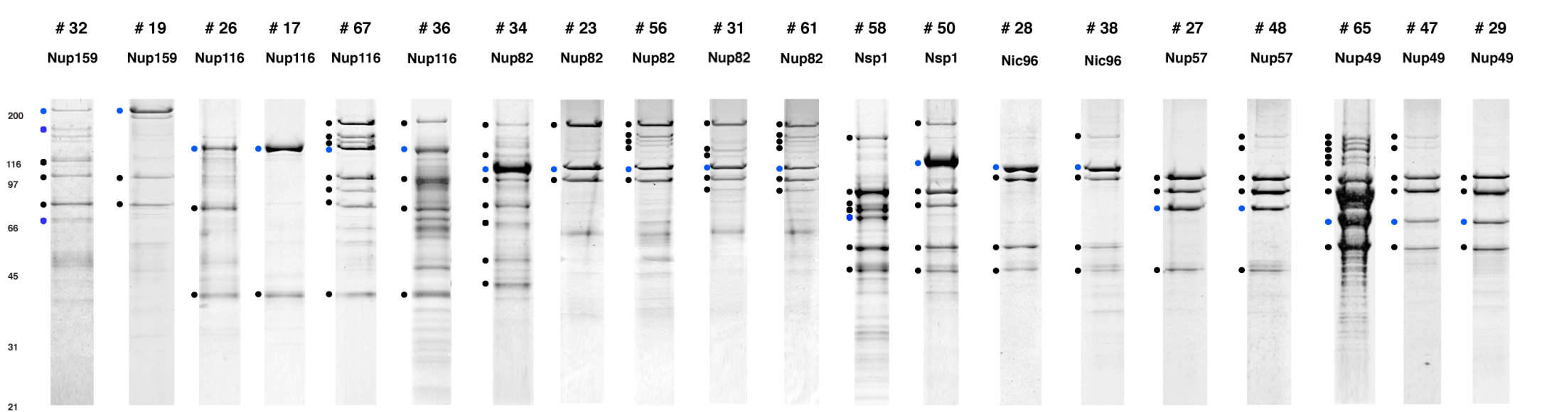
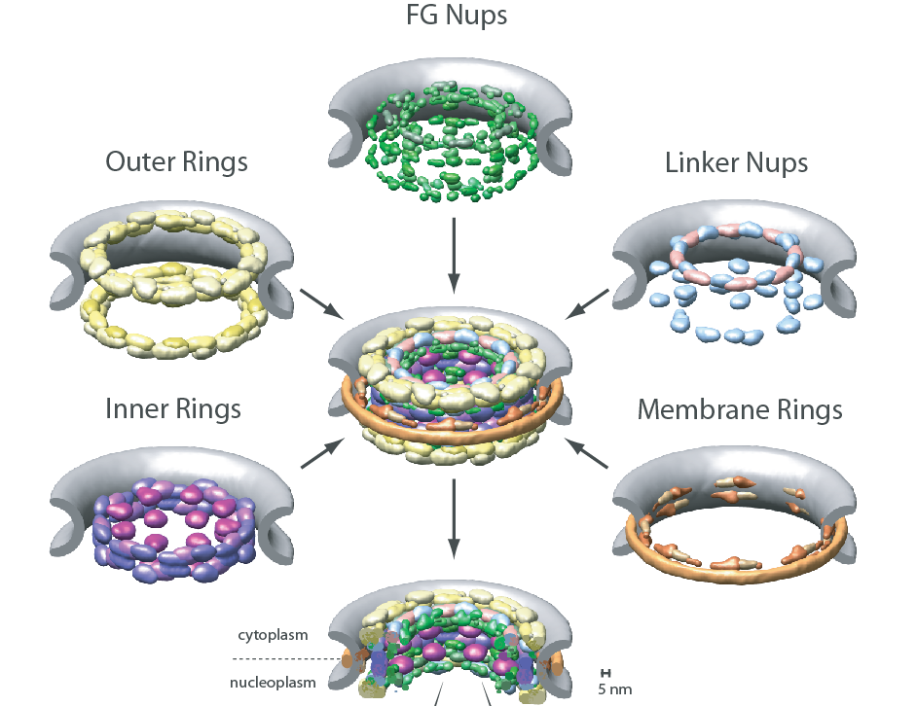
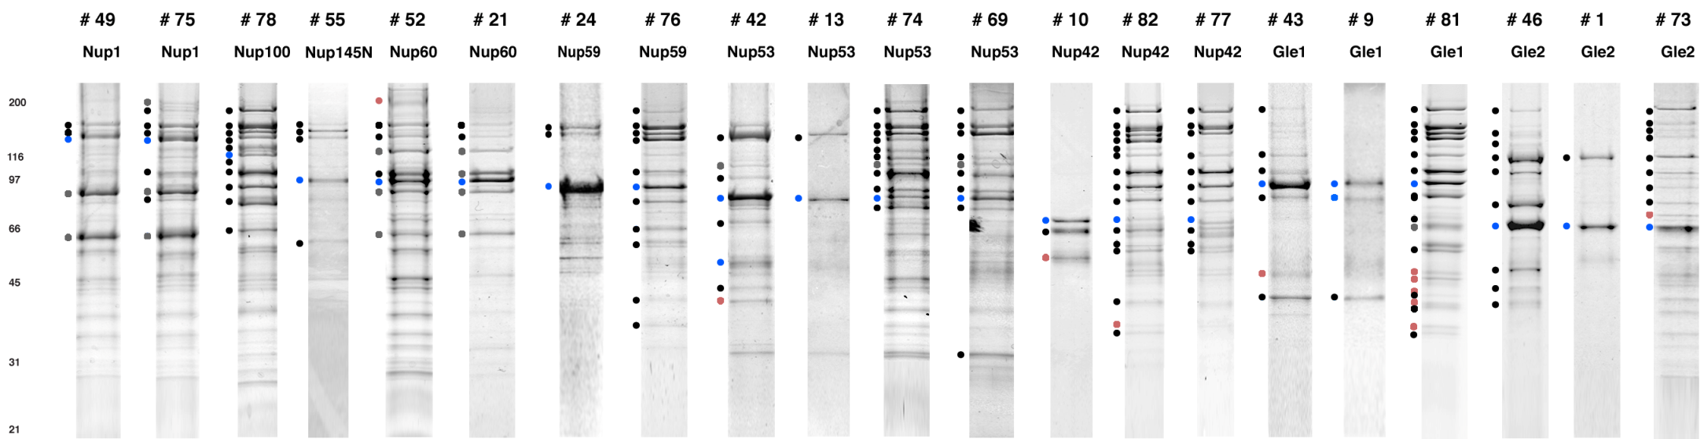
Molecular Architecture of the NPC
Over 20 different extraction and washing
conditions ~ 10 years or art.
(41 pullouts are shown)
Actual model
Alber F. et al. Nature (450) 683-694. 2007
Alber F. et al. Nature (450) 695-700. 2007
Notes:
Molecular architecture of the nuclear pore – “Blob Map” (Also applied to the eukaryotic 80S ribosome & 26S proteasome)
456 subunits / 50 MDa / 30 different protein
(But only ~8 folds)
some purifications good, some poor – not every protein responded with equal enthusiasm to our desire to capture its physiological interaction partners - but the value of the data for determining the NPC molecular architecture was high

Slide 17
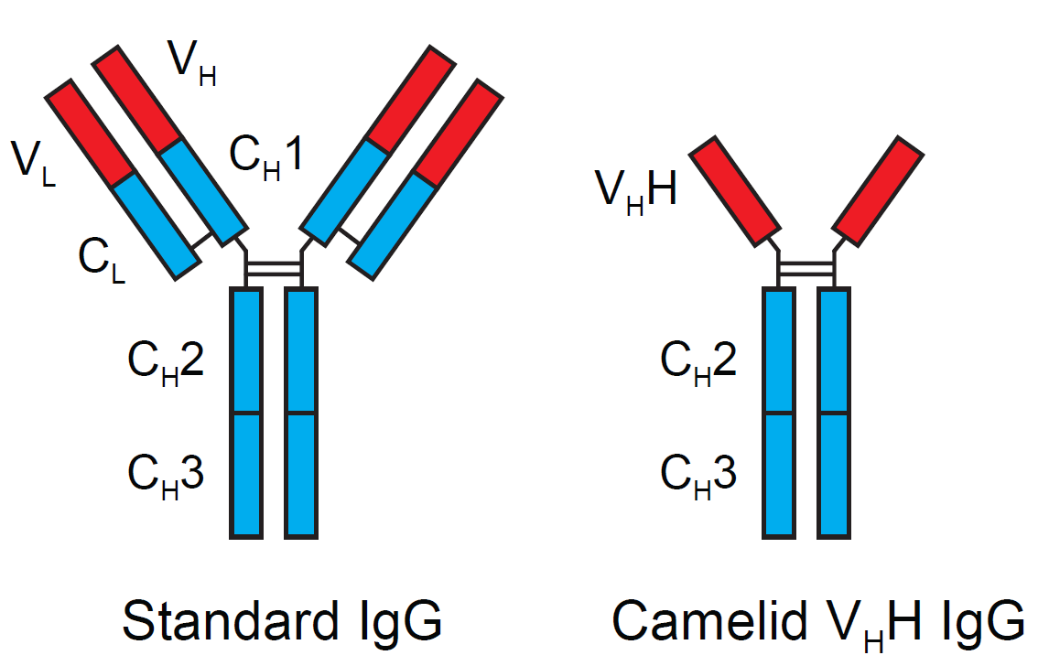
Cloning nanobodies for GFP pullouts
Atypical heavy chain-only IgG antibody produced in camelid family – retain high affinity for antigen without light chain
Aimed to clone individual single-domain VHH antibodies against GFP – only ~15 kDa, can be recombinantly expressed, used as bait for pullouts, etc.
To identify full repertoire, will identify GFP binders through combination of high-throughput DNA sequencing and mass spectrometry
VHH clone for recombinant expression
Notes:
Long-term goal has been development of improved reagents for tagging, isolating proteins/complexes of interest.
Antibodies to existing, ubiquitous tags, like GFP, most useful, effective tools
Looking to develop a recombinant alternative to replace antibodies otherwise required.
Can easily make large quantities of a defined sequence – avoids production problems, mass spec interference

Slide 18
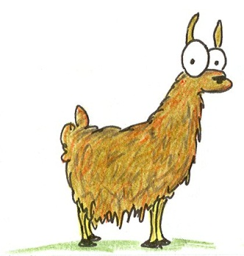
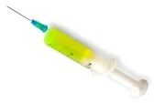
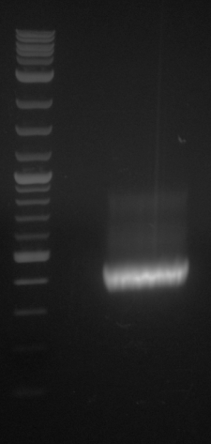
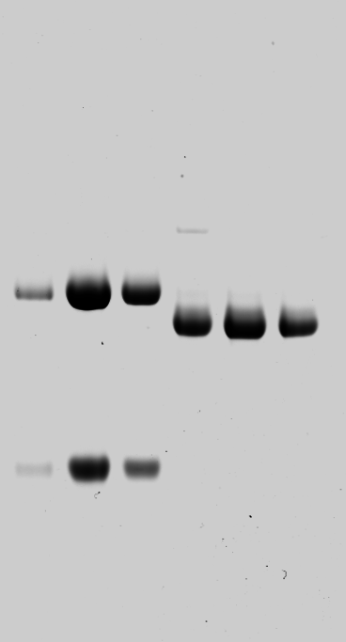
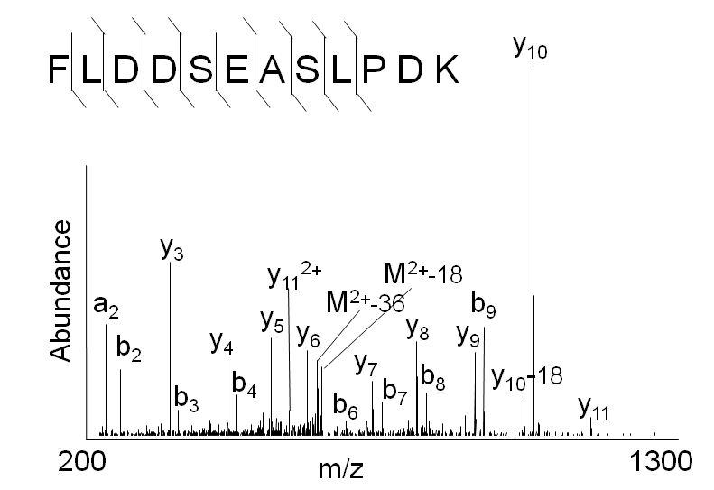
Cloning llamabodies for GFP pullouts
Llama GFP immunization
Bone marrow aspiration
Serum bleed
VH
VHH
Lymphocyte
total RNA
Crude serum
1000 bp
RT / Nested PCR
IgG fractionation &
GFP affinity purification
500
400
300
VHH amplicon
GFP-specific
VHH fraction
454 DNA sequencing
VHH DNA sequence library
LC-MS/MS
No. of Reads
GFP-specific
VHH clones
Read length (bp)
Fridy, Li, Keegan, Chait, Rout

Slide 19
Identifying full-length sequences from peptides
Underlined regions are covered by MS
CDR1
CDR2
CDR3
CDR3: 100.0% (14/14); combined CDR: 100.0% (33/33); DNA count: 10
MAQVQLVESGGGLVQAGGSLRLSCVASGRTFSGYAMGWFRQTPGREREAVAAITWSAHSTYYSDSVKDRFTISIDNTRNTGYLQMNSLKPEDTAVYYCTVRHGTWFTTSRYWTDWGQGTQVTVS
CDR3: 100.0% (14/14); combined CDR: 72.7% (24/33); DNA count: 1
MAQVQLVESGGALVQAGASLSVSCAASGGTISKYNMAWFRRAPGREREAVAAITWSAHSTYYSDSVKDRFTISIDNTRNTGYLQMNSLKPEDTAVYYCTVRHGTWFTTSRYWTDWGQGTQVTVS
CDR3: 100.0% (14/14); combined CDR: 72.7% (24/33; DNA count: 1
MADVQLVESGGGLVQSGGSRTLSCAASGRVLATYHLGWFRQSPGREREAVAAITWSAHSTYYSDSVKGRFTISIDNARNTGYLQMNSLKPEDTAVYYCTVRHGTWFTVSRYWTDWGQGTQVTVS
CDR3: 100.0% (14/14); combined CDR: 42.4% (14/33); DNA count: 1
MAQVQLEESGGGLVQAGDSLTLSCSASGRTFTNYAMAWSRQAPGKERELLAAIDAAGGATYYSDSVKGRFTISIDNTRNTGYLQMNSLKPEDTAVYYCTVRHGTWFTTSRYWTDWGQGTQVTVS
CDR3: 100.0% (14/14); combined CDR: 42.4% (14/33); DNA count: 1
MAQVQLVESGGGRVQAGGSLTLSCVGSEGIFWNHVMGWFRQSPGKDREFVARISKIGGTTNYADSVKGRFTISIDNTRNTGYLQMNSLKPEDTAVYYCTVRHGTWFTTSRYWTDWGQGTQVTVS
Rank sequences according to:
CDR3 coverage; Overall coverage;
Combined CDR coverage; DNA counts;

Slide 20
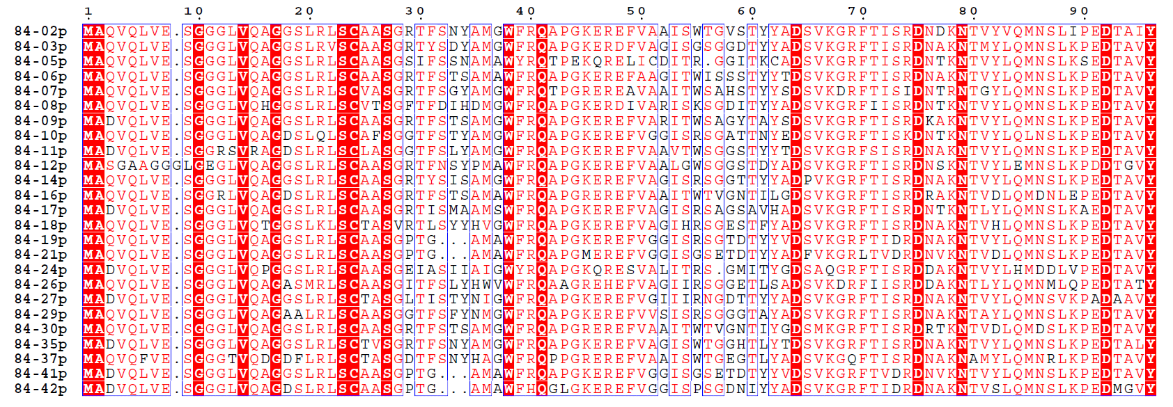
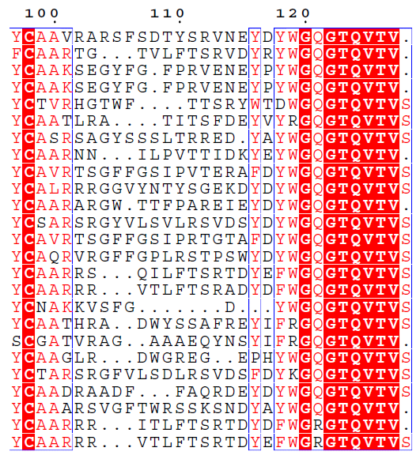
Sequence diversity of 26 verified
anti-GFP nanobodies
Of ~200 positive sequence hits, 44 high confidence clones were synthesized and tested for expression and GFP binding: 26 were confirmed GFP binders.
Sequences have characteristic conserved VHH residues, but significant diversity in CDR regions.
FR1
CDR1
FR2
CDR2
FR3
CDR3
FR4

Slide 21
HIV-1
gp120
Lipid Bilayer
gp41
RT
MA
IN
PR
Genome
NC
CA
MA
CA
NC
p6
gp120
gp41
RNA
vpu
nef
Particle
gag
vif
env
5’ LTR
pol
tat
3’ LTR
vpr
rev
PR
RT
IN
9,200 nucleotides

Slide 22
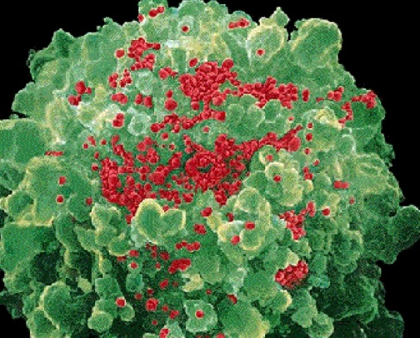

Genetic-Proteomic Approach
Tagged Viral Protein
Tag
*
Protein Complex
Mass Spectrometry
SDS-PAGE

Slide 23
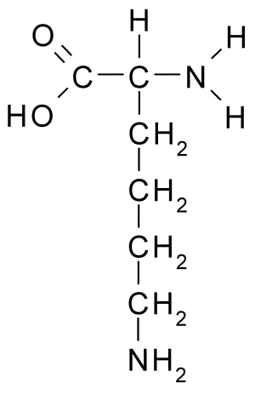
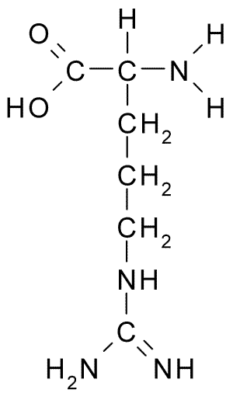
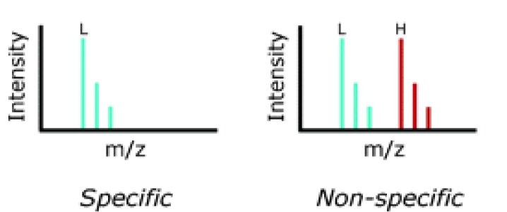
I-Dirt for Specific Interaction
I-DIRT = Isotopic Differentiation of Interactions as Random or Targeted
3xFLAG Tagged HIV-1
WT HIV-1
Infection
Light
Heavy
(¹³C labeled Lys, Arg)
1:1 Mix
Immunoisolation
MS
Lys
Arg
Modified from Tackett AJ et al., J Proteome Res. (2005) 4, 1752-6.
(+6 daltons)
(+6 daltons)

Slide 24
IDIRT and Reverse IDIRT
Env-3xFLAG
Vif-3xFLAG
Luo, Jacobs, Greco, Cristae, Muesing, Chait, Rout

Slide 25
Protein Exchange
IP in heavy labeled Vif-3F lysate
Incubation with light labeled wt lysate
Heavy labeled Vif-3F lysate
Light labeled wt lysate
Vif-3F
Vif-3F
60min
5min
Interactor with fast exchange
15min
Stable Interactor
Vif-3F
Vif-3F
Vif-3F

Slide 26
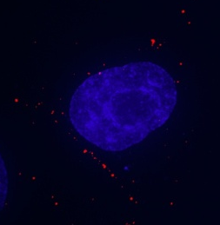
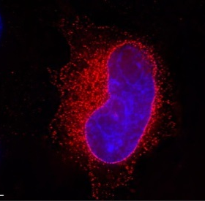
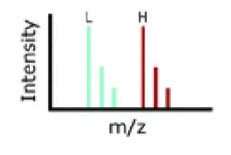
Env Time Course SILAC
Early during infection
Late during infection
Differentially labeled infection harvested at early or late stage of infection
Distinguish proteins that interact with Env at early or late stage during infection
Heavy
(¹³C labeled Lys, Arg)
Light
1:1 Mix
Immunoisolation
MS
Early interactor
Late interactor

Slide 27
Protein
Complex
Interaction Partners by
Chemical Cross-Linking
Chemical Cross-Linking
Cross-Linked
Protein Complex
Enzymatic Digestion
MS
Proteolytic
Peptides
Isolation
Fragmentation
MS/MS
Peptides
Fragments
M/Z

Slide 28
Protein
Complex
Interaction Sites by
Chemical Cross-Linking
Chemical Cross-Linking
Cross-Linked
Protein Complex
Enzymatic Digestion
MS
Proteolytic
Peptides
Isolation
Fragmentation
MS/MS
Peptides
Fragments
M/Z

Slide 29
Cross-linking
protein
n peptides with reactive groups
(n-1)n/2 potential ways to cross-link peptides pairwise
+ many additional uninformative forms
Protein A + IgG heavy chain 990 possible peptide pairs
Yeast NPC ˜10⁶ possible peptide pairs

Slide 30
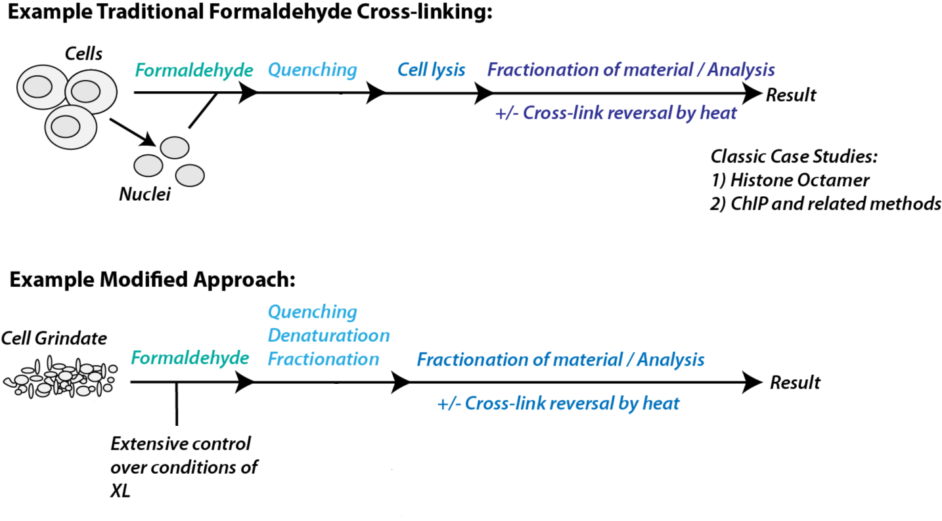
Protein Crosslinking by Formaldehyde
~1% w/v Fal
20 – 60 min
~0.3% w/v Fal
5 – 20 min
1/100 the volume
LaCava

Slide 31
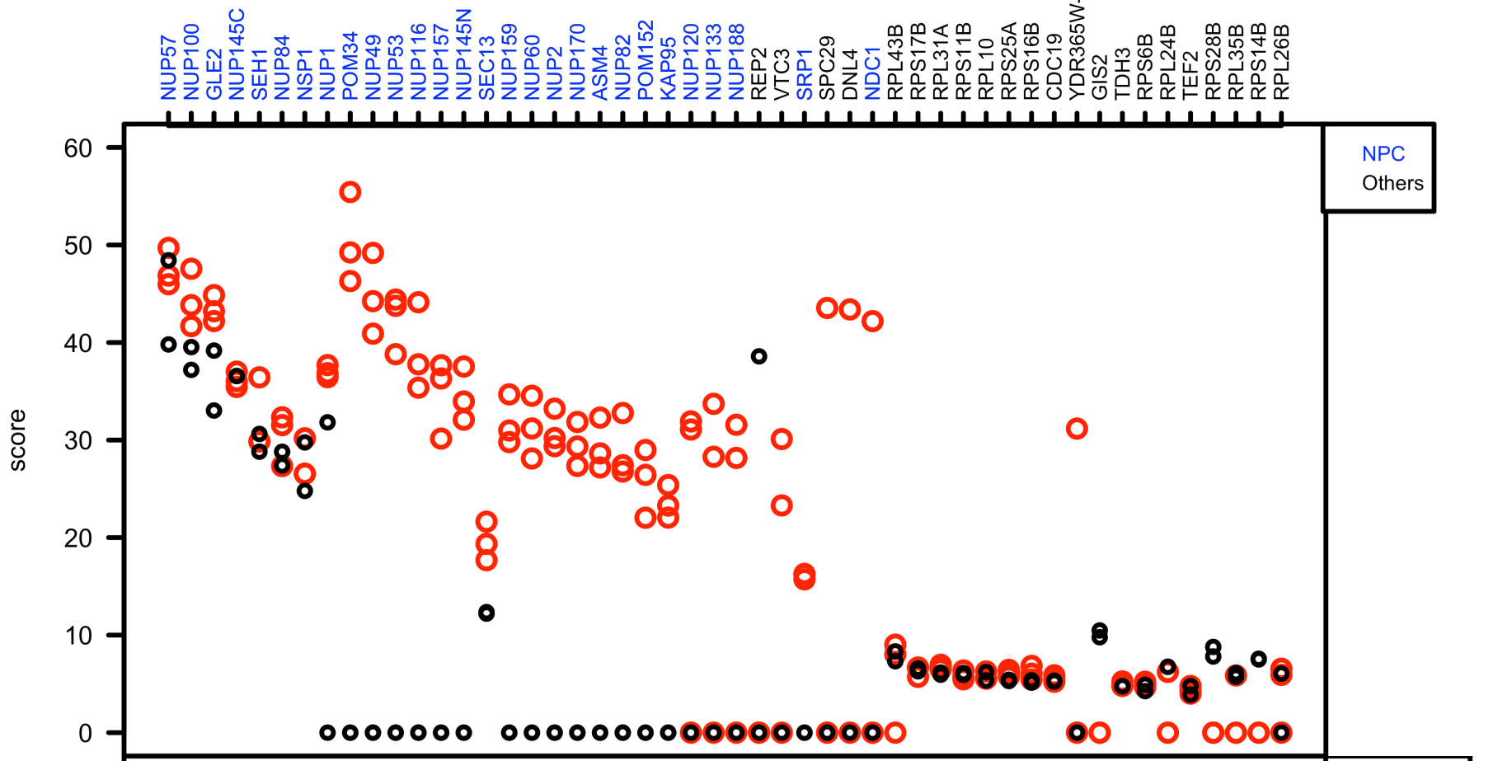
Protein Crosslinking by Formaldehyde
RED: triplicate experiments, FAl treated grindate
BLACK: duplicated experiments, FAl treated cells (then ground)
SCORE: Log Ion Current / Log protein abundance
Akgöl, LaCava, Rout
Notes:
Both are native. OR201206029_RS_XL1. is grindate ,VE20121001_84IV_Std1. is in vivo.

Slide 32
Cross-linking
Mass spectrometers have a limited dynamic range and it therefore important to limit the number of possible reactions not to dilute the cross-linked peptides.
For identification of a cross-linked peptide pair, both peptides have to be sufficiently long and required to give informative fragmentation.
High mass accuracy MS/MS is recommended because the spectrum will be a mixture of fragment ions from two peptides.
Because the cross-linked peptides are often large, CAD is not ideal, but instead ETD is recommended.

Slide 33
Localization of modifications
Phosphopeptide identification
m_{precursor} = 2000 Da
Δm_{precursor} = 1 Da
Δm_{fragment} = 0.5 Da
Phosphorylation

Slide 34
Localization of modifications
d_{min}>=3 for 47% of human tryptic peptides
Localization (d_{min}=3)
m_{precursor} = 2000 Da
Δm_{precursor} = 1 Da
Δm_{fragment} = 0.5 Da
Phosphorylation
Notes:
34

Slide 35
Localization of modifications
d_{min}=2 for 33% of human tryptic peptides
Localization (d_{min}=2)
m_{precursor} = 2000 Da
Δm_{precursor} = 1 Da
Δm_{fragment} = 0.5 Da
Phosphorylation
Notes:
35

Slide 36
Localization of modifications
d_{min}=1 for 20% of human tryptic peptides
Localization (d_{min}=1)
m_{precursor} = 2000 Da
Δm_{precursor} = 1 Da
Δm_{fragment} = 0.5 Da
Phosphorylation
Notes:
36

Slide 37
Localization of modifications
Localization
(d=1*)
m_{precursor} = 2000 Da
Δm_{precursor} = 1 Da
Δm_{fragment} = 0.5 Da
Phosphorylation
Notes:
37

Slide 38
Localization of modifications
Peptide with two possible modification sites

Slide 39
Localization of modifications
Peptide with two possible modification sites
MS/MS spectrum
Intensity
m/z

Slide 40
Localization of modifications
Peptide with two possible modification sites
Matching
MS/MS spectrum
Intensity
m/z

Slide 41
Localization of modifications
Peptide with two possible modification sites
Matching
MS/MS spectrum
Intensity
m/z
Which assignment does
the data support?
1, 1 or 2, or 1 and 2?

Slide 42
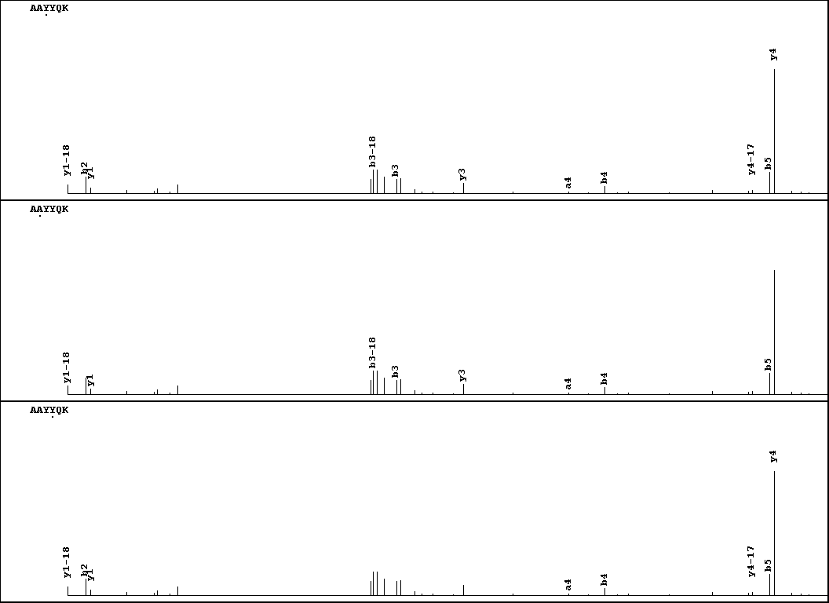
Visualization of evidence for localization
AAYYQK
AAYYQK

Slide 43
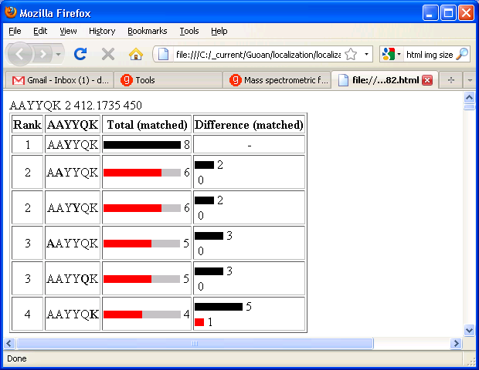
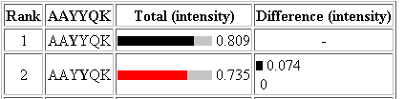
Visualization of evidence for localization

Slide 44
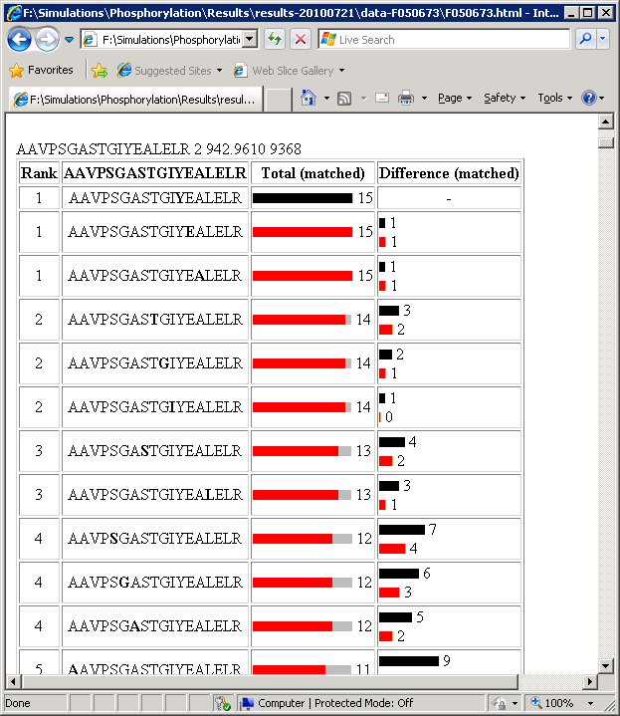
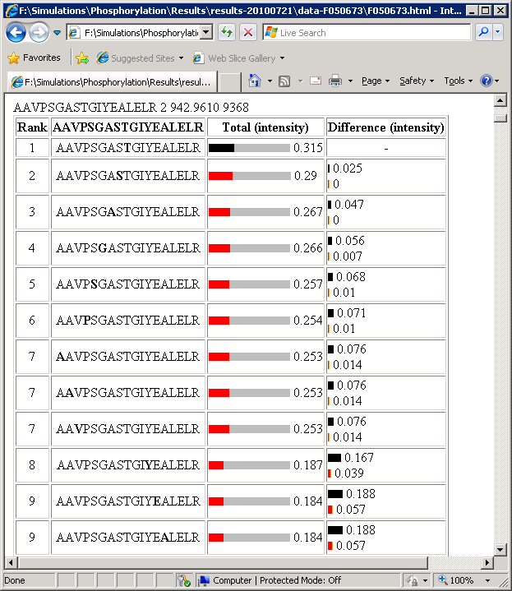
Visualization of evidence for localization
1
2
3
1
2
3

Slide 45
Estimation of global false
localization rate using decoy sites
By counting how many times the phosphorylation is localized to amino acids that can not be phosphorylated we can estimate the false localization rate as a function of amino acid frequency.
False localization frequency
Y
Amino acid frequency

Slide 46
How much can we trust a
single localization assignment?
If we can generate the distribution of scores for assignment 1 when 2 is the correct assignment, it is possible to estimate the probability of obtaining a certain score by chance for a given peptide sequence and MS/MS spectrum assignment.

Slide 47
Is it a mixture or not?
If we can generate the distribution of scores for assignment 2 when 1 is the correct assignment, it is possible to estimate the probability of obtaining a certain score by chance for a given peptide sequence and MS/MS spectrum assignment.

Slide 48
Localization of modifications
1 and 2
1
Ø
1 or 2

Slide 49
Proteomics Informatics –
Protein characterization: post-translational modifications and protein-protein interactions (Week 10)

