Slide 1
Proteomics Informatics –
Protein identification I: searching protein sequence collections and significance testing (Week 4)

Slide 2
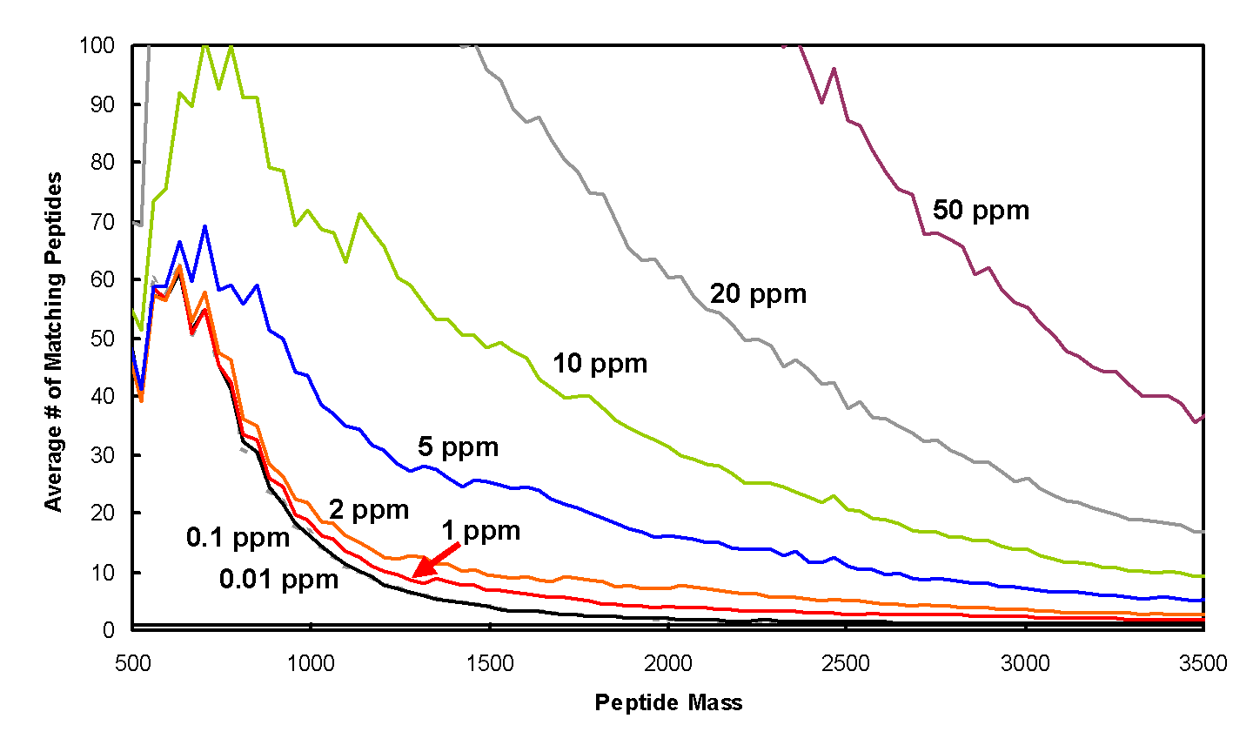
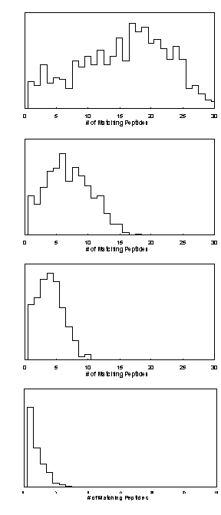
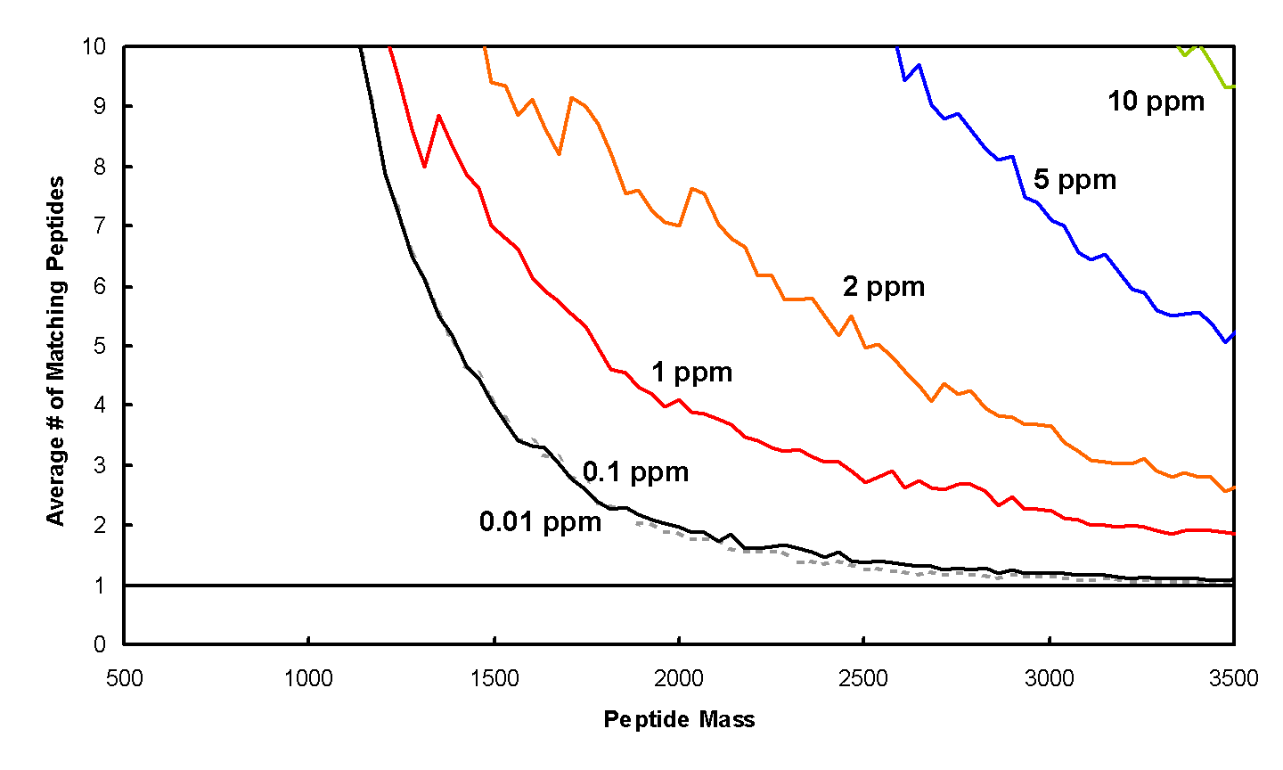
Peptide Mapping - Mass Accuracy

Slide 3
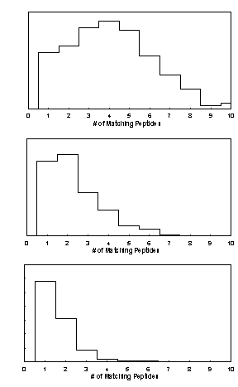
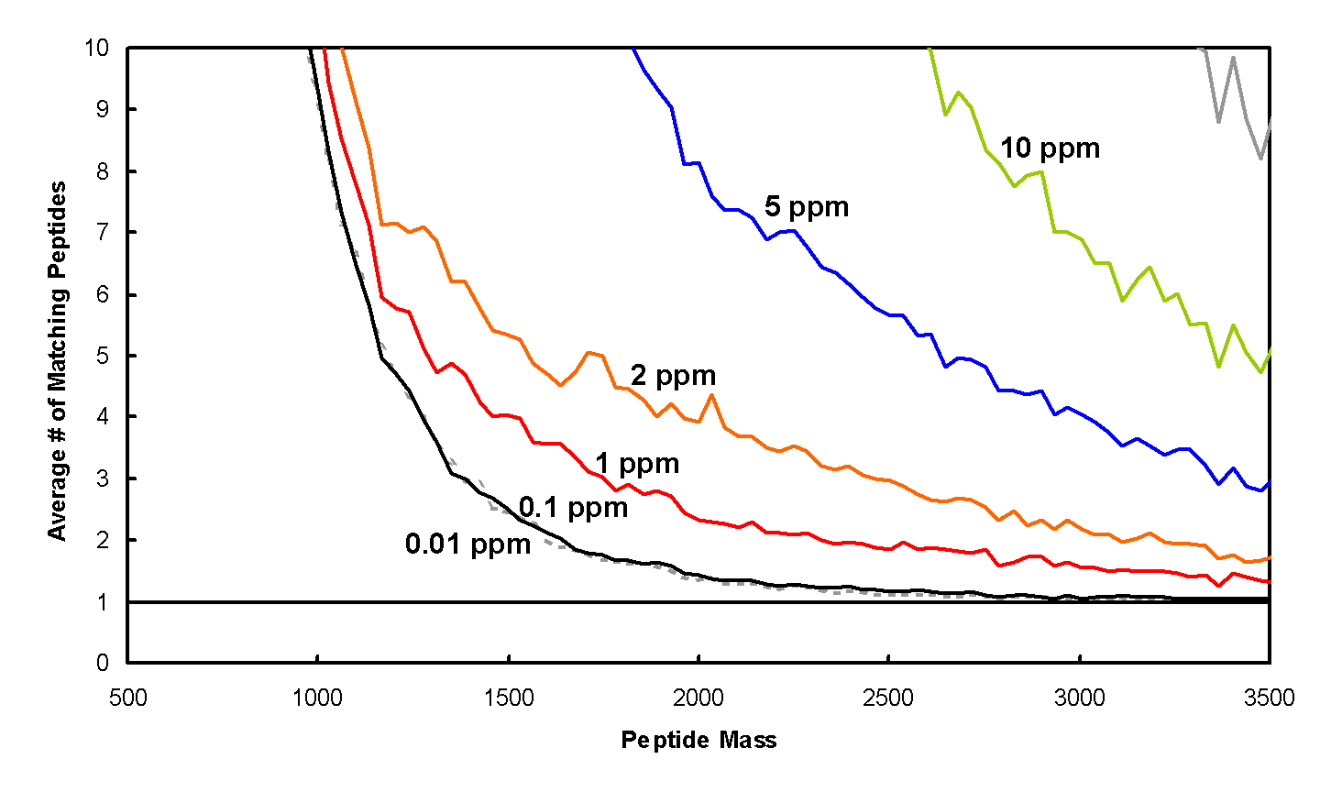
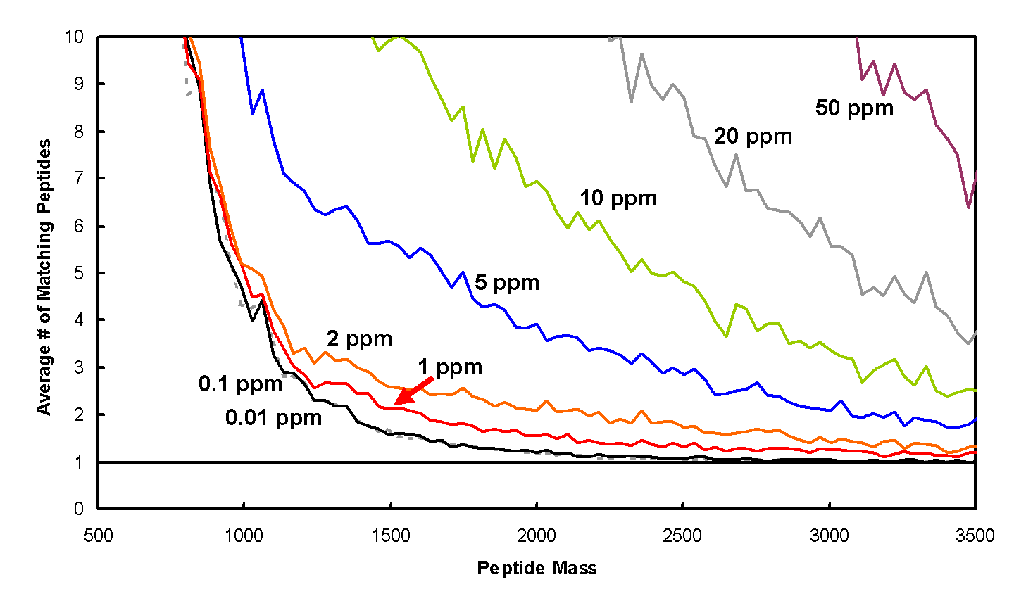
Peptide Mapping
Database Size
Human
C. elegans
S. cerevisiae

Slide 4
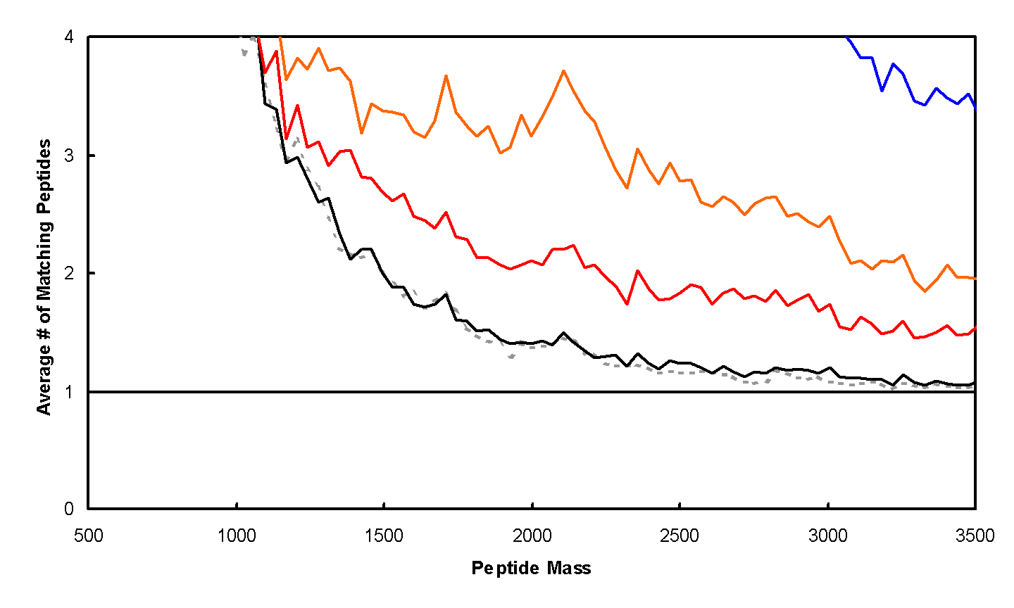
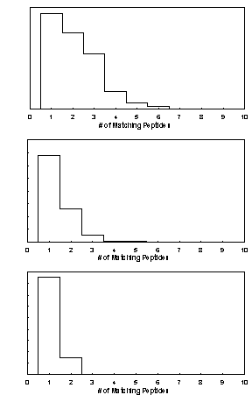
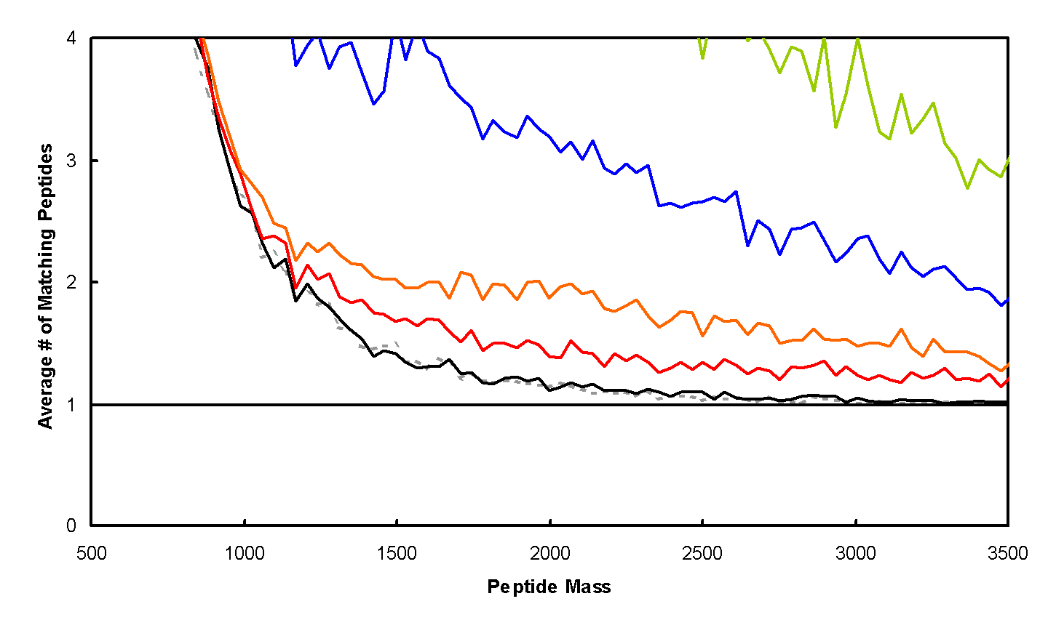
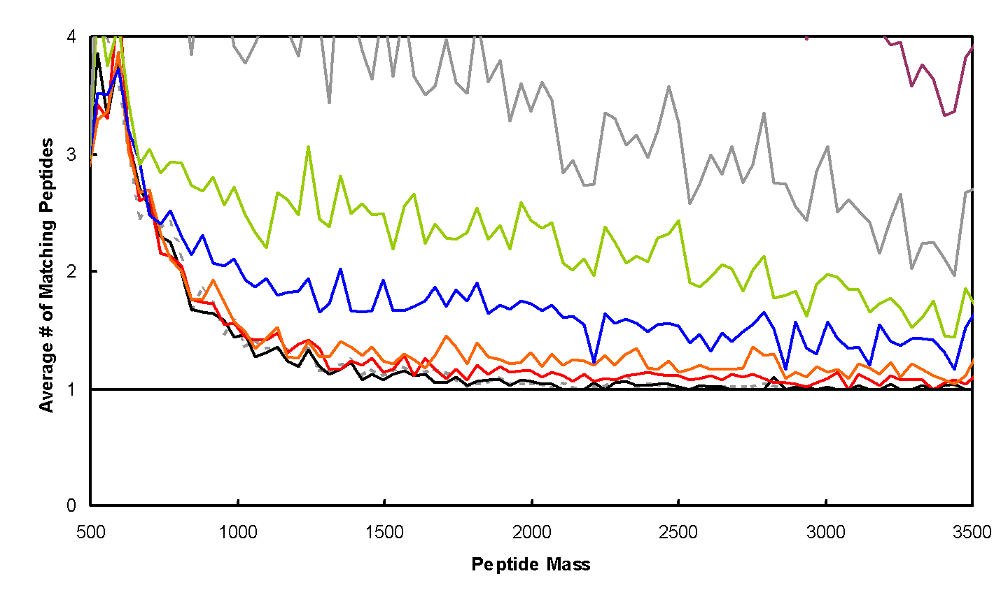
Peptide Mapping
Cys-Containing
Peptides
Human
C. elegans
S. cerevisiae

Slide 5
Identification – Peptide Mass Fingerprinting
Sequence
DB
Pick Protein
Digestion
MS
All Peptide
Masses
Repeat for each protein
MS
Compare, Score, Test Significance
Identified Proteins

Slide 6
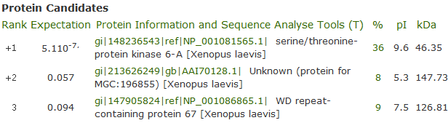
ProFound Results

Slide 7
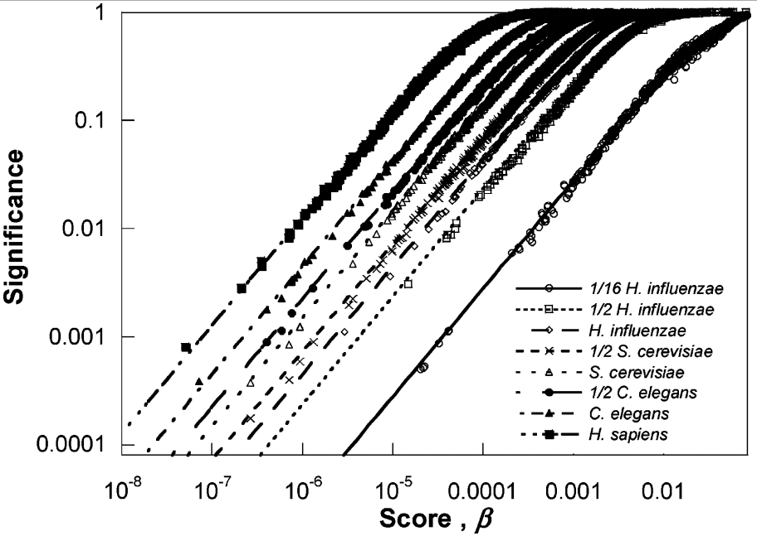
Database size

Slide 8
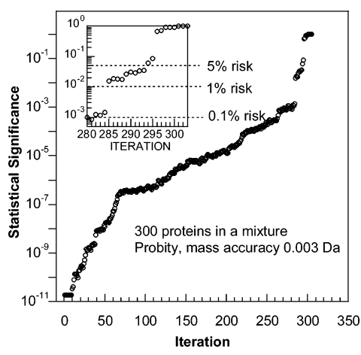
Mixtures

Slide 9
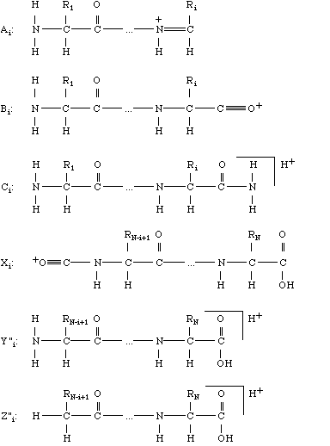
Peptide Fragmentation
Ion Source
Mass Analyzer 1
Frag-mentation
Mass Analyzer 2
Detector
b
y

Slide 10
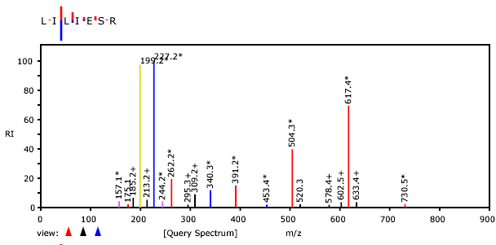
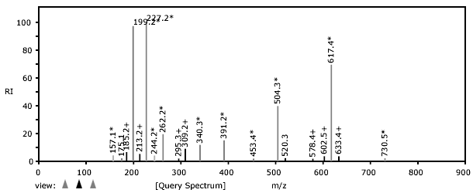
Identification – Tandem MS

Slide 11
Tandem MS – Sequence Confirmation
S
G
F
L
E
E
D
E
L
K
100
% Relative Abundance
0
250
500
750
1000
m/z

Slide 12
Tandem MS – Sequence Confirmation
S
G
F
L
E
E
D
E
L
K
88
145
292
405
534
663
778
907
1020
1166
b ions
S
G
F
L
E
E
D
E
L
K
100
% Relative Abundance
0
250
500
750
1000
m/z

Slide 13
Tandem MS – Sequence Confirmation
S
G
F
L
E
E
D
E
L
K
88
145
292
405
534
663
778
907
1020
1166
b ions
S
G
F
L
E
E
D
E
L
K
1166
1080
1022
875
762
633
504
389
260
147
y ions
100
% Relative Abundance
0
250
500
750
1000
m/z

Slide 14
Tandem MS – Sequence Confirmation
S
G
F
L
E
E
D
E
L
K
88
145
292
405
534
663
778
907
1020
1166
b ions
S
G
F
L
E
E
D
E
L
K
1166
1080
1022
875
762
633
504
389
260
147
y ions
762
100
875
[M+2H]²⁺
% Relative Abundance
633
292
405
534
260
389
1022
504
907
1020
663
778
1080
0
250
500
750
1000
m/z

Slide 15
Tandem MS – Sequence Confirmation
S
G
F
L
E
E
D
E
L
K
88
145
292
405
534
663
778
907
1020
1166
b ions
S
G
F
L
E
E
D
E
L
K
1166
1080
1022
875
762
633
504
389
260
147
y ions
762
100
875
[M+2H]²⁺
% Relative Abundance
633
292
405
534
260
389
1022
504
907
1020
663
778
1080
0
250
500
750
1000
m/z

Slide 16
Tandem MS – Sequence Confirmation
S
G
F
L
E
E
D
E
L
K
88
145
292
405
534
663
778
907
1020
1166
b ions
S
G
F
L
E
E
D
E
L
K
1166
1080
1022
875
762
633
504
389
260
147
y ions
762
100
875
[M+2H]²⁺
113
113
% Relative Abundance
633
292
405
534
260
389
1022
504
907
1020
663
778
1080
0
250
500
750
1000
m/z

Slide 17
Tandem MS – Sequence Confirmation
S
G
F
L
E
E
D
E
L
K
88
145
292
405
534
663
778
907
1020
1166
b ions
S
G
F
L
E
E
D
E
L
K
1166
1080
1022
875
762
633
504
389
260
147
y ions
762
100
129
875
[M+2H]²⁺
% Relative Abundance
129
633
292
405
534
260
389
1022
504
907
1020
663
778
1080
0
250
500
750
1000
m/z

Slide 18
Tandem MS – Sequence Confirmation
S
G
F
L
E
E
D
E
L
K
88
145
292
405
534
663
778
907
1020
1166
b ions
S
G
F
L
E
E
D
E
L
K
1166
1080
1022
875
762
633
504
389
260
147
y ions
762
100
875
[M+2H]²⁺
% Relative Abundance
633
292
405
534
260
389
1022
504
907
1020
663
778
1080
0
250
500
750
1000
m/z

Slide 19
Tandem MS – Sequence Confirmation
S
G
F
L
E
E
D
E
L
K
88
145
292
405
534
663
778
907
1020
1166
b ions
S
G
F
L
E
E
D
E
L
K
1166
1080
1022
875
762
633
504
389
260
147
y ions
762
100
875
[M+2H]²⁺
% Relative Abundance
633
292
405
534
260
389
1022
504
907
1020
663
778
1080
0
250
500
750
1000
m/z

Slide 20
Tandem MS – Sequence Confirmation
S
G
F
L
E
E
D
E
L
K
88
145
292
405
534
663
778
907
1020
1166
b ions
S
G
F
L
E
E
D
E
L
K
1166
1080
1022
875
762
633
504
389
260
147
y ions
762
100
875
[M+2H]²⁺
% Relative Abundance
633
292
405
534
260
389
1022
504
907
1020
663
778
1080
0
250
500
750
1000
m/z

Slide 21
Tandem MS – de novo Sequencing
762
100
Amino acid masses
875
[M+2H]²⁺
% Relative Abundance
292
633
260
405
534
1022
389
504
907
1020
663
778
1080
0
250
500
750
1000
m/z
Mass Differences
Sequences
consistent
with spectrum

Slide 22
Tandem MS – de novo Sequencing

Slide 23
Tandem MS – de novo Sequencing

Slide 24
Tandem MS – de novo Sequencing
X
X
X
SGF(I/L)EEDE(I/L)…
1166 – 1020 – 18 = 128
K or Q
SGF(I/L)EEDE(I/L)(K/Q)
…GF(I/L)EEDE(I/L)…
…(I/L)EDEE(I/L)FG…
…GF(I/L)EEDE(I/L)…
…(I/L)EDEE(I/L)FG…
Peptide M+H = 1166
1166 -1079 = 87 => S
SGF(I/L)EEDE(I/L)…
X
X
X

Slide 25
Tandem MS – de novo Sequencing
Challenges in de novo sequencing
Neutral loss (-H₂O, -NH₃)
Modifications
Background peaks
Incomplete information
Challenges in de novo sequencing
Neutral loss (-H₂O, -NH₃)
Modifications
Background peaks
Incomplete information

Slide 26
Tandem MS – Database Search
Sequence
DB
Lysis
Fractionation
Pick Protein
Digestion
LC-MS
Pick Peptide
MS/MS
Repeat for all proteins
All Fragment
Masses
Repeat for
all peptides
MS/MS
Compare, Score, Test Significance

Slide 27
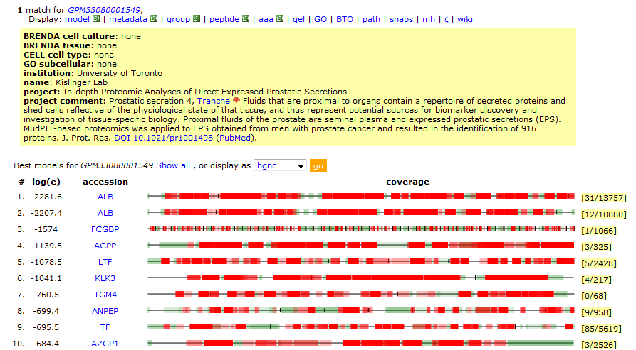
Search Results

Slide 28
Significance Testing
False protein identification is caused by random matching
An objective criterion for testing the significance of protein identification results is necessary.
The significance of protein identifications can be tested once the distribution of scores for false results is known.

Slide 29
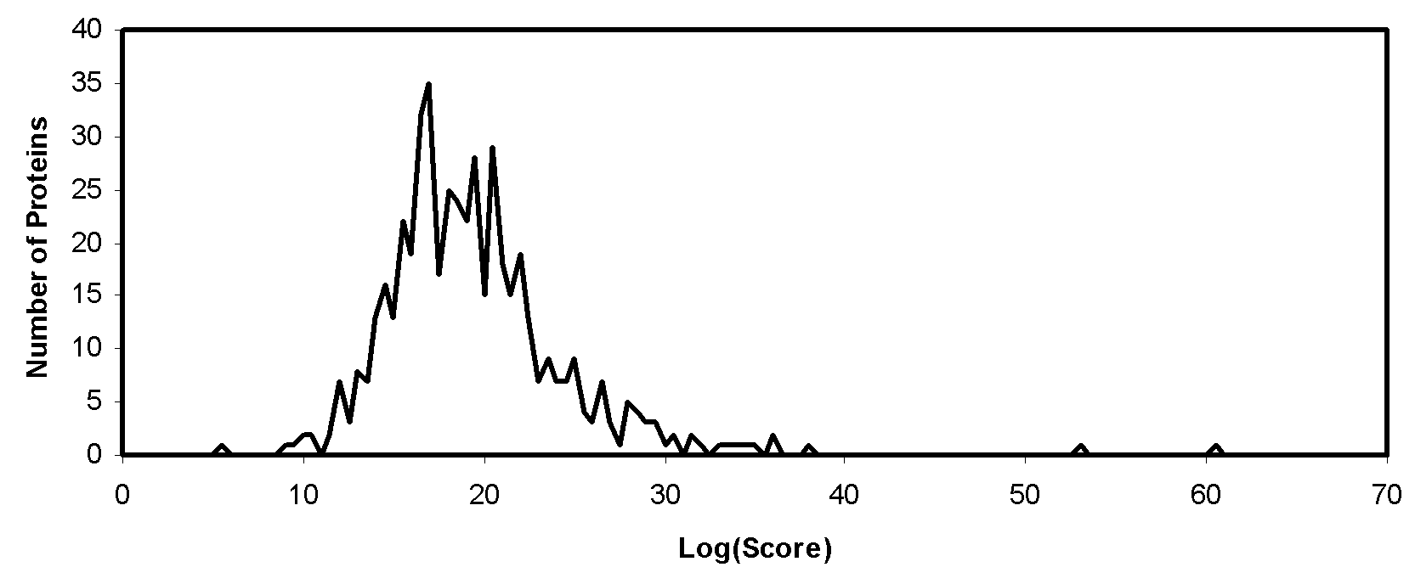
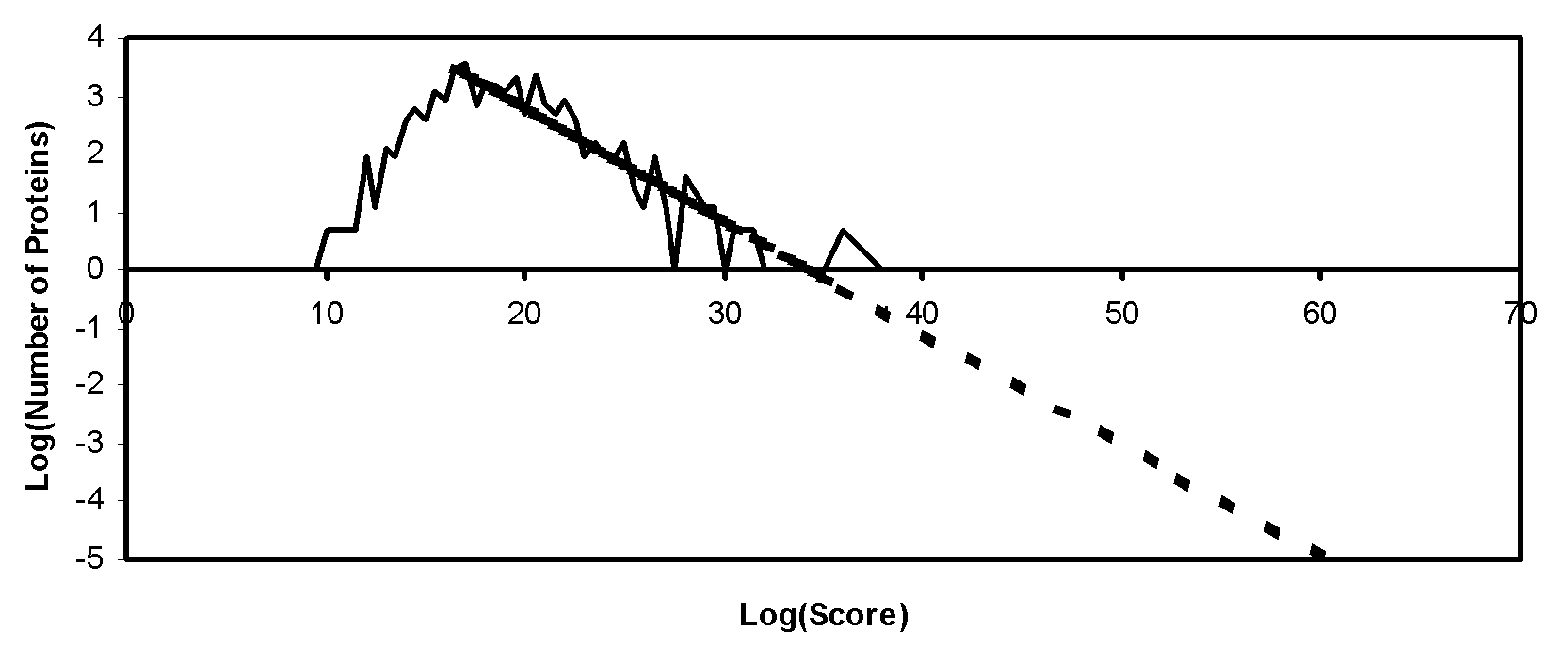
Significance Testing - Expectation Values
The majority of sequences in a collection will give a score due to random matching.

Slide 30
Significance Testing - Expectation Values
Database Search
List of Candidates
M/Z
Distribution of Scores
for Random and False
Identifications
Extrapolate
And Calculate
Expectation Values
List of Candidates With Expectation Values

Slide 31
Rho-diagrams: Overall Quality of a Data Set
Expectation values as a function of score for random matching:
Definition: E_{i} (i=0,-1,-2,…) is the number of spectra that has been assigned an expectation value between exp(i) and exp(i-1). For random matching:

Slide 32
Rho-diagram
Random Matching

Slide 33
Rho-diagram
Data Quality

Slide 34
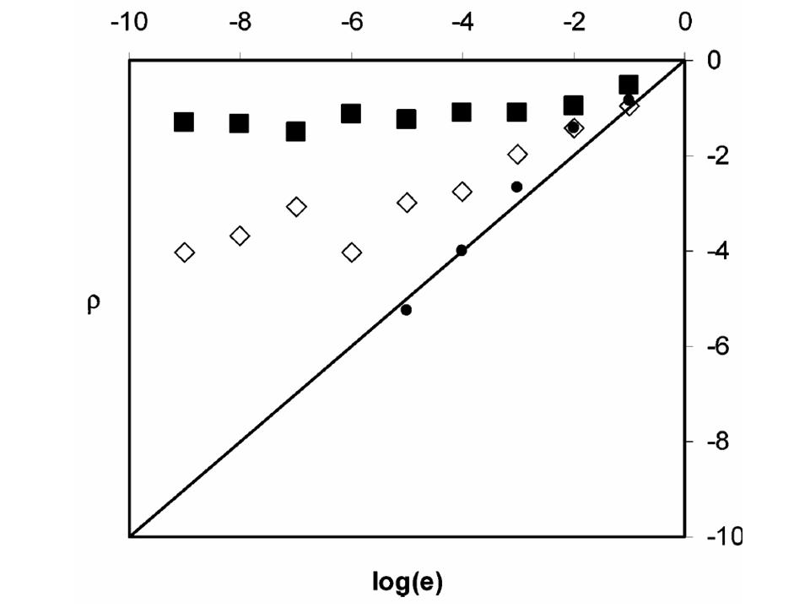
Rho-diagram
Parameters

Slide 35
How many fragments are sufficient?
To identify an unmodified peptide?
To identify an unmodified peptide?
To identify a modified peptide?
To localize a modification on a peptide?
To identify an unmodified peptide?
To identify a modified peptide?

Slide 36
How many fragments are sufficient?
How does it depend on different parameters?
Precursor mass
Precursor mass error
Fragment mass error
Background peaks

Slide 37
Simulations using synthetic spectra
Select a peptide sequence
Calculate possible
fragment ion masses
Choose number of
fragment ions to select
Randomly select
fragment ions
Search and store result
Average over peptides
Seq.
DB
LSDPGVSPAVLSLEMLTDR

Slide 38
Simulations using synthetic spectra
1825.92
1710.89
1609.84
1496.76
1365.72
1236.68
1123.59
1036.56
923.48
824.41
753.37
656.32
569.29
470.22
413.20
316.15
201.12
114.09
175.12
290.15
391.19
504.28
635.32
764.36
877.44
964.48
1077.56
1176.63
1247.67
1344.72
1431.75
1530.82
1587.84
1684.89
1799.92
1886.95
Select a peptide sequence
Calculate possible
fragment ion masses
Choose number of
fragment ions to select
Randomly select
fragment ions
Search and store result
Average over peptides
LSDPGVSPAVLSLEMLTDR
Seq.
DB

Slide 39
Simulations using synthetic spectra
Select a peptide sequence
Calculate possible
fragment ion masses
Choose number of
fragment ions to select
Randomly select
fragment ions
Search and store result
Average over peptides
LSDPGVSPAVLSLEMLTDR
1825.92
1710.89
1609.84
1496.76
1365.72
1236.68
1123.59
1036.56
923.48
824.41
753.37
656.32
569.29
470.22
413.20
316.15
201.12
114.09
175.12
290.15
391.19
504.28
635.32
764.36
877.44
964.48
1077.56
1176.63
1247.67
1344.72
1431.75
1530.82
1587.84
1684.89
1799.92
1886.95
6
5
8
7
8
9

Slide 40
Simulations using synthetic spectra
Select a peptide sequence
Calculate possible
fragment ion masses
Choose number of
fragment ions to select
Randomly select
fragment ions
Search and store result
Average over peptides
✓
1825.92
1710.89
1609.84
1496.76
1365.72
1236.68
1123.59
1036.56
923.48
824.41
753.37
656.32
569.29
470.22
413.20
316.15
201.12
114.09
175.12
290.15
391.19
504.28
635.32
764.36
877.44
964.48
1077.56
1176.63
1247.67
1344.72
1431.75
1530.82
1587.84
1684.89
1799.92
1886.95
✓
✓
201.12
504.28
964.48
1123.59
1247.67
1496.76
1530.82
1710.89
✓
8
✓
✓
✓
6
5
✓
7
8
9

Slide 41
Simulations using synthetic spectra
Select a peptide sequence
Calculate possible
fragment ion masses
Choose number of
fragment ions to select
Randomly select
fragment ions
Search and store result
Average over peptides
LSDPGVSPAVLSLEMLTDR
Seq.
DB
Is the identified sequence
identical to the one used to
generate the synthetic data?
201.12
504.28
964.48
1123.59
1247.67
1496.76
1530.82
1710.89
Seq.
DB
Is it significant?
Search
engine
Identification

Slide 42
Simulations using synthetic spectra
Select a peptide sequence
Calculate possible
fragment ion masses
Choose number of
fragment ions to select
Randomly select
fragment ions
Search and store result
Average over peptides
✓
1825.92
1710.89
1609.84
1496.76
1365.72
1236.68
1123.59
1036.56
923.48
824.41
753.37
656.32
569.29
470.22
413.20
316.15
201.12
114.09
175.12
290.15
391.19
504.28
635.32
764.36
877.44
964.48
1077.56
1176.63
1247.67
1344.72
1431.75
1530.82
1587.84
1684.89
1799.92
1886.95
✓
✓
201.12
504.28
964.48
1123.59
1247.67
1496.76
1530.82
1710.89
✓
8
✓
✓
✓
✓
6
5
7
8
9
Search
engine
Identification
Seq.
DB

Slide 43
Simulations using synthetic spectra
Select a peptide sequence
Calculate possible
fragment ion masses
Choose number of
fragment ions to select
Randomly select
fragment ions
Search and store result
Average over peptides
1825.92
1710.89
1609.84
1496.76
1365.72
1236.68
1123.59
1036.56
923.48
824.41
753.37
656.32
569.29
470.22
413.20
316.15
201.12
114.09
1825.92
1710.89
1609.84
1496.76
1365.72
1236.68
1123.59
1036.56
923.48
824.41
753.37
656.32
569.29
470.22
413.20
316.15
201.12
114.09
175.12
290.15
391.19
504.28
635.32
764.36
877.44
964.48
1077.56
1176.63
1247.67
1344.72
1431.75
1530.82
1587.84
1684.89
1799.92
1886.95
✓
175.12
290.15
391.19
504.28
635.32
764.36
877.44
964.48
1077.56
1176.63
1247.67
1344.72
1431.75
1530.82
1587.84
1684.89
1799.92
1886.95
✓
✓
201.12
504.28
964.48
1123.59
1247.67
1496.76
1530.82
1710.89
✓
✓
✓
✓
✓
6
✓
5
9
7
8
9
Search
engine
Identification
Seq.
DB

Slide 44
Simulations using synthetic spectra
1825.92
1710.89
1609.84
1496.76
1365.72
1236.68
1123.59
1036.56
923.48
824.41
753.37
656.32
569.29
470.22
413.20
316.15
201.12
114.09
175.12
290.15
391.19
504.28
635.32
764.36
877.44
964.48
1077.56
1176.63
1247.67
1344.72
1431.75
1530.82
1587.84
1684.89
1799.92
1886.95
Select a peptide sequence
Calculate possible
fragment ion masses
Choose number of
fragment ions to select
Randomly select
fragment ions
Search and store result
Average over peptides
Select a peptide sequence
Calculate possible
fragment ion masses
Choose number of
fragment ions to select
Randomly select
fragment ions
Search and store result
Average over peptides
Prot.
seq.
LSDPGVSPAVLSLEMLTDR
LSDPGVSPAVLSLEMLTDR
LSDPGVSPAVLSLEMLTDR
Is the identified sequence
identical to the one used to
generate the synthetic data?
✓
✓
✓
201.12
504.28
964.48
1123.59
1247.67
1496.76
1530.82
1710.89
✓
✓
✓
✓
6
5
✓
8
7
8
9
201.12
504.28
964.48
1123.59
1247.67
1496.76
1530.82
1710.89
Seq.
DB
Is it significant?
Search
engine
Identification

Slide 45
Simulations using synthetic spectra
Each point is an average of 50 peptides.
Average over peptides
Each point is an average of searches with 20 randomly generated synthetic fragment mass spectra.
Threshold

Slide 46
Critical number of fragment masses

Slide 47
Small peptides are slightly more difficult to identify
m_{precursor}
Δm_{precursor} = 1 Da
Δm_{fragment} = 0.5 Da
No modification

Slide 48
A lower precursor mass error
requires fewer fragment masses for
identification of unmodified peptides
m_{precursor} = 2000 Da
Δm_{fragment} = 0.5 Da
No modification

Slide 49
The dependence on the fragment mass error is weak below a threshold for identification of unmodified peptides
Δm_{fragment}
m_{precursor} = 2000 Da
Δm_{precursor} = 1 Da
No modification

Slide 50
A moderate number of background peaks can be tolerated when identifying unmodified peptides
Background
m_{precursor} = 2000 Da
Δm_{precursor} = 1 Da
Δm_{fragment} = 0.5 Da
No modification

Slide 51
A large number of background peaks can be tolerated if the fragment mass is accurate
Background
m_{precursor} = 2000 Da
Δm_{precursor} = 1 Da
Δm_{fragment} = 0.01 Da
No modification

Slide 52
Identification of phosphopeptides
is only slightly more difficult
m_{precursor} = 2000 Da
Δm_{precursor} = 1 Da
Δm_{fragment} = 0.5 Da

Slide 53
Proteomics Informatics –
Protein identification I: searching protein sequence collections and significance testing (Week 4)

