Slide 1
Proteomics Informatics –
Protein identification II: search engines and protein sequence databases (Week 5)

Slide 2
General Criteria for a Good Protein Identification Algorithms
The response to random input data should be random.
Maximum number of correct identification and minimum number of incorrect identifications for any data set.
Maximal separation between scores for correct identifications and the distribution of scores for random matching proteins for any data set.
The statistical significance of the results should be calculated.
The searches should be fast.

Slide 3
Search Parameters
Parent tolerance | +/- daltons/ppm
Frag. Tolerance | +/- daltons/ppm
Complete mods | Cys alkylation
Potential mods (artifacts) | Met/Trp oxidation, Gln/Asn deamidation
Potential mods (PTMs) | Phosphoryl, sulfonyl, acetyl, methyl, glycosyl, GPI
Cleavage | Trypsin ([KR]|{P})
Scoring method | Scores or statistics
Sequences | FASTA files

Slide 4
Identification – Peptide Mass Fingerprinting
Sequence
DB
Pick Protein
Digestion
MS
All Peptide
Masses
Repeat for each protein
MS
Compare, Score, Test Significance
Identified Proteins

Slide 5
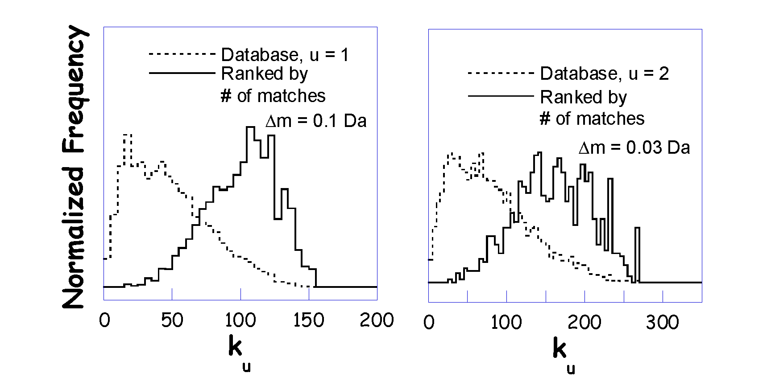
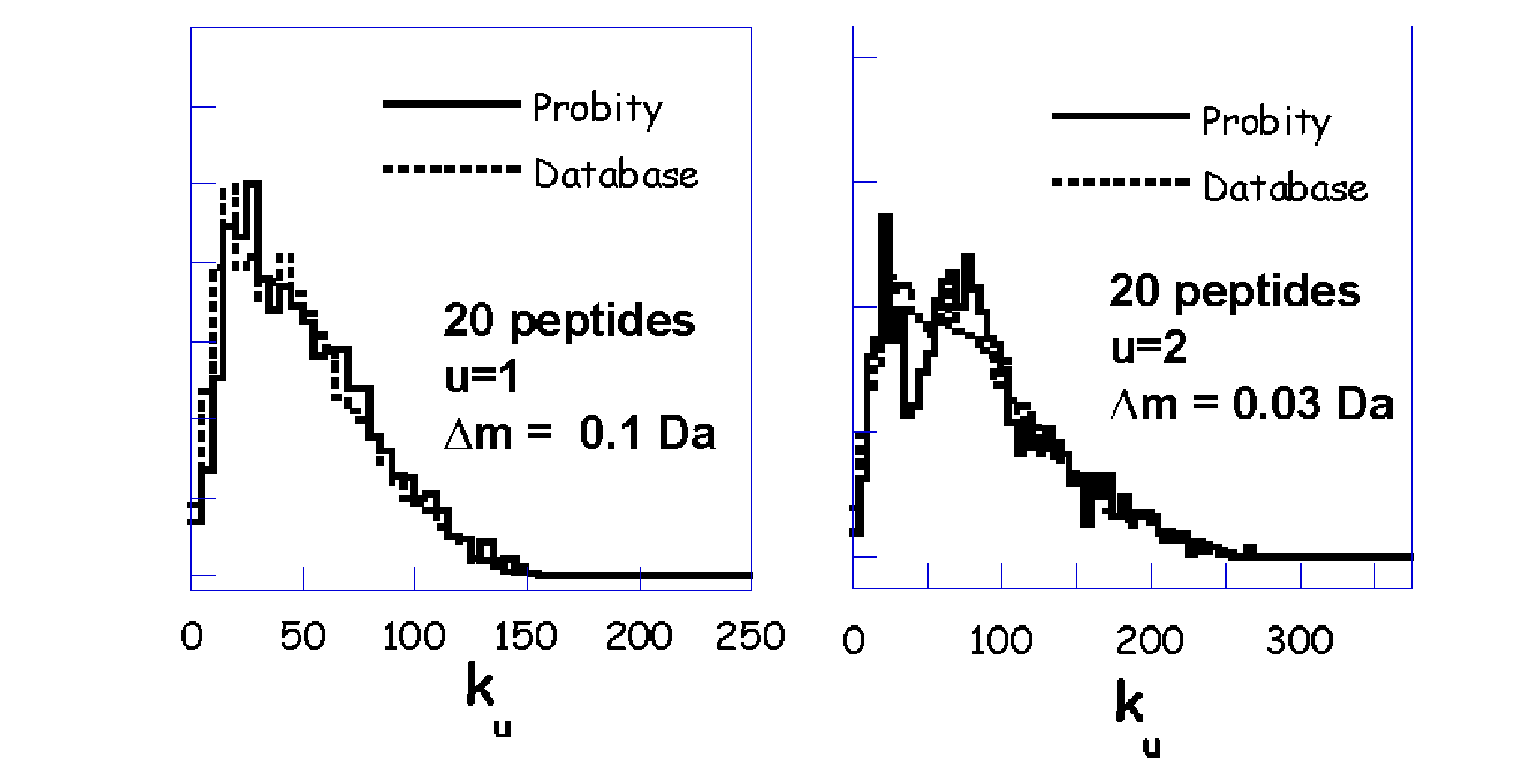
Response to Random Data
Normalized Frequency

Slide 6
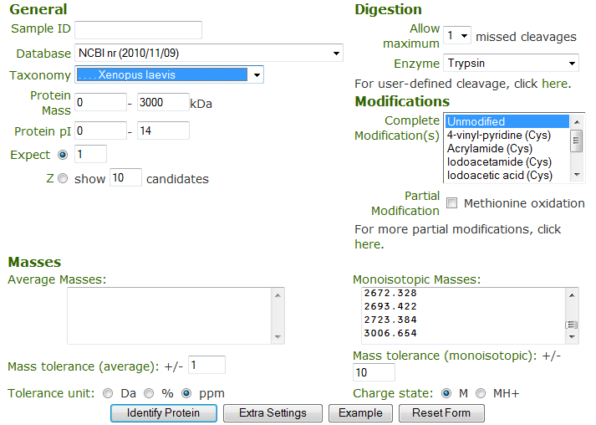
ProFound – Search Parameters
http://prowl.rockefeller.edu/

Slide 7
ProFound – Protein Identification by Peptide Mapping
W. Zhang & B.T. Chait,
Analytical Chemistry
72 (2000) 2482-2489

Slide 8
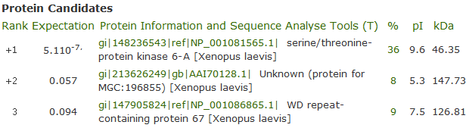
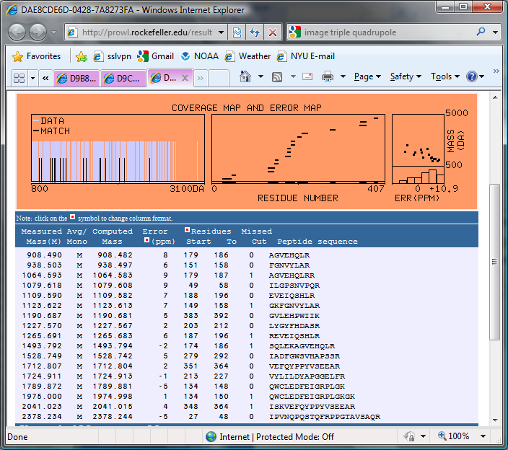
ProFound Results

Slide 9
Peptide Mapping – Mass Accuracy

Slide 10
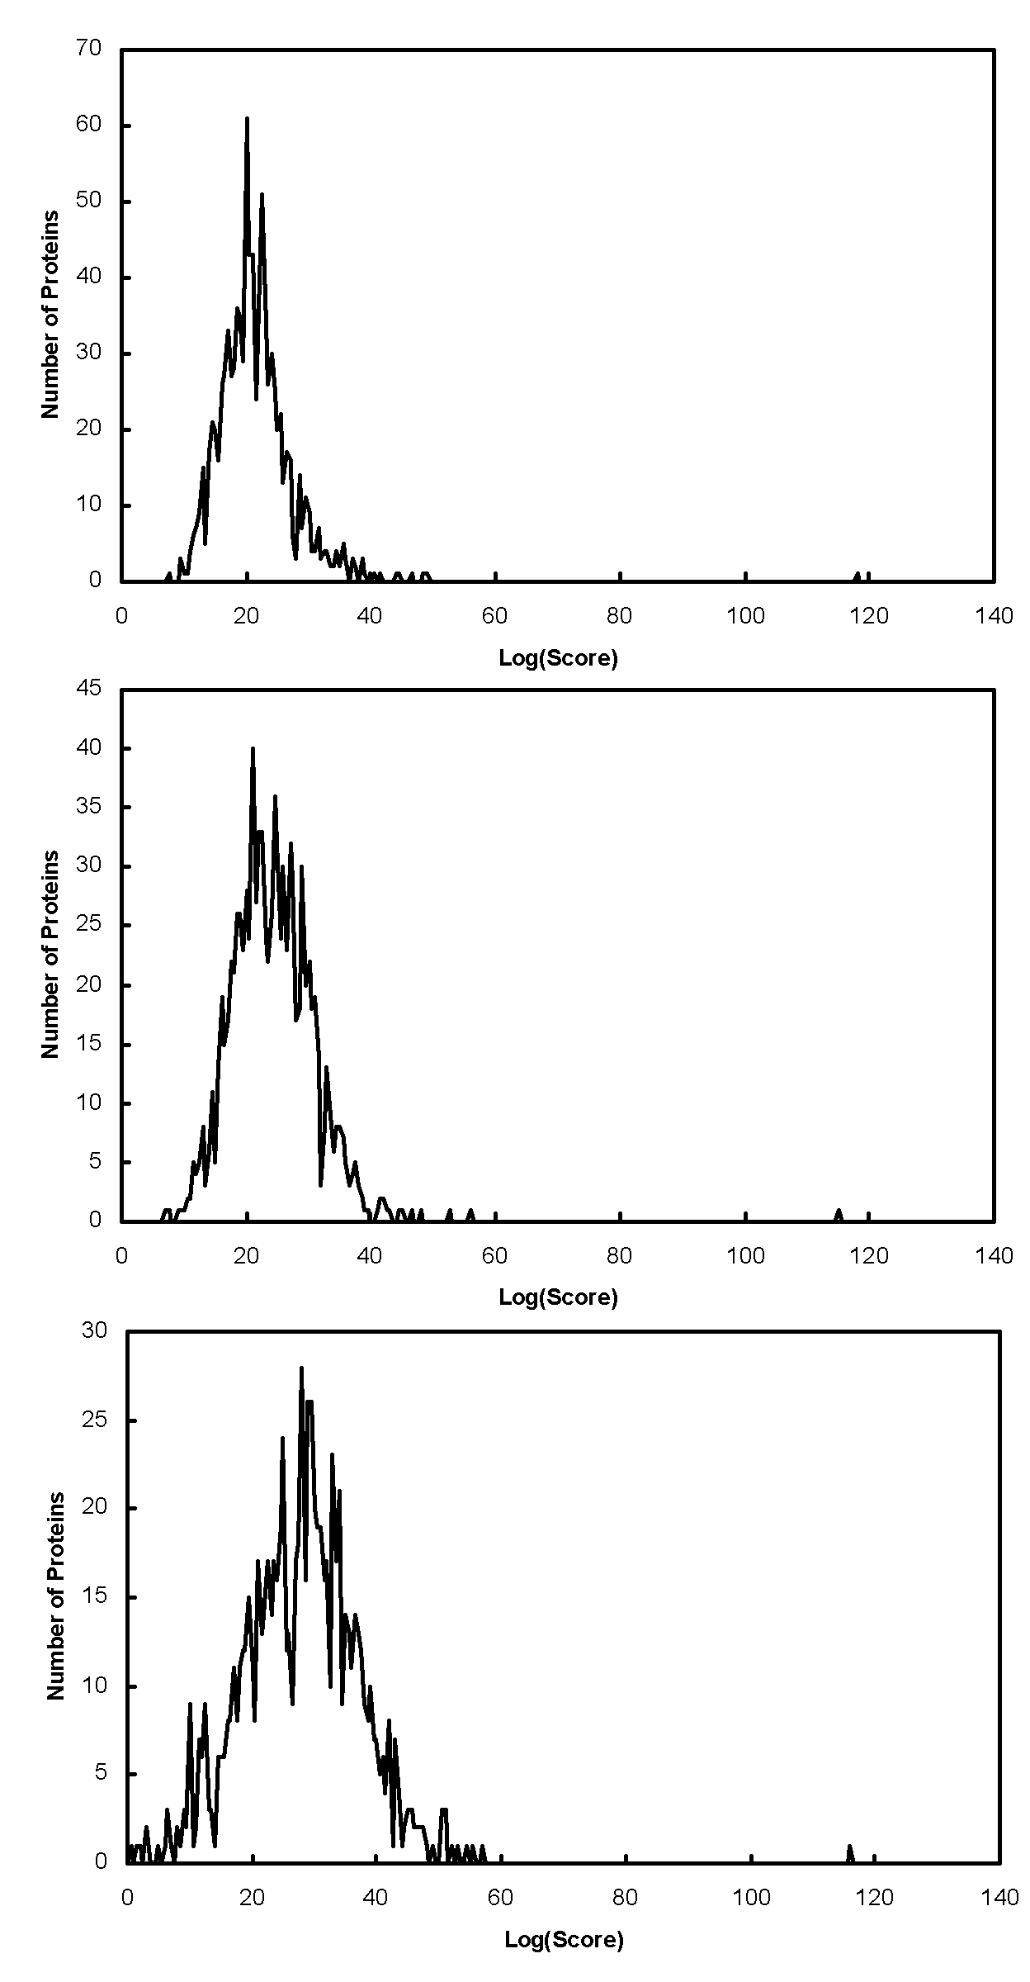
Peptide Mapping - Database Size
S. cerevisiae
Expectation Values
Peptide mapping example:
S. Cerevisiae 4.8e-7
Fungi 8.4e-6
All Taxa 2.9e-4
Fungi
All Taxa

Slide 11
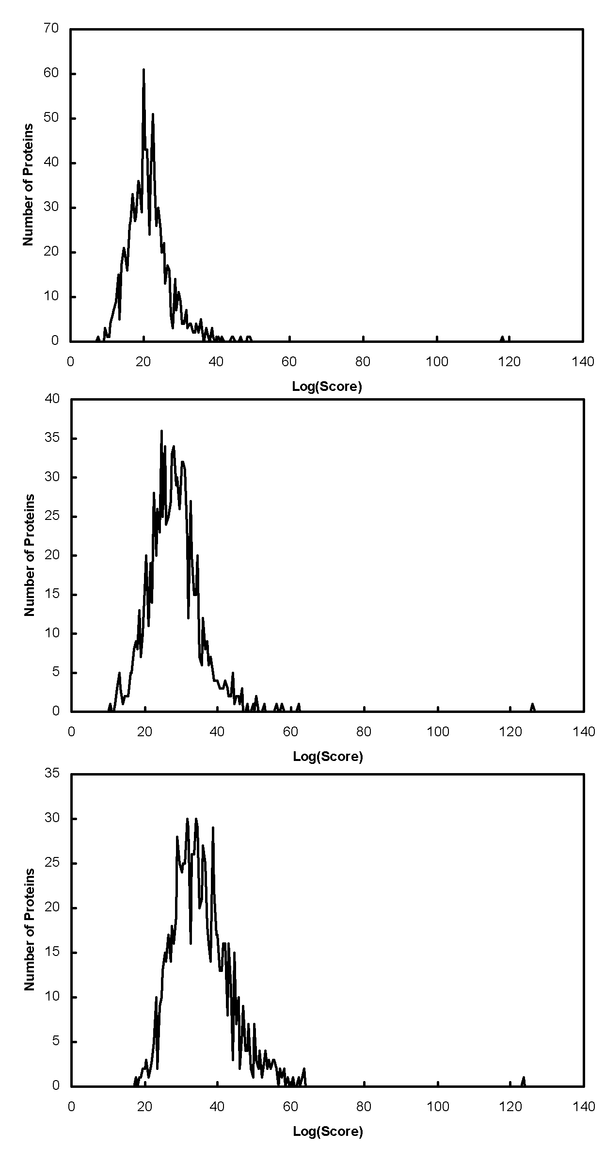
Missed Cleavage Sites
u = 1
Expectation Values
Peptide mapping example:
u=1 4.8e-7
u=2 1.1e-5
u=4 6.8e-4
u = 2
u = 4

Slide 12
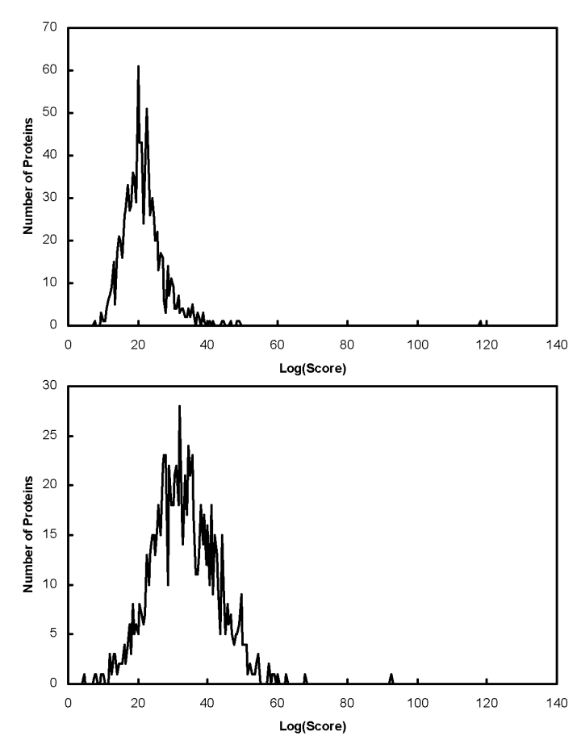
Peptide Mapping - Partial Modifications
No Modifications
Searched Searched With
Without Possible
Modifications Phosphorylation
of S/T/Y
DARPP-32 0.00006 0.01
CFTR 0.00002 0.005
Even if the protein is modified it is usually better to search a protein sequence database without specifying possible modifications using peptide mapping data.
Phophorylation (S, T, or Y)

Slide 13
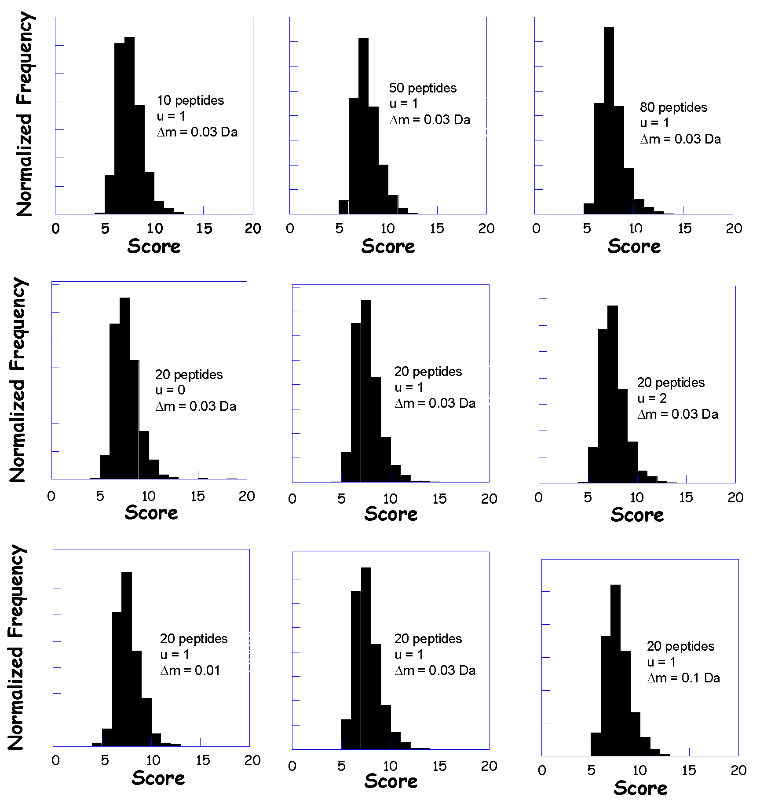
Peptide Mapping - Ranking by
Direct Calculation of the Significance

Slide 14
Tandem MS – Database Search
Sequence
DB
Lysis
Fractionation
Pick Protein
Digestion
LC-MS
Pick Peptide
MS/MS
Repeat for all proteins
All Fragment
Masses
Repeat for
all peptides
MS/MS
Compare, Score, Test Significance

Slide 15
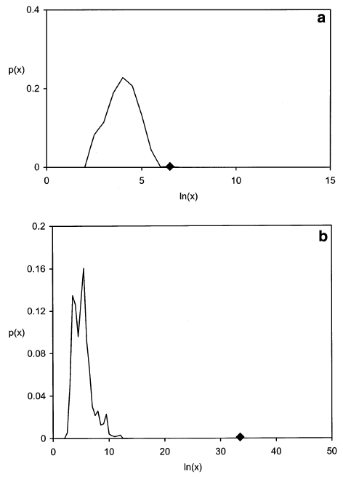
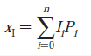
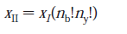
Algorithms

Slide 16
Comparing and Optimizing Algorithms

Slide 17
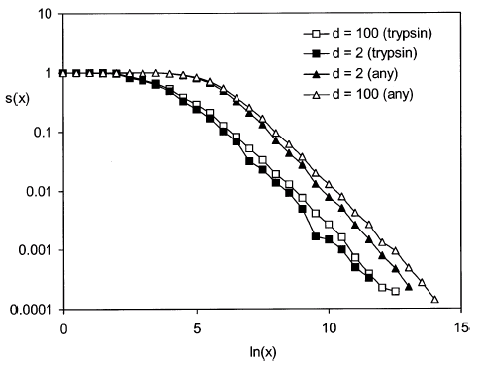
MS/MS - Parent Mass Error
and Enzyme Specificity
Expectation Values
MS/MS example:
Δm=2, Trypsin 2.5e-5
Δm=100, Trypsin 2.5e-5
Δm=2, non-specific 7.9e-5
Δm=100, non-specific 1.6e-4

Slide 18
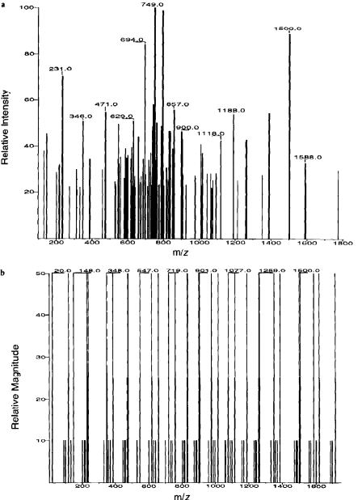
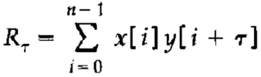
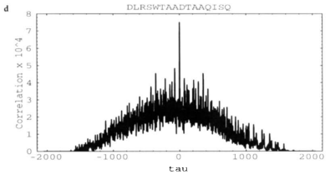
Sequest
Cross-correlation

Slide 19
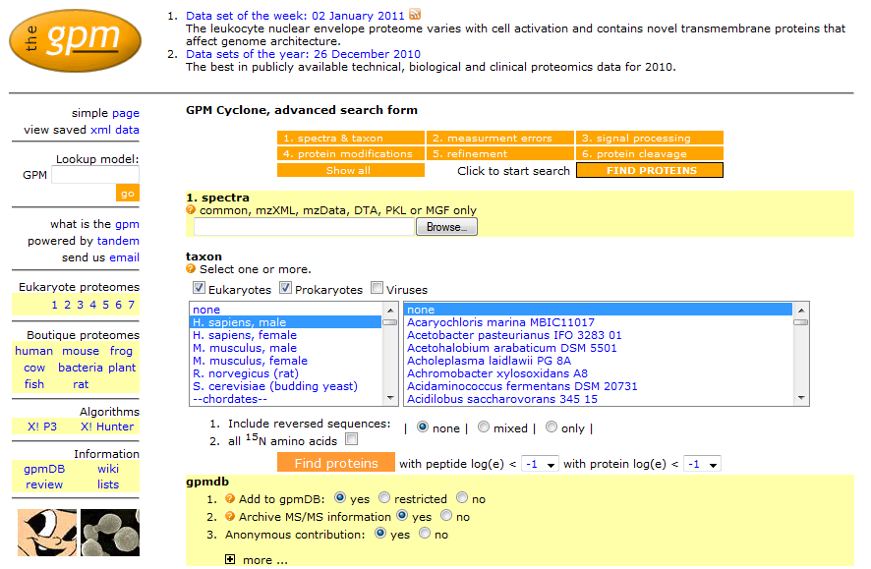
X! Tandem - Search Parameters
http://www.thegpm.org/

Slide 20
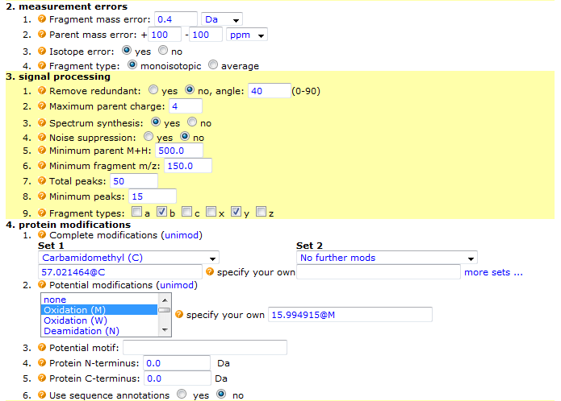
X! Tandem - Search Parameters

Slide 21
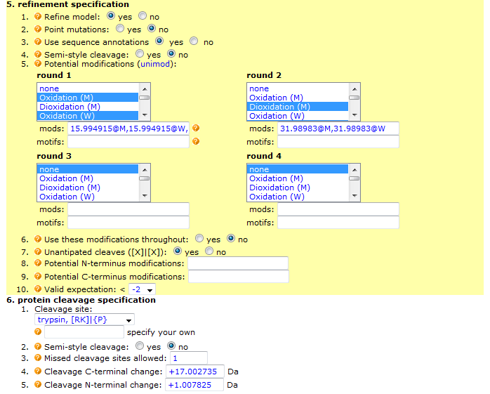
X! Tandem - Search Parameters

Slide 22
spectra
Generic search engine
Test all
cleavages,
modifications,
& mutations
for all sequences
sequences
sequences
Conventional,
single stage searching

Slide 23
Some hard problems in MS/MS
analysis in proteomics
Allowing for unanticipated peptide cleavages
- e.g., chymotryptic contamination in trypsin
- calculation order ~ 200 × tryptic cleavage
- “unfortunate” coefficient
Determining potential modifications
- e.g., oxidation, phosphorylation, deamidation
- calculation order 2^{n}
- NP complete
Detecting point mutations
- e.g., sequence homology
- calculation order 18^{N}
- NP complete

Slide 24
Multi-stage searching
spectra
Tryptic
cleavage
Modifications #1
sequences
Modifications #2
sequences
Point mutation
X! Tandem

Slide 25
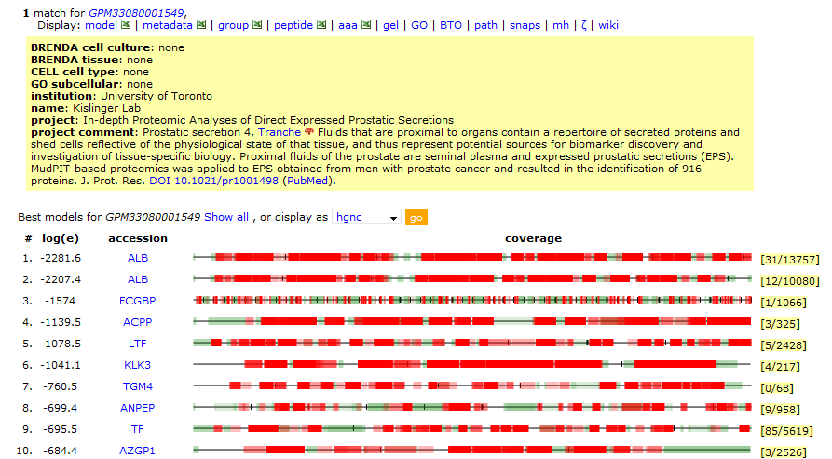
Search Results

Slide 26
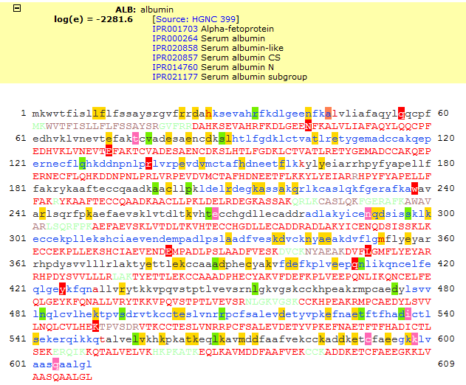
Search Results

Slide 27
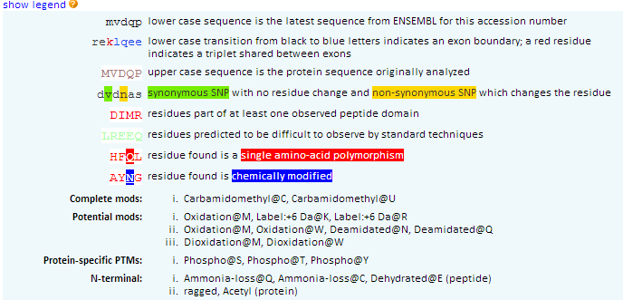
Sequence Annotations

Slide 28
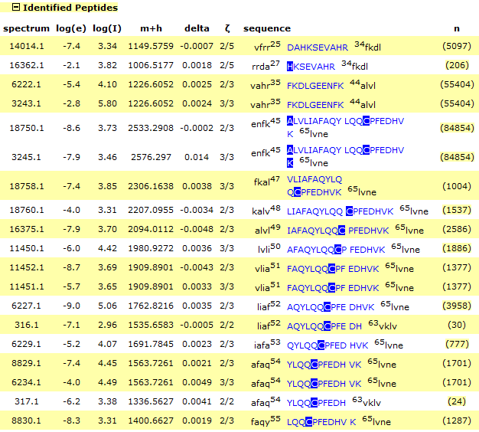
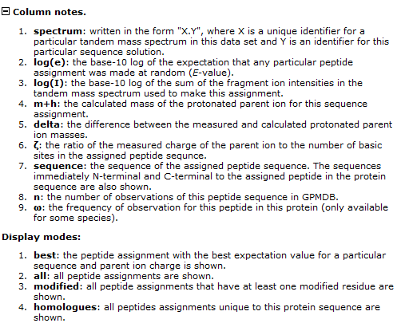
Search Results

Slide 29
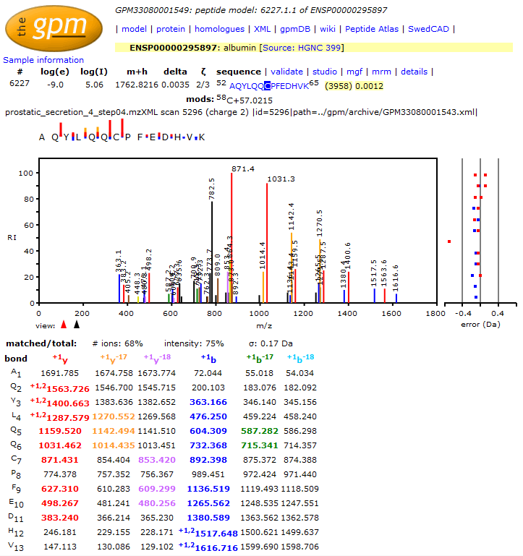
Search Results

Slide 30
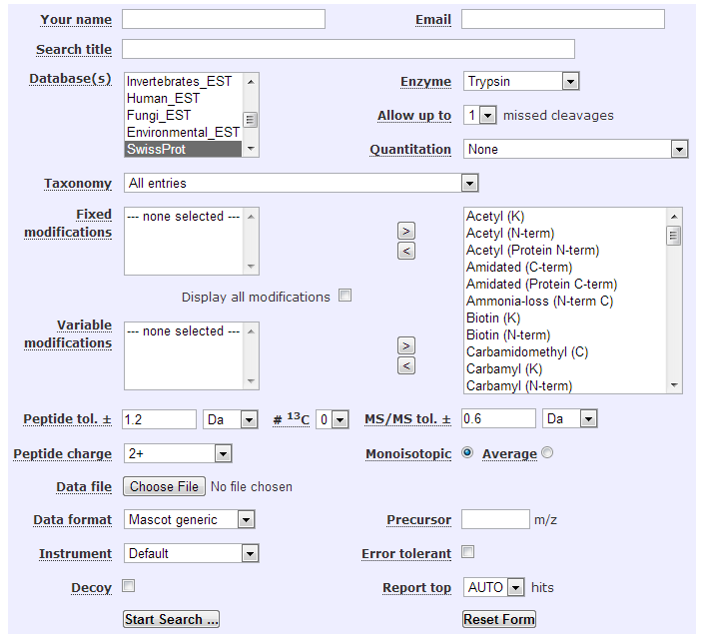
Mascot
http://www.matrixscience.com/cgi/search_form.pl?FORMVER=2&SEARCH=MIS

Slide 31
Identification – Spectrum Library Search
Spectrum
Library
Lysis
Fractionation
Digestion
LC-MS/MS
Pick
Spectrum
Repeat for
all spectra
MS/MS
Compare, Score, Test Significance
Identified Proteins

Slide 32
Steps in making an
Annotated Spectrum Library (ASL):
1. Find the best 10 spectra for a particular sequence, with the same PTMs and charge.
2. Add the spectra together and normalize the intensity values.
3. Assign a “quality” value: the median expectation value of the 10 spectra used.
4. Record the 20 most intense peaks in the averaged spectrum, it’s parent ion z, m/z, sequence, protein accessions & quality.

Slide 33
Spectrum Library Characteristics – Peptide Length

Slide 34
Spectrum Library Characteristics – Protein Coverage

Slide 35
Identification – Spectrum Library Search
Library spectrum
(5:25)
Test spectrum
(5:25)
Results: 4 peaks selected, 1 peak missed

Slide 36
Identification – Spectrum Library Search
How likely is this?
Apply a hypergeometric probability model:
- 25 possible m/z values;
- 5 peaks in the library spectrum; and
- 4 selected by the test spectrum.
Matches | Probability
1 | 0.45
2 | 0.15
3 | 0.016
4 | 0.00039
5 | 0.0000037

Slide 37
Identification – Spectrum Library Search
If you have 1000 possible m/z values and 20 peaks in test and library spectrum?
1 matched: p = 0.6
5 matched: p = 0.0002
10 matched: p = 0.0000000000001

Slide 38
Identification – Spectrum Library Search
Library of Assigned
Mass Spectra
Experimental
Mass Spectrum
☹
✓
M/Z
Best search result

Slide 39
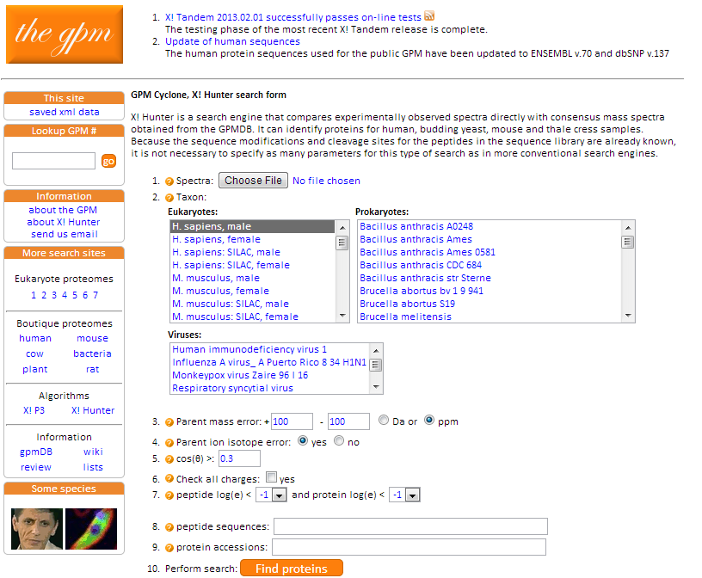
X! Hunter

Slide 40
X! Hunter algorithm:
1. Use dot product to find a library spectrum that best matches a test spectrum.
2. Calculate p-value with hypergeometric distribution.
3. Use p-value to calculate expectation value, given the identification parameters.
4. If expectation value is less than the median expectation value of the library spectrum, report the median value.

Slide 41
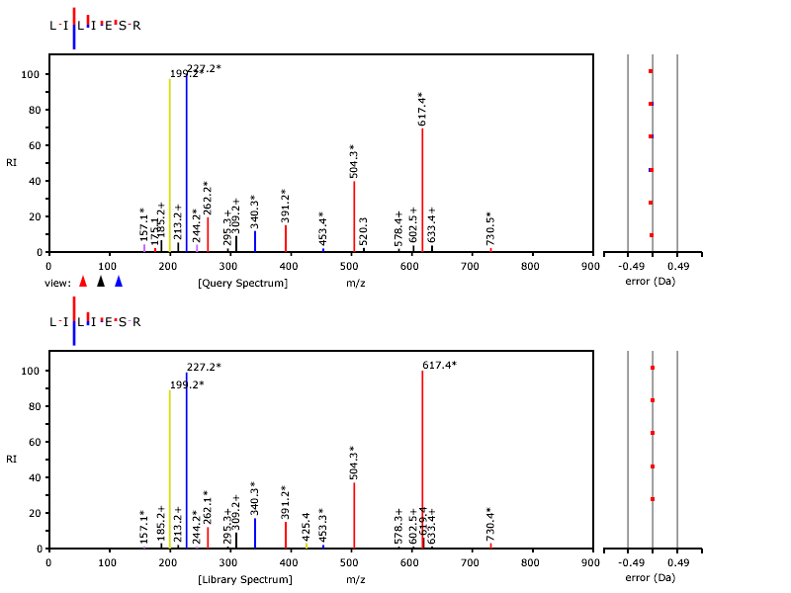
X! Hunter Result
Query Spectrum
Library Spectrum

Slide 42
Dynamic Range In Proteomics
Distribution of
Protein Amounts
Number of Proteins
Experimental
Dynamic Range
Log (Protein Amount)
Desired Dynamic Range
Large discrepancy between the experimental dynamic
range and the range of amounts of different proteins in
a proteome
The goal is to identify and characterize all components of
a proteome

Slide 43
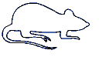
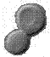
Digestion
Mass
Separation
Sample
Extraction
Fragmentation
Peptide
Labeling
Protein
Labeling
Mass
Separation
Peptide
Separation
Protein
Separation
Ionization
Detection

Slide 44
Experimental
Designs
Simulated

Slide 45
Parameters in Simulation
● Distribution of protein amounts in sample
● # of Proteins in each fraction
● Total amount of peptides that are loaded on column (limited by column loading capacity)
● Total amount of peptides that are loaded on column (limited by column loading capacity)
● Loss of peptides before binding to the column
● # of peptide fractions
● # of peptide fractions
● Loss of peptides after elution off the column
● Distribution of mass spectrometric response for different peptides present at the same amount
● Dynamic range of mass spectrometer
● Detection limit of mass spectrometer

Slide 46
Simulation Results for 1D-LC-MS
Tissue
No Protein
Separation
Body Fluid
No Protein
Separation
Complex Mixtures
of Proteins
Digestion
RPC
Tissue
Protein
Separation:
10 fractions
Body Fluid
Protein
Separation:
10 fractions
MS Analysis

Slide 47
Success Rate of a Proteomics Experiment
Distribution of
Protein Amounts
Number of Proteins
Proteins
Detected
Log (Protein Amount)
DEFINITION: The success rate of a proteomics experiment is defined as the number of proteins detected divided by the total number of proteins in the proteome.

Slide 48
Relative Dynamic Range of a
Proteomics Experiment
Distribution of
Protein Amounts
Number of Proteins
Proteins
Detected
RDR₉₀
RDR₅₀
Fraction of
Proteins Detected
RDR₁₀
Log (Protein Amount)
DEFINITION: RELATIVE DYNAMIC RANGE, RDR_{x},
where x is e.g. 10%, 50%, or 90%

Slide 49
Number of Proteins in Mixture
RDR₅₀
Success Rate
2
1
2
1
Tissue
Body Fluid
Tissue
1
Tissue
2
Body Fluid
1
Body Fluid
2

Slide 50
Amount of Peptides Loaded on the Column
Tissue
Body Fluid
RDR₅₀
Success Rate
3
3
2
2
Tissue
2
Tissue
3
Body Fluid
2
Body Fluid
3

Slide 51
Peptide Separation
4
RDR₅₀
4
Success Rate
3
3
Tissue
Body Fluid
Tissue
3
Tissue
4
Body Fluid
3
Body Fluid
4

Slide 52
Amount loaded and peptide separation
Tissue
Peptide
separation
Tissue
Tissue
Tissue
Order:
Amount
loaded
1. Protein separation
2. Amount loaded
3. Peptide separation
Amount
loaded
Protein
separation
Protein
separation
Protein
separation
Tissue
Tissue
Tissue
Amount
loaded
1. Protein separation
2. Peptide separation
3. Amount loaded
Peptide
separation
Peptide
separation
Protein
separation
Protein
separation
Protein
separation
Ranges:
Protein separation: 30000 – 3000 proteins in each fraction
Amount loaded: 0.1 ug – 10 ug
Peptide separation: 100 – 1000 fractions
Protein separation
Amount loaded
Peptide separation

Slide 53
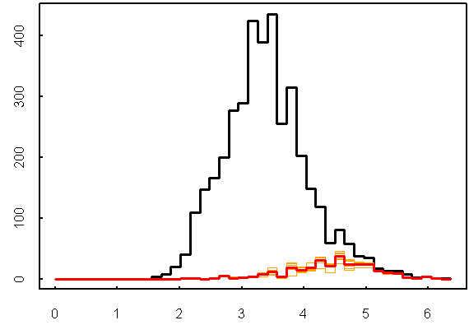
Repeat Analysis
1 Analysis

Slide 54
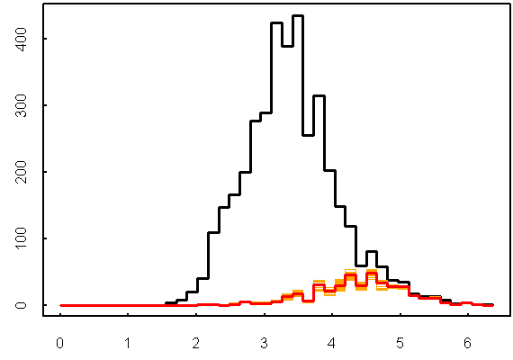
Repeat Analysis
2 Analyses

Slide 55
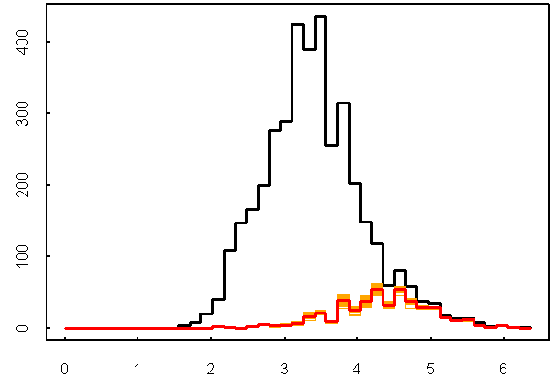
Repeat Analysis
3 Analyses

Slide 56
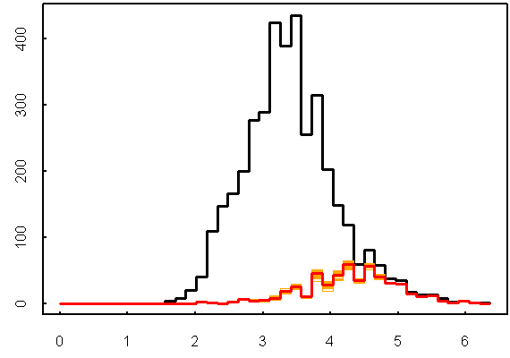
Repeat Analysis
4 Analyses

Slide 57

Repeat Analysis
5 Analyses

Slide 58
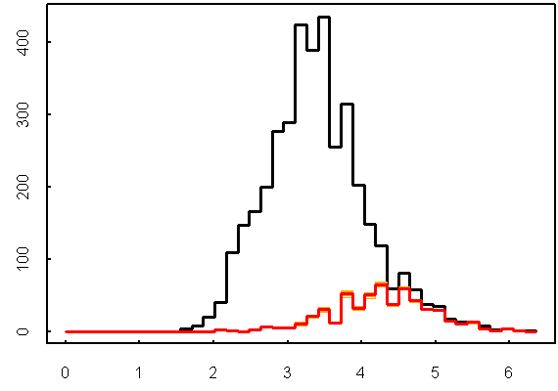
Repeat Analysis
6 Analyses

Slide 59
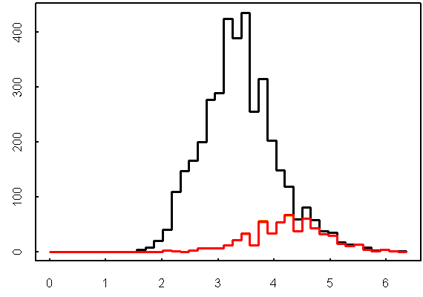
Repeat Analysis
7 Analyses

Slide 60
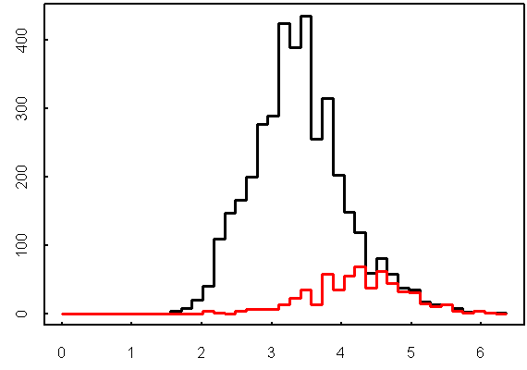
Repeat Analysis
8 Analyses

Slide 61
Repeat Analysis: Simulations

Slide 62
Summary
The success rate of proteome analysis is influenced by the following factors (listed in order of importance):
The degree of protein separation
Amount of peptides loaded on column or mass spectrometric detection limit
The degree of peptide separation or mass spectrometric dynamic range

Slide 63
Proteomics Informatics –
Protein identification II: search engines and protein sequence databases (Week 5)

