Slide 1
Proteomics Informatics –
Protein identification III:
de novo sequencing (Week 6)

Slide 2
De Novo Sequencing of MS Spectra
Only a manually confirmed spectrum is a correct spectrum
Beatrix Ueberheide
March 12th 2013

Slide 3
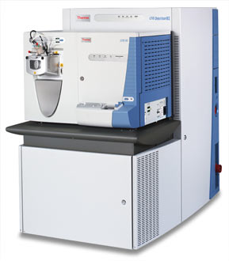
Biological Mass Spectrometry
Proteolytic digestion
Protein(s)
Peptides
Base Peak Chromatogram
MS
500
1000
1500
Time (min)
m/z
Mass Spectrometer
MS/MS
Database Search
Manual Interpretation
200
600
m/z
1000

Slide 4
Peptide Sequencing using Mass Spectrometry
S
G
F
L
E
E
D
E
L
K
100
% Relative Abundance
0
250
500
750
1000
m/z

Slide 5
Peptide Sequencing using Mass Spectrometry
88
145
292
405
534
663
778
907
1020
1166
b ions
S
G
F
L
E
E
D
E
L
K
100
% Relative Abundance
0
250
500
750
1000
m/z

Slide 6
Peptide Sequencing using Mass Spectrometry
S
G
F
L
E
E
D
E
L
K
1166
1080
1022
875
762
633
504
389
260
147
y ions
100
% Relative Abundance
0
250
500
750
1000
m/z

Slide 7
Peptide Sequencing using Mass Spectrometry
88
145
292
405
534
663
778
907
1020
1166
b ions
S
G
F
L
E
E
D
E
L
K
1166
1080
1022
875
762
633
504
389
260
147
y ions
762
100
875
[M+2H]²⁺
% Relative Abundance
633
292
405
534
260
389
1022
504
907
1020
663
778
1080
0
250
500
750
1000
m/z

Slide 8
Peptide Sequencing using Mass Spectrometry
88
145
292
405
534
663
778
907
1020
1166
b ions
S
G
F
L
E
E
D
E
L
K
1166
1080
1022
875
762
633
504
389
260
147
y ions
762
100
113
875
113
[M+2H]²⁺
% Relative Abundance
633
292
405
534
260
389
1022
504
907
1020
663
778
1080
0
250
500
750
1000
m/z

Slide 9
Peptide Sequencing using Mass Spectrometry
88
145
292
405
534
663
778
907
1020
1166
b ions
S
G
F
L
E
E
D
E
L
K
1166
1080
1022
875
762
633
504
389
260
147
y ions
762
100
129
875
[M+2H]²⁺
% Relative Abundance
129
633
292
405
534
260
389
1022
504
907
1020
663
778
1080
0
250
500
750
1000
m/z

Slide 10
Peptide Sequencing using Mass Spectrometry
88
145
292
405
534
663
778
907
1020
1166
b ions
S
G
F
L
E
E
D
E
L
K
1166
1080
1022
875
762
633
504
389
260
147
y ions
762
100
875
[M+2H]²⁺
% Relative Abundance
633
292
405
534
260
389
1022
504
907
1020
663
778
1080
0
250
500
750
1000
m/z

Slide 11
Peptide Sequencing using Mass Spectrometry
88
145
292
405
534
663
778
907
1020
1166
b ions
S
G
F
L
E
E
D
E
L
K
1166
1080
1022
875
762
633
504
389
260
147
y ions
762
100
875
[M+2H]²⁺
% Relative Abundance
633
292
405
534
260
389
1022
504
907
1020
663
778
1080
0
250
500
750
1000
m/z

Slide 12
Peptide Sequencing using Mass Spectrometry
88
145
292
405
534
663
778
907
1020
1166
b ions
S
G
F
L
E
E
D
E
L
K
1166
1080
1022
875
762
633
504
389
260
147
y ions
762
100
875
[M+2H]²⁺
% Relative Abundance
633
292
405
534
260
389
1022
504
907
1020
663
778
1080
0
250
500
750
1000
m/z

Slide 13
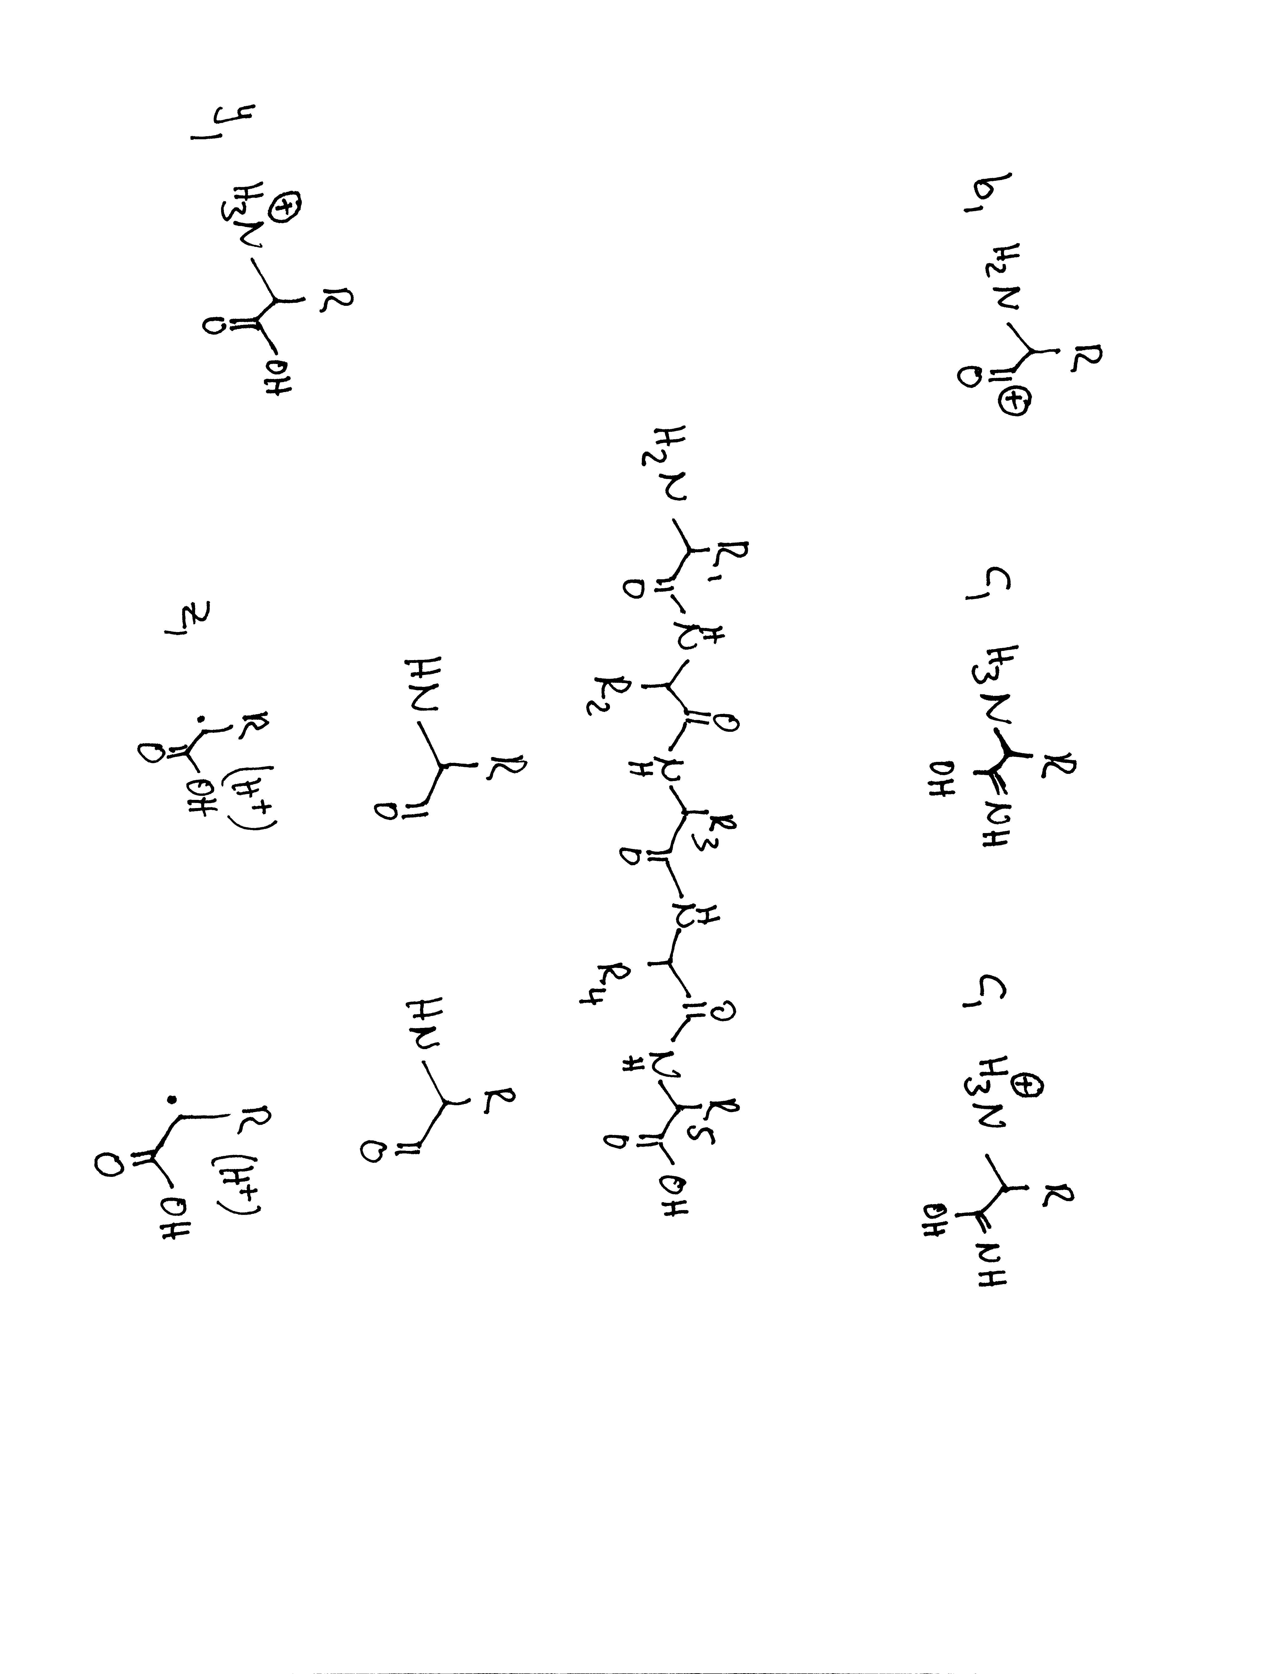
How to Sequence: CAD
Residue Mass (RM)
The very first N- and C-terminal fragment ions are not just their corresponding residue masses. The peptides N or C-terminus has to be taken into account.
b ion
y ion
b1 = RM +
1
y1 = RM +
19

Slide 14
Example of how to calculate theoretical fragment ions
88
159
290
387
500
629
803
S A M P L E R
803
716
645
514
417
304
175
Residue Mass
The first b ion
The first y ion

Slide 15
How to calculate theoretical fragment ions
RM+1
+ RM
+ RM
+ RM
+ RM
+ RM
+RM+18
88
159
290
387
500
629
803
S A M P L E R
803
716
645
514
417
304
175
+ RM
+ RM
+ RM
+ RM
+ RM
+ RM
RM+19
The first b ion
The first y ion
Residue Mass

Slide 16
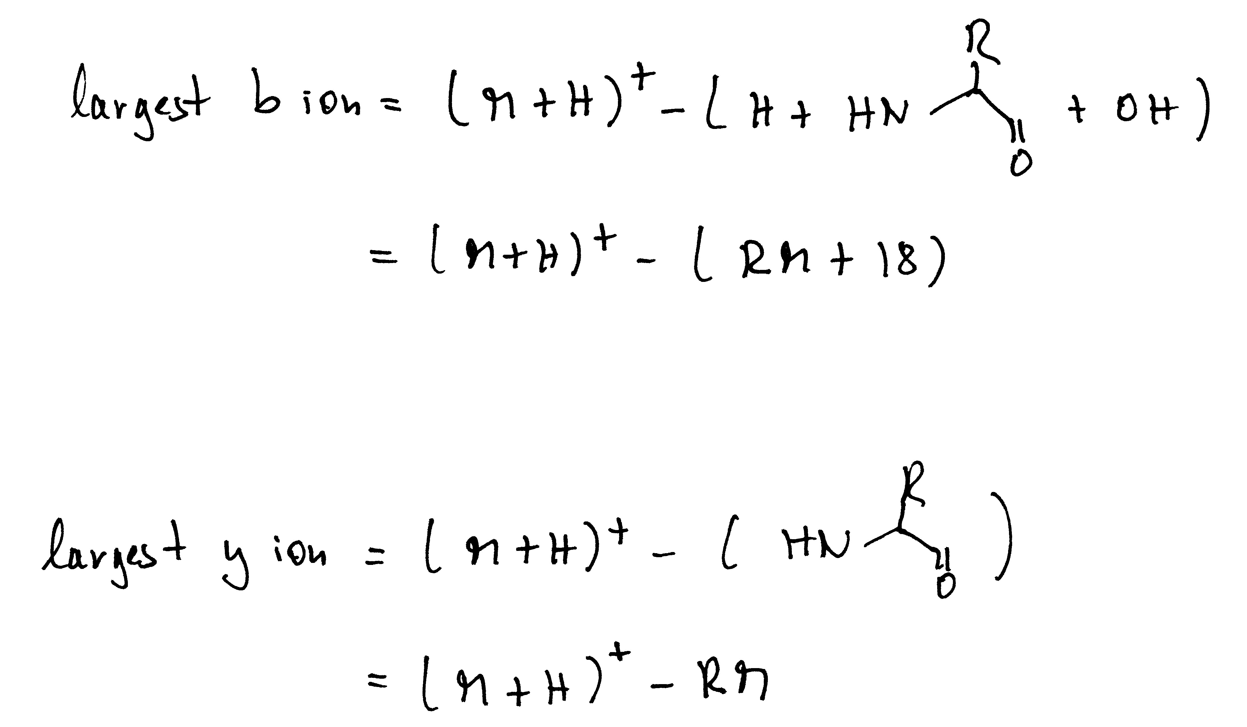
Finding ‘pairs’ and ‘biggest’ ions
If trypsin was used for digestion, one can assume that the peptide terminates in K or R. Therefore the biggest observable b ion should be:
Mass of peptide [M+H] ⁺¹ -128 (K) -18
Mass of peptide [M+H] ⁺¹ -156 (K) -18
y ions are truncated peptides. Therefore subtract a residue mass from the parent ion [M+H] ⁺¹ . The highest possible ion could be at [M+H] ⁺¹ -57 (G) and the lowest possible ion at [M+H] ⁺¹ -186 (W)
b and y ion pairs:
Complementary b and y ions should add up and result in the mass of the intact peptide, except since both b and y ion carry 1H⁺ the peptide mass will be by 1H⁺ too high therefore: b (m/z) + y (m/z)-1 = [M+H] ⁺¹
Check the SAMPLER example

Slide 17
How to start sequencing
Know the charge of the peptide
Know the sample treatment (i.e. alkylation, other derivatizations that could change the mass of amino acids)
Know what enzyme was used for digestion
Calculate the [M+1H]+1 charge state of the peptide
Find and exclude non sequence type ions (i.e. unreacted precursor, neutral loss from the parent ion, neutral loss from fragment ions
Try to see if you can find the biggest y or b ion in the spectrum. Note, if you used trypsin your C-terminal ion should end in lysine or arginine
Try to find sequence ions by finding b/y pairs
You usually can conclude you found the correct sequence if you can explain the major ions in a spectrum

Slide 18
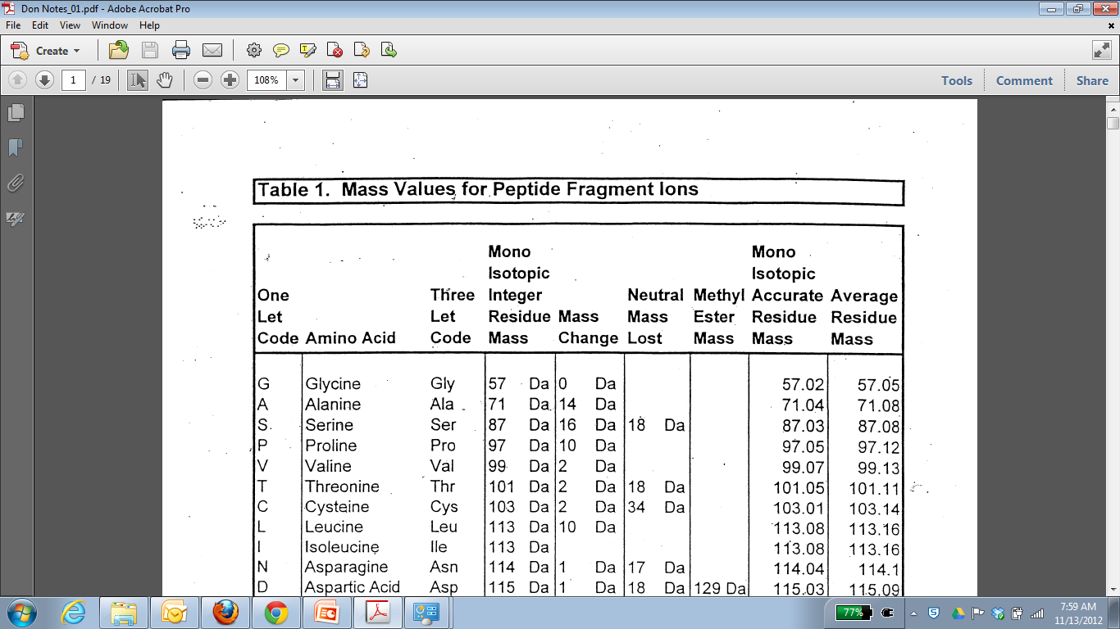
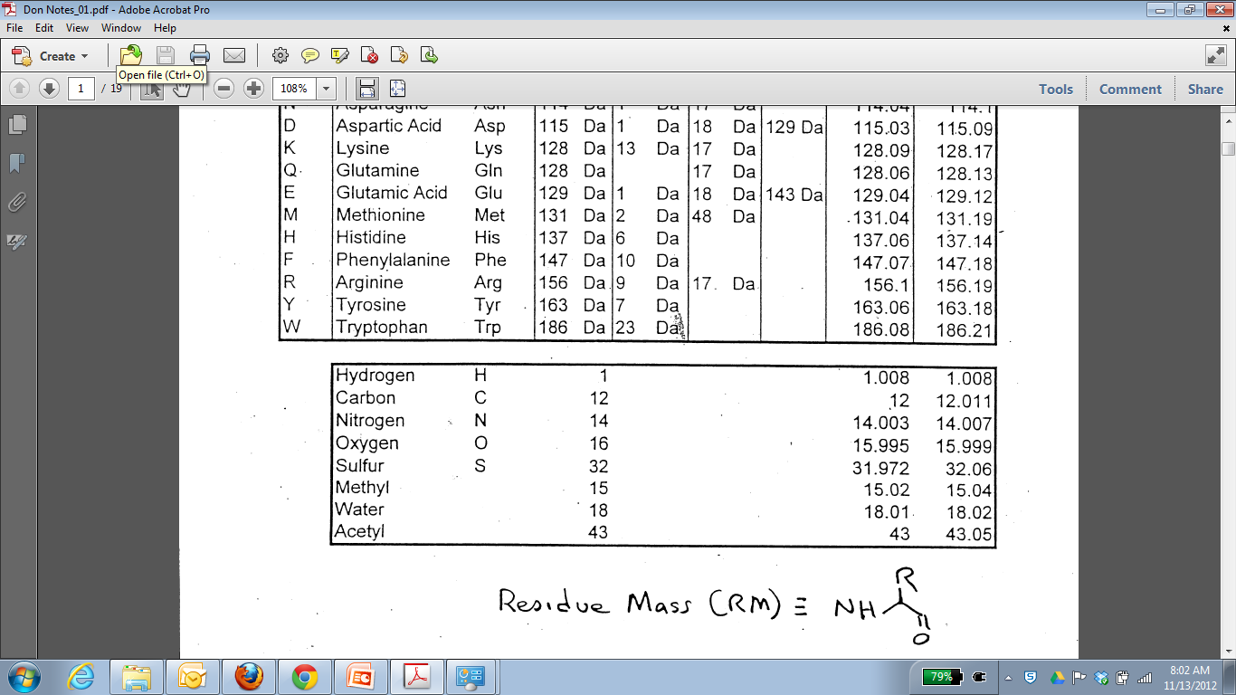
Common observed neutral losses and mass additions:
Ammonia -17
Water -18
Carbon Monoxide from b ions -28
Phosphoric acid from phosphorylated serine and threonine -98
Carbamidomethyl modification on cysteines upon alkylation with iodoacetamide +57
Oxidation of methionine +18
Calculate with nominal mass during sequencing, but use the monoisotopic masses to check if the parent mass fits. For high res. MS/MS check that the residue mass difference is correct.

Slide 19
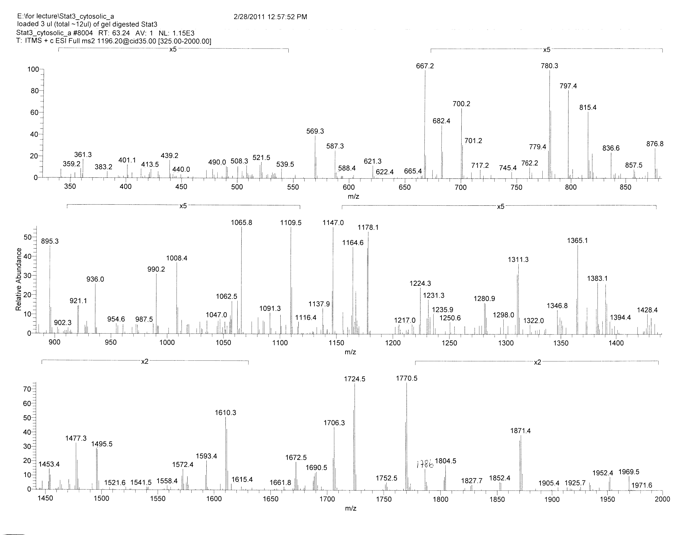

Slide 20
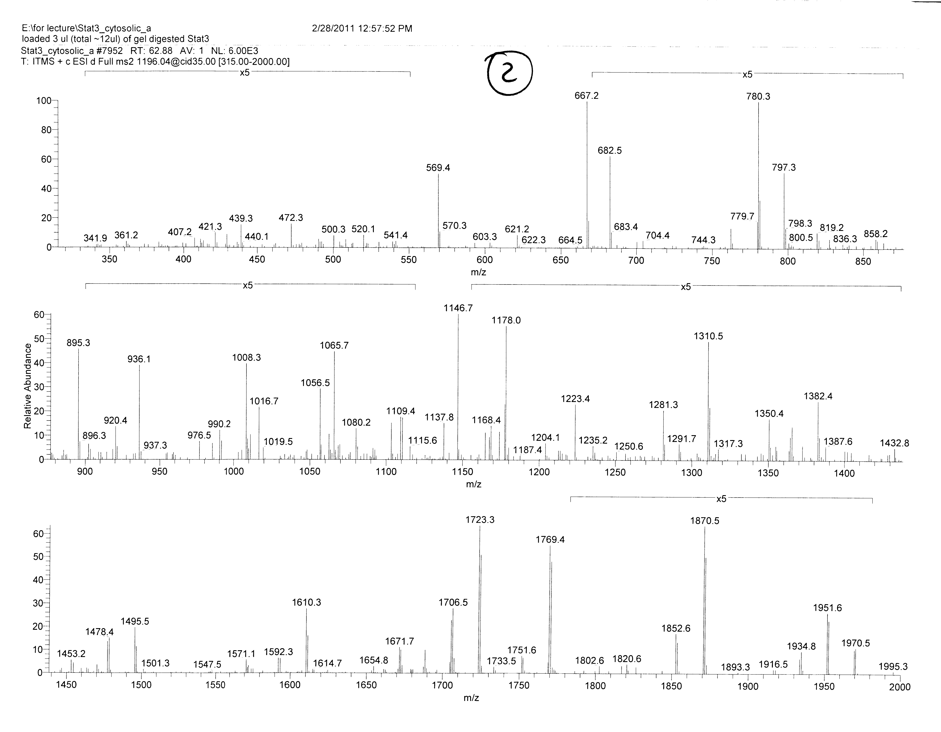

Slide 21
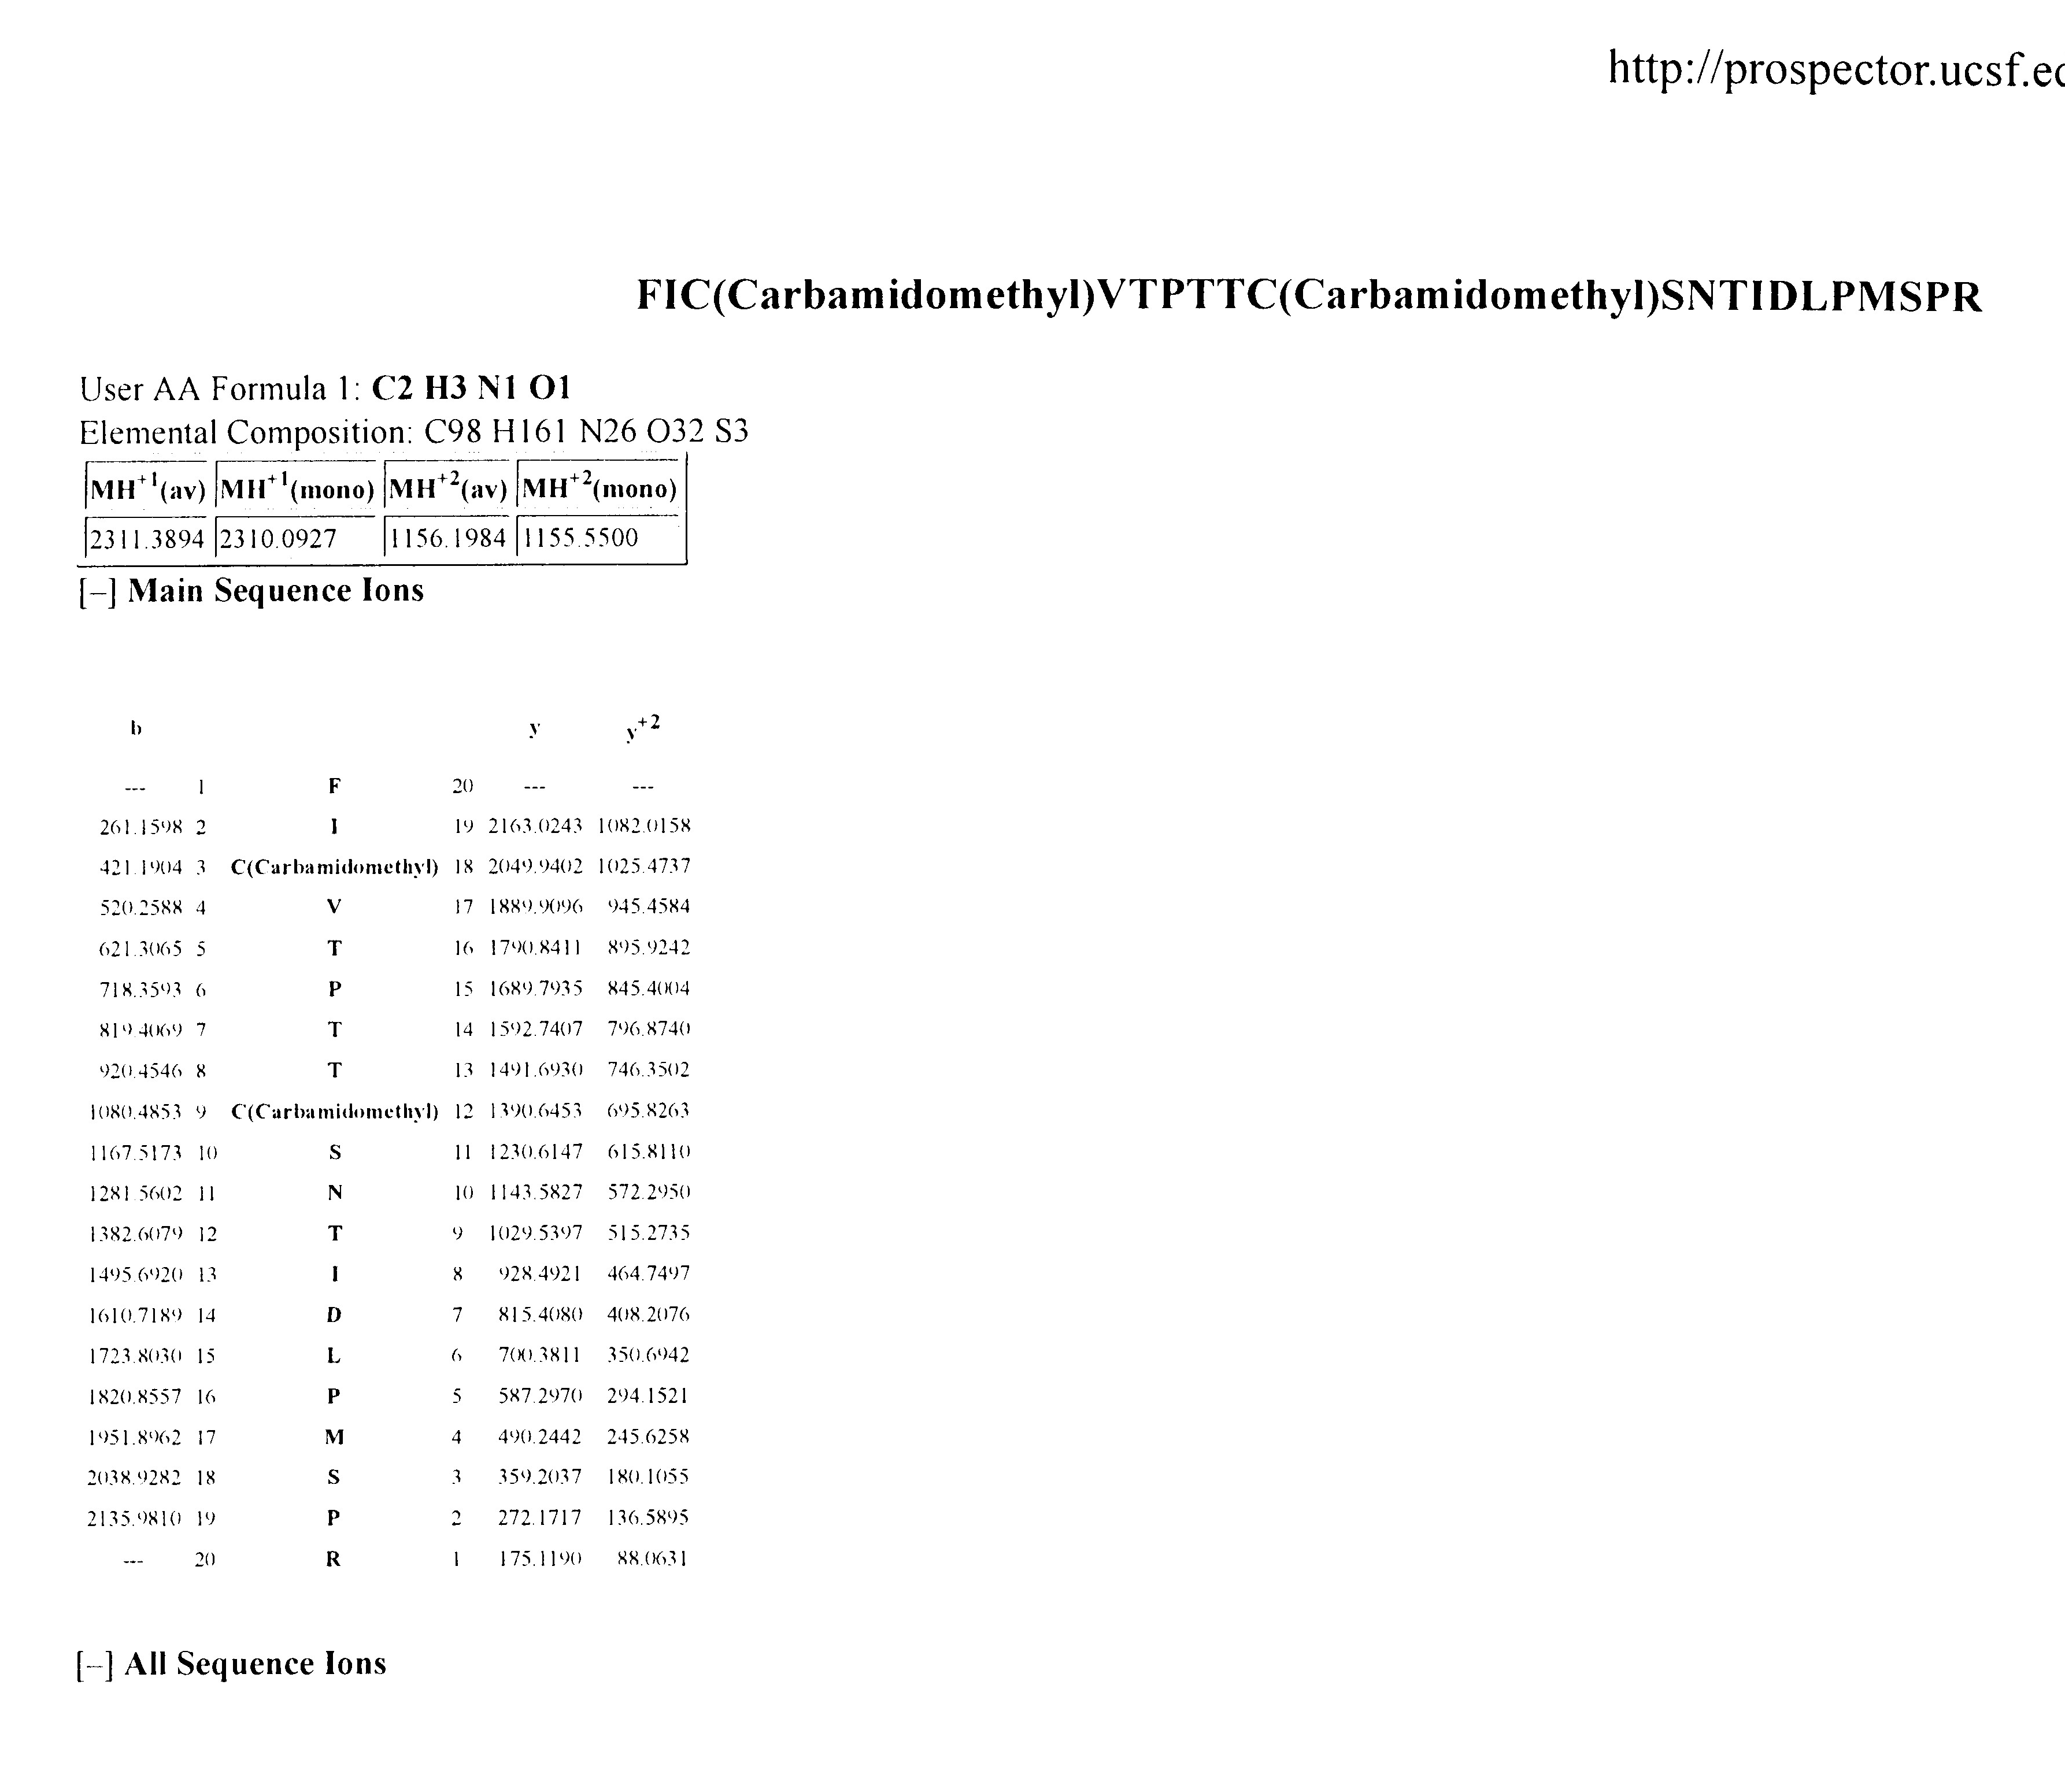
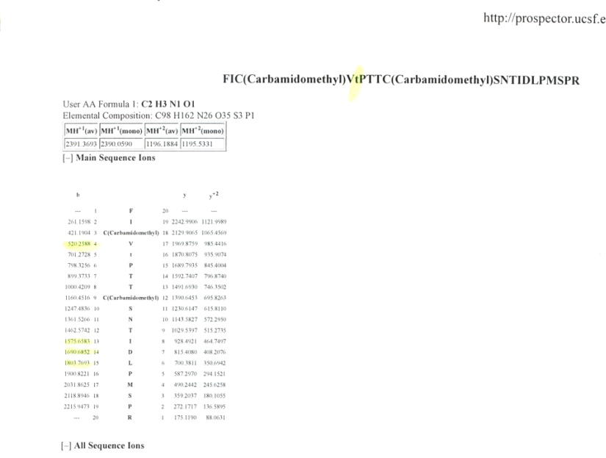
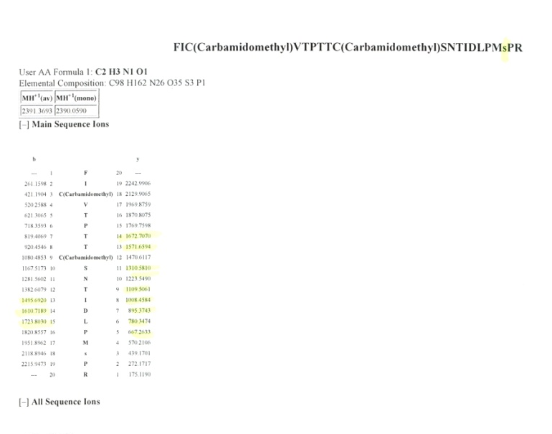
Mixed Phospho spectra
unmodified
1 Phospho site
1 Phospho site

Slide 22
First ‘on your own example’
Remember what you need to know first!

Slide 23
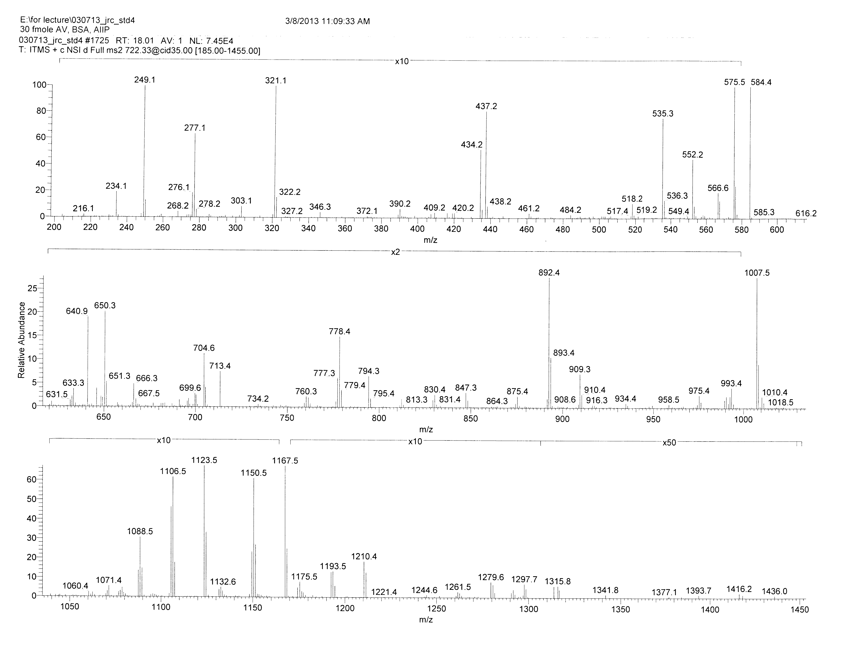
What is the charge state?
Neutral loss of water
Water = 18; 18/z; 9
Neutral loss of water?
Any ions about (z * parent mass)?
Confirm with b/y pairs!

Slide 24
Search for ‘biggest ion’
1433-18-RM
1433-18- a residue after which an enzyme cleaves
1433-18-156 = 1249
1433-18-128 = 1297

Slide 25
1297
1433
K
147

Slide 26
1210
1297
1433
S
K
1433
87
234
147

Slide 27
Find the biggest y ion!
Peptide Mass – RM
Lowest possible ion = Glycine
Highest possible ion = Tryptophan
Glycine = 1443-57 = 1386
Tryptophan = 1443-186 = 1257
164
1210
1297
1433
Y
S
K
1433
1280
87
234
147
1443-163 = 1280

Slide 28
And the sequence is……..

Slide 29
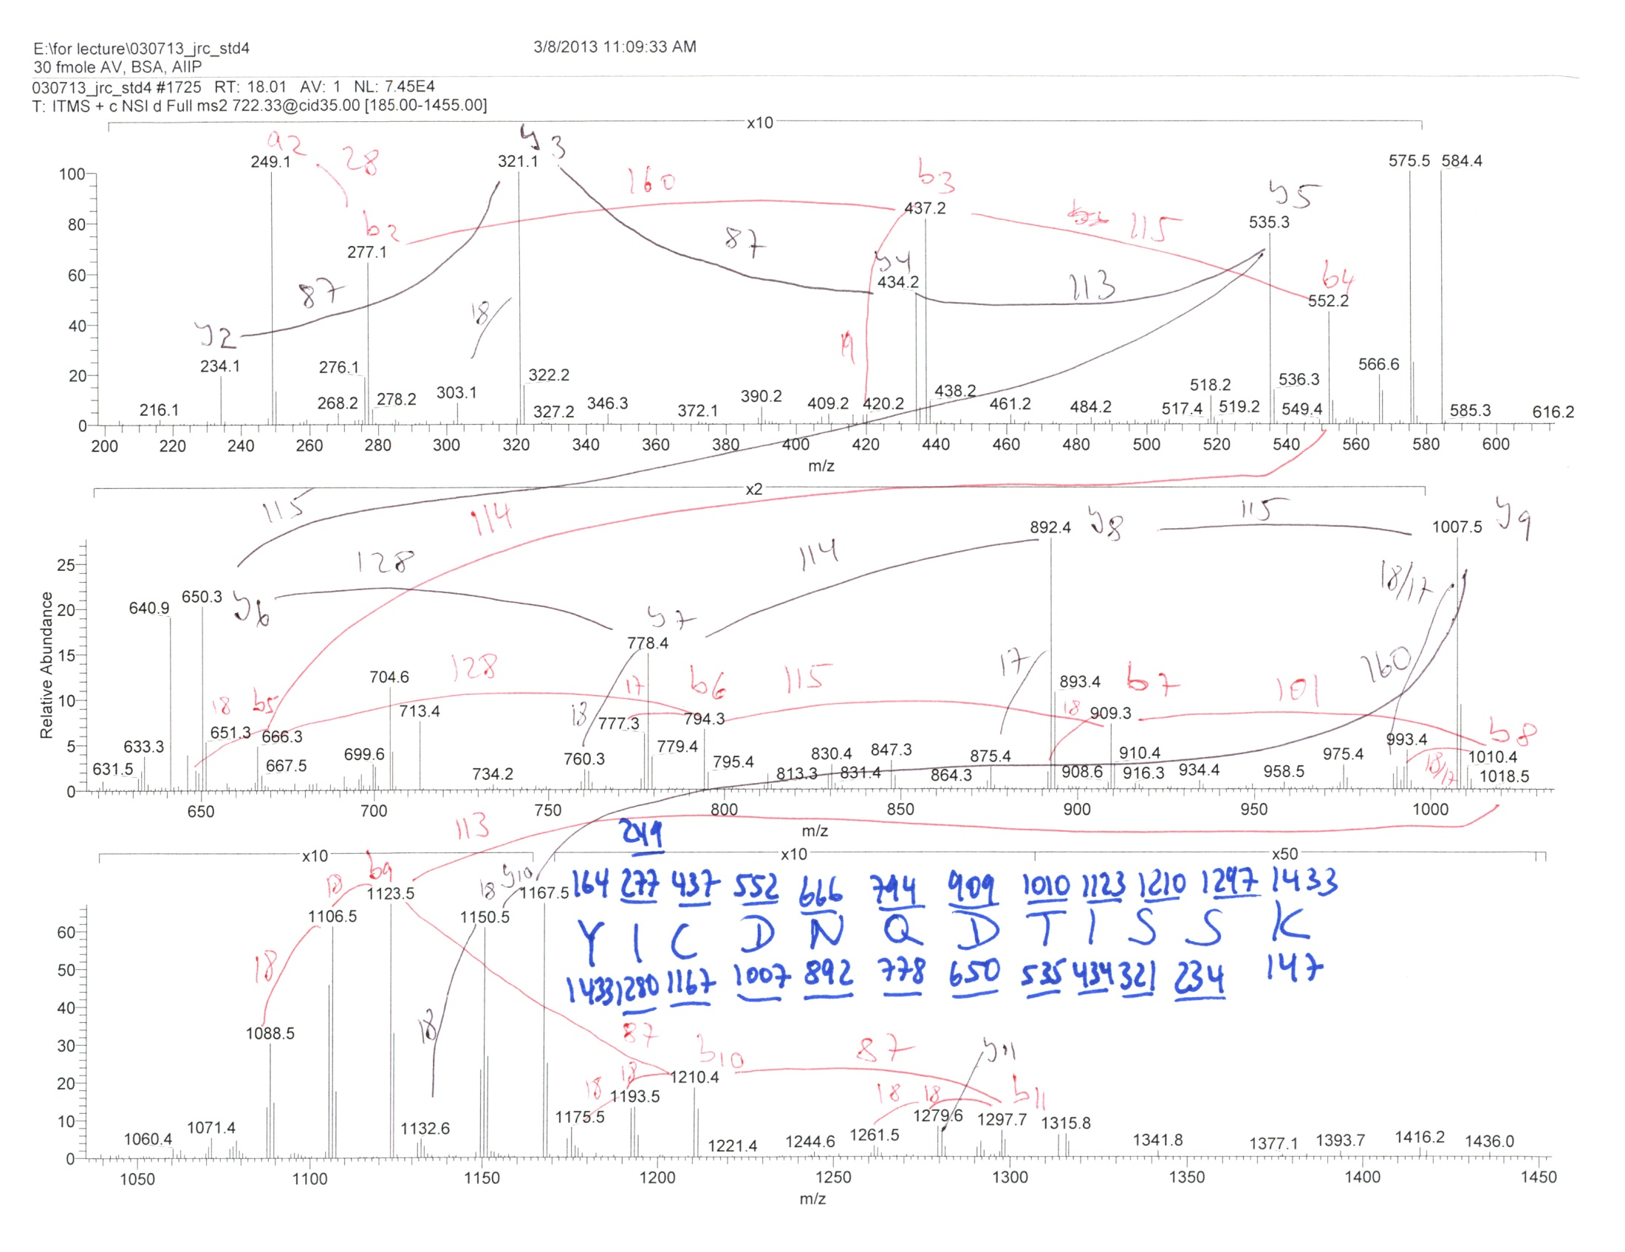

Slide 30
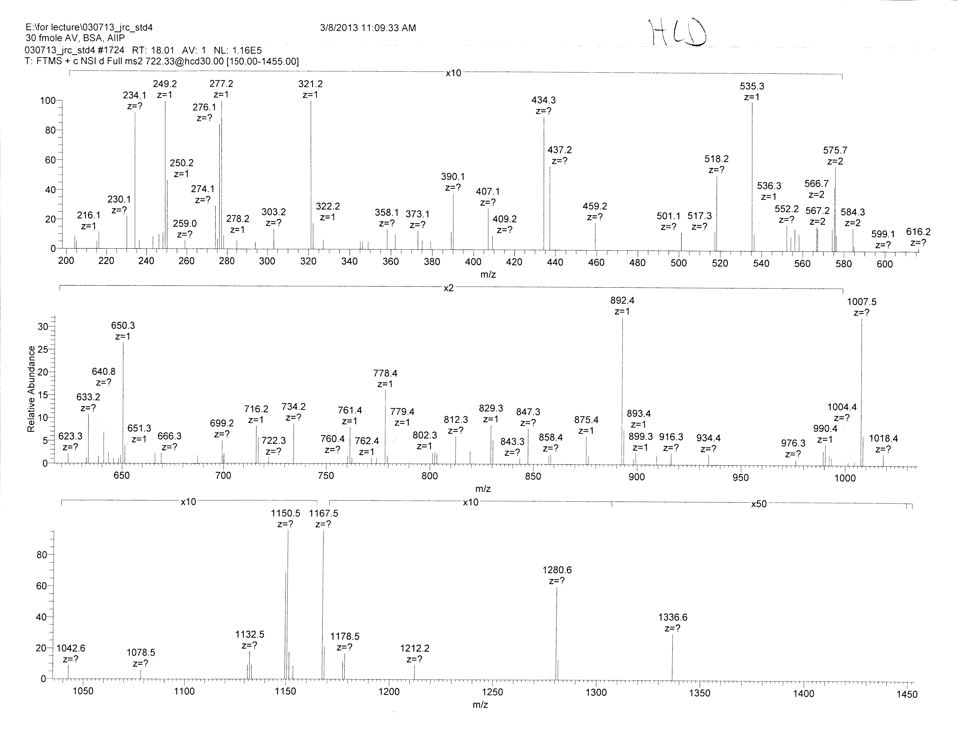
What is the difference ?
Less b ions
A bit of precursor is left
Accurate mass

Slide 31
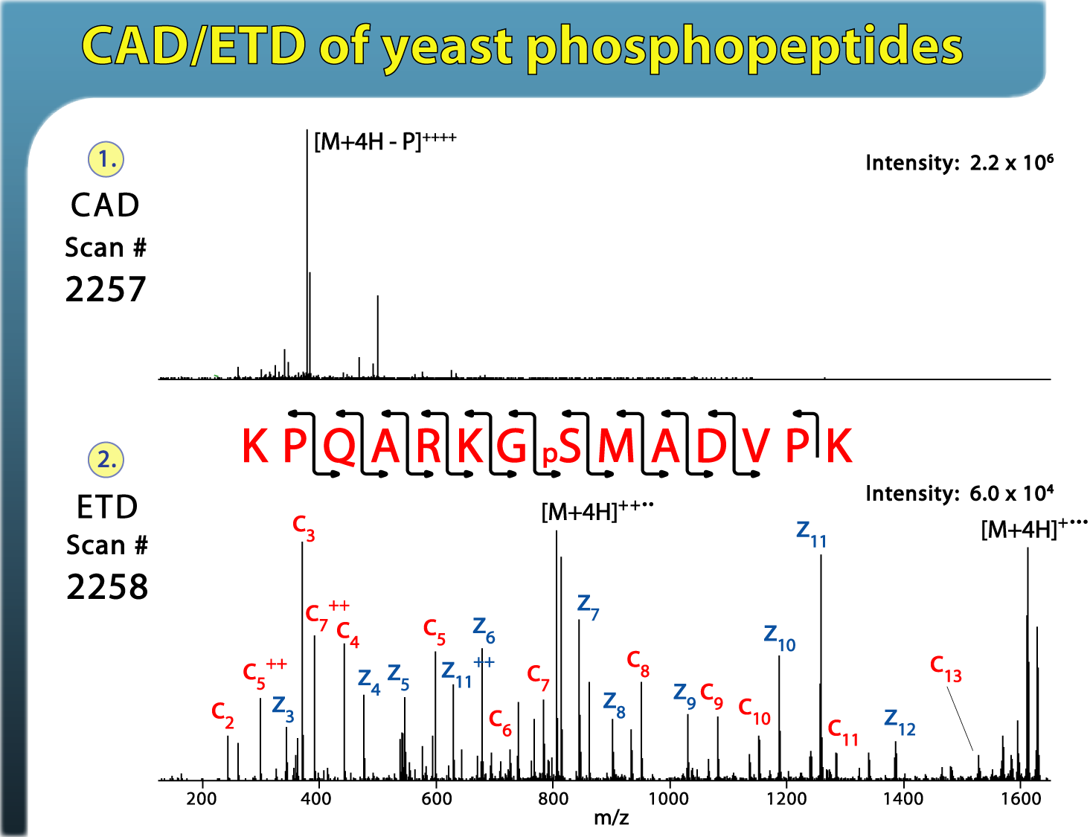
What if we do not get good fragmentation?

Slide 32
Try a different mode of dissociation

Slide 33
ETD

Slide 34
Electron Transfer Dissociation
+

Slide 35
Tandem MS - Dissociation Techniques
CAD: Collision Activated Dissociation (b, y ions)
⇒increase of internal energy through collisions
ETD: Electron Transfer Dissociation (c, z ions)
⇒bombardment of peptides with electrons
(radical driven fragmentation)

Slide 36

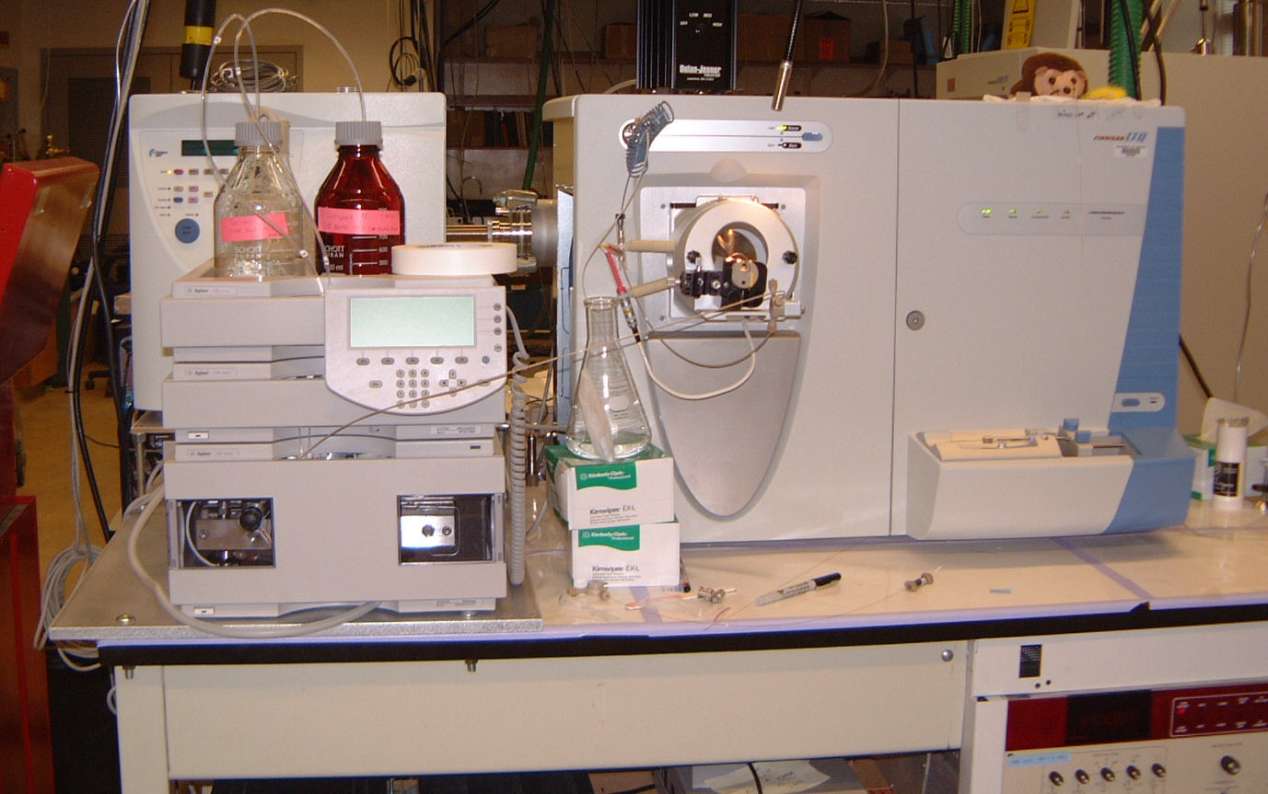
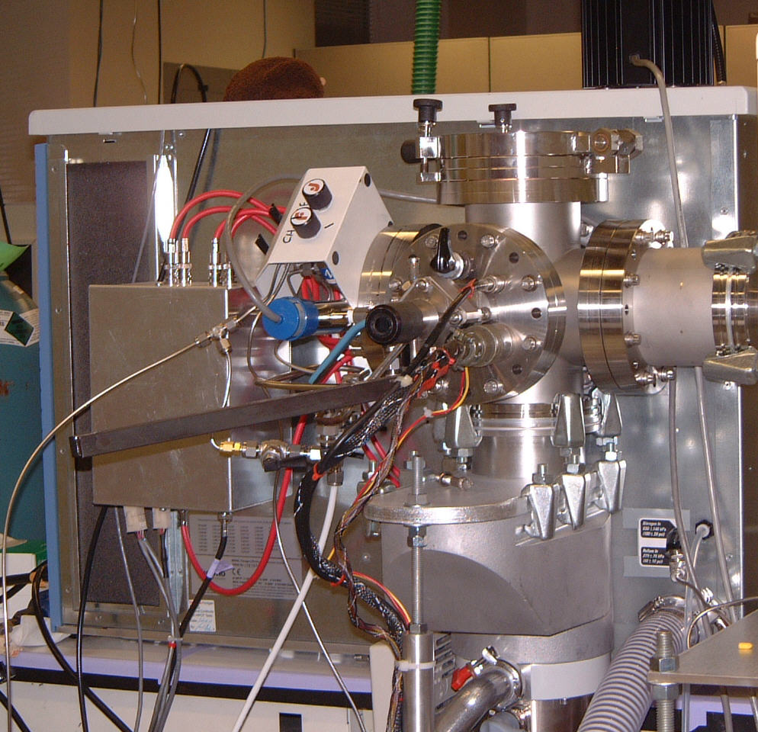
The Prototype Instrument
Modified rear / CI source
HPLC LTQ front

Slide 37
Modifications For Ion/Ion Experiments
Anion Precursor
(Fluoranthene)
Three Section
RF Linear Quadrupole Trap
Filament
e⁻
Cations
3 mTorr He
-
NICI
Source
+
Anions
From
ESI
Source
~700 mTorr
Ion
Detector
1 0f 2
Methane
Secondary RF Supply
0-150 V_{peak} @ 600 kHz

Slide 38
Injection of Positive Ions (ESI)

Slide 39
Precursor Storage in Front Section

Slide 40
Injection of Negative Ions (CI)

Slide 41
Charge-Sign Independent Trapping
Positive and negative ions react while
trapped in axial pseudo-potential
Pseudo-
potential
created by
+150 V_{p} 600 kHz
applied
to lenses
+
0 V
-

Slide 42
Charge sign independent radial confinement
0 V
+
-
Axial Confinement With DC Potentials
Trapping is Charge Sign Dependent

Slide 43
Charge sign independent axial confinement
with combined RF Quadrupole and
end lens RF pseudo-potentials
+
0 V
-

Slide 44
End ion/ion reactions
prepare for product ion analysis
Product Cations Trapped in
Center Section For Scan Out
+
+
+
+
+
0 V
-12 V
-
-
Reagent Anions
Removed Axially

Slide 45
Electron Transfer - Proton Transfer
Fragmentation(ETD)
100
+3
Precursor
50
0
200
400
600
800
1000
1200
1400
m/z

Slide 46
Electron Transfer - Proton Transfer
Fragmentation(ETD)
100
+3
Precursor
50
0
200
400
600
800
1000
1200
1400
m/z
Charge Reduction (PTR)
100
+2
+2
O
-
+3
Precursor
+1
50
+1
O
0
200
400
600
800
1000
1200
1400
m/z

Slide 47
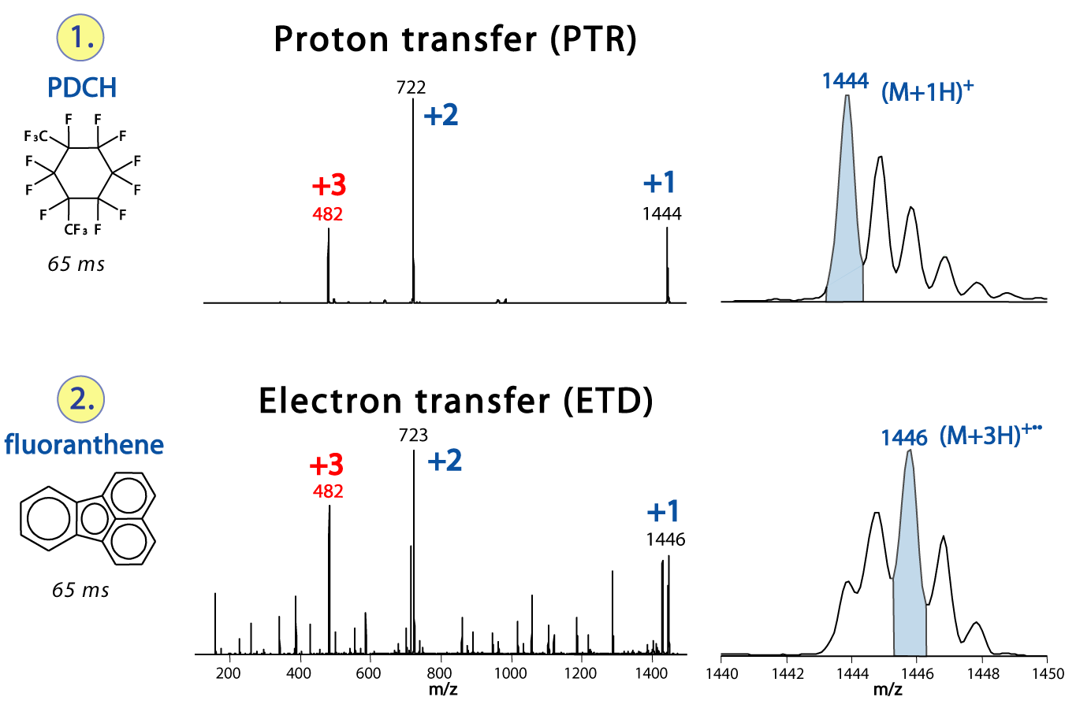
The two types of ion reactions

Slide 48
ET or ETD
[M + 3H]^{2+•}
Mass ?
m/z ?
Charge (z)
Sequence ?
Temperature ?
Anion ?
He Pressure?
Intact
Charge-Reduced
Products
Fragmentation
Products
c, z, etc.
[M + 3H]^{2+•}

Slide 49
ET or ETD
[M + 3H]^{2+•}
Mass ?
m/z ?
Charge (z)
Sequence ?
Temperature ?
Anion ?
He Pressure?
Intact
Charge-Reduced
Products
Fragmentation
Products
c, z, etc.
[M + 3H]^{2+•}
CAD

Slide 50
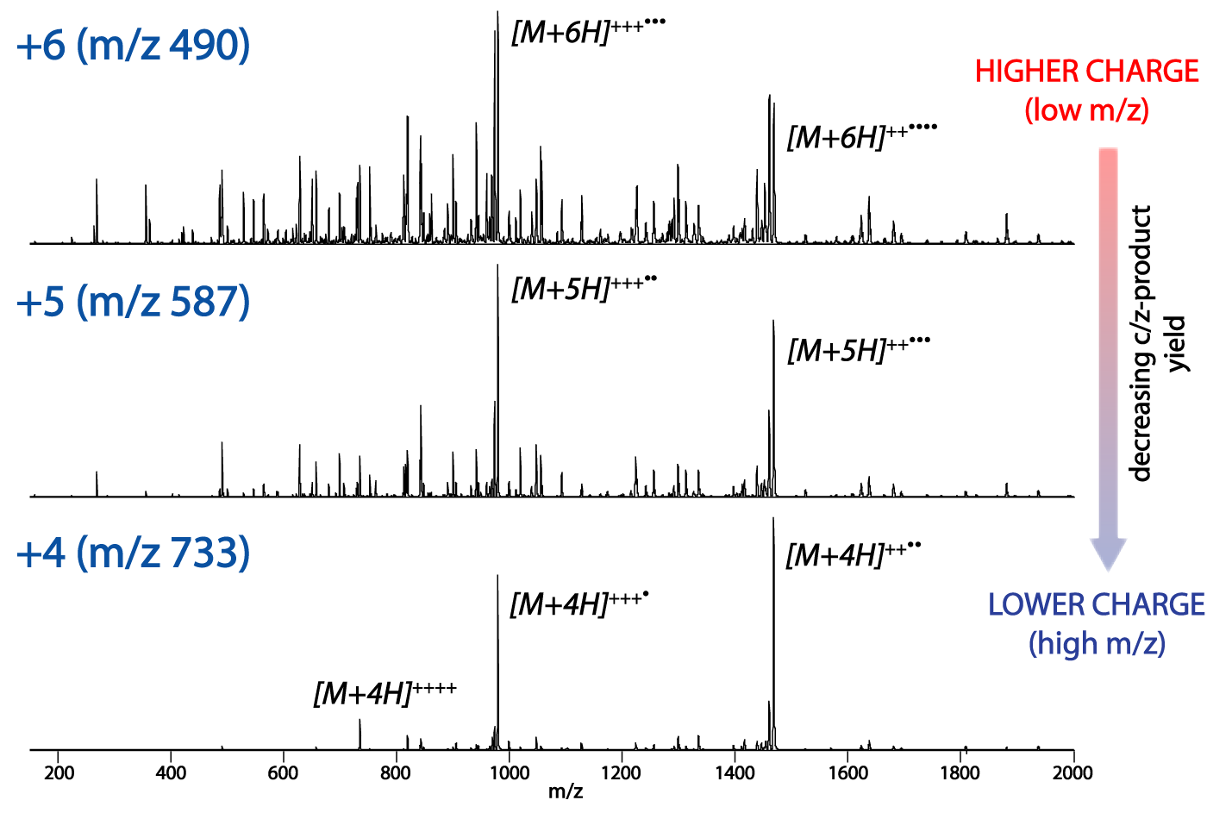
Charge dependence in fragmentation

Slide 51
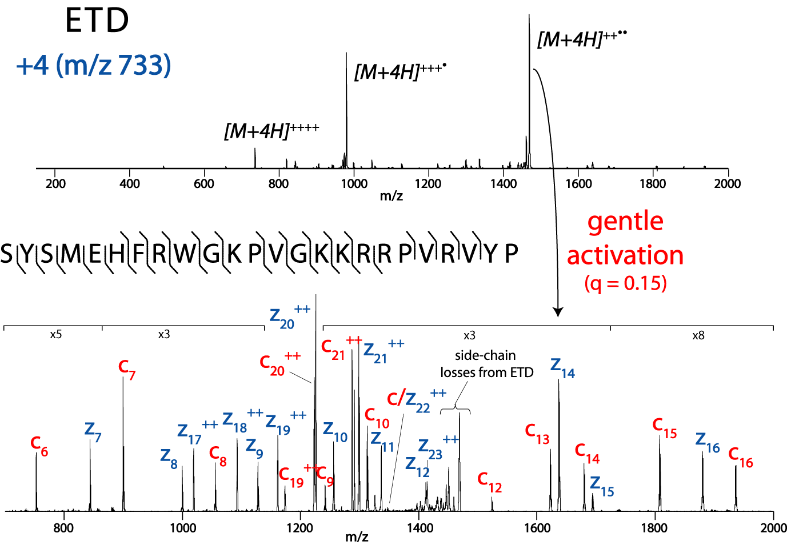
Gentle off resonance activation

Slide 52
How to Sequence ETD
Residue Mass (RM)
c1 ion
z1 ion
+ NH
c1 = RM +
18
z1 = RM +
3

Slide 53
Example of how to calculate theoretical fragment ions
105
176
307
404
517
646
803
S A M P L E R
803
700
629
498
401
288
159
The first z ion
The first c ion
Residue Mass

Slide 54
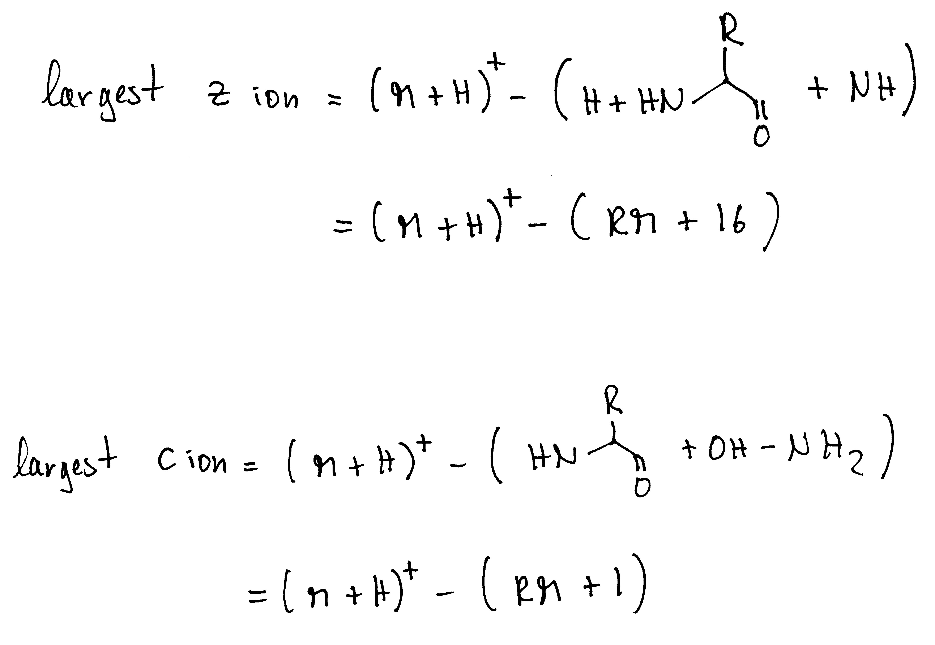
Largest c and z ions

Slide 55
Background necessary to know
Show a hand annotated spectra from one of my toxin talks
Show how to calculate a charge state, also in a spectrum, give a spectrum where they should find out the charge state for CAD and then for ETD and how they confirm that by finding pairs (must have mentioned that in the previous slide for the example)
Ask them if they know how to calculate a charge state etc.

Slide 56
Characteristics of CAD and ETD spectra
Show the precursor issue, show the neutral loss from the parent, show the neutral loss from peptides

Slide 57
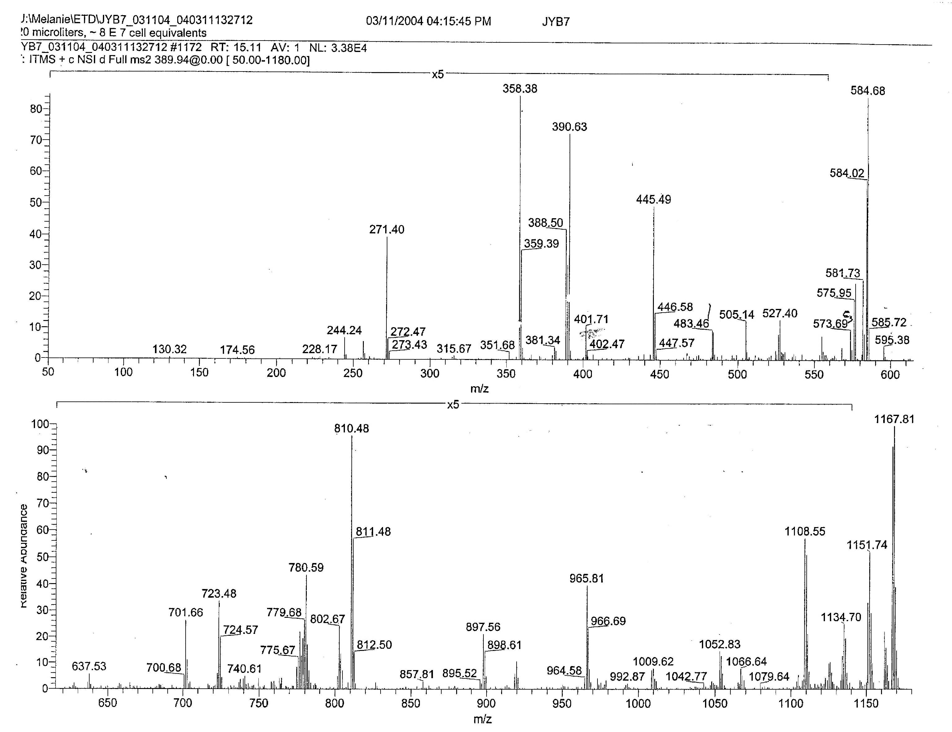
Sample:
Antigens from MHC molecules:
Proline in the 2nd position!

Slide 58
1. What charge state ?
[M + H]⁺¹ = m/z
(m = m + H)
Number of Hs = z
Remember to calculate with nominal masses

Slide 59
(m · z) – (z-1) = [M + H]⁺¹
(389.5 · 3) – 2 = 1166

Slide 60
(m · z) – (z-1) = [M + H]⁺¹
(389.5 · 3) – 2 = 1166
check
[M + H]⁺¹ + 1H /2
[M + 2H]⁺² = (1166 + 1) /2 = 584

Slide 61
[M + 3H]^{+3·}
+3
+2
[M + 2H]⁺²
+1

Slide 62
2. Eliminate non-sequencing relevant ions!
3. biggest c ion ?
4. biggest z ion ?

Slide 63
No suitable z_{biggest} ion! Remember 2nd position is a proline?
1052
1166
P
I/L
1166
130
c_{biggest}

Slide 64
Now find the first c ion (c₁),
look for c and z pairs,
and sequence ladders
Let’s find c and z pairs!
z + c = [M + H]⁺¹ +2
[M + H]⁺¹ – c + 2 = z
1052
1166
P
I/L
1166
130

Slide 65
174
271
358
445
573
701
802
965
1052
1166
R
P
S
S
Q/K
Q/K
S
T
I/L
I/L
1166
994
897
810
723
595
467
366
203
116

Slide 66
2nd Example

Slide 67
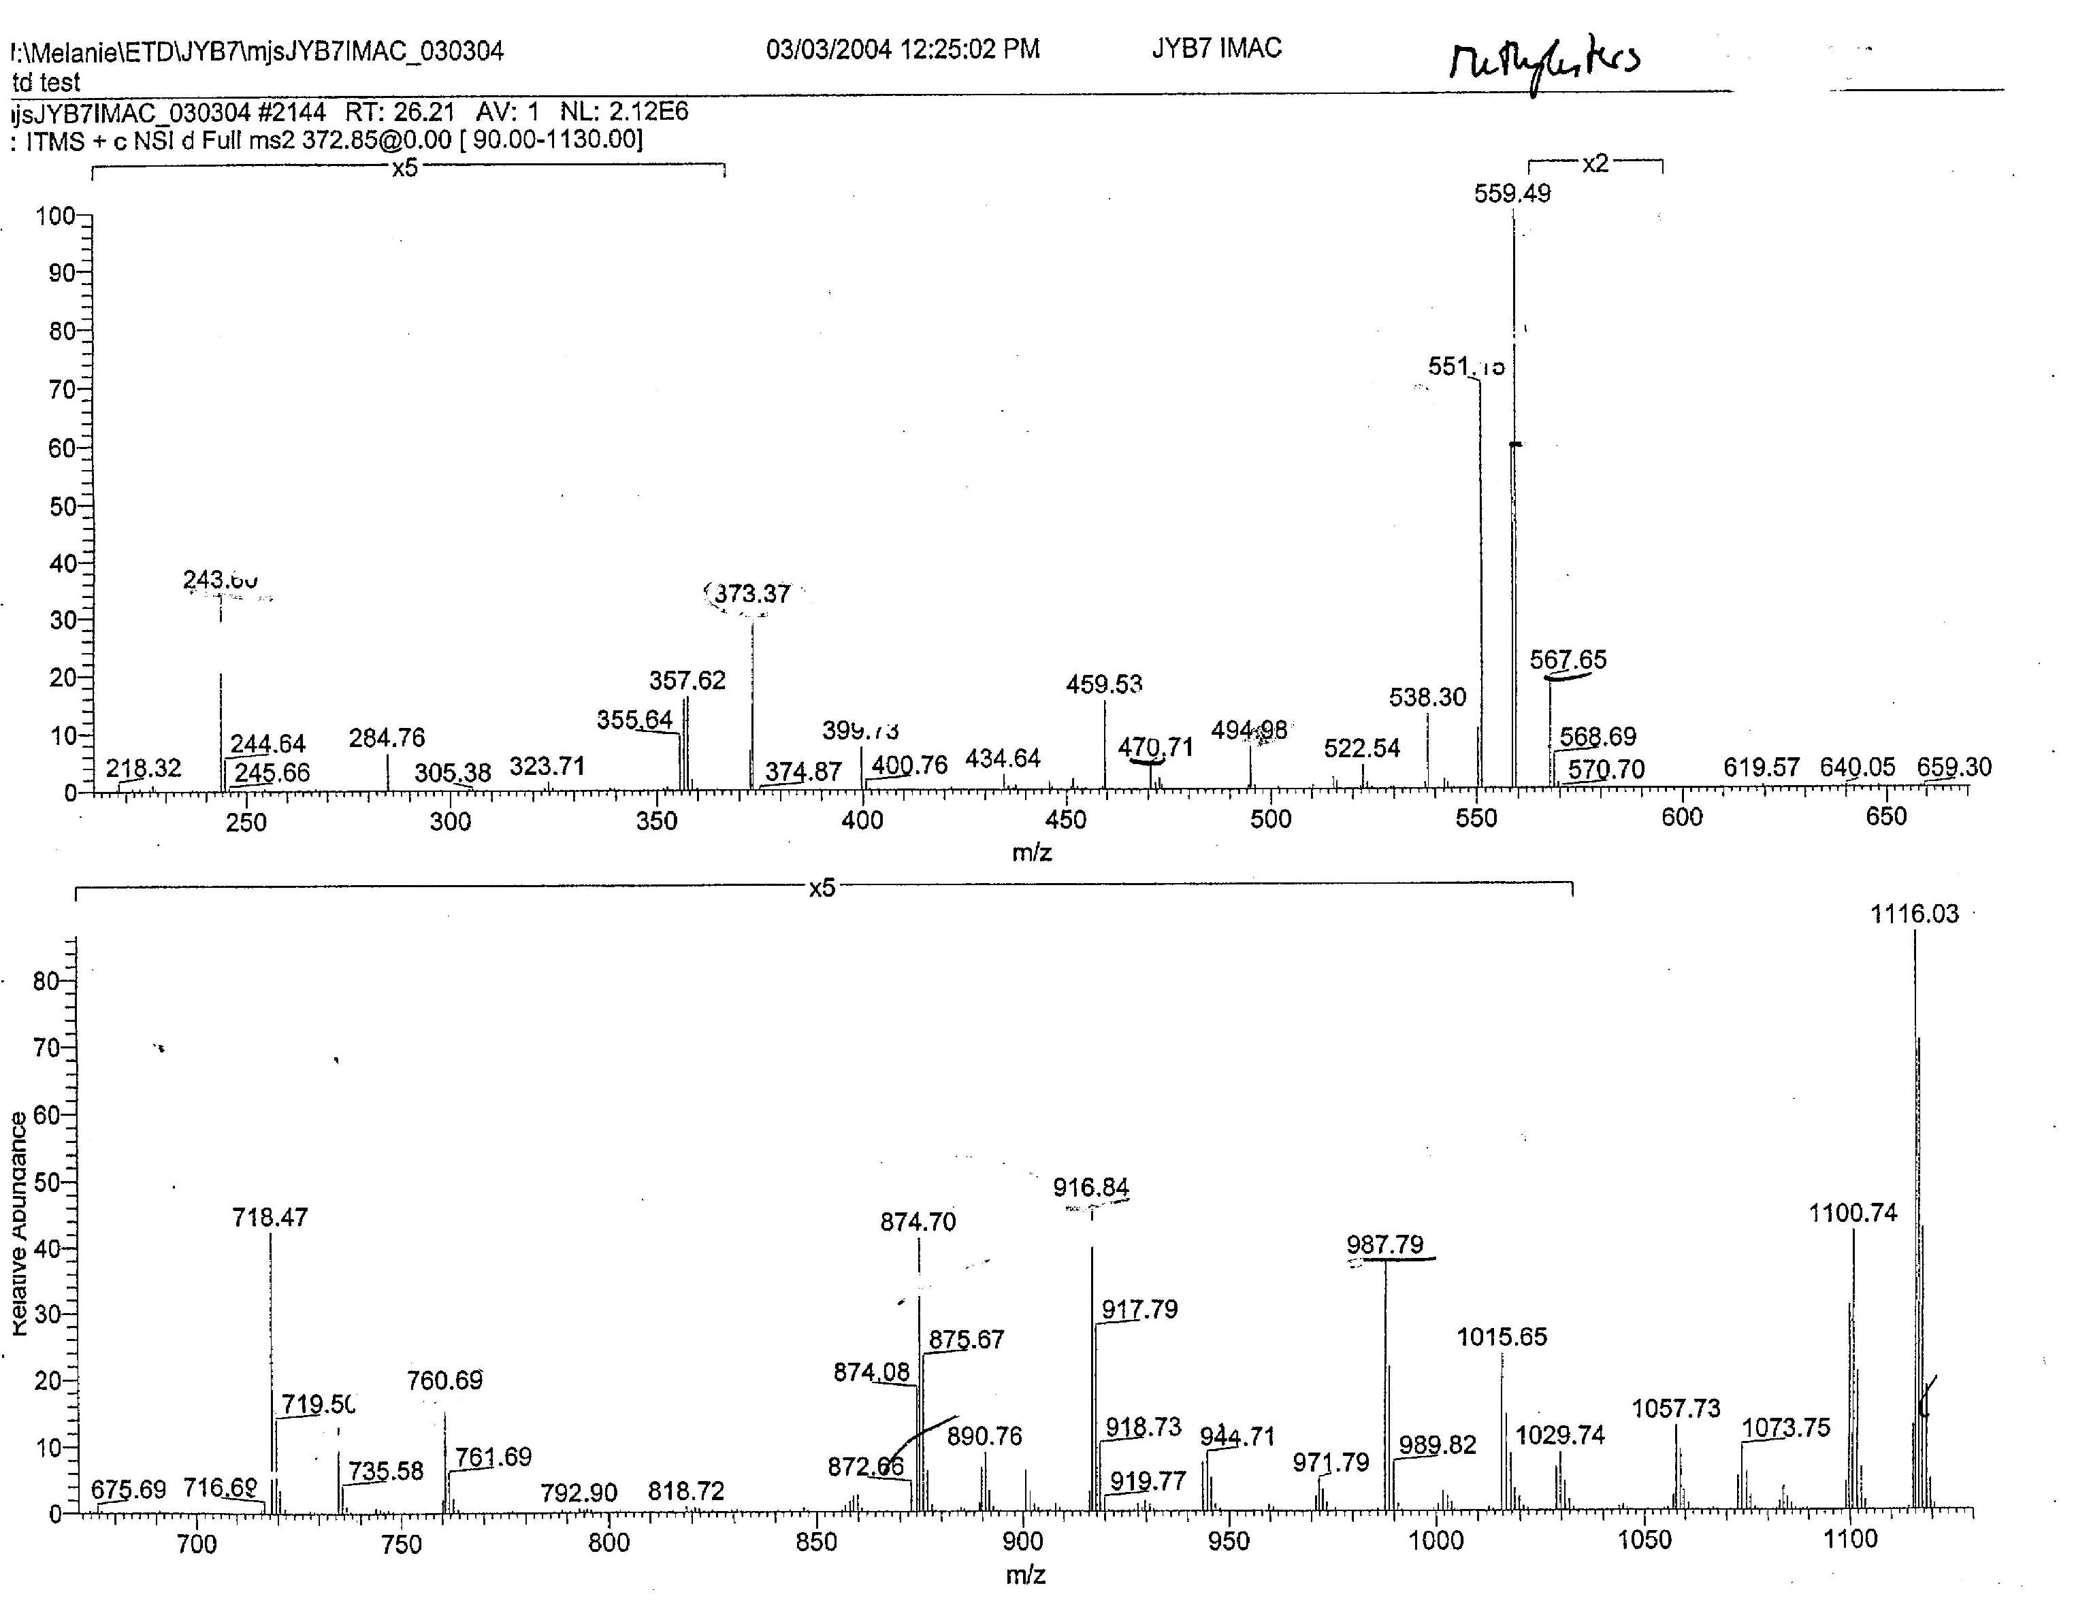
Important to know:
This sample was converted to Methylesters
(+14 on C-term and D/E side chains)
and analyzed after IMAC!
Sample:
Antigens from MHC molecules: 9mer with Proline in the 2nd position!

Slide 68
1. What charge state ?
(372.5 · 3) – 2 = 1115
check
[M + H]⁺¹ + 1H /2
= [M + 2H]⁺²
[M + 2H]⁺² = (1115 + 1) /2
= 558

Slide 69
+2
[M + 3H]^{+3·}
[M + 2H]⁺²
+3
+1

Slide 70
2. Eliminate non-sequencing relevant ions!
3. biggest c ion ?
4. biggest z ion ?
For c-ions remember to also subtract 14!

Slide 71
No suitable z₈ ion! Remember 2nd position is a proline?
c₈

Slide 72
Let’s find c and z pairs!
z + c = [M + H]⁺¹ +2
[M + H]⁺¹ – c + 2 = z
c₈

Slide 73
Let’s find c and z pairs!
z + c = [M + H]⁺¹ +2
[M + H]⁺¹ – c + 2 = z
+2
+2
130
201
c₈

Slide 74
146
243
399
760
916
987
1115
Q/K
P
R
R
A
I/L
1115
971
874
718
357
201
130

Slide 75
146
243
399
566
663
760
916
987
1115
Q/K
P
R
pS
P
P
R
A
I/L
1115
971
874
718
551
454
357
201
130

Slide 76
Proteomics Informatics –
Protein identification III:
de novo sequencing (Week 6)

