Slide 1
Proteomics Informatics –
Databases, data repositories and standardization (Week 7)

Slide 2
Protein Sequence Databases

Slide 3
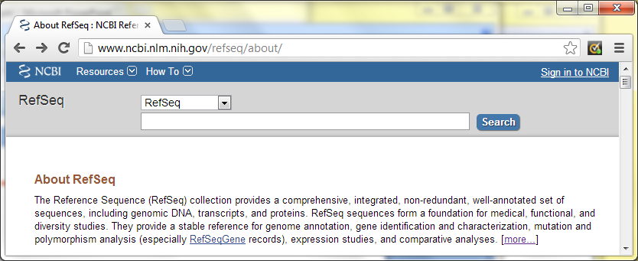
RefSeq
Distinguishing Features of the RefSeq collection include:
non-redundancy
explicitly linked nucleotide and protein sequences
updates to reflect current knowledge of sequence data and biology
data validation and format consistency
ongoing curation by NCBI staff and collaborators, with reviewed records indicated
http://www.ncbi.nlm.nih.gov/books/NBK21091/

Slide 4
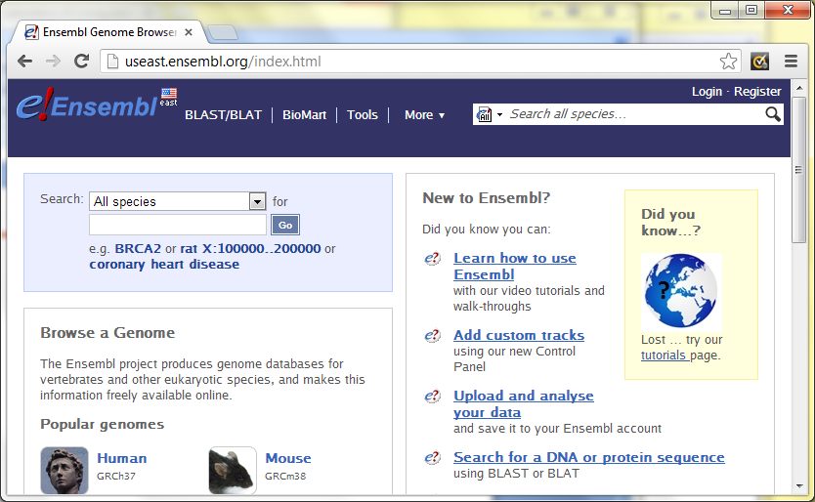
Ensembl
genome information for sequenced chordate genomes.
evidenced-based gene sets for all supported species
large-scale whole genome multiple species alignments across vertebrates
variation data resources for 17 species and regulation annotations based on ENCODE and other data sets.
http://www.ensembl.org/

Slide 5
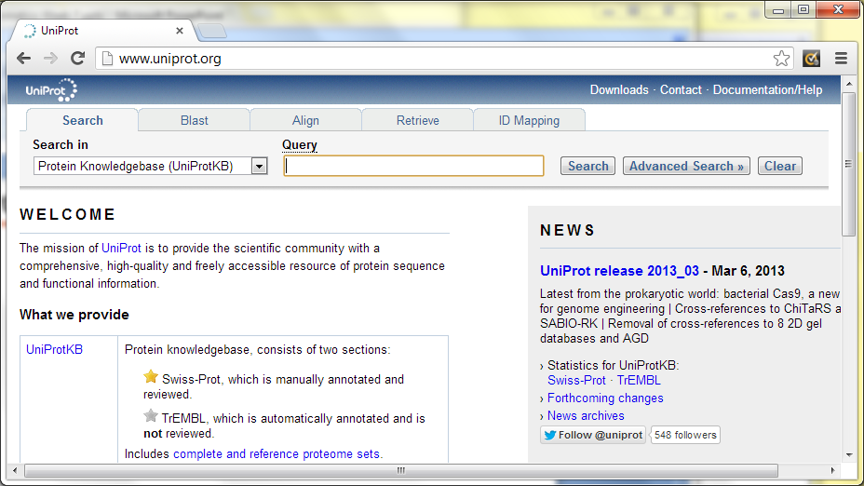
UniProt
The mission of UniProt is to provide the scientific community with a comprehensive, high-quality and freely accessible resource of protein sequence and functional information.
http://www.uniprot.org/

Slide 6
Species-Centric Consortia
For some organisms, there are consortia that provide high-quality databases:
Yeast (http://yeastgenome.org/)
Fly (http://flybase.org/)
    Arabidopsis (http://arabidopsis.org/)

Slide 7
FASTA
RefSeq:
>gi|168693669|ref|NP_001108231.1| zinc finger protein 683 [Homo sapiens]
MKEESAAQLGCCHRPMALGGTGGSLSPSLDFQLFRGDQVFSACRPLPDMVDAHGPSCASWLCPLPLAPGRSALLACLQDL
DLNLCTPQPAPLGTDLQGLQEDALSMKHEPPGLQASSTDDKKFTVKYPQNKDKLGKQPERAGEGAPCPAFSSHNSSSPPP
LQNRKSPSPLAFCPCPPVNSISKELPFLLHAFYPGYPLLLPPPHLFTYGALPSDQCPHLLMLPQDPSYPTMAMPSLLMMV
NELGHPSARWETLLPYPGAFQASGQALPSQARNPGAGAAPTDSPGLERGGMASPAKRVPLSSQTGTAALPYPLKKKNGKI
LYECNICGKSFGQLSNLKVHLRVHSGERPFQCALCQKSFTQLAHLQKHHLVHTGERPHKCSVCHKRFSSSSNLKTHLRLH
SGARPFQCSVCRSRFTQHIHLKLHHRLHAPQPCGLVHTQLPLASLACLAQWHQGALDLMAVASEKHMGYDIDEVKVSSTS
QGKARAVSLSSAGTPLVMGQDQNN
Ensembl:
>ENSMUSP00000131420 pep:known supercontig:NCBIM37:NT_166407:104574:105272:-1
gene:ENSMUSG00000092057 transcript:ENSMUST00000167991
MFSLMKKRRRKSSSNTLRNIVGCRISHCWKEGNEPVTQWKAIVLGQLPTNPSLYLVKYDGIDSIYGQELYSDDRILNLKVL
PPIVVFPQVRDAHLARALVGRAVQQKFERKDGSEVNWRGVVLAQVPIMKDLFYITYKKDPALYAYQLLDDYKEGNLHMIPD
TPPAEERSGGDSDVLIGNWVQYTRKDGSKKFGKVVYQVLDNPSVFFIKFHGDIHIYVYTMVPKILEVEKS
UniProt:
>sp|Q16695|H31T_HUMAN Histone H3.1t OS=Homo sapiens GN=HIST3H3 PE=1 SV=3
MARTKQTARKSTGGKAPRKQLATKVARKSAPATGGVKKPHRYRPGTVALREIRRYQKSTELLIRKLPFQRLMREIAQDFK
TDLRFQSSAVMALQEACESYLVGLFEDTNLCVIHAKRVTIMPKDIQLARRIRGERA
http://en.wikipedia.org/wiki/FASTA_format

Slide 8
PEFF - PSI Extended Fasta Format
>sp:P06748 \ID=NPM_HUMAN
\Pname=(Nucleophosmin) (NPM) (Nucleolar phosphoprotein B23) (Numatrin) (Nucleolar protein NO38)
\NcbiTaxId=9606
\ModRes=(125|MOD:00046)(199|MOD:00047)
\Length=294
>sp:P00761 \ID=TRYP_PIG
\Pname=(Trypsin precursor) (EC 3.4.21.4) \NcbiTaxId=9823
\Variant=(20|20|V)
\Processed=(1|8|PROPEP)(9|231|CHAIN)
\Length=231
http://www.psidev.info/node/363

Slide 9
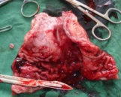
Sample-specific protein sequence databases
Samples
Peptides
MS
Protein DB
Identified and quantified
peptides and proteins

Slide 10
Sample-specific protein sequence databases
Next-generation sequencing
of the genome
and transcriptome
Samples
Peptides
MS
Sample-specific
Protein DB
Identified and quantified
peptides and proteins

Slide 11
Sample-specific protein sequence databases
Next-generation sequencing
of the genome
and transcriptome
Samples
Peptides
MS
Sample-specific
Protein DB
Identified and quantified
peptides and proteins

Slide 12
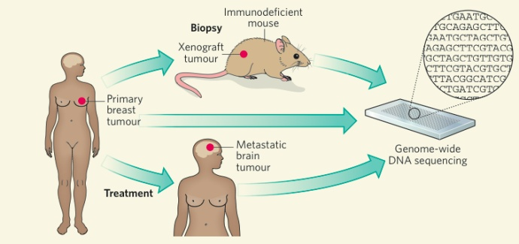
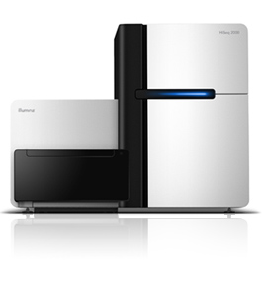
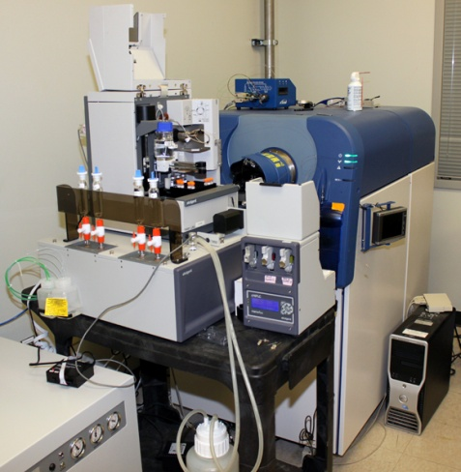
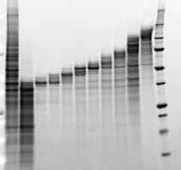
Proteomics and Transcriptomics of Breast Tumors
Xenograft
tumor
Primary
Breast
tumor
RNA-Seq
Illumina HiSeq
MS/MS
---250,000
ABI 5600 Triple TOF
---150,000
---100,000
---75,000
---50,000
---37,000
---25,000
---20,000
---15,000
---10,000

Slide 13
Germline and Somatic Variants
The frequency of proteins as a function of the number of amino acid changes due to germline and somatic variants for the basal and luminal breast tumor xenografts

Slide 14
Alternative Splicing
The number of exon/exon junctions as a function of the number of RNA-Seq reads for the basal breast tumor xenograft.

Slide 15
Protein identification using sample-specific sequence databases
Protein DB
Germline
variants
Somatic
variants
362
9
Tumor genome sequence
+ germline / somatic variants
Tumor RNA-Seq
Potentially
novel
peptides
1114
Potentially novel peptides
70
Spans splice
site

Slide 16
Data Repositories

Slide 17
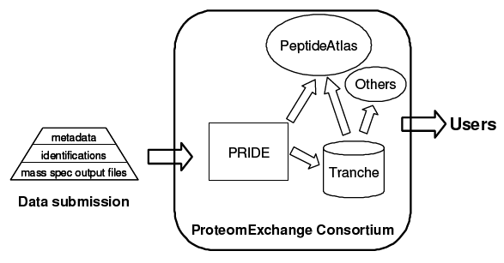
ProteomeExchange
http://www.proteomeexchange.org/

Slide 18
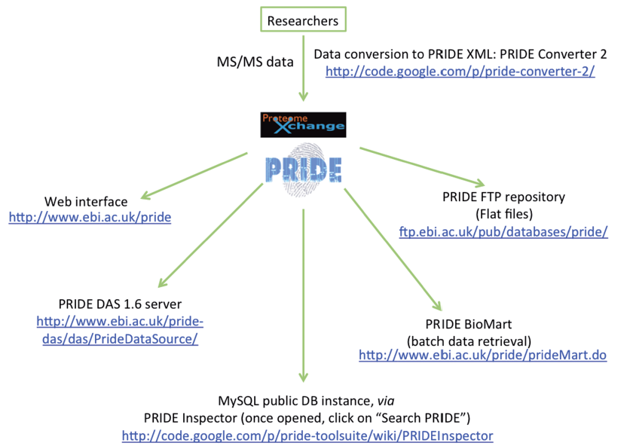
PRIDE
http://www.ebi.ac.uk/pride/

Slide 19
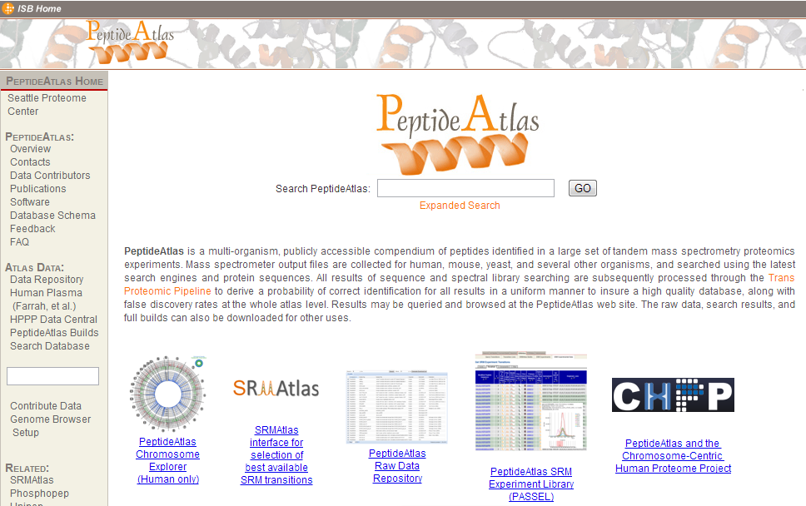
PeptideAtlas
http://www.peptideatlas.org/

Slide 20
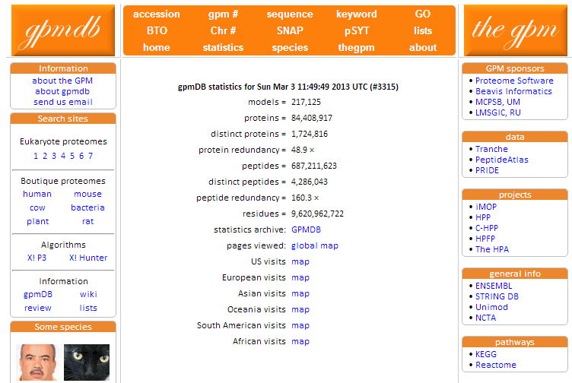
The Global Proteome Machine Databases (GPMDB)
http://gpmdb.thegpm.org

Slide 21
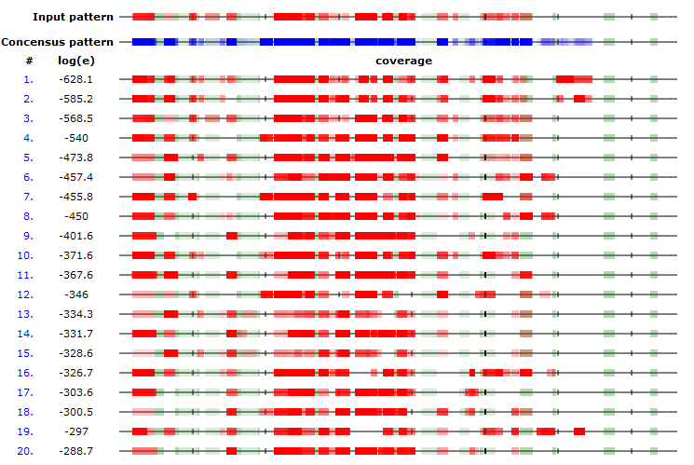
Comparison with GPMDB
Most proteins show very reproducible peptide patterns

Slide 22
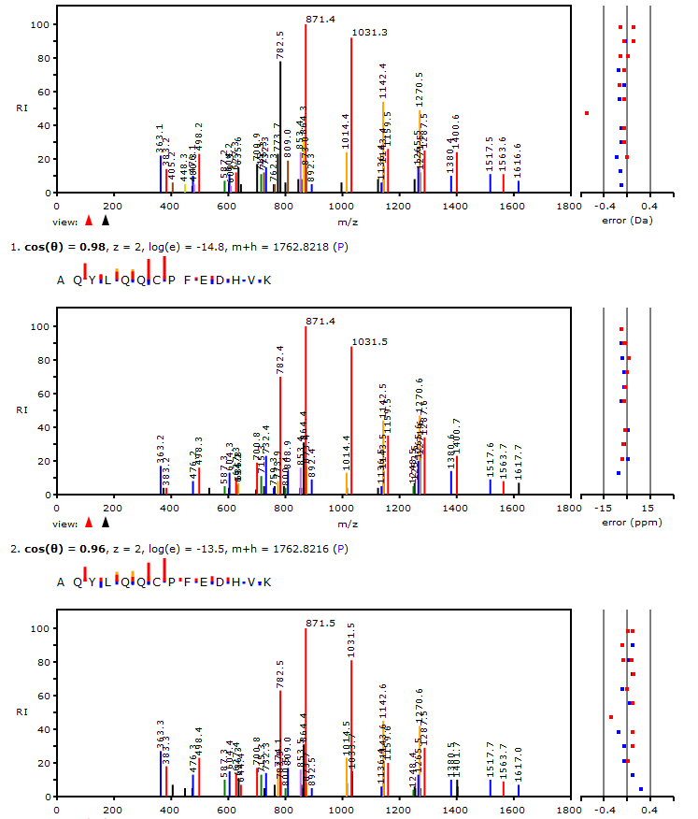
Comparison with GPMDB
Query Spectrum
Best match
In GPMDB
Second
best match
In GPMDB

Slide 23
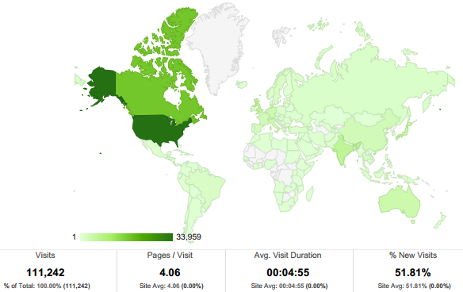
GPMDB usage last month

Slide 24
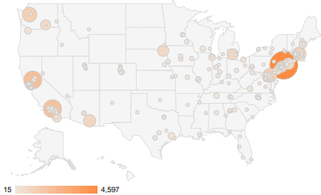
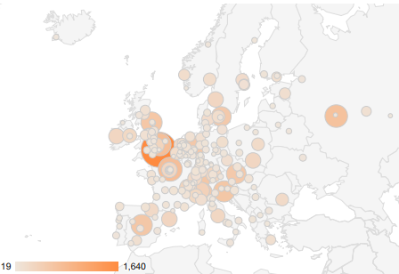
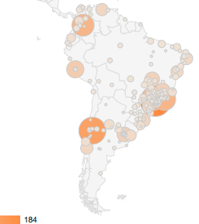
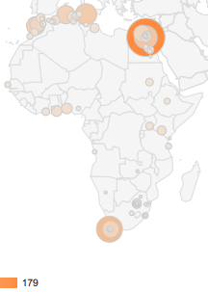
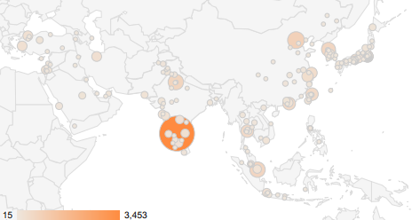
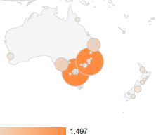
GPMDB usage last month

Slide 25
GPMDB Data Crowdsourcing
Any lab performs experiments
Raw data sent to public repository (TRANCHE, PRIDE)
Data imported by GPMDB
Data analyzed & accepted/rejected
Accepted information loaded into public collection
General community uses information and inspects data

Slide 26
Information for including a data set in GPMDB
MS/MS data (required)
  MS raw data files
  ASCII files: mzXML, mzML, MGF, DTA, etc.
  Analysis files: DAT, MSF, BIOML
Sample Information (supply if possible)
  Species : human, yeast
  Cell/tissue type & subcellular localization
  Reagents: urea, formic acid, etc.
  Quantitation: SILAC, iTRAQ
  Proteolysis agent: trypsin, Lys-C
Project information (suggested)
  Project name
  Contact information

Slide 27
How to characterize the evidence in GPMDB for a protein?
High confidence
Medium confidence
Low confidence
No observation

Slide 28
Statistical model for 212 observations of TP53
Start | End | N | -2 | -3 | -4 | -5 | -6 | -7 | -8 | -9 | -10 | -11 | Skew | Kurt
214 | 248 | 539 | 0.15 | 0.18 | 0.22 | 0.17 | 0.15 | 0.07 | 0.03 | 0.01 | 0.01 | 0.00 | -0.01 | -2.01
249 | 267 | 1010 | 0.04 | 0.09 | 0.13 | 0.16 | 0.16 | 0.14 | 0.13 | 0.06 | 0.04 | 0.05 | -0.08 | -1.89
182 | 196 | 832 | 0.09 | 0.15 | 0.20 | 0.19 | 0.18 | 0.13 | 0.05 | 0.01 | 0.00 | 0.00 | -0.12 | -1.84
250 | 267 | 4 | 0.25 | 0.00 | 0.25 | 0.00 | 0.25 | 0.00 | 0.00 | 0.00 | 0.00 | 0.25 | 0.48 | -2.28
1 | 24 | 269 | 0.10 | 0.12 | 0.12 | 0.17 | 0.12 | 0.12 | 0.14 | 0.04 | 0.04 | 0.03 | -0.33 | -0.88
24 | 65 | 51 | 0.22 | 0.22 | 0.20 | 0.14 | 0.06 | 0.00 | 0.04 | 0.08 | 0.02 | 0.04 | 0.47 | -1.62
66 | 101 | 334 | 0.09 | 0.08 | 0.11 | 0.11 | 0.09 | 0.11 | 0.09 | 0.13 | 0.08 | 0.12 | 0.10 | -1.21
249 | 273 | 60 | 0.02 | 0.00 | 0.20 | 0.10 | 0.13 | 0.25 | 0.20 | 0.07 | 0.03 | 0.00 | 0.45 | -1.36
214 | 242 | 10 | 0.00 | 0.10 | 0.00 | 0.00 | 0.00 | 0.00 | 0.30 | 0.20 | 0.20 | 0.20 | 0.54 | -1.39
214 | 239 | 32 | 0.03 | 0.06 | 0.16 | 0.16 | 0.09 | 0.22 | 0.09 | 0.16 | 0.00 | 0.03 | 0.20 | -0.99
111 | 120 | 117 | 0.09 | 0.20 | 0.15 | 0.26 | 0.29 | 0.01 | 0.00 | 0.00 | 0.00 | 0.00 | 0.62 | -1.36
251 | 267 | 16 | 0.00 | 0.00 | 0.13 | 0.25 | 0.19 | 0.13 | 0.13 | 0.13 | 0.06 | 0.00 | 0.24 | -0.60
214 | 241 | 14 | 0.00 | 0.00 | 0.00 | 0.07 | 0.29 | 0.21 | 0.07 | 0.29 | 0.00 | 0.07 | 0.87 | -0.97
159 | 174 | 100 | 0.30 | 0.25 | 0.31 | 0.03 | 0.07 | 0.03 | 0.01 | 0.00 | 0.00 | 0.00 | 0.99 | -1.07
68 | 101 | 10 | 0.00 | 0.00 | 0.00 | 0.00 | 0.00 | 0.20 | 0.10 | 0.10 | 0.30 | 0.30 | 0.86 | -0.91
235 | 248 | 30 | 0.00 | 0.03 | 0.00 | 0.00 | 0.30 | 0.20 | 0.23 | 0.13 | 0.03 | 0.07 | 0.81 | -0.82

Slide 29
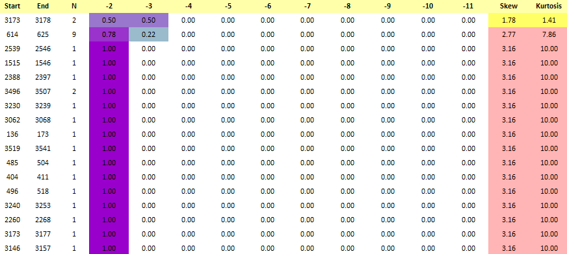
Statistical model for observations of DNAH2

Slide 30
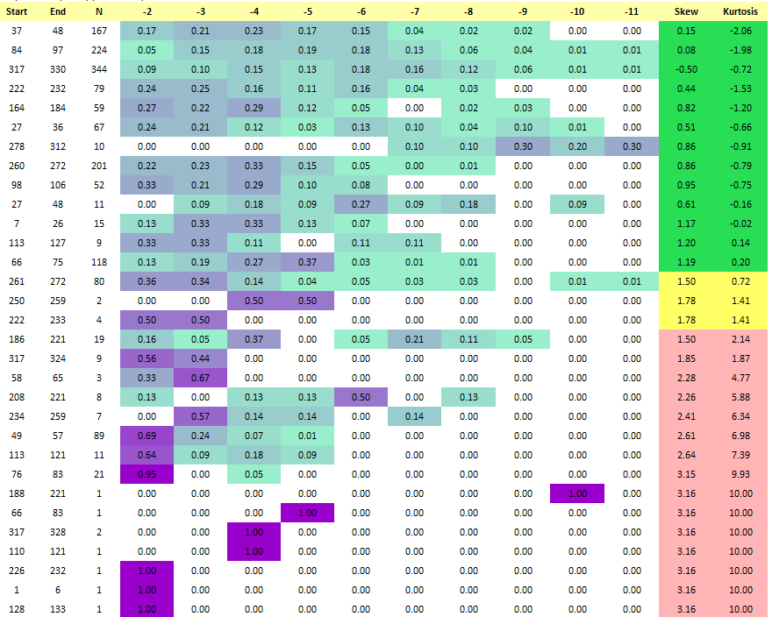
Statistical model for observations of GRAP2

Slide 31
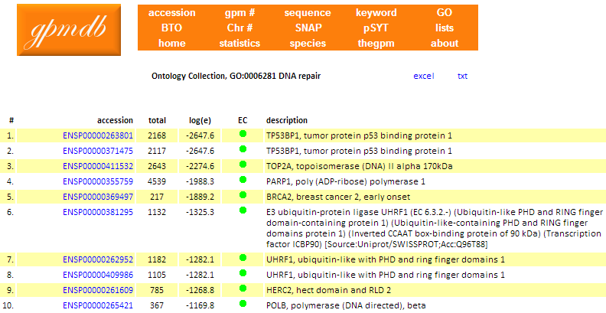
DNA Repair

Slide 32
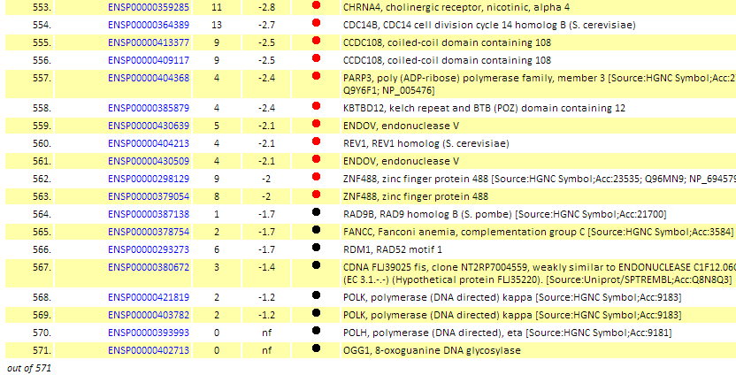
DNA Repair

Slide 33
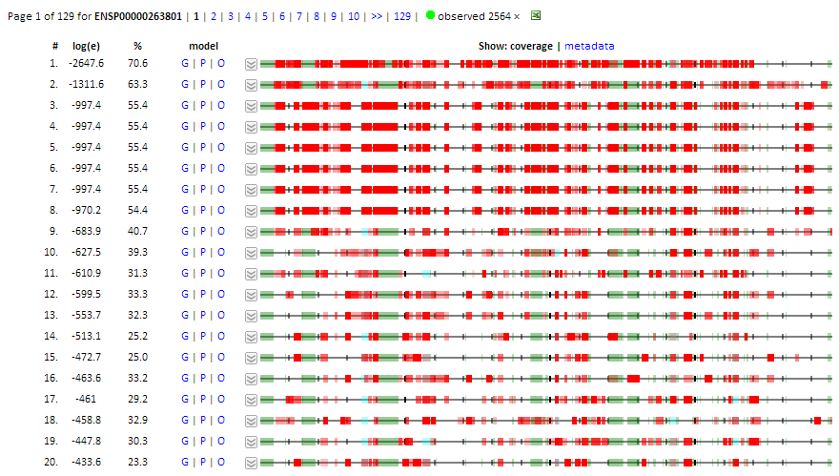
TP53BP1:p, tumor protein p53 binding protein 1

Slide 34
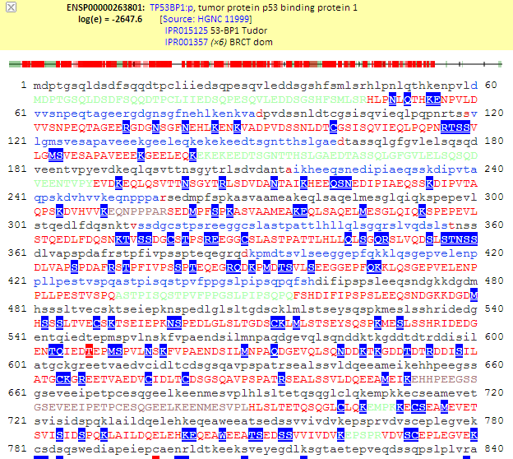
TP53BP1:p, tumor protein p53 binding protein 1

Slide 35
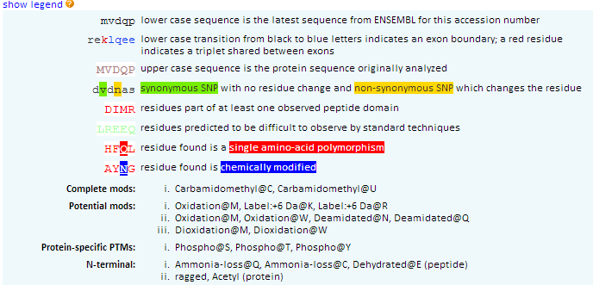
Sequence Annotations

Slide 36
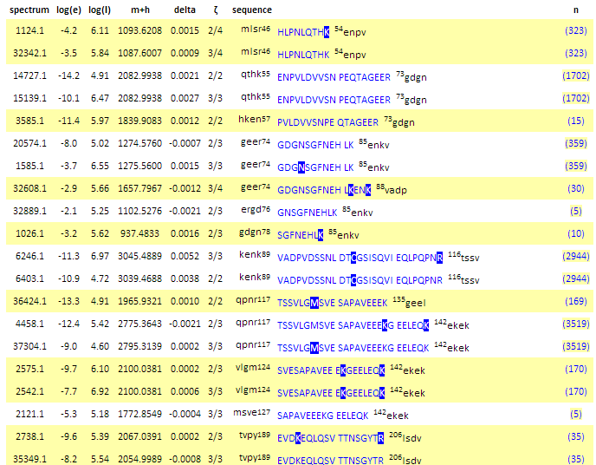
TP53BP1:p, tumor protein p53 binding protein 1

Slide 37
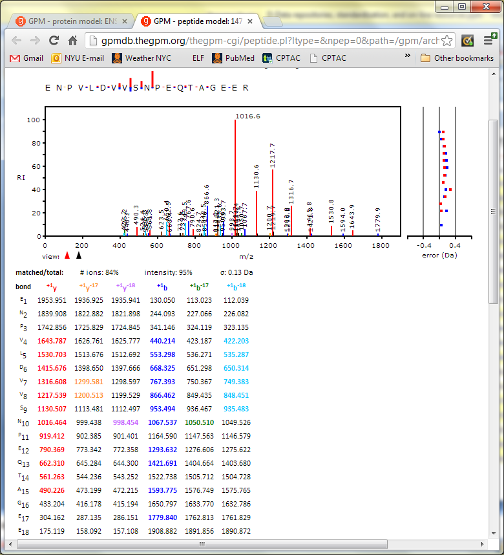
TP53BP1:p, tumor protein p53 binding protein 1

Slide 38
Peptide observations, catalase
Peptide Sequence | Observations
FSTVAGESGSADTVR | 2633
FNTANDDNVTQVR | 2432
AFYVNVLNEEQR | 1722
LVNANGEAVYCK | 1701
GPLLVQDVVFTDEMAHFDR | 1637
LSQEDPDYGIR | 1560
LFAYPDTHR | 1499
NLSVEDAAR | 1400
FYTEDGNWDLVGNNTPIFFIR | 1386
ADVLTTGAGNPVGDK | 1338

Slide 39
Peptide frequency (ω), catalase
Peptide Sequence | ω
FSTVAGESGSADTVR | 0.08
FNTANDDNVTQVR | 0.07
AFYVNVLNEEQR | 0.05
LVNANGEAVYCK | 0.05
GPLLVQDVVFTDEMAHFDR | 0.05
LSQEDPDYGIR | 0.04
LFAYPDTHR | 0.04
NLSVEDAAR | 0.04
FYTEDGNWDLVGNNTPIFFIR | 0.04
ADVLTTGAGNPVGDK | 0.04

Slide 40
Global frequency of observation (ω), catalase
ω
Peptide sequences

Slide 41
Omega (Ω) value for a protein identification
For any set peptides observed in an experiment assigned to a particular protein (1 to j ):

Slide 42
Protein Ω’s for a set of identifications
Protein ID | Ω (z=2) | Ω (z=3)
SERPINB1 | 0.88 | 0.82
SNRPD1 | 0.88 | 0.59
CFL1 | 0.81 | 0.87
SNRPE | 0.8 | 0.81
PPIA | 0.79 | 0.64
CSTA | 0.79 | 0.36
PFN1 | 0.76 | 0.61
CAT | 0.71 | 0.78
GLRX | 0.66 | 0.8
CALM1 | 0.62 | 0.76
FABP5 | 0.57 | 0.17

Slide 43
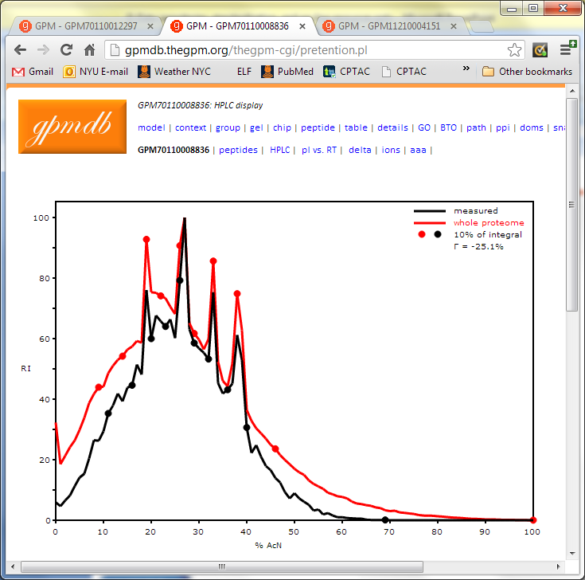
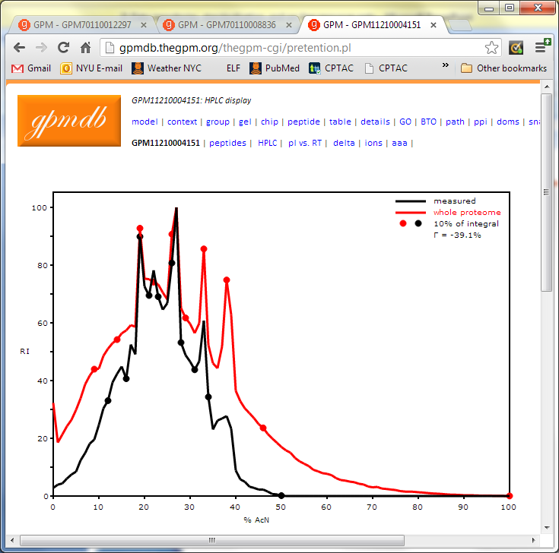
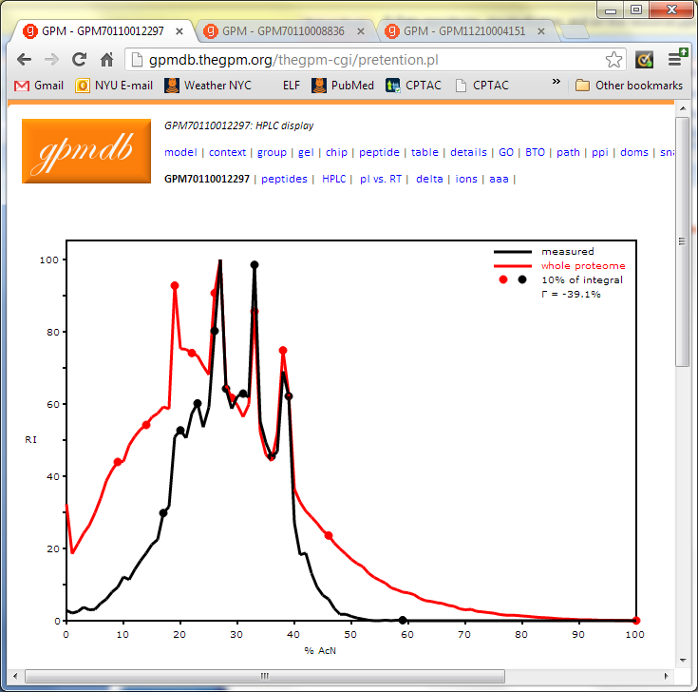
Retention Time Distribution

Slide 44
Mass Accuracy

Slide 45
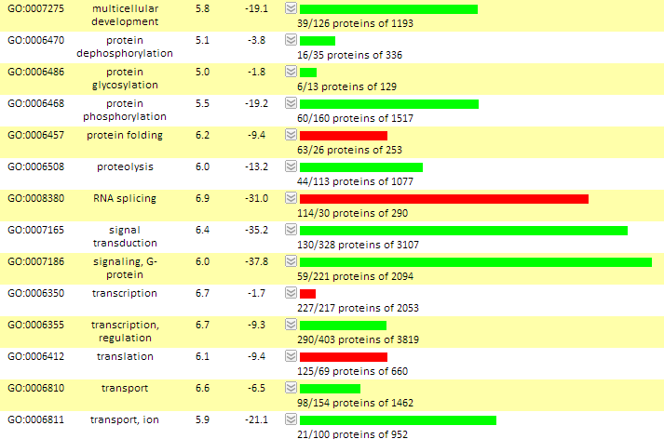
GO Cellular Processes

Slide 46
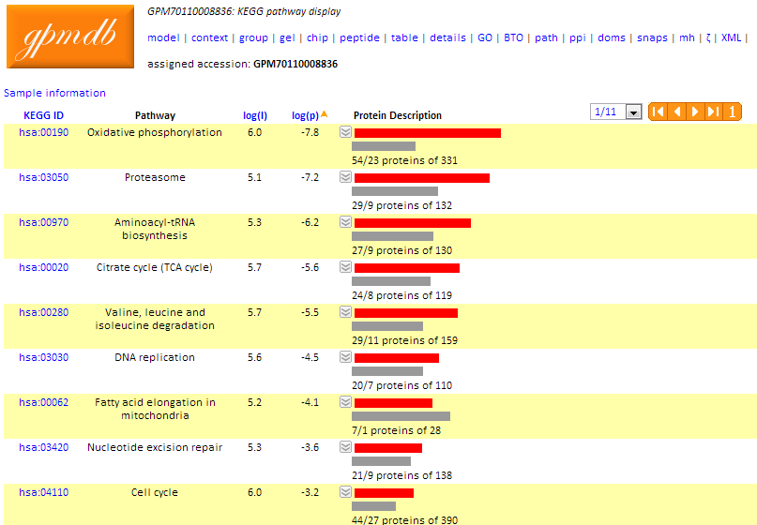
KEGG Pathways

Slide 47
Open-Source Resources

Slide 48
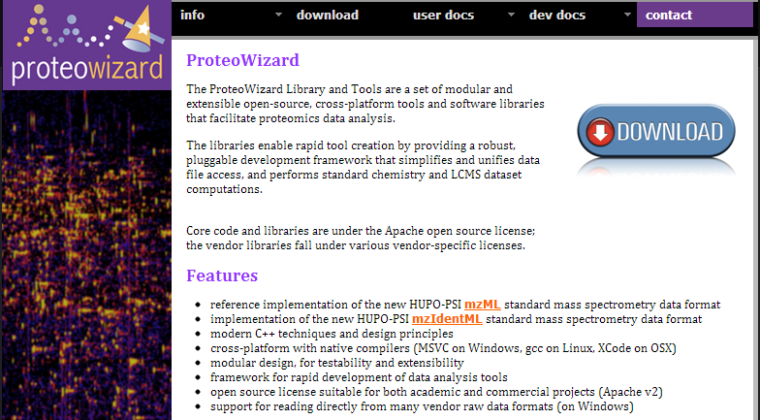
ProteoWizard
http://proteowizard.sourceforge.net

Slide 49
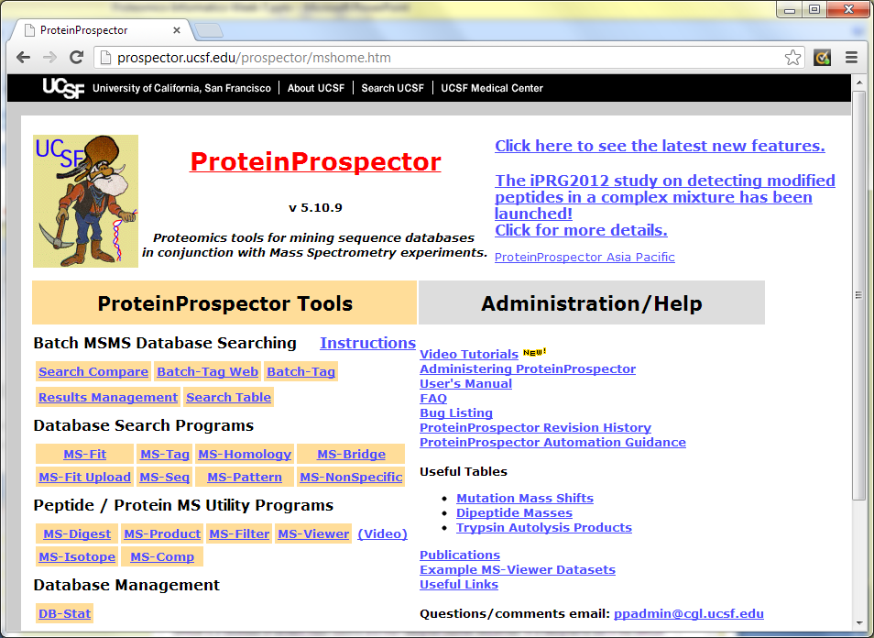
Protein Prospector
http://prospector.ucsf.edu/

Slide 50
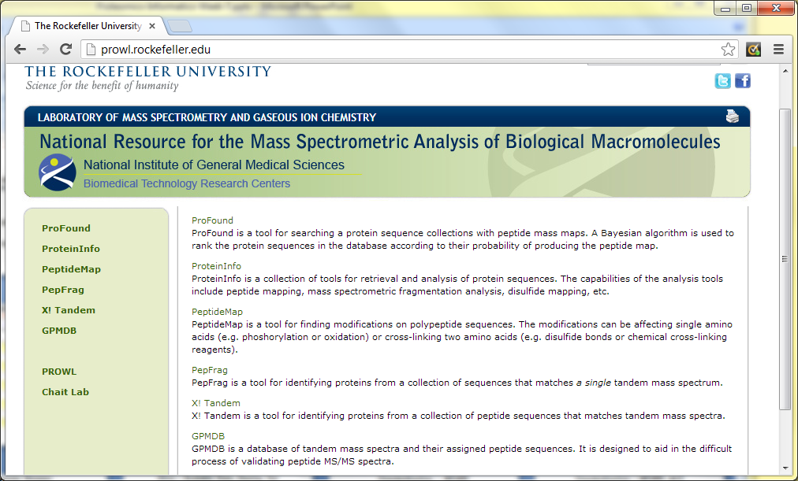
PROWL
http://prowl.rockefeller.edu/

Slide 51
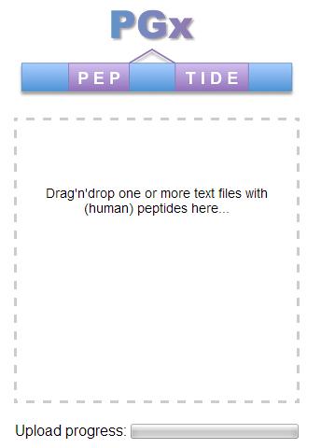
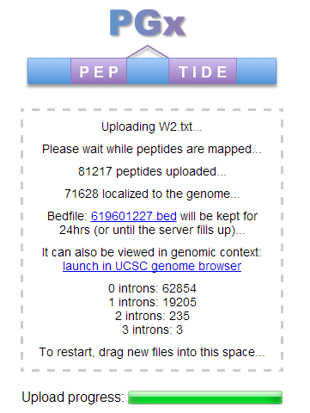
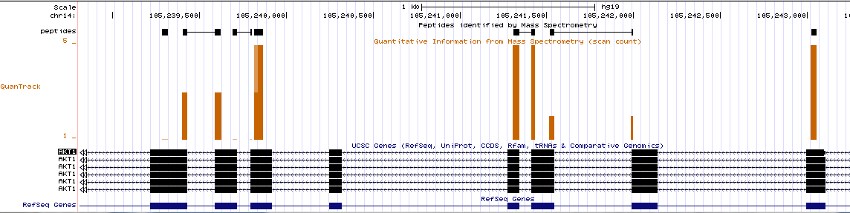
Proteogenomics - PGx
http://pgx.fenyolab.org/

Slide 52
UCSC Genome Browser
http://genome.ucsc.edu/

Slide 53
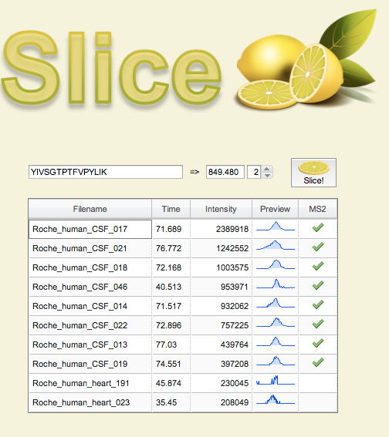
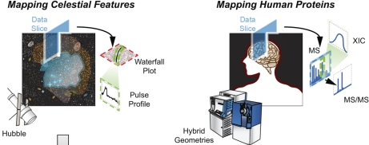
Slice - Scalable Data Sharing for
Remote Mass Informatics
Developed by Manor Askenazi
slice.ionomix.com
Most mass spectrometry data is acquired in discovery mode, meaning that the data is amenable to open-ended analysis as our understanding of the target biochemistry increases. In this sense, mass spectrometry based discovery work is more akin to an astronomical survey, where the full list of object-types being imaged has not yet been fully elucidated, as opposed to e.g. micro-array work, where the list of probes spotted onto the slide is finite and well understood.

Slide 54
Standardization

Slide 55
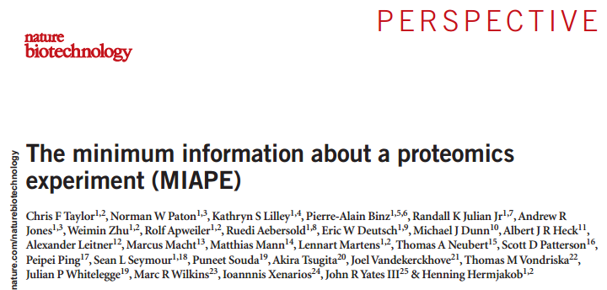
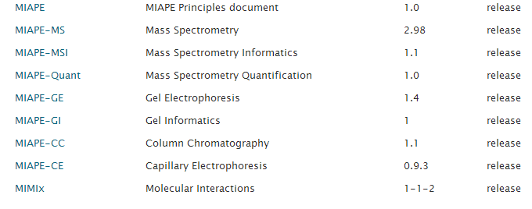
Standardization - MIAPE

Slide 56
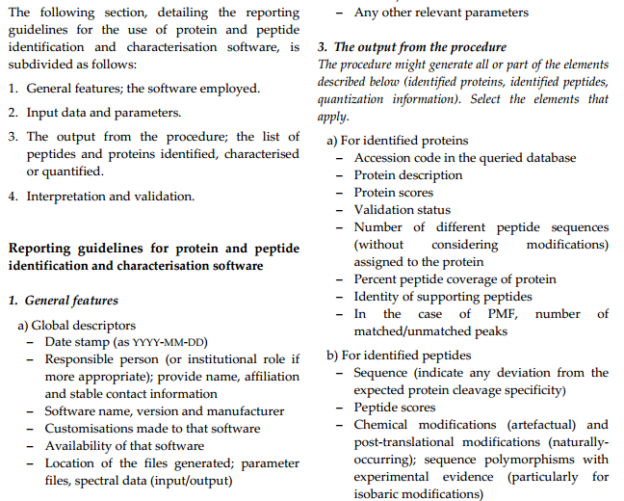
Standardization – MIAPE-MSI

Slide 57
Standardization – XML Formats
mzML - experimental results obtained by mass spectrometric analysis of biomolecular compounds
mzIdentML - describe the outputs of proteomics search engines
TraML - exchange and transmission of transition lists for selected reaction monitoring (SRM) experiments
mzQuantML - describe the outputs of quantitation software for proteomics
mzTab - defines a tab delimited text file format to report proteomics and metabolomics results.
MIF - decribes the molecular interaction data exchange format.
GelML - describes the processing and separations of proteins in samples using gel electrophoresis, within a proteomics experiment.

Slide 58
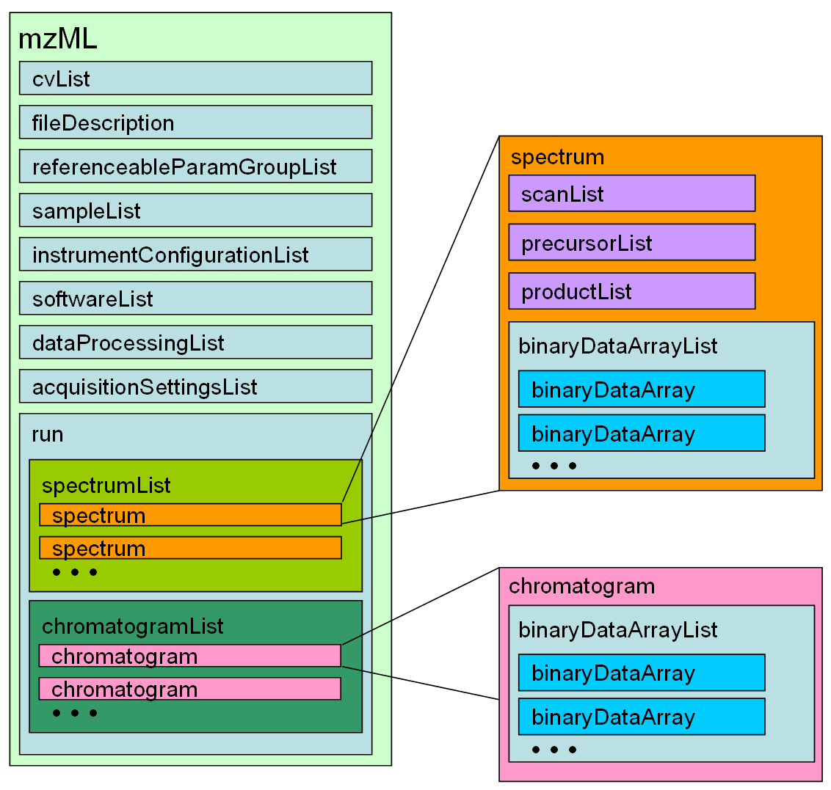
Standardization - mzML

Slide 59
Standardization - mzIdentML

Slide 60
Proteomics Informatics –
Databases, data repositories and standardization (Week 7)

