Slide 1
Protein Quantitation II: Multiple Reaction Monitoring
Kelly Ruggles
kelly@fenyolab.org
New York University

Slide 2
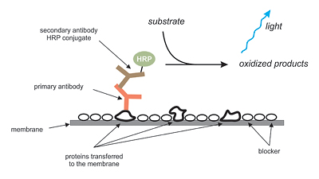
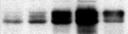
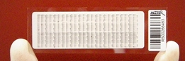
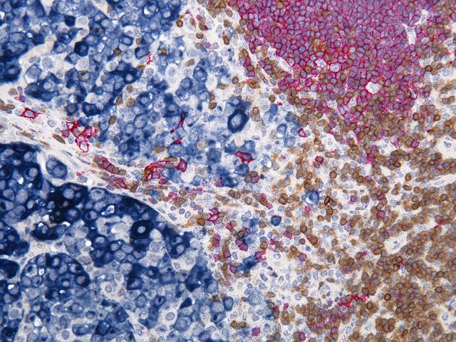
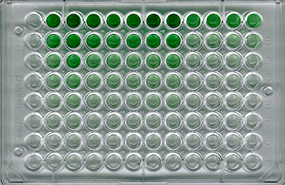
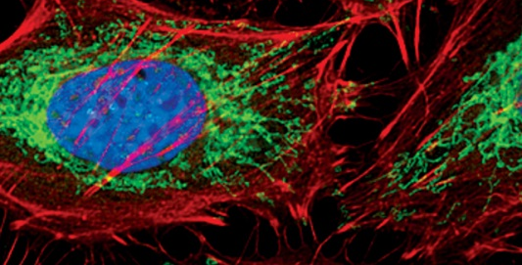
Traditional Affinity-based proteomics
Use antibodies to quantify proteins
  Western Blot
  RPPA
  Immunohistochemistry
  ELISA
  Immunofluorescence
Notes:
Need specific, reliable antibodies
High specificity of antibodies and sensitivity of measurements make detection of low level proteins in complex backgrounds doable.
Human protein Atlas aims to create a collection of antibodies against all proteins
Antibody validation may take months to years to validate
Reporter enzyme
Horse Radish Peroxidase- when oxidized by the substrate, HRP produces light which can be measured and used for quantitation
RPPA-reverse phase protein microarrays

Slide 3
Mass Spectrometry based proteomic quantitation
Shotgun proteomics
LC-MS
Targeted MS
1. Records M/Z
1. Select precursor ion
MS
MS
Digestion
2. Selects peptides based on abundance and fragments
Fractionation
2. Precursor fragmentation
MS/MS
MS/MS
Lysis
3. Protein database search for peptide identification
3. Use Precursor-Fragment pairs for identification
Data Dependent Acquisition (DDA)
Uses predefined set of peptides
Notes:
As you’ve seen in previous classes, we lyse the sample, fractionate and digest using an enzyme (in most cases trypsin). Following this we can do proteomic identification and quantitation through LC-MS. You’ve already heard about shotgun proteomics, in which the MS1 scan occurs and the instrument selects peptides based on proteomics. These peptides are fractionated and the MS2 spectra is collected. These spectra are then used in protein identification using database search. Shotgun proteomics is known as data dependent acquisition because peptide fragmentation is guided by the abundance of precursor ions. This method is powerful for protein identification but not quantitation due to its low sensitivity. Another method, known as targeted MS is far better for quantitation. In targeted MS, we preselect for a precursor ion in MS1, and fragment this peptide in MS2. We then use the precursor-fragment pair for peptide identification.
Shotgun is used for discovery and large scale mapping of cellular proteomes

Slide 4
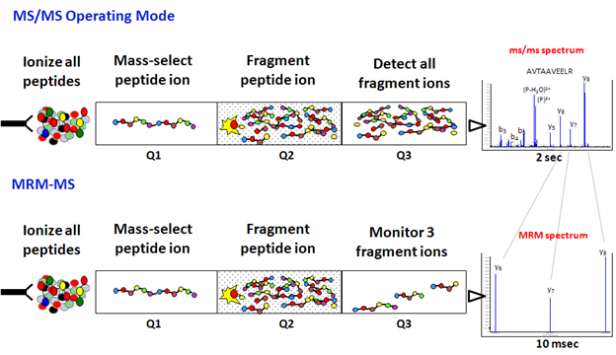
Multiple Reaction Monitoring (MRM) Selected Reaction Monitoring (SRM)
Triple Quadrupole acts as ion filters
Precursor selected in first mass analyzer (Q1)
Fragmented by collision activated dissociation (Q2)
One or several of the fragments are specifically measured in the second mass analyzer (Q3)
Notes:
The most used method for targeted MS is known as SRM. This requires the use of a triple quadrupole instrument which acts as ion filters. On the top panel you see normal MS/MS operating mode, in which the peptides are ionized and a peptide is selected in Q1. The peptide is then fragmented in Q2 and all of the fragments are detected in Q3. The SRM works differently in that following ionization, the first quadrupole is set to only allow the predefined m/z value of the precursor ion to pass into the second quadrupole or the collision cell. In the collision cell, the selected ions enter an higher pressure region with argon or nitrogen gas resulting in low energy collisitions and framgementation of the selected precursor ion into many project ions. Finally, only the pre-selected product ion with specific m/z values are allowed to pass through the third quadrupole and on to the detector. The result is a very selective means for separating the target ions away from everything that is being introduced into the MS.

Slide 5
Peptide Identification with MRM
Mass Select
Precursor
Mass Select
Fragment Ion
Fragment
Q1
Q2
Q3
Transition
Transition: Precursor-Fragment ion pair are used for protein identification
Select both Q1 and Q3 prior to run
  Pick Q3 fragment ions based on discovery experiments, spectral libraries
  Q1 doubly or triply charged peptides
Use the 3 most intense transitions for quantitation

Slide 6
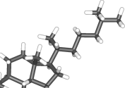
Peptide Identification with MRM
Used for to analyze small molecules since the late 1970s
More recently, used for proteins and peptide quantitation in complex biological matrices
    Particularly for biomarker discovery
With small molecules, the matrix and analyte have different chemical natures so separation step is able to remove other components from analytes
Separation
MS analysis
With proteomics, both the analytes and the background matrix are made up of peptides, so this separation cannot occur
Separation
MS analysis

Slide 7
Strengths of MRM
Can detect multiple transitions on the order of 10msec per transition
Can analyze many peptides (100s) per assay and the monitoring of many transitions per peptide
High sensitivity
High reproducibility
Detects low level analytes even in complex matrix
Golden standard for quantitation!

Slide 8
Weaknesses of SRM
Focuses on defined set of peptide candidates
  Need to know charge state, retention time and relative product ion intensities before experimentation
Physical limit to the number of transitions that can be measured at once
  Can get around this by using time-scheduled SRM, monitor transitions for a peptide in small window near retention time
Notes:
High reproducability makes it good for systems biology and biomedical applications where same set of proteins have to be reproducably measured in many samples
SRM data acquisition. Once the SRM assay is validated, one can apply it to determine presence and amount of the target protein(s) across different samples, ideally by measuring multiple transitions per peptide in each labeling state and multiple peptides per protein2. However, there is a physical limit to the number of transitions that can be measured in the same analysis. The SRM cycle time is the product of the number of transitions recorded in the cycle and the time spent on acquiring each transition signal (dwell time). The higher the dwell time, the higher the signal-to-noise ratio and thus the lower the limit of detection for a transition8. Monitoring too many transitions in an SRM run results in too long a cycle time and hence an insufficient number of data points to reconstruct the chromatographic elution profile of the targeted peptide, compromising accurate quantification. Alternatively, this results in a low dwell time and hence a reduced signal-to-noise ratio, compromising the detection of low-abundance components. This generates the well-known tradeoff between the number of transitions and the limit of detection of an SRM experiment.

Slide 9
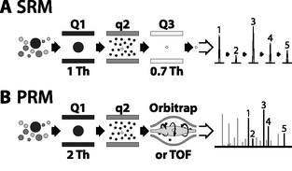
Parallel Reaction Monitoring (PRM)
Q3 is substituted with a high resolution mass analyzer to detect all target product ions
Generates high resolution, full scan MS/MS data
All transitions can be used to confirm peptide ID
Don’t have to choose ions beforehand
Peterson et al., 2012
Notes:
PRM use a high resolution quadrupole-equipped 3rd quad substutited with a high resolution and accurate mass analyzer to permit parallel detection of all target ions at once

Slide 10
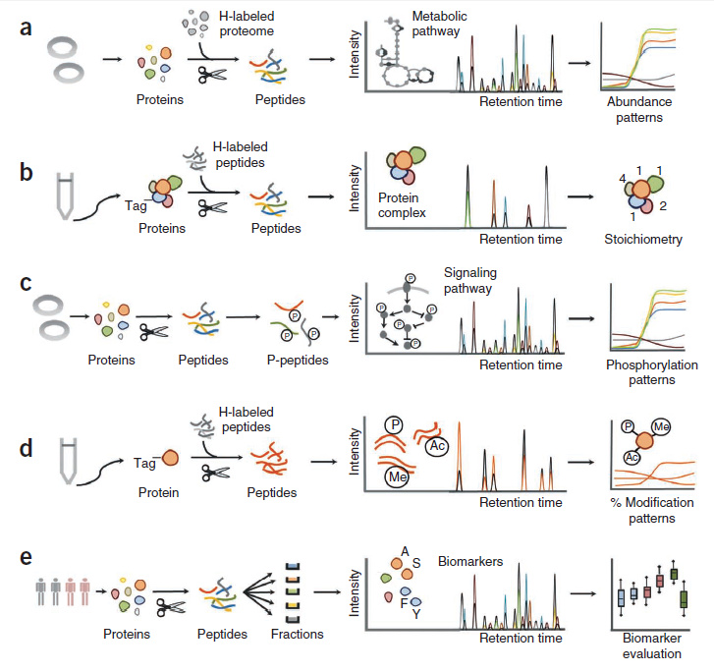
Applications of MRM
Metabolic pathway analysis
Protein complex
subunit stoichiometry
Phosphorylation
Modifications within protein
Biomarkers: protein indicator correlating to a disease state
Can enrich for proteins/peptides using antibody
Notes:
proteomics. (a) SRM assays for a set of proteins involved in a metabolic pathway are used to measure protein abundance changes in a pathway to a series of perturbations, starting from unfractionated cell extracts, adapted from ref. 2. (b) SRM assays for the subunits of a protein complex are used to derive the subunit stoichiometry, using the affinity purified protein complex and accurately quantified, heavy isotope–labeled (H-labeled) synthetic peptides as internal standards, adapted from ref. 53. (c) Phosphorylation events in a signaling pathway are quantitatively analyzed by SRM over a time course after stimulation, starting from whole cell proteome digests enriched for phosphopeptides, adapted from ref. 85. (d) The cross-talk between different modifications of the same protein is analyzed using a tryptic digest of the affinity purified protein and AQUA peptides, adapted from ref. 86. (e) A set of candidate biomarkers is verified by applying SRM assays for the candidate proteins to fractionated sera from patient and control groups, for example, as in refs. 51,103,107. Optionally, mutants of the target proteins are monitored in the sampled population
We quantified a network of 45 enzymes from glycolysis and the tricarboxylic and glyoxylate cycles of yeast (Fig. 3a) throughout different growth phases and a metabolic shift. The analysis highlighted functional modules in the network, and the comparison to transcript data suggested potential points of post-transcriptional regulation. Similarly, others applied SRM to monitor a plant defense response system that is induced upon simulation of insect attack73. Thirteen components of the conifer terpenoid biosynthetic pathway were quantified at high temporal resolution. SRM assays for proteotypic peptides were used to quantify the induction of multiple terpene synthases with high sequence overlap (>90%). Because of the high degree of sequence similarity, these proteins could not be quantified by western blotting, and their transcripts could not be discriminated. The SRM measurement of a larger set of ~200 metabolic proteins throughout a set of conditions inducing different metabolic states suggested differential functionality for several metabolic isoenzymes with high sequence overlap in S. cerevisiae74. Similarly, Wang et al.75 applied SRM to quantify the occurrence of peptides associated to somatic mutations of Ras, a cancer-associated protein, including peptides differing by only one amino acid, in cancer cell lines and clinical specimens. These data indicate the power of targeting mass spectrometry to distinguish highly sequence homologous proteins.
SRM has also been applied to study signaling pathways, for example, Wnt/β-catenin signaling, a system of high biological and biomedical importance given its deregulation in different types of cancer76. Absolute quantification via synthetic peptide standards was obtained for 17 proteins in the pathway, across different colon cancer cell lines. Representative proteins with high and low signals could be quantified from as few as 5,000 cells, in frozen tissue sections and in protein extracts from laser-capture microdissected cells. This demonstrated that the amount of material needed for SRM analyses is compatible with that obtained in core biopsies or fine needle aspirates and even with heterogenous tissue samples76. Similarly, Hewel et al.77 used SRM to quantitatively monitor 12 components of the transcriptional network linked to mammalian stem cell renewal and pluripotency in nuclear extracts from mouse embryonic stem cells. Recently, Bisson et al.37 used a combination of affinity purification and SRM to study the dynamics of the different protein complexes that form around GRB2, an adaptor protein, involved in multiple signaling pathways.
Another intriguing application of SRM to protein analysis is the determination of the stoichiometry of protein complexes. Schmidt et al.53, determined via SRM in conjunction with isotopically labeled peptide standards the stoichiometry of the spliceosomal hPrp19/CDC5L complex, which is involved in the assembly of the active spliceosome during eukaryotic pre-mRNA splicing. The complex was affinity-purified from human cells, and the stoichiometry of its components, Prp19, CDC5L, SPF27, PRL1 and CTNNBL1 (Fig. 3b), was calculated to be 4:2:1:1:1. The study revealed the importance of optimal digestion conditions and targeting multiple peptides per protein to reliably determine stoichiometry.
SRM is also the method of choice to validate potentially interesting protein hits emerging from large-scale screens, computational predictions or prior knowledge by quantifying them across a large number of samples, a task that would be prohibitive by discovery proteomic methods. Jovanovic et al.78 measured by SRM a set of putative targets of the microRNA let-7 in Caenorhabditis elegans extracts. They chose target proteins from the results of different microRNA target prediction algorithms, prior microarray RNAi screens and literature evidence. Around 50% of the 380 target proteins could be measured in whole C. elegans larvae extracts and quantified in wild-type and mutant worms with reduced let-7 expression. The analysis highlighted known let-7 targets and suggested new targets that the researchers then confirmed by independent analyses78.
SRM to study protein modifications. Many proteins are post-translationally modified and—for example, for protein phosphorylation—extensive catalogs of identified sites of modification are becoming available79,80. The use of SRM to quantify post-translational modifications requires that the structure and mass shift introduced by the modification are known or at least hypothesized. For example, in early studies SRM was used to identify phosphorylated sites on immunopurified proteins. Transitions corresponding to all potential phosphopeptides in a protein were used to trigger acquisition of fragment-ion spectra and to confirm their identification. The target Q1 masses were calculated by adding 80 Da to the mass of every serine-, threonine- or tyrosine-containing peptide, and Q3 ions included neutral losses and phospho-specific immonium ions. The approach was used to map the phosphorylation pattern on the myocyte enhancer factor 2A (ref. 81), cyclin B and its interactors Cdc2 and Hsp60 (ref. 82), and this method had higher sensitivity than methods based on precursor-ion and neutral-loss scans82. Glinski and Weckwerth83 monitored by SRM the phosphorylation of synthetic peptide probes spiked into whole Arabidopsis thaliana leaf extracts, thus quantifying in vitro kinase phosphorylation activities. A recently presented approach based on phosphatase treatment, heavy isotope–labeled peptide standards and SRM, allowed the calculation of the extent of phosphorylation of specific proteins in complex mixtures84.
In the first large-scale targeted proteomic analysis of a phosphorylation network, White and co-workers85 investigated by SRM the dynamics of previously identified tyrosine phosphorylation events in the EGFR signaling network during a time course of EGF stimulation. They used a combination of peptide immunoprecipitation and immobilized-metal affinity chromatography to enrich for phosphotyrosine-containing peptides (Fig. 3c). Overall, they monitored >200 phosphorylation events quantitatively in a single, two-hour SRM analysis, highlighting early and late phosphorylation changes occurring in the network upon stimulation.
SRM has also been applied to analyze protein modifications other than phosphorylation. In a recent elegant application, Darwanto et al.86 concurrently quantified, in a two-hour analysis, nearly 20 modifications of core histones H2A, H2B, H3 and H4, including acetylation, propionylation, methylation and ubiquitination (Fig. 3d). The assays for low-abundance modifications were developed using synthetic peptide preparations. The analysis of histone preparations from wild-type and mutant cell lines revealed the existence of a cross-talk mechanism between H2B ubiquitination and H3 methylation and allowed modeling of its dynamics.

Slide 11
Label-free quantification
Usually use 3 or more precursor-product ion pairs (transitions) for quantitation
Relies on direct evaluation of MS signal intensities of naturally occurring peptides in a sample.
Simple and straightforward
Low precision
Several peptides for each protein should be quantified to avoid false quantification

Slide 12
Stable Isotope Dilution (SID)
Use isotopically labeled reference protein
13C and/or 15N labeled peptide analogs
Chemically identical to the target peptide but with mass difference
Add known quantity of heavy standard
Compare signals for the light to the heavy reference to determine for precise quantification
Lysis
Fractionation
Digestion
Synthetic
Peptides
(Heavy)
Light
LC-MS
MS
L
H
Notes:
If isotopically labeled proteins are unavailable
(such as uniformly 15N-incorporated proteins, or
proteins with 13C and/or 15N modified amino acids such
as arginine or lysine), then peptide analogs can be synthesized
with isotopically labeled amino acids and spiked in
pre- or post enzymatic digestion of the sample. These peptide
standards behave similarly to the target peptide with
regards to chromatographic separation, ionization, and
fragmentation.
Deuterium

Slide 13
Quantification Details
MS
L
H
SIS: Stable Isotope Standard
PAR: Peak Area Ratio
Analyte
SIS
PAR = Light (Analyte) Peak Area
Heavy (SIS) Peak Area
Analyte concentration= PAR*SIS peptide concentration
-Use at least 3 transitions
-Have to make sure these transitions do not have interferences

Slide 14

Workflow of SRM proteomics
Define Set of
Proteins
Clinical/Biological Question
Proteotypic
LC and MS properties
Select Peptides
Intensity of transitions
Interferences
Select Transitions
Experimental Measurements
Validate Transitions
Protein Quantitation

Slide 15
Workflow of SRM proteomics
Define Set of
Proteins
Clinical/Biological Question
Proteotypic
LC and MS properties
Select Peptides
Intensity of transitions
Interferences
Select Transitions
Experimental Measurements
Validate Transitions
Protein Quantitation

Slide 16
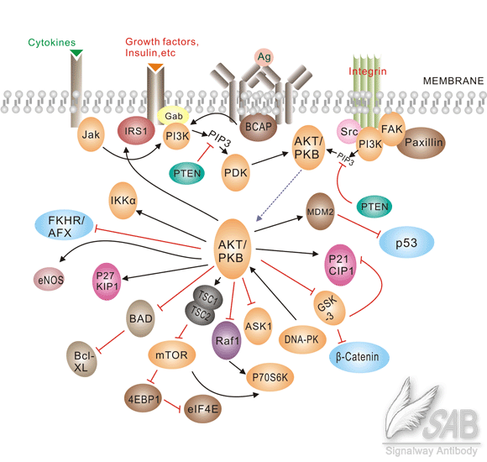
Motivating Example:
AKT1 and Breast Cancer
Notes:
Regulator of metabolism, apoptosis, cell proliferation, cell migration and transcription

Slide 17
Workflow of SRM proteomics
Define Set of
Proteins
Clinical/Biological Question
Proteotypic
LC and MS properties
Select Peptides
Intensity of transitions
Interferences
Select Transitions
Experimental Measurements
Validate Transitions
Protein Quantitation

Slide 18
Selecting Peptides
A few representative peptides will be used to quantify each protein
Need to fulfill certain characteristics
  Have an unique sequence
  Consistently observed by LC-MS methods
  8-25 amino acids
  Good ionization efficiency
  m/z within the range of the instrument
  No missed cleavages
  Not too hydrophillic (poorly retained) or hydrophobic (may stick to column)

Slide 19
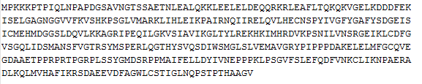
Identifying Proteotypic Peptides
Step 1: Full protein sequence in FASTA format
Set of Proteins
Trypsin
Peptides
Step 2: Tryptic Peptides
PTPIQLNPAPDGSAVNGTSSAETNLEALQK
LEAFLTQK
PSNIVLVNSR
LEELELDEQQR
DDDFEK…..
RefSeq
Ensembl
Uniprot
Proteotypic Peptides
Step 3: Compare to human reference database
-Contain all peptide sequences
-Find all peptides that only map back to one gene
PTPIQLNPAPDGSAVNGTSSAETNLEALQK
LEAFLTQK
PSNIVLVNSR
LEELELDEQQR
DDDFEK…..
Match peptide to proteins
Match proteins to genes
(Reference Protein DB)
(Using protein names and genomic DB)

Slide 20
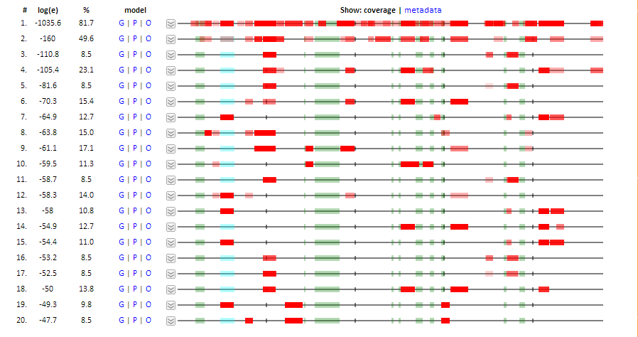
LC/MS Properties: GPMDB
-Compares peptides to a collection of previously observed results
-Determines how many times the peptide has been observed by others
-Most proteins show very reproducible peptide patterns
Notes:
Here we can see an example of protein coverage by the data in the GPMDB database for a specific protein. On your input, the red area indicates how your experiment matches with the previous MS data available in this dataset. The more red the better the match with the concensus pattern. The green areas are peptides we do not expect to see based on their size and hydrophobicity. Each of these peptides are the previously reported results for this protein. Because protein analysis and preparation techniques are fairly consistent throughout labs, one should expect to see the same observed peptides in future experiments as those seen in the GPMDB dataset. We used this site to determine which peptides were most likely to be seen in our own MS experimentation.

Slide 21
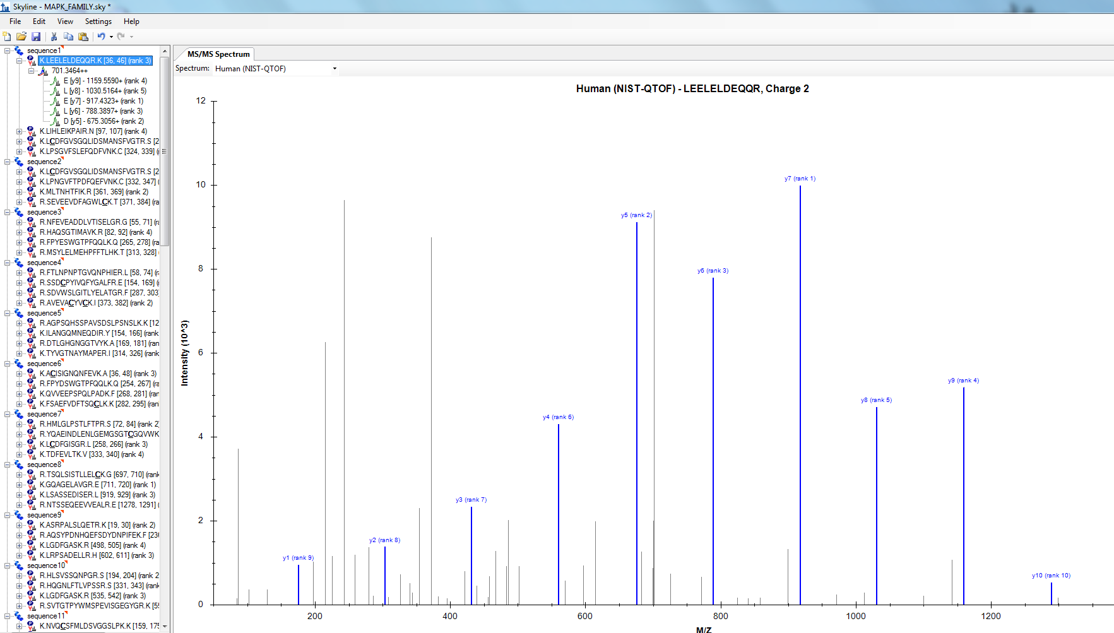
LC/MS Properties: Skyline
-Compares peptides to MS/MS spectral library
-Predicts most abundant transitions
Notes:
We import the proteins from these families into Skyline and compared the peptides to the MS/MS NIST spectral library. As I mentioned, we used the NIST human library here but in the future we could also use a CPTAC tumor specific library at this step. The NIST libraries are made up of approximately 350,000 spectra for human peptide tandem mass spectra (IonTrap and QTOF combined, mostly QTOF). We then export a transitions file which contains the peptides that were identified in this MS/MS library to a new file. This step decreased our working peptide list from 1325 to 682 peptides.

Slide 22
Workflow of SRM proteomics
Define Set of
Proteins
Clinical/Biological Question
Proteotypic
LC and MS properties
Select Peptides
Intensity of transitions
Interferences
Select Transitions
Experimental Measurements
Validate Transitions
Protein Quantitation

Slide 23
Selecting Transitions
Limitation of MRM-MS: ~1-2 m/z unit window for precursor and fragment ion occasionally let in interfering peptides with similar characteristics
If we want to use these transitions for quantitation, we need to be confident there are no interferences
Largest always largest, smallest always smallest etc.
  b-fragments of high m/z are less represented on QqQ
MRM
Notes:
Usually found by painstaking/subjective examination of raw data
This is hard in high throughput situations

Slide 24
Selecting Transitions
Limitation of MRM-MS: ~1-2 m/z unit window for precursor and fragment ion occasionally let in interfering peptides with similar characteristics
If we want to use these transitions for quantitation, we need to be confident there are no interferences
Largest always largest, smallest always smallest etc.
  b-fragments of high m/z are less represented on QqQ
MRM
Peptide of interest
Interfering peptide

Slide 25
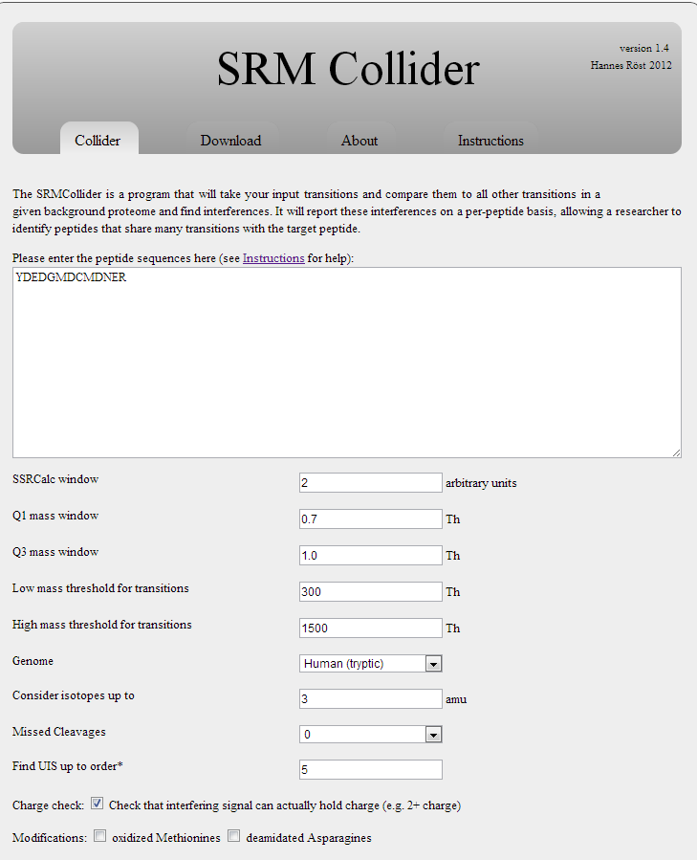
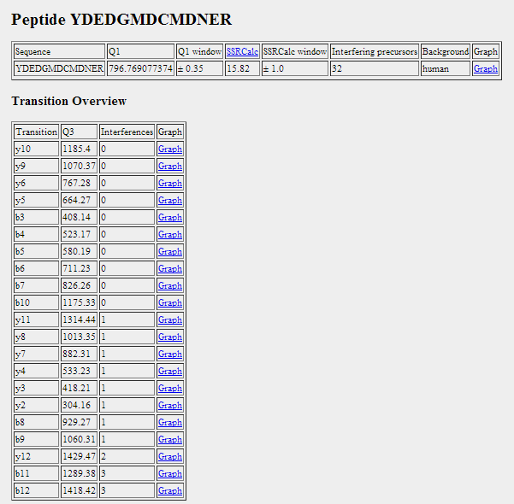
Selecting Transitions: SRMCollider
Input peptides of interest
Determines the m/z values for transition pair
Simulates a typical SRM experiment
Predicts fragment intensities and retention time information for input peptide
Compares the transition to all other transitions in a background proteome
Outputs the number of predicted interferences for each transition for that peptide
Input peptide sequence
Choose peptides that have at least one transition with zero interferences
Notes:
Python based tool
SRM Collider calculates unique ion signatures (UIS) for a given proteomic background, in this case the whole human proteome. This tool simulates a typical SRM experiment performed on a triple quadropole instrument and incorporates the empirical fragment ion intensities and predicted retention time information to help solve the problem of transition redundancies in complex backgrounds. This layout allows you to search a number of peptide transitions against different background databases.
The parameters it uses are :
Mass window
Background database
Number of missed cleavages
Modifications in the background
Ion series for the background
How many isotopes to consider
Retention time – to avoid false positives they stimulate time-schedule acquisition experiments using SSRCalc to predict retention times for all peptides in the respective background. SSR unit of 4 (on a 30 minute gradient) corresponds to a 2 minute retention time window. Here we used a value of 2, corresponding to 2 min (on a 60 minute gradient)
The search produces interfering peptides for each transition of the query peptide and unique ion signatures of the query up to order 5. UIS are sets of transitions from the query peptide that are not found in any other peptide in the background.
From here we chose peptides that had at least one transition with zero interferences.

Slide 26
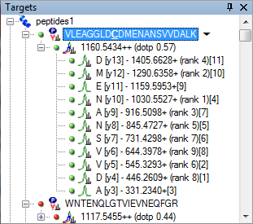
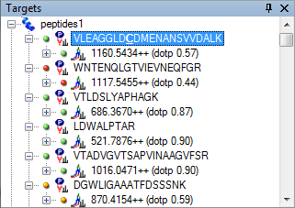
Selecting Transitions: Skyline
Can use to find best transitions to pick
  Intensity (rank)
  Dot product (similarity to reference spectra)
Want high rank and dotp close to 1

Slide 27
Workflow of SRM proteomics
Define Set of
Proteins
Clinical/Biological Question
Proteotypic
LC and MS properties
Select Peptides
Intensity of transitions
Interferences
Select Transitions
Experimental Measurements
Validate
Transitions
Protein Quantitation

Slide 28
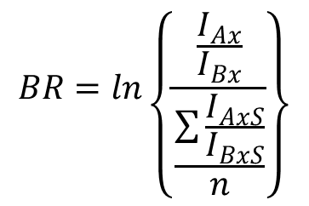
Validating Transitions:
“Branching ratio”
Branching Ratio (BR): ratio of the peak intensities
$$BR=ln\left\{\frac{\frac{I_{Ax}}{I_{Bx}}}{\frac{\sum{\frac{I_{AxS}}{I_{BxS}}}}{n}}\right\}$$
Light (Analyte)
Heavy(SIS)
I₁
I₃
I₁
I₂
I₂
I₃
I_{Ax}, I_{Bx} : Peak areas of Analyte
I_{AxS}, I_{BxS} : Peak areas of SIS
n=number of SIS transitions
Kushnir, 2005

Slide 29
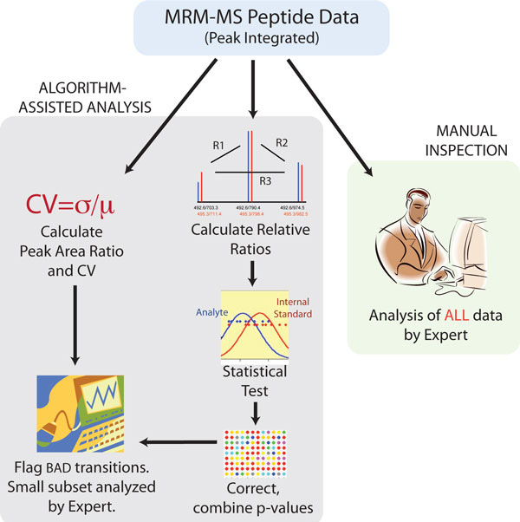
Validating Transitions: AuDIT
AuDIT: Automated Detection of Inaccurate and imprecise Transitions
Uses “branching ratio”
1. Calculate relative ratios of each transition from the same precursor
2. Apply t-test to determine if relative ratios of analyte are different from relative ratios of SIS
http://www.broadinstitute.org/cancer/software/genepattern/modules/AuDIT.html.

Slide 30
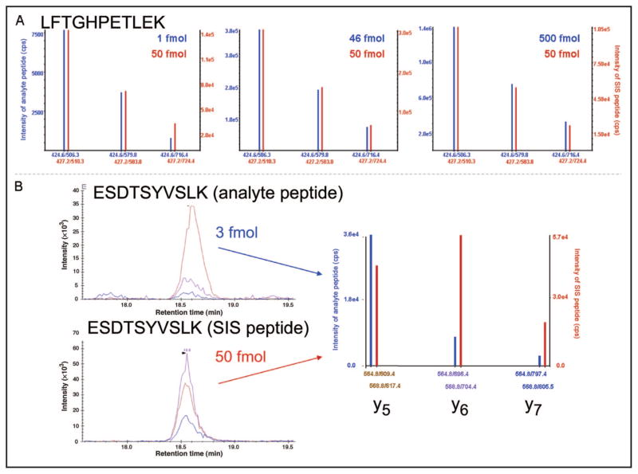
Validating Transitions: AuDIT
Blue: Light
Red: Heavy
Relative product ions should have a constant relationship
Abbatiello, 2009
Notes:
(A), MRM mass spectra of analyte peptide (LFTGHPETLEK, blue spectra) and the corresponding heavy SIS peptide (red spectra) in digested plasma matrix. Three separate LC-MRM-MS runs are shown with a fixed amount of SIS peptide (50 fmol) and varying analyte peptide (1, 46, and 500 fmol) spiked into 1 μg digested plasma. Although the absolute intensities of the fragments (y axes) vary with concentration and potentially as a function of sample introduction into the mass spectrometer, the relative intensities of the product ions at m/z 506.3, 579.8, and 716.4 maintain a constant relationship with one another. Furthermore, the relative intensities of the analyte fragment ions agree precisely with the intensities of the fragment ions from the heavy peptide. (B), Example of an interference in peptide ESDTSYVSLK (transition y₅, m/z 564.8/609.4) in digested plasma, which gives rise to an altered MRM-MS profile. The XICs are shown for the 3 transitions monitored for analyte peptide (top) and SIS peptide (bottom).
Use of SID-MRM-MS methods for accurate peptide quantification relies on the physiochemical similarities between the analyte peptide and its stable isotope–labeled analog. Under identical conditions of chromatography, ionization, and collision-induced dissociation, each peptide and its corresponding fragment ions are sequentially detected on a millisecond time scale in the mass spectrometer. Quantification is accomplished by comparing the intensity of the analyte signal measured by the mass spectrometer with that of the SIS, which is added to the sample in a known quantity. Under the same conditions, the analyte and the SIS peptide dissociate to generate the same pattern of fragment ions, which differ only by m/z [reflecting addition of the stable isotope–labeled amino acid(s)] and absolute intensity. Importantly, the relative intensities of the complement of product ions formed by each precursor are nearly identical, as long as the amount of peptide detected is within the linear range of detection by MS

Slide 31
Finding Interference:
Simple vs Complex Matrix
PRM and MRM are most useful when quantifying protein in a complex matrix
  Tumor lysate
  Plasma
Simple Matrix (buffer) should have no interferences
Compare the transitions in complex to those in simple
Ratio close to 1 indicates low interference

Slide 32
Simple Example of Complex v. Simple
Simple Matrix
Complex Matrix
y3
Transition | Simple | Complex
y2 | 200 | 200
y3 | 400 | 400
y4 | 100 | 300
y3
y2
y4
intensity
y2
y4
intensity
m/z
m/z
Ratio of Transitions
Simple Matrix
Complex Matrix
 | y2 | y3 | y4
y2 | y2/y2 | y2/y3 | y2/y4
y3 | y3/y2 | y3/y3 | y3/y4
y4 | y4/y2 | y4/y3 | y4/y4
 | y2 | y3 | y4
y2 | 1 | 0.5 | 2
y3 | 2 | 1 | 4
y4 | 0.5 | 0.25 | 1
 | y2 | y3 | y4
y2 | 1 | 0.5 | 0.67
y3 | 2 | 1 | 1.33
y4 | 1.5 | 0.75 | 1
 | y2 | y3 | y4
y2 | 1 | 1 | .335
y3 | 1 | 1 | .333
y4 | 3 | 3 | 1
Transition Ratio Matrix
Complex/Simple
y2 and y3 are “good” transitions
with no interference

Slide 33
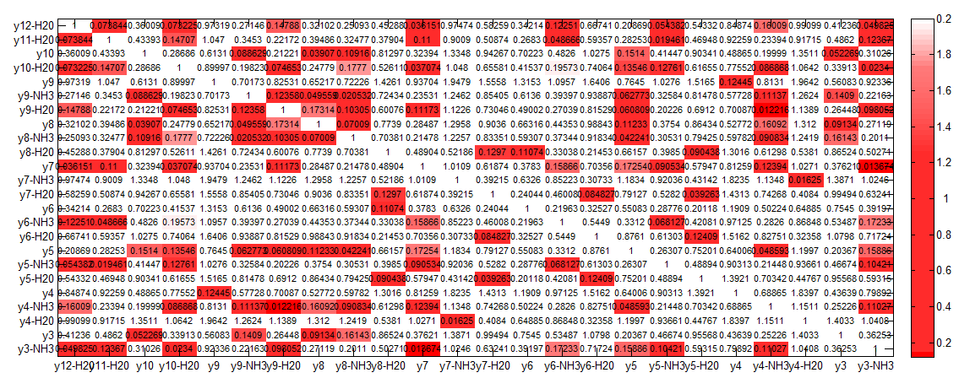
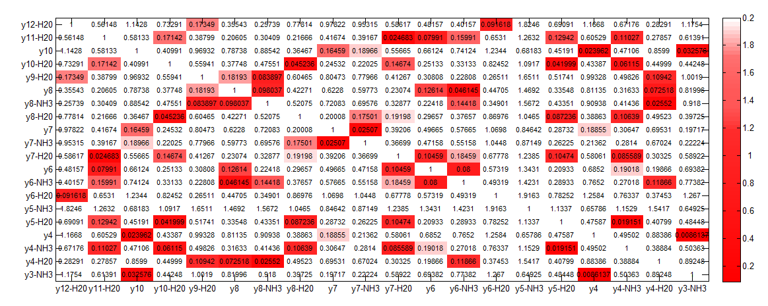
Finding Interference:
Simple vs Complex Matrix
Heavy
Heatmaps
Complex
Ratio of Ratios -Matrix
Complex/Simple
Simple
List of “good” and “bad” transitions based on 0.15 cutoff
Use these to make bar graphs
Light
Complex
Complex/Simple
Simple

Slide 34
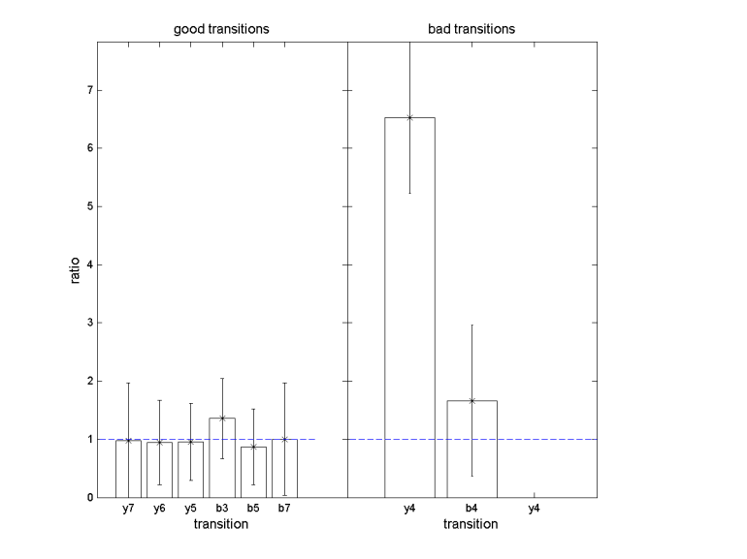
Finding Interference:
Simple vs Complex Matrix
SIS Transition ratios
Complex
Simple
List of “good” and “bad” transitions based on 0.15 cutoff
Use these to make bar graphs
Use the “good” transitions as a denominator to create ratios for every transition
Find average ratio of both “good” and “bad” transitions using these denominators
Graph Mean +/- Stdeviation
The closer to 1 the lower the interference
SIS Transition ratios
Complex
Simple

Slide 35
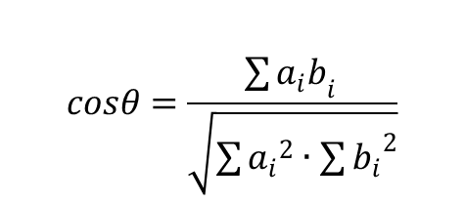

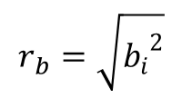
Validating Transitions: Contrast Angle
Spectral Contrast Angle: each spectrum represented as a vector in N-dimensional space
Spectra that resemble each other have vectors pointing in the same direction (θ ~ 0°)
$$cosθ=\frac{\sum{{a_{i}b}_{i }}}{\sqrt{\sum{{a_{i}}^{2}}∙\sum{{b_{i}}^{2}}}}$$
Analyte
SIS
a₁
b₂
b₁
$$r_{a}=\sqrt{{a_{i}}^{2}}$$
a₂
r_{a}
$$r_{b}=\sqrt{{b_{i}}^{2}}$$
r_{b}

Slide 36
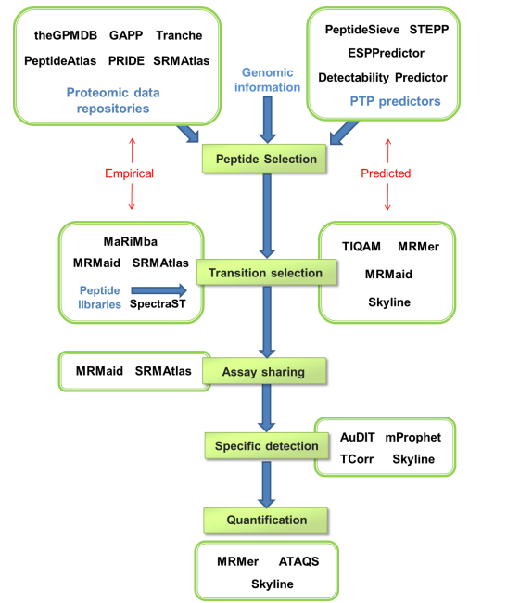
Open Source MRM analysis tools
Notes:
Stages of an SRM experiment and publicly available tools and databases to support each step.
Target peptides for each target protein are selected based on genomic information and information
stored in publicly accessible proteomic data repositories or computational prediction. Suitable SRM
transitions for each target peptide are empirically extracted from mass spectrometry data, preferably
collected on triple quadrupole-type instruments, or calculated, using suitable computational interfaces.
Optionally, SRM transitions are derived from consensus spectra obtained from synthetic peptide
libraries, measured in batches on a triple quadrupole instrument. The validated SRM assays are shared
within the scientific community via publicly accessible databases and used to measure the target
peptides and thus target proteins in the sample(s) of interest. The resulting SRM peaks are then
evaluated for their capability to specifically detect the target peptide and quantitatively analyzed to
derive the abundance (changes) of the target analytes
MS experiments have been performed and the data has been deposited in online repositories (PeptideAtlas, Human Proteinpedia, GPMDB, PRIDE)

Slide 37
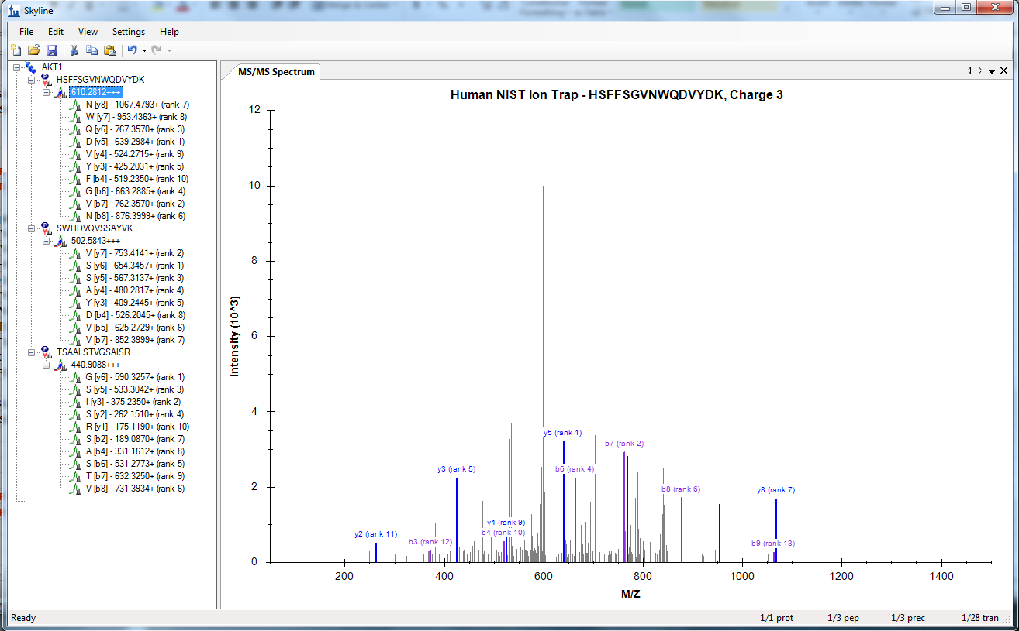
SKYLINE for creating targeted MS/MS methods
Skyline digests proteins and fragments peptides and uses spectral library to find transition intensity

Slide 38
Skyline for MRM: Method Building
Input all peptides of interest
Shows graphs of MS/MS spectra from spectral library

Slide 39
Skyline for MRM:
Method Building
Helps generate protetypic peptide lists using MS/MS spectral libraries
Find which peptides can be measured in specific matrix
Find best transitions to measure for a peptide
Creates transition lists and vendor-specific instrument methods for MRM experiements

Slide 40
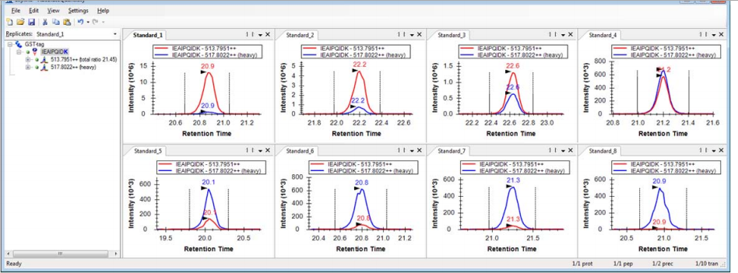
Skyline for MRM: Quantification
Import raw files into skyline
Pick peptide of interest
Check standard peaks

Slide 41
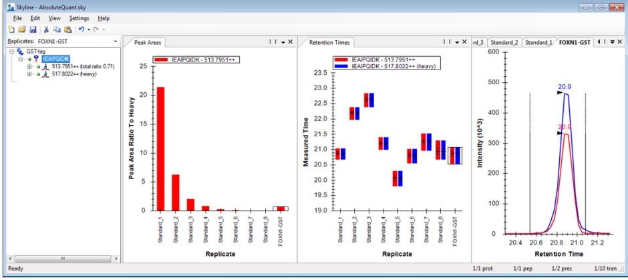
Skyline for MRM: Quantification
Use the heavy standard PAR to make calibration curve
Determine sample quantity based on curve

Slide 42
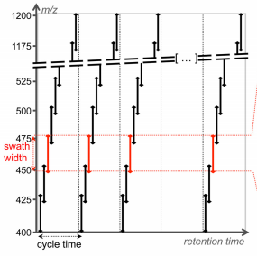
SWATH-MS: Data Collection
Data acquired on quadrupole-quadrupole TOF high resolution instrument cycling through 32-consecutive 25-Da precursor isolation windows (swaths).
Generates fragment ion spectra for all precursor ions within a user defined precursor retention time and m/z
Records the fragment ion spectra as complex fragment ion maps
32 discrete precursor isolation windows of
25–Da width across the 400-1200 m/z range
Gillet et al., 2012
Notes:
Swath-ms makes fragment ion maps generated by DIA methods that can be search in silico

Slide 43
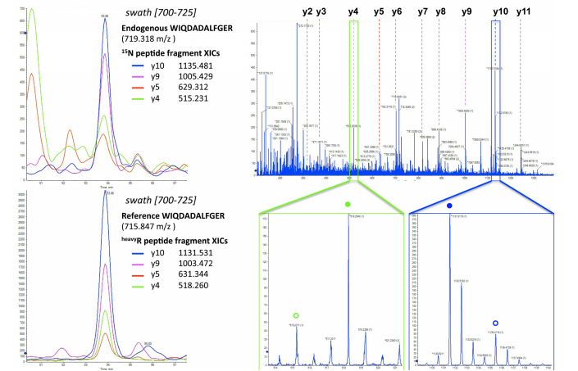
SWATH-MS: Data Analysis
Complete mass fragment spectra
From spectral libraries, find fragment ion maps for peptides of interest
Mine the SWATH data for these spectra
Extract fragment ion traces for quantification
Endogenous (open) and reference peptide (closed) y4/y10 fragments
Gillet et al., 2012
Notes:
representation of the actual data acquired in one swath (450 – 475 m/z range) shown here as an MS2 map, with retention time as the
abscissa, fragment ion m/z as the ordinate, and ion intensity represented by color intensity. The darker horizontal band visible between 450 and
475 m/z corresponds to residual precursor ions for this swath. The signals co-eluting in the vertical direction are likely fragment ions originating
from the same precursor ion. C, the targeted data analysis consists of retrieving the most intense fragment ions of a peptide of interest from
a spectral library (list of fragment masses for the 15N-labeled peptide WIQDADALFGER or the corresponding C-terminal isotopically labeled
reference) and extracting those fragment ion traces in the appropriate 700 –725 swath using a narrow m/z window (e.g., 10 ppm). These
fragment ion traces can be plotted as overlaid extracted ion chromatograms, similarly to SRM transitions. The peak group displaying the best
co-eluting characteristics and matching best to the peak group of extracted reference fragment ion traces identifies and quantifies the target
peptide. D, the complete high resolution, accurate mass fragment ion spectra underlying the best candidate peak group can be extracted from
the raw data. These spectra can be inspected to confirm that the extracted signals originate from mass accurate monoisotopic fragment ion
with the right charge state (e.g., lower panel zooms on the y4 (green box) and y10 (blue box) fragment, with the endogenous and reference
peptide fragments annotated with open or closed circles, respectively). They can also be extensively annotated to strengthen the identification
of the peptide (top panel).

Slide 44
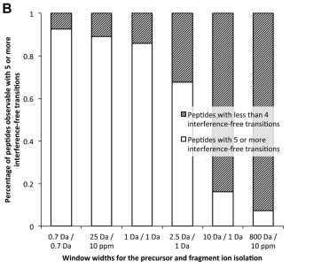
SWATH-MS Fragment Ion Interferences
0
0
0
SRM
SWATH
Low Resolution
Instruments
No isolation
window
Gillet et al., 2012
Notes:
A, fragment ion interference cumulative plots
are computed as described under “Materials and Methods” by taking into account fragments ions from doubly charged yeast tryptic peptide
precursors against the fragment ions from the doubly and triply charged yeast tryptic peptides reported in PeptideAtlas (www.peptideatlas.
org). The distribution of peptides with specific numbers of interference-free transitions are shown for the following simulations (precursor and
fragment ion isolation respectively): 0.7 Da/0.7 Da (open diamonds), 25 Da/10 ppm (black squares), 1 Da/1 Da (open triangles), 2.5 Da/1 Da
(crosses), 10 Da/1 Da (asterisks), and 800 Da/10 ppm (open circles). Simulation plots for other background or acquisition scenarios are available
in supplemental Fig. S3. B, the fraction of peptides observable with five or more interference-free transitions for the various acquisition
scenarios is presented in the histogram with white bars. Accordingly, the shaded bars represent the fraction of peptides having less than four
interference-free transitions.

Slide 45
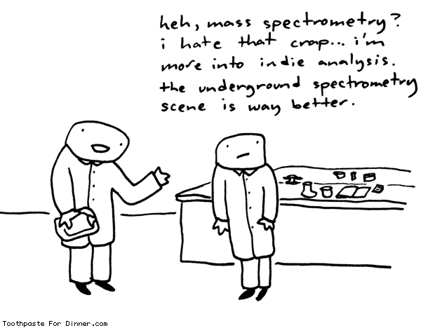
Questions?

