Slide 1
Proteogenomics
Kelly Ruggles, Ph.D.
Proteomics Informatics
Week 9

Slide 2
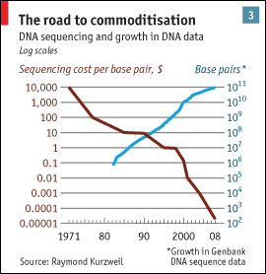
Proteogenomics: Intersection of proteomics and genomics
As the cost of high-throughput genome sequencing goes down whole genome, exome and RNA sequencing can be easily attained for most proteomics experiments
In combination with mass spectrometry-based proteomics, sequencing can be used for:
Genome annotation
Studying the effect of genomic variation in proteome
Biomarker identification

Slide 3
Proteogenomics: Intersection of proteomics and genomics
First published on in 2004 “Proteogenomic mapping as a complementary method to perform genome annotation” (Jaffe JD, Berg HC and Church GM) using genomic sequencing to better annotate Mycoplasma pneumoniae
Renuse S, Chaerkady R and A Pandey, Proteomics. 11(4) 2011

Slide 4
Proteogenomics
In the past, computational algorithms were commonly used to predict and annotate genes.
Limitations: Short genes are missed, alternative splicing prediction difficult, transcription vs. translation (cDNA predictions)
With mass spectrometry we can
Confirm existing gene models
Correct gene models
Identify novel genes and splice isoforms
Essentials for Proteogenomics
Renuse S, Chaerkady R and A Pandey, Proteomics. 11(4) 2011

Slide 5
Proteogenomics
Genome annotation
Studying the effect of genomic variation in proteome
Proteogenomic mapping

Slide 6
Proteogenomics
Genome annotation
Studying the effect of genomic variation in proteome
Proteogenomic mapping

Slide 7
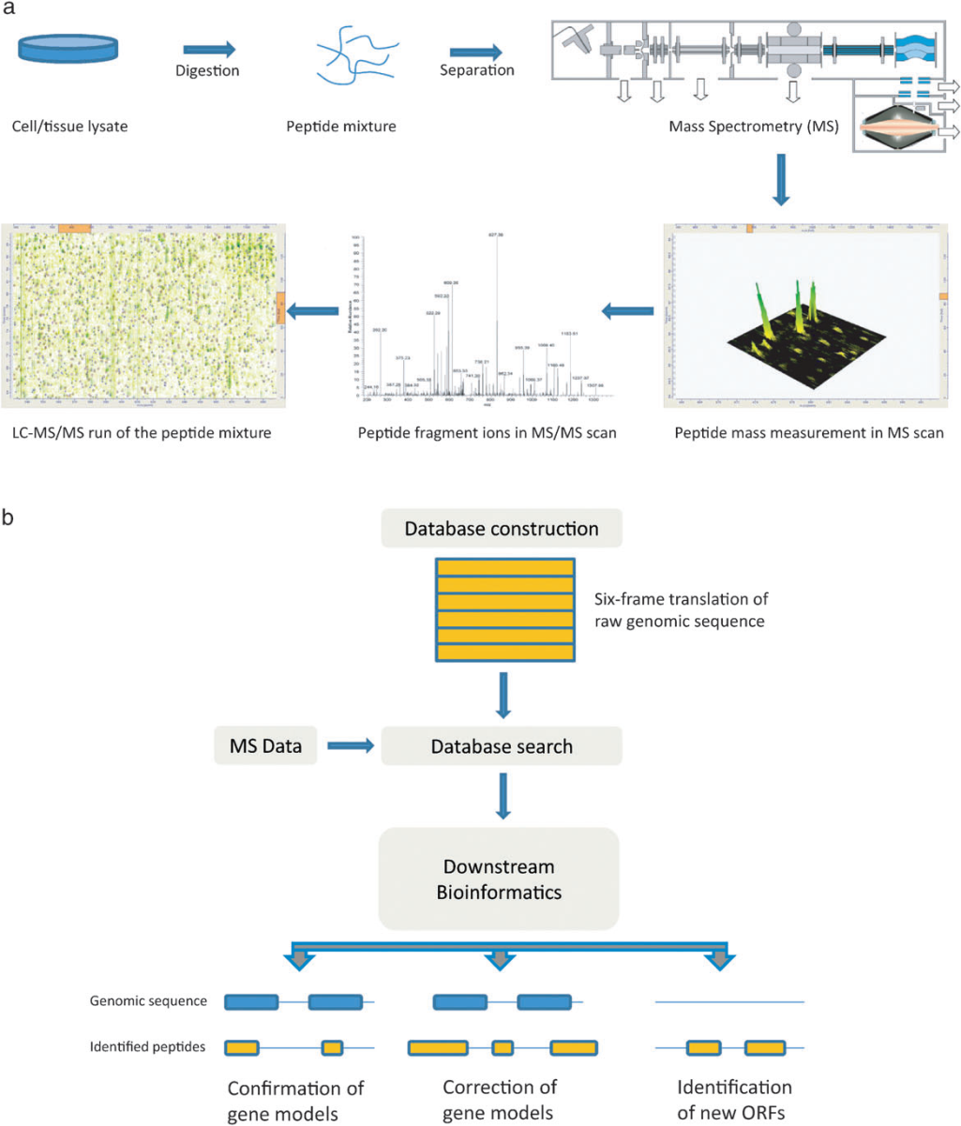
Proteogenomics Workflow
Krug K., Nahnsen S, Macek B, Molecular Biosystems 2010
Renuse S, Chaerkady R and A Pandey, Proteomics. 11(4) 2011

Slide 8
Protein Sequence Databases
Identification of peptides from MS relies heavily on the quality of the protein sequence database (DB)
DBs with missing peptide sequences will fail to identify the corresponding peptides
DBs that are too large will have low sensitivity
Ideal DB is complete and small, containing all proteins in the sample and no irrelevant sequences

Slide 9
Genome Sequence-based database for genome annotation
MS/MS
6 frame translation of genome sequence
intensity
Reference
protein DB
m/z
Compare, score, test significance
Compare, score, test significance
annotated + novel
peptides
annotated peptides

Slide 10
Creating 6-frame translation database
ATGAAAAGCCTCAGCCTACAGAAACTCTTTTAATATGCATCAGTCAGAATTTAAAAAAAAAATC
Positive Strand
M
K
S
L
S
L
Q
K
L
F
*
Y
A
S
V
R
I
*
K
K
N
*
K
A
S
A
Y
R
N
S
F
N
M
H
Q
S
E
F
K
K
K
I
E
K
P
Q
P
T
E
T
L
L
I
C
I
S
Q
N
L
K
K
K
S
Negative Strand
H
F
A
E
A
*
L
F
E
K
L
I
C
*
D
S
N
L
F
F
I
S
F
G
*
G
V
S
V
R
K
I
H
M
L
*
F
K
F
F
F
D
F
L
R
L
R
C
F
S
K
*
Y
A
D
T
L
I
*
F
F
F
G
Software:
Peppy: creates the database + searches MS, Risk BA, et. al (2013)
BCM Search Launcher: web-based Smith et al., (1996)
InsPecT: perl script Tanner et. al, (2005)

Slide 11
Genome Annotation Example 1: A. gambiae
Peptides mapping to annotated 3’ UTR
Peptides mapping to novel exon within an existing gene
Renuse S, Chaerkady R and A Pandey, Proteomics. 11(4) 2011

Slide 12
Genome Annotation Example 1: A. gambiae
Peptides mapping to unannotated gene
related strain
Renuse S, Chaerkady R and A Pandey, Proteomics. 11(4) 2011

Slide 13
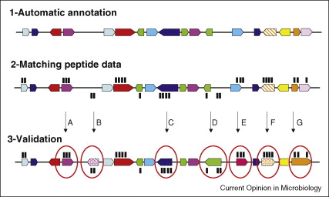
Genome Annotation Example 2:
Correcting Miss-annotations
currently annotated genes
peptide mapping to nucleic acid sequence
manual validation of miss-annotation
Armengaud J, Curr. Opin Microbiology 12(3) 2009
A. Hypothetical protein confirmed
B. Confirm unannotated gene
C. Initiation codon is downstream
D. Initiation codon is upstream
E. Peptides indicate the gene frame is wrong
F. Peptides indicate that gene on wrong strand
G. In frame stop-codon or frameshift found

Slide 14
RNA Sequence-based database for alternatively splicing identification
MS/MS
RNA-Seq junction DB
intensity
m/z
Compare, score, test significance
Identification of novel splice isoforms

Slide 15
Annotation of organisms which lack genome sequencing
MS/MS
intensity
Reference DB of related species
m/z
De novo MS/MS sequencing
Compare, score, test significance
Identification of potential protein coding regions

Slide 16
Proteogenomics: Genome Annotation Summary
Renuse S, Chaerkady R and A Pandey, Proteomics. 11(4) 2011

Slide 17
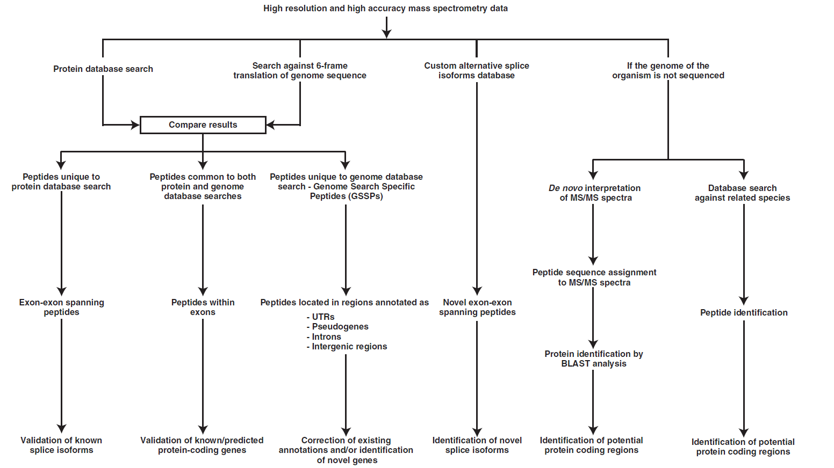
Proteogenomic Genome Annotation Summary
Renuse S, Chaerkady R and A Pandey, Proteomics. 11(4) 2011

Slide 18
Proteogenomics
Genome annotation
Studying the effect of genomic variation in proteome
Proteogenomic mapping

Slide 19
Single nucleotide variant database for variant protein identification
MS/MS
intensity
Reference
protein DB
+
Variant DB
m/z
Compare, score, test significance
Variants predicted from genome sequencing
TCGAGAGCTG
TCGAGAGCTG
TCGAGAGCTG
TCGAGAGCTG
TCGAGAGCTG
TCGATAGCTG
Identification of variant proteins
Exon 1

Slide 20
Creating variant sequence DB
VCF File Format
# Meta-information lines
Columns:
Chromosome
Position
ID (ex: dbSNP)
Reference base
Alternative allele
Quality score
Filter (PASS=passed filters)
Info (ex: SOMATIC, VALIDATED..)

Slide 21
Creating variant sequence DB
EXON 1
EXON2
…
…
…GTATTGCAAAAATAAGATAGAATAAGAATAATTACGACAAGATTC…
Add in variants within exon boundaries
…CTATTGCAAAAATACGATAGCATAAGAATAGTTACGACAAGATTC…
In silico translation
…LLQKYDSIRIVTTRF…
Variant DB

Slide 22
Splice junction database for novel exon, alternative splicing identification
MS/MS
intensity
Reference
protein DB
RNA-Seq
junction
DB
+
m/z
Compare, score, test significance
Intron/Exon boundaries from RNA sequencing
Alt. Splicing
Novel Expression
Identification of novel splice proteins
Exon 1
Exon 2
Exon 3
Exon 1
Exon X
Exon 2

Slide 23
Creating splice junction DB
BED File Format
Columns:
Chromosome
Chromosome Start
Chromosome End
Name
Score
Strand (+or-)
7-9. Display info
10. # blocks (exons)
11. Size of blocks
12. Start of blocks

Slide 24
Creating splice junction DB
Bed file with
new gene
mapping
Map to known
intron/exon boundaries
Junction bed file
1. Annotated Splicing
2. Unannotated alternative splicing
Exon 1
Exon 2
Exon 1
Exon 2
Exon 3
3. One end matches,
one within exon
4. One end matches,
one within intron
5. No matching exons
Exon 1
Exon 2
Exon 1
Exon 2
Intronic region

Slide 25
Fusion protein identification
MS/MS
intensity
Reference
protein DB
Fusion Gene
DB
+
m/z
Compare, score, test significance
Gene X
Exon 1
Gene X
Exon 2
Gene Y
Exon 1
Gene Y
Exon 2
Identification of variant proteins
Chr 1
Chr 2
Gene X
Exon 1
Gene Y
Exon 2

Slide 26
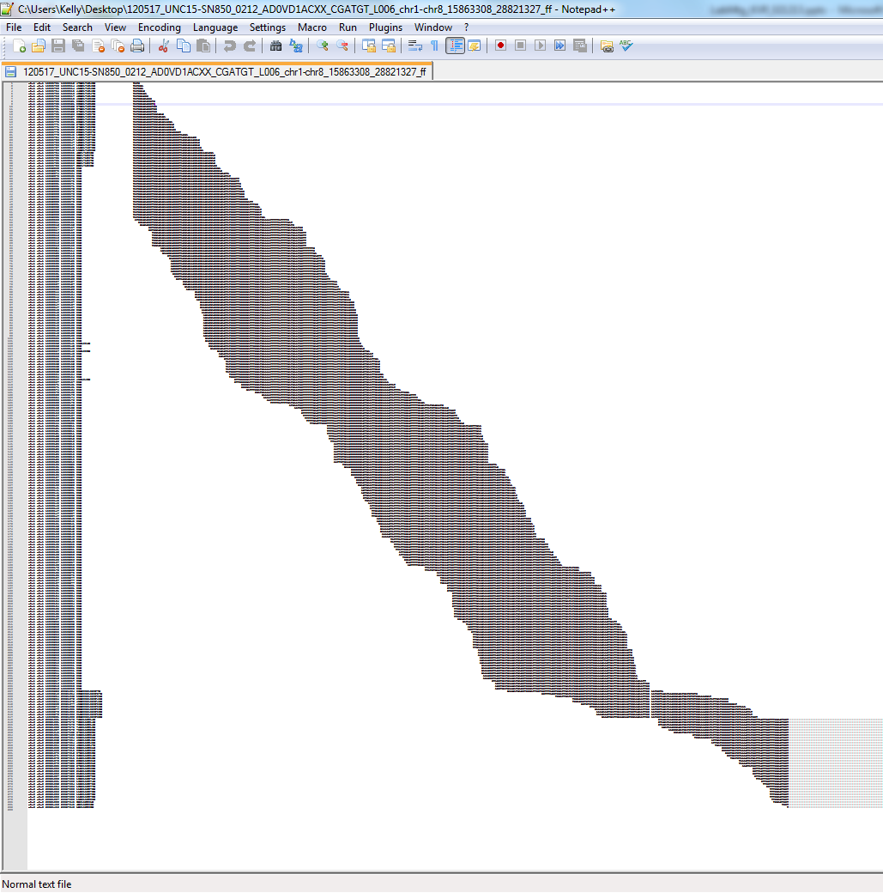
Fusion Genes
Find consensus sequence
.…AGAACTGGAAGAATTGG*AATGGTAGATAACGCAGATCATCT..…
Fusion Location
6 frame translation FASTA

Slide 27
Informatics tools for customized DB creation
QUILTS: perl/python based tool to generate DB from genomic and RNA sequencing data (Fenyo lab)
customProDB: R package to generate DB from RNA-Seq data (Zhang B, et al.)
Splice-graph database creation (Bafna V. et al.)

Slide 28
Proteogenomics and Human Disease: Genomic Heterogeneity
Whole genome sequencing has uncovered millions of germline variants between individuals
Genomic, proteome studies typically use a reference database to model the general population, masking patient specific variation
Nature October 28, 2010

Slide 29
Proteogenomics and Human Disease: Cancer Proteomics
Cancer is characterized by altered expression of tumor drivers and suppressors
Results from gene mutations causing changes in protein expression, activity
Can influence diagnosis, prognosis and treatment
Cancer proteomics
Are genomic variants evident at the protein level?
What is their effect on protein function?
Can we classify tumors based on protein markers?

Slide 30
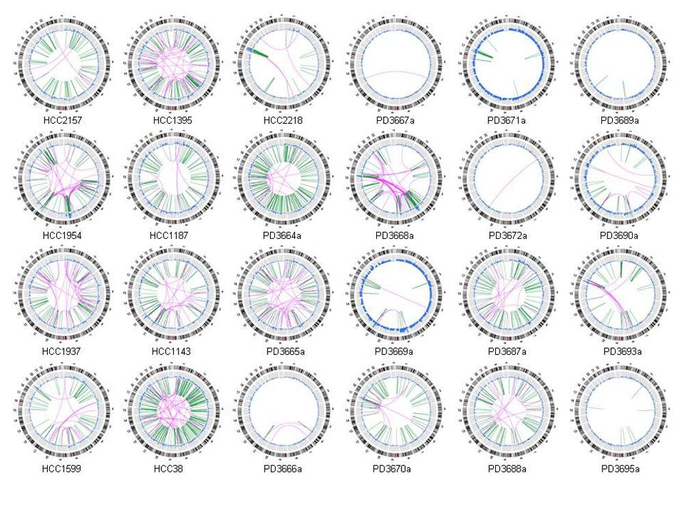
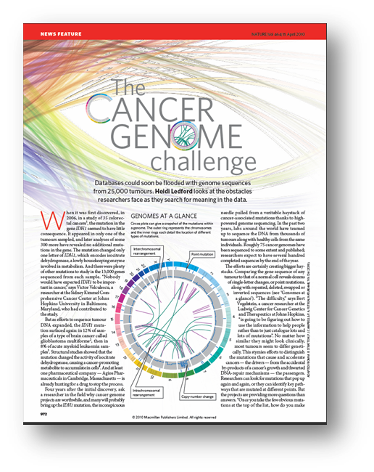
Tumor Specific Proteomic Variation
Nature April 15, 2010
Stephens, et al. Complex landscape of somatic rearrangement in human breast cancer genomes. Nature 2009

Slide 31
Personalized Database for Protein Identification
Germline Variants
Somatic Variants
MQYAPNTQVEIIPQGR
SSAEVIAQSR
ASSSIIINESEPTTNIQIR
QRAQEAIIQISQAISIMETVK
SSPVEFECINDK
SPAPGMAIGSGR…
SVATGSSEAAGGASGGGAR
GQVAGTMKIEIAQYR
DSGSYGQSGGEQQR
EETSDFAEPTTCITNNQHS
EPRDPR
FIKGWFCFIISAR….
MS/MS
intensity
Protein DB
m/z
Compare, score, test significance
Identified peptides and proteins
Notes:
In general, protein identification is done as follows, prepare and separate peptides from samples and analyze by MS to identify these we compare the MS measurements to protein sequence DB. If the protein sequence is not in the DB we won’t find it, but if we add irrelevant sequences then it decreases our sensitivity because we add a lot of noise. In many cases we can use the protein sequence DB and get good results, but sometimes the samples are different from what we can predict from a reference genome. Because tumor samples have unpredicted genetic rearrangments, it is likely that many protein variants will not be present in a normal reference database. Therefore, both germline (patient specific) and somatic (tumor specific) variants will not be identified. In order to identify these novel peptides, we need to add all possible variant proteins into our database.
In a typical proteomics workflow, tandem mass spectra are compared to peptide sequences in the protein database to find the best match. The quality of the protein sequence databases used greatly affects protein identification, i.e. ideally databases should contain the sequences for all proteins in the sample and no other sequences. If a sequence is not in the collection, the corresponding protein cannot be identified, and if there are many irrelevant sequences the sensitivity of the search decreases (Fenyö et al. 2010). Given the large diversity of protein sequences that are expected in the CPTAC samples, and the availability of personalized sequence for each tumor, it is advantageous and desirable to create a personalized protein sequence database for each tumor sample.

Slide 32
Personalized Database for Protein Identification
RNA-Seq
Genome Sequencing
MS/MS
Tumor Specific Protein DB
intensity
m/z
Compare, score, test significance
Identified peptides and proteins
+ tumor specific
+ patient specific peptides
Notes:
We do this by using the RNA-Seq and Genomic Sequencing information to create a tumor specific database of potential variant proteins, as coded within the genome. As sequencing gets cheaper, its within the scope for proteomics projects to do this on a large scale. Once we have incorporated these novel peptides into our protein DB we can then identify tumor specific and patient specific peptides from our MS analysis.
TopHat: unspliced reads are aligned with bowtie and then after these reads are assembled resulting in islands of sequences. The splice junctions are then determined based on the initially unmapped reads.
Star: ultrafast tool employs “sequential maximum mappable seed search followed by seed clustering and stitching”. Detects canonical, non-canonical splice junctions and chimeric fusion sequences.
Variants: GATK, CASAVA, SAMtools

Slide 33
Tumor Specific Protein Databases
Non-Tumor Sample
Genome sequencing
Identify germline variants
Genome sequencing
RNA-Seq
Identify alternative splicing,
somatic variants and
novel expression
Tumor Sample
Alt. Splicing
Novel Expression
Tumor Specific
Protein DB
Exon 1
Exon 2
Exon 3
Exon 1
Exon X
Exon 2
Fusion Genes
Variants
Reference Human Database (Ensembl)
TCGAGAGCTG
TCGAGAGCTG
TCGAGAGCTG
TCGAGAGCTG
TCGAGAGCTG
TCGATAGCTG
Gene X
Exon 1
Gene X
Exon 2
Gene Y
Exon 1
Gene Y
Exon 2
Exon 1
Gene X
Gene Y
Notes:
Lets first focus on the creation of the tumor specific protein database. We start with a reference human database. We then incorporate patient specific germline variants, determined through genome sequencing into the database. We also use sequencing information from the tumor, which gives us somatic variants, alternative splicing and novel expression.
Here are examples of these changes within the transcriptome with orange lines representing RNA-Seq reads. Alternative splicing occurs when exons from one gene are recombined in new ways through exon skipping as seen in the first panel. Novel expression, when there is evidence for transcription in a part of the genome which was thought to be noncoding. Fusion genes occur when two different genes, from the same chromosome or different chromosome are combined and lastly variants, which indicate single nucleotide changes in the genome. All of these sample specific proteins must be incorporated into the protein database to allow for their potential identification from proteomic data.

Slide 34
Proteogenomics and Biomarker Discovery
Tumor-specific peptides identified by MS can be used as sensitive drug targets or diagnostic tools
Fusion proteins
Protein isoforms
Variants
Effects of genomic rearrangements on protein expression can elucidate cancer biology

Slide 35
Proteogenomics
Genome annotation
Studying the effect of genomic variation in proteome
Proteogenomic mapping

Slide 36
Proteogenomic mapping
Map back observed peptides to their genomic location.
Use to determine:
Exon location of peptides
Proteotypic
Novel coding region
Visualize in genome browsers
Quantitative comparison based on genomic location

Slide 37
Informatics tools for proteogenomic mapping
PGx: python-based tool, maps peptides back to genomic coordinates using user defined reference database (Fenyo lab)
The Proteogenomic Mapping Tool: Java-based search of peptides against 6-reading frame sequence database (Sanders WS, et al).

Slide 38
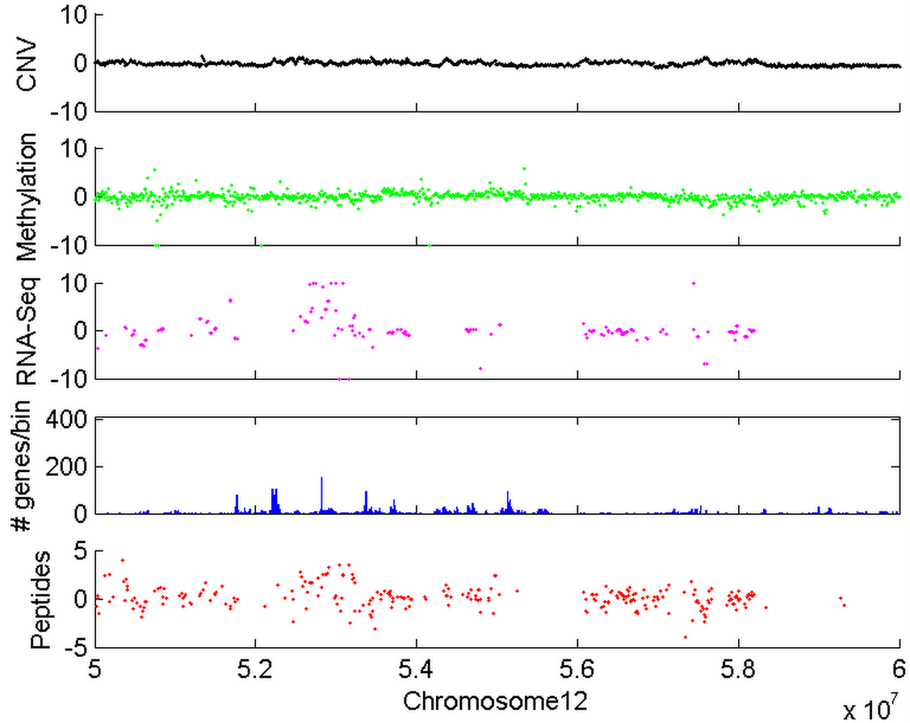
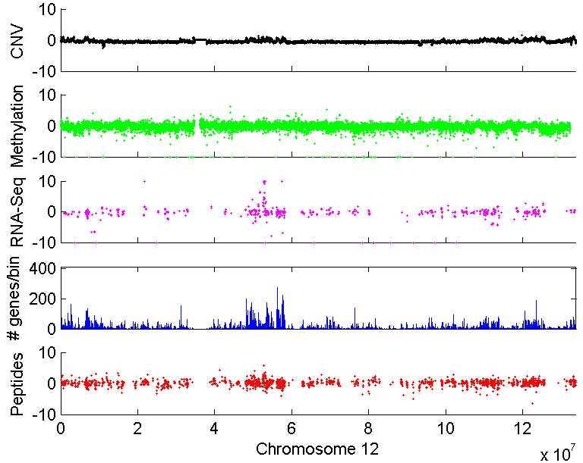
PGX: Proteogenomic mapping tool
Sample specific protein database
Peptides
Log Fold Change in Expression (10,000 bp bins)
Copy Number Variation
Methylation Status
Manor Askenazi
David Fenyo
Exon Expression (RNA-Seq)
Number of Genes/Bin
Peptides
Peptides mapped onto genomic coordinates

Slide 39
Variant Peptide Mapping
Peptides with single amino acid changes corresponding to germline and somatic variants
Exon Skipping
Unannotated
Exons
SVATGSSETAGGASGGGAR
ACG->GCG
ENSEMBL Gene
SVATGSSEAAGGASGGGAR
Tumor Peptide
Reference Peptide

Slide 40
Novel Peptide Mapping
Peptides corresponding to RNA-Seq expression in non-coding regions
ENSEMBL Gene
Tumor Peptide
Tumor RNA-Seq

Slide 41
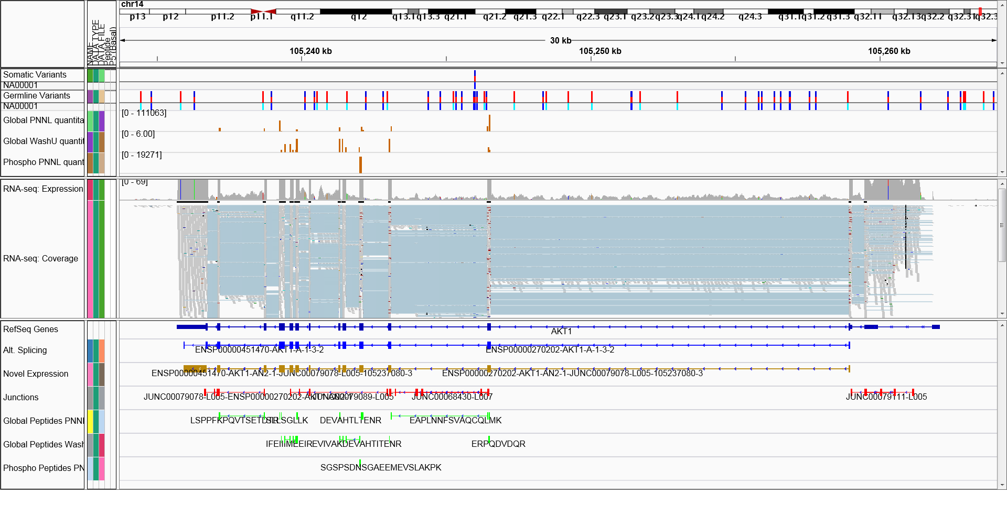
Proteogenomic integration
Variants
Proteomic Quantitation
RNA-Seq Data
Predicted gene expression
Proteomic Mapping
Maps genomic, transcriptomic and proteomic data to same coordinate system including quantitative information

Slide 42
Questions?

